Slide 1
Lane Extraction and Quality Evaluation:
A Hough Transform Based Approach
Xingyao Wang (UMich), Da Yan* (UAB), Ke Chen(HUST), Yancong Deng (UCSD)
Cheng Long (NTU), Kunlin Zhang (Wuhan University), Sibo Yan (KPMG)
Contact: xingyaow@umich.edu (Xingyao Wang)
Presenter: Da Yan
Department of Computer Science
University of Alabama at Birmingham (UAB)
Notes:
My name is Da Yan, I am from the University of Alabama at Birmingham, I am the presenter of our paper “Lane Extraction and Quality Evaluation: A Hough Transform Based Approach,” a work mainly contributed by Xingyao Wang, a student from the University of Michigan who is doing internship now and cannot make it for pre-recording this video.
We are happy to have our paper published in IEEE MIPR 2020, which is held virtually this year due to the coronavirus pandemic.

Slide 2
Motivations
Motivations for Lane Recognition
To guide vehicles
Driving assistance
Advanced driver-assistance systems (ADAS)
Autonomous driving
Notes:
This work studies the problem of lane recognition from each video frame image, which is important in applications such as driving assistance. In fact, lane recognition has been used in ADAS of many car models to adjust the steering wheel or give warnings if your wheel touches the lane lines.
In the future technology of self-driving cars, lane recognition is also an essential first step.
In our problem, we are actually detecting lines that mark lane boundaries, and we call them lane-lines hereafter.

Slide 3
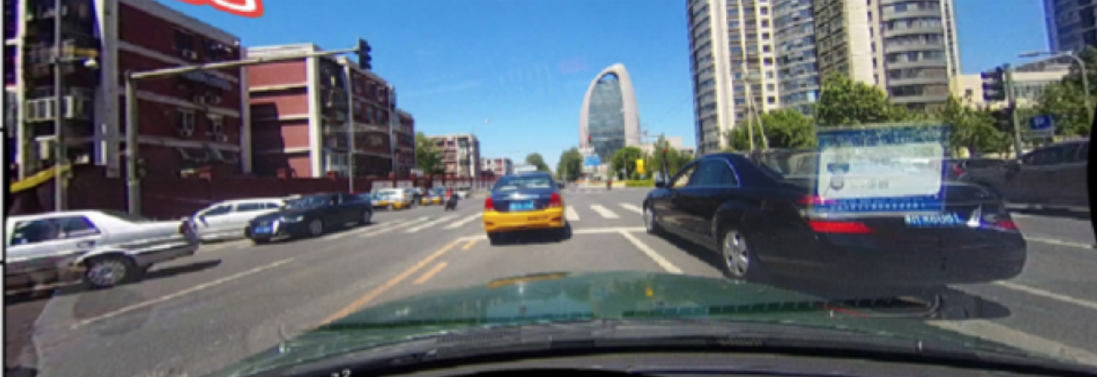
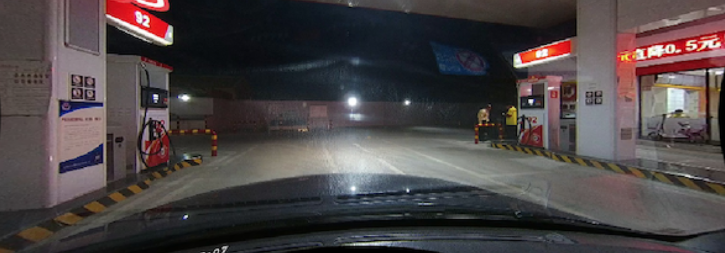
Challenges
Challenges for Lane Recognition
Noise: occlusion, reflection, raining, annotation shift …
Notes:
There are a lot of challenges for accurate lane line detection
For example, the blue car in the upper image occludes the lane line on its right, while the lane lines in the bottom image are just as bright as the road light reflections.

Slide 4
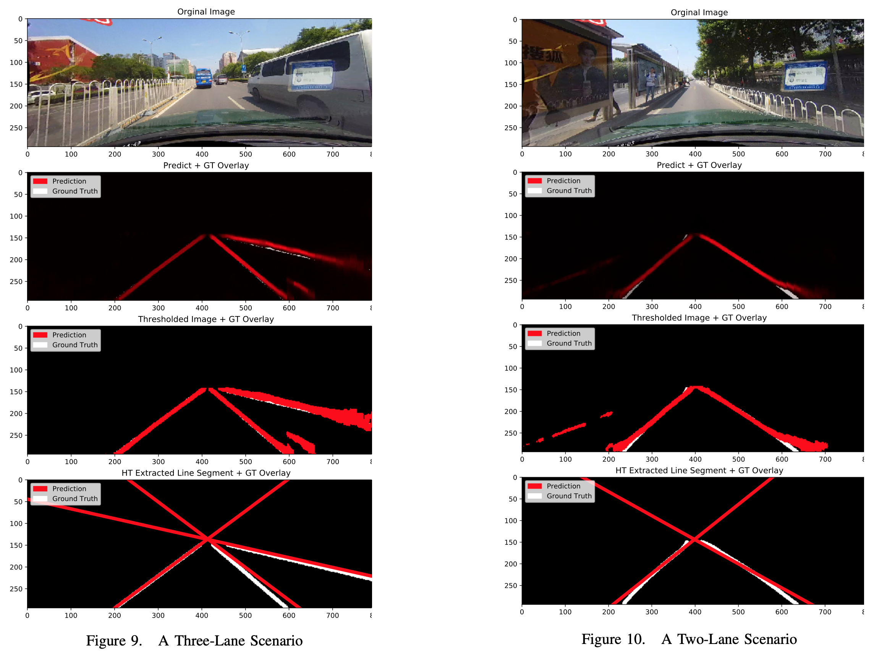
Experiments
Notes:
Another problem is with evaluations, since a small shift of the line may be considered a total error if we use pixel-level error metrics. For example, in the figure here, the white pixels are ground-truth pixels for lane-lines annotated by human, and the red lines are those that are extracted by our model.
Intuitively the prediction is close to the reality, but the pixel-wise matching result is terrible. Even worse, the annotators may not always draw the lines exactly overlapping with the actually lane-lines, especially when difficult scenarios such as occlusions happen where annotators kind of have to guess the lines based on their intuition, which introduces another source of errors.

Slide 5
Challenges
Challenges for Lane Recognition
Prediction outputs are pixels, how to retrieve lines?
Popular instance segmentation methods such as region proposals are preprocessing methods before inputting into a ConvNet model
In contrast, our evaluator requires a postprocessing approach for instance (lane) matching
How to design a scientific evaluator?
Notes:
So this work addresses both problems of how to extract lines from pixel-level segmentation models, and how to evaluate the line matches more scientifically
We remark that our problem is different from the object instance segmentation problem addressed by region proposal based models such as Mask RCNN and Yolov3, since our lane-lines are long objects, and are also the only type of foreground object to segment
Moreover, after getting the lane-line pixels, we want to extract them into lines so that they can be compared with the ground truth lane-lines more scientifically
For prediction, the geometry of the lane-lines can also help in the building the 3D model of the driving environment which is important for the future autonomous driving technology

Slide 6
Solution Overview
Challenges for Lane Recognition
Part I: line extraction from the image
Part II: line-to-lane matching & evaluation
Notes:
Our model design consists of two parts, one for extracting lane-lines from each image, and the other for matching the extracted lines to the corresponding lane-lines for more scientific quality evaluation

Slide 7
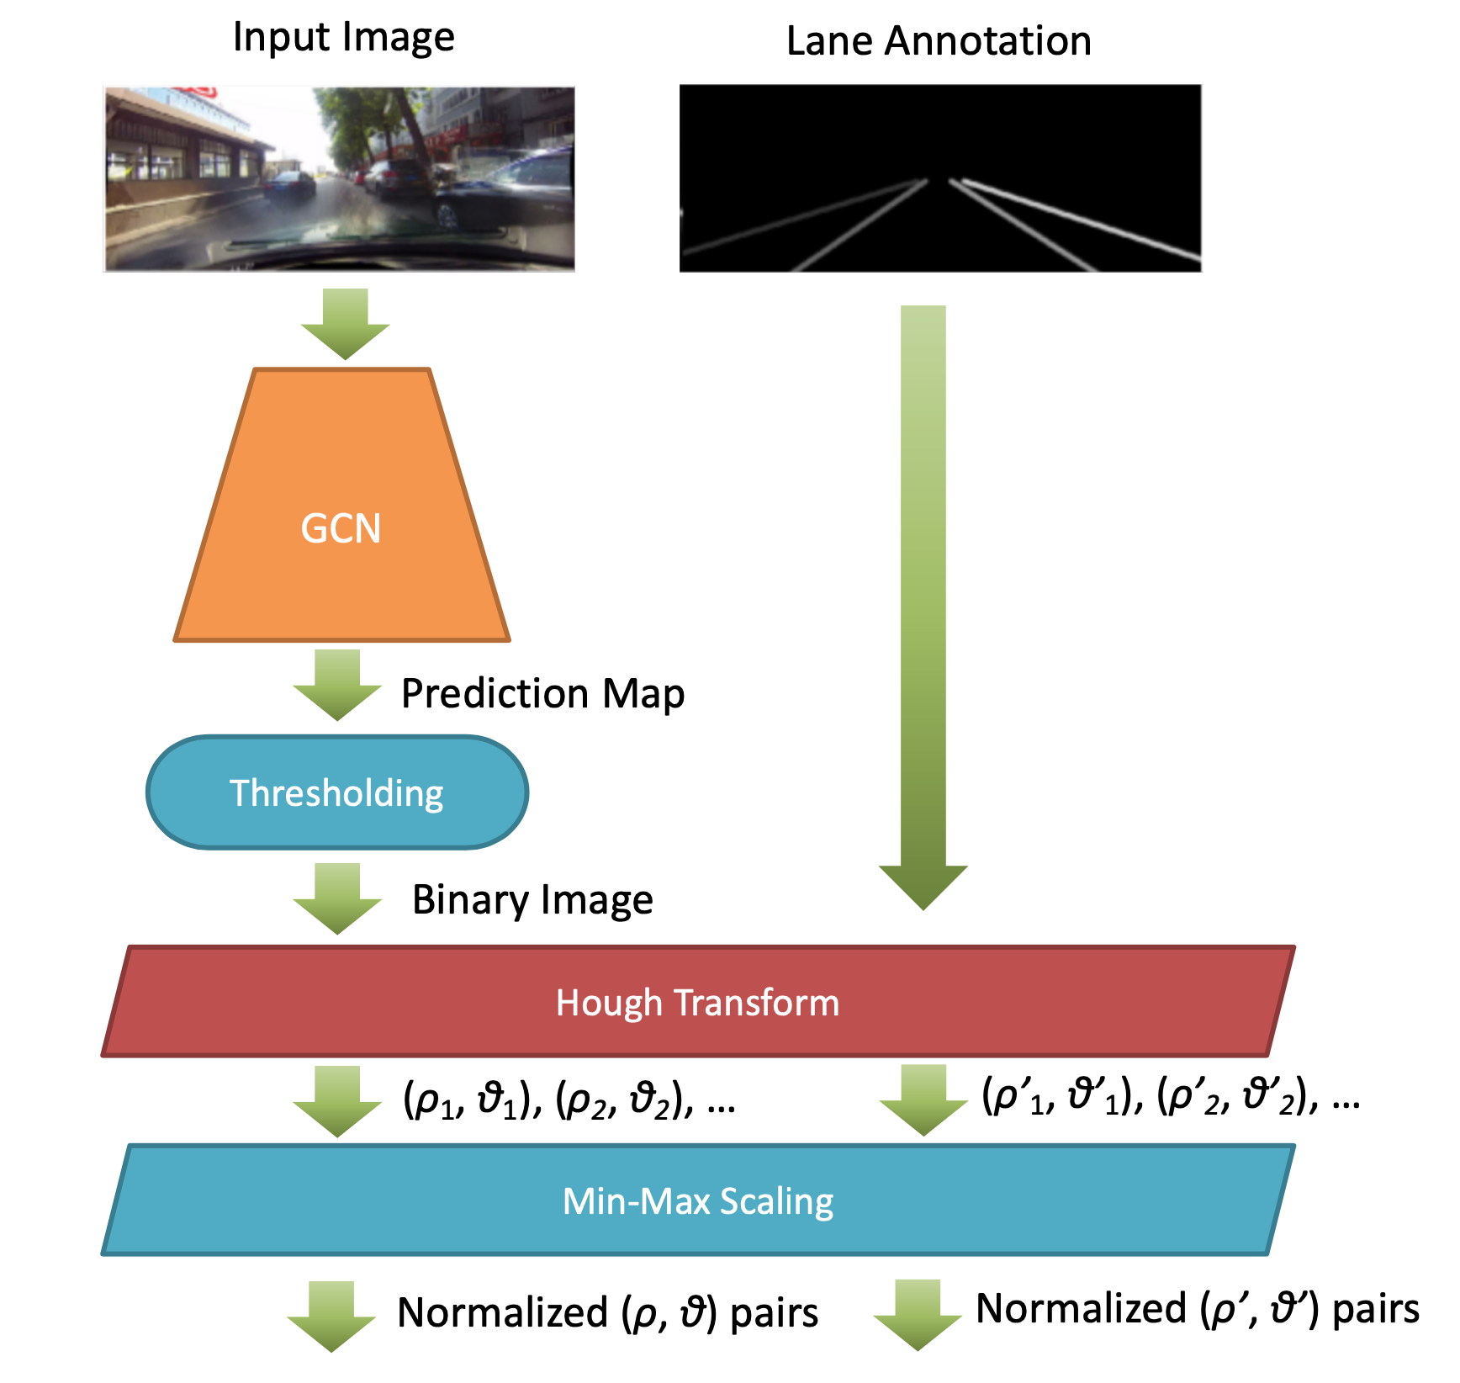
Part I: Line Extraction
Notes:
In stage one, we first use GCN to extract a prediction map from each input image, where each output pixel is associated with a predicted probability that the pixel is part of a lane-line.
Here, GCN refers to the global convolutional network, not the graph convolutional neural network that has become quite actively researched lately.

Slide 8
Global Convolutional Network (GCN)
Contradictory Between Classification and Localization
For the classification task, the models are required to be invariant to various transformations like translation and rotation.
But for the localization task, models should be transformation-sensitive, i.e., precisely locate every pixel for each semantic category.
Notes:
The reason we choose GCN to extract lane-line pixels is that it is designed exactly for this task
GCN adopts a large kernel that is able to capture line objects that are long.
GCN is designed by noticing a confliction between the goals of object classification and localization.
For classification, we often use pooling and dense layers to extract semantic features that are invariant to transformations, in order to better predict the type of objects
For localization, however, the spatial transformations matter since we would like to get their boundaries down to the pixel level

Slide 9
Global Convolutional Network (GCN)
Design
From the localization view, the model structure should be fully convolutional to retain the localization performance and no fully-connected or global pooling layers should be used as these layers will discard the localization information
From the classification view, large kernel size should be adopted in the network architecture to enable densely connections between feature maps and per-pixel classifiers, which enhances the capability to handle different transformations.
Notes:
Therefore, to make our model spatial-sensitive, we want to avoid dense layers and pooling layers, making the model fully convolutional
Meanwhile, we want to use large kernels so that the object type can be captured from an entire object

Slide 10
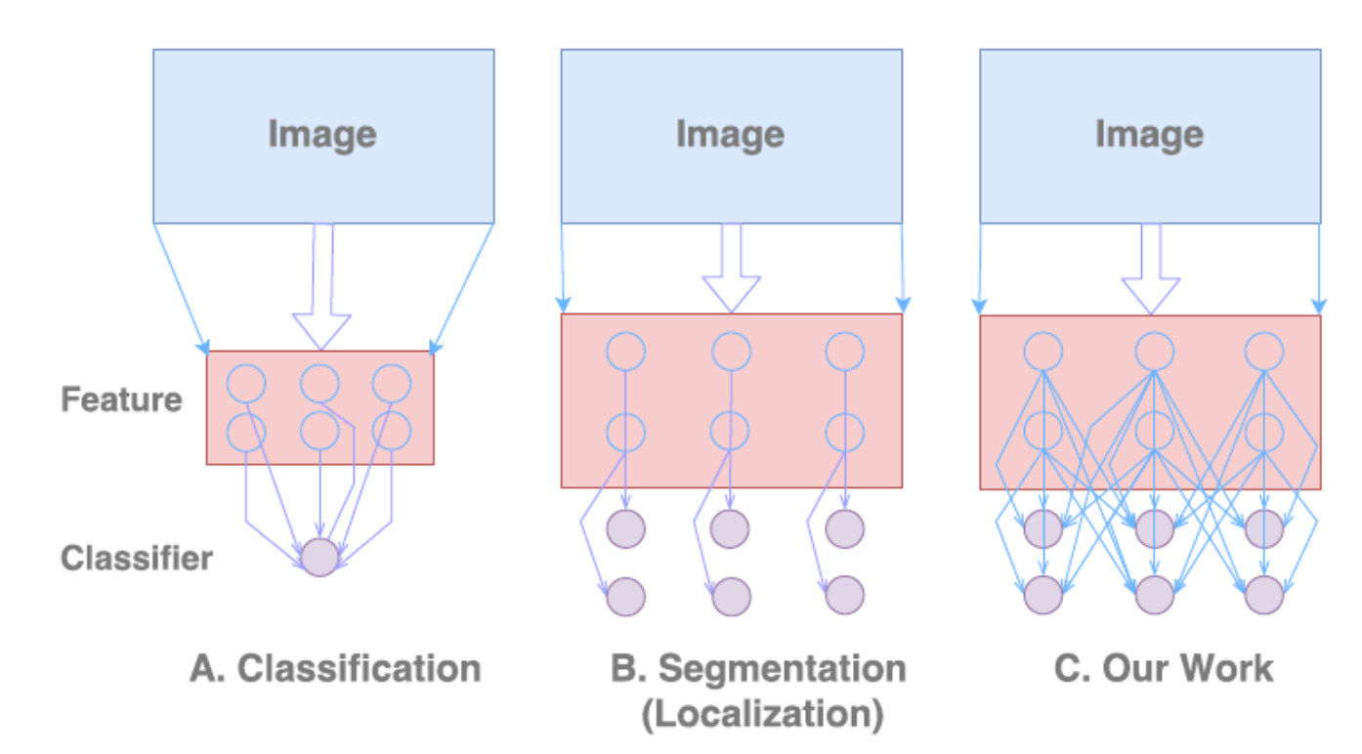
Global Convolutional Network (GCN)
GCN
Notes:
Here’s a comparison between GCN and existing models, where we can see that GCN is fully convolutional and uses large kernels

Slide 11
Getting Quality Pixel-Level Predictions
Notes:
Here’s the detailed model of GCN architecture, where during the encoding stage, a feature pyramid is applied to a backbone ResNet to extract image features at different scales
The feature maps are then decoded to obtain the pixel-level predictions using binary cross-entropy loss.
Notably, in B, each GCN module decomposes a k by k large kernel into two layers of 1 by k and then k by 1 kernels for approximation, which avoids a high computation overhead.
There is also a boundary refinement module in C which uses residual links to learn the incremental details on the object boundary.
The large kernel used is able to capture an entire long lane-line to allow accurate recognition in our studied application.

Slide 12
Part I: Line Extraction
Notes:
After we the get pixel-level probability map, we use thresholding to get a binary map where each pixel is either 0 or 1, which refers to the background or foreground pixels.
The foreground pixels are the detected lane-lines

Slide 13
Part I: Line Extraction
Notes:
We then feed all foreground pixels into a Hough Transform to extract lane-lines, which are represented in spherical coordinates

Slide 14
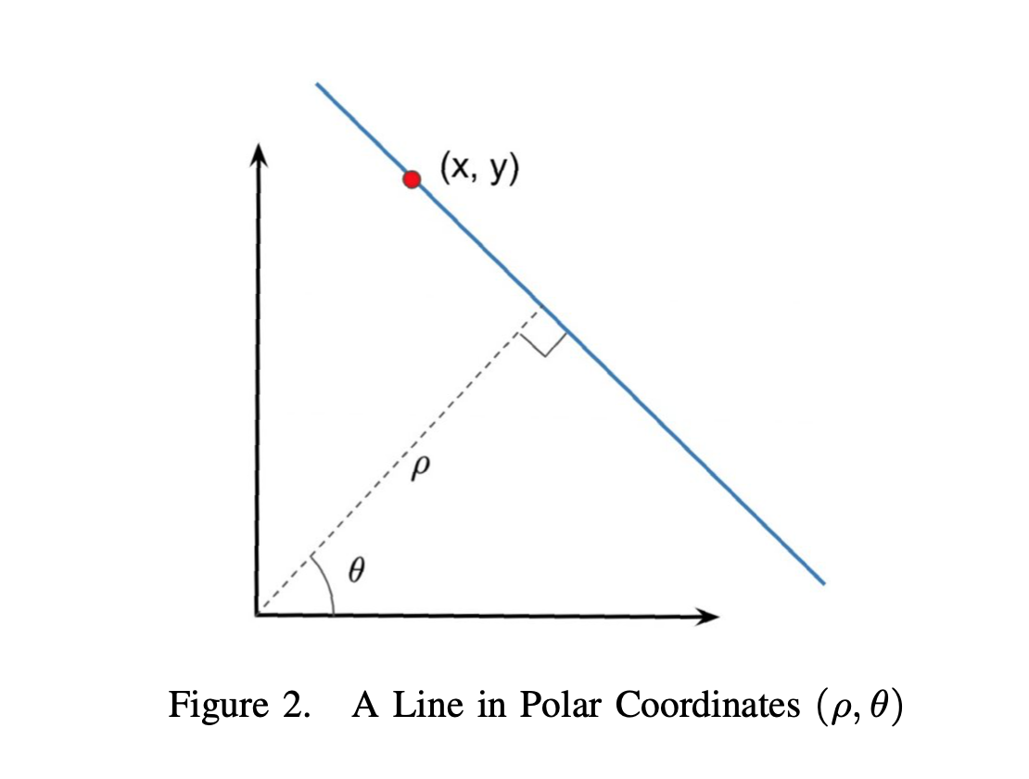
Hough Transform
Notes:
In Hough Transform, each foreground pixel corresponds to a set of lines that pass through it,
[click]
or rotating round it, where each line can be represented with coordinates (rho and theta)

Slide 15
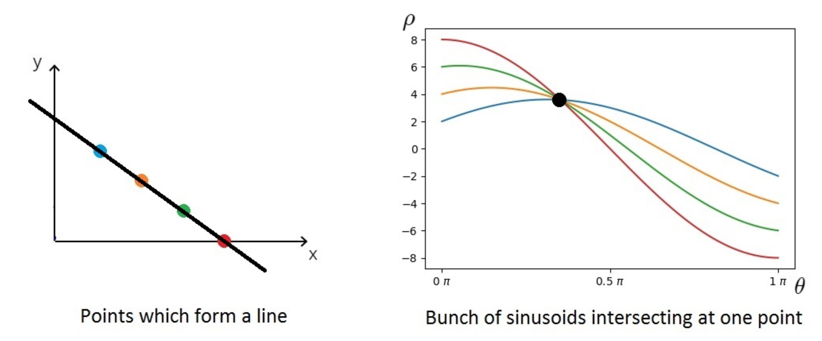
Hough Transform
A threshold τ is used to find only those cells with counts at least τ, which correspond to the detected lines.
Notes:
These lines form a curve in the (rho-theta) coordinate system
Now if we have many foreground pixels that are on the same line, their (rho-theta) curves will overlap at the same point in the spherical coordinate system, corresponding to this line.
So in the (rho-theta) coordinate system where a grid structure is imposed, those grid cells with a high hitting count will be selected to recover the extracted lines

Slide 16
Part I: Line Extraction
Notes:
However, since we are extracting lines using thresholding, each actual lane-line can have many lines clustered around it,
we will normalize them so that later data mining models in stage 2 can then group them into lane lines effectively

Slide 17
Part I: Line Extraction
Notes:
For the ground truth annotations that are already binary images, we can directly apply Hough transform to extract the lines

Slide 18
Evaluation Module
Group the lines by lanes and extract a unique line from each group
Compare the lane-lines extracted from the prediction with those from the ground-truth annotation to evaluate the accuracy of lane recognition.
Notes:
Now let’s look at the second stage, where we will extract a unique lane-line from each line cluster
And if ground truth annotation exists, we will match the lane-lines predicted from the input images with those extracted from the annotations, to provide a scientific error estimate

Slide 19
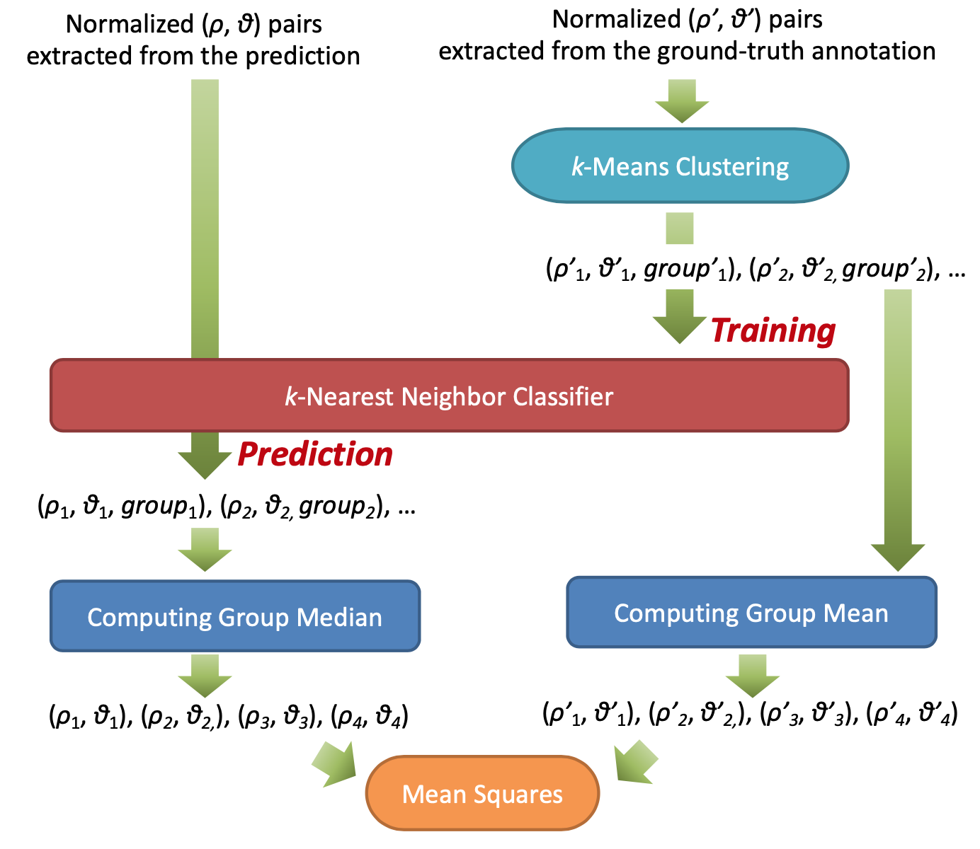
Part II: Lane Matching & Evaluation
Choosing k: elbow method
Notes:
Specifically, for those lines extracted from annotated images,
[click]
we will use k-means clustering to group them into k groups, where each group corresponds to one lane-line
[click]
Here, k is selected using the well-known elbow method that can almost always recover the actual number of lane-lines in our annotations.
We then train a k-nearest neighbor classifier that predicts the group ID of a line according to its (rho-theta) coordinates

Slide 20
Part II: Lane Matching & Evaluation
Notes:
The trained classifier can then be used to match those lines extracted from the input image with their corresponding groups obtained from the annotations, so that we can compute the error within each group.

Slide 21
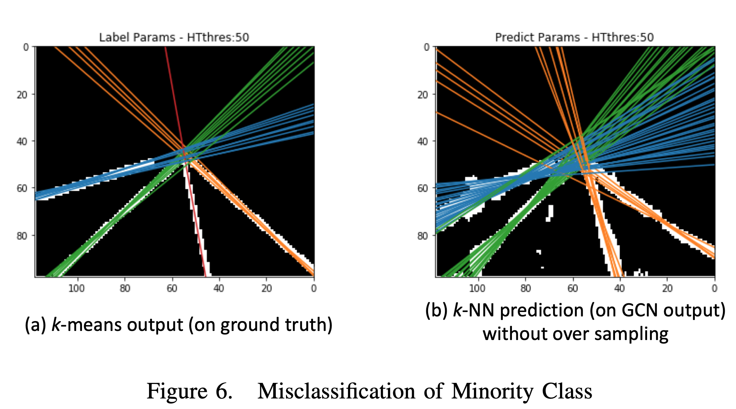
Part II: Lane Matching & Evaluation
Notes:
When training the group classifier, we notice that it is necessary to conduct oversampling over minority classes, since some lane lines are perfectly annotated leading to just one line or only a couple of lines inside one group.
The image on the left shows this case, where the red line is clearly extracted since there is no ambiguity in its pixel-level annotation. However, as the image on the right shows, this will cause the predicted lines to be classified into the orange group since the top-k nearest template lines are mostly orange and only one is red.

Slide 22
Part II: Lane Matching & Evaluation
Median is more robust to noise
Notes:
Now that the lines are properly grouped, for those lines predicted from the input image that tend to be noisy, we use their group median as the representative lane-line for that group
[click]
Using median tends to be more robust to individual noisy foreground pixels predicted

Slide 23
Part II: Lane Matching & Evaluation
Notes:
In contrast, the lines extracted from annotations are relatively clean and thus we simply use group mean as the representative lane-line

Slide 24
Part II: Lane Matching & Evaluation
Notes:
Finally, since the groups have been matched due to our k-nearest neighbor classifier, we can compute the mean squared error of their rho-theta coordinates
We call this error as the Hough Transform based error which reflects the similarity of lines rather than individual pixels

Slide 25
Experiments
Dataset: CULane
Created for academic research regarding traffic lane detection by the multimedia laboratory of the Chinese University of Hong Kong
The dataset includes video frames recorded by vehicles driven by different drivers in Beijing on different days
It contains 133,235 image frames including 88,800 in the training set, 9675 in the validation set, and 34,680 in the test set
Notes:
We have evaluated our model using the CULane dataset prepared by the multimedia lab of the Chinese University of Hong Kong
The dataset includes video frames recorded by vehicles driven by different drivers in Beijing on different days

Slide 26
Experiments
Notes:
Here are some examples of the results from different stages of our workflow, where we can see that the extracted lines are very similar to the actual lane-lines,
But if we simply compare the pixel alignment, the error will be large

Slide 27
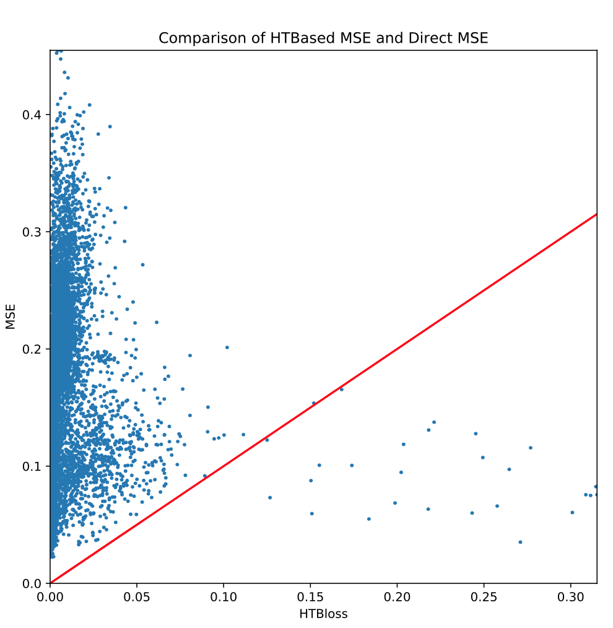
Experiments
Notes:
Here we show the comparison between our loss which is the x-axis, and the pixel-level loss which is the y-axis
[click]
We can see that most of our losses are very small, meaning that our model performs well on most video frames
[click]
However, this cannot be reflected if we use the pixel-level loss, since for the same line-level error, we can see that the pixel-level error can vary a lot and can be very large
A weakness of our method is that the evaluation stage is not integrated end-to-end into the neural network training, but during training, we can compute our line-level loss on the validation set to obtain a more accurate estimate of when the model begins to overfit

Slide 28
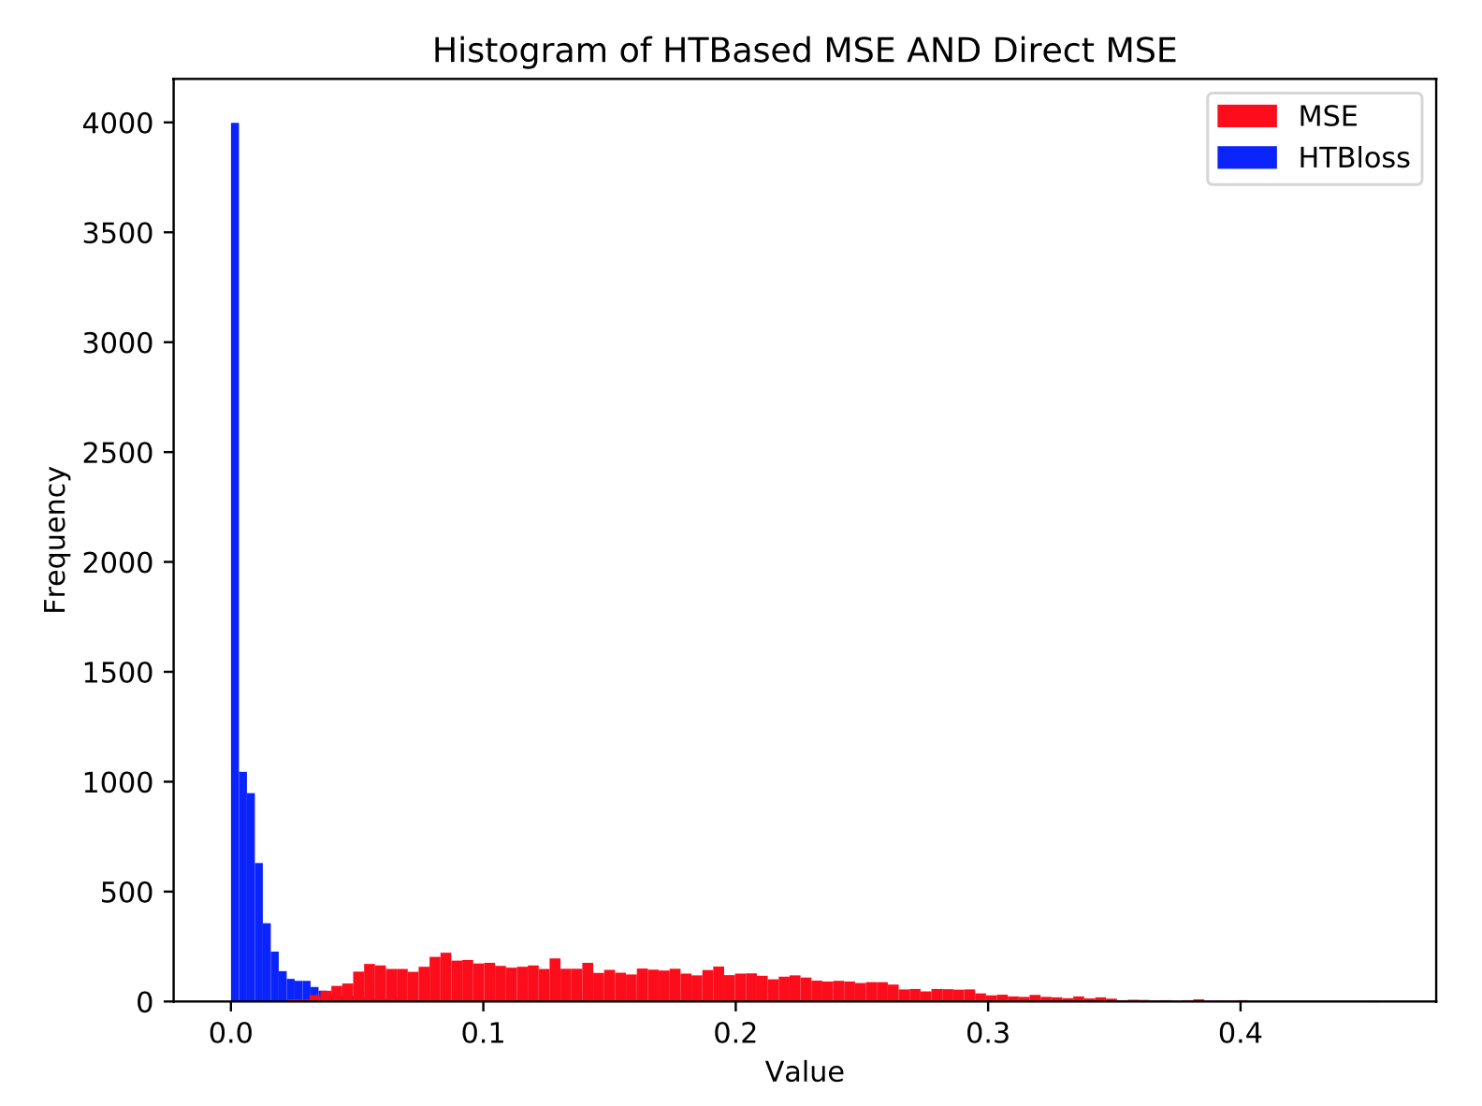
Experiments
Notes:
Here we provide a histogram of how many video frames are at each error range for both our line-level error and the pixel-level error, and we can see that our line-level error is very clustered close to 0, while the pixel-level error scatters over a wide range and is not indicative of the real performance of line extraction

Slide 29
If you have any questions, please email Xingyao Wang at xingyaow@umich.edu
Thanks !
YAN, Da
Contact Info:
Email: yanda@uab.edu
Webpage: https://yanlab19870714.github.io/yanda
Notes:
This ends our presentation and thanks for your attention!
If you have any questions regarding this work, please feel free to contact Xingyao Wang who is the first author of this work.

