Slide 1
Parallel Mining of Frequent Subtree Patterns
Wenwen Qu* (ECNU), Da Yan* (UAB), Guimu Guo (UAB),
Xiaoling Wang (ECNU), Lei Zou (Peking University), Yang Zhou (Auburn)
Contact:
wenwenqu@sei.ecnu.edu.cn (Wenwen Qu)
yanda@uab.edu (Da Yan)
Notes:
Good morning everyone, it’s our great pleasure to present our invited paper “Parallel Mining of Frequent Subtree Patterns” in the 2nd LSGDA workshop
Since we are allocated 30 minutes for the talk and Q&A, we will break this talk into two parts.
The first part is presented by me, Da Yan from the University of Alabama at Birmingham, about a new research direction that we are working on these days.
The current work also falls into this category
Then, the second part will be presented by Wenwen Qu from East China Normal University to elaborate a bit more on the details of the current work.

Slide 2
PART I: Compute-Intensive Frameworks
Presenter: Da Yan
yanda@uab.edu
Notes:
Let’s begin ☺

Slide 3
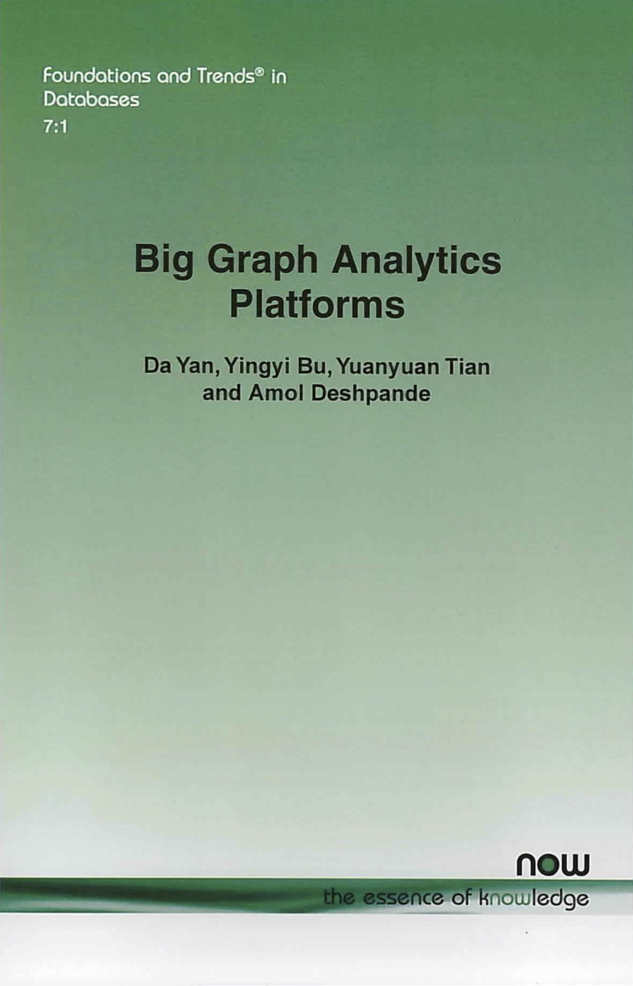
Motivation
IO-Bound Execution!
Vertex-Centric Graph-Parallel Systems
Pregel+: techniques to reduce message numbers (PVLDB’14, WWW’15, ICDE’18, TCBB’19)
Blogel: graph partitioning + think like a partition (PVLDB’14)
Quegel: online query processing with interactive speed (PVLDB’16)
GraphD: distributed out-of-core execution (TPDS’18)
LWFT: faster checkpointing and recovery (ICPP’19)
Full book available on my website
An algorithm researcher working on techniques that improve systems in general
Notes:
I have been working on a category of distributed graph processing systems that adopt a so-called think-like-a-vertex programming paradigm, as pioneered by Google’s Pregel system published in SIGMOD 2010
An example of a vertex-centric program is PageRank, where each vertex distributes its PageRank value along outgoing edges in each iteration, and so the bottleneck is communication for message shuffling.
I have been focusing on proposing general techniques for reducing the IO bottleneck, such as graph partitioning and message reduction.
We have been quite successful in this area with a number of works published.

Slide 4
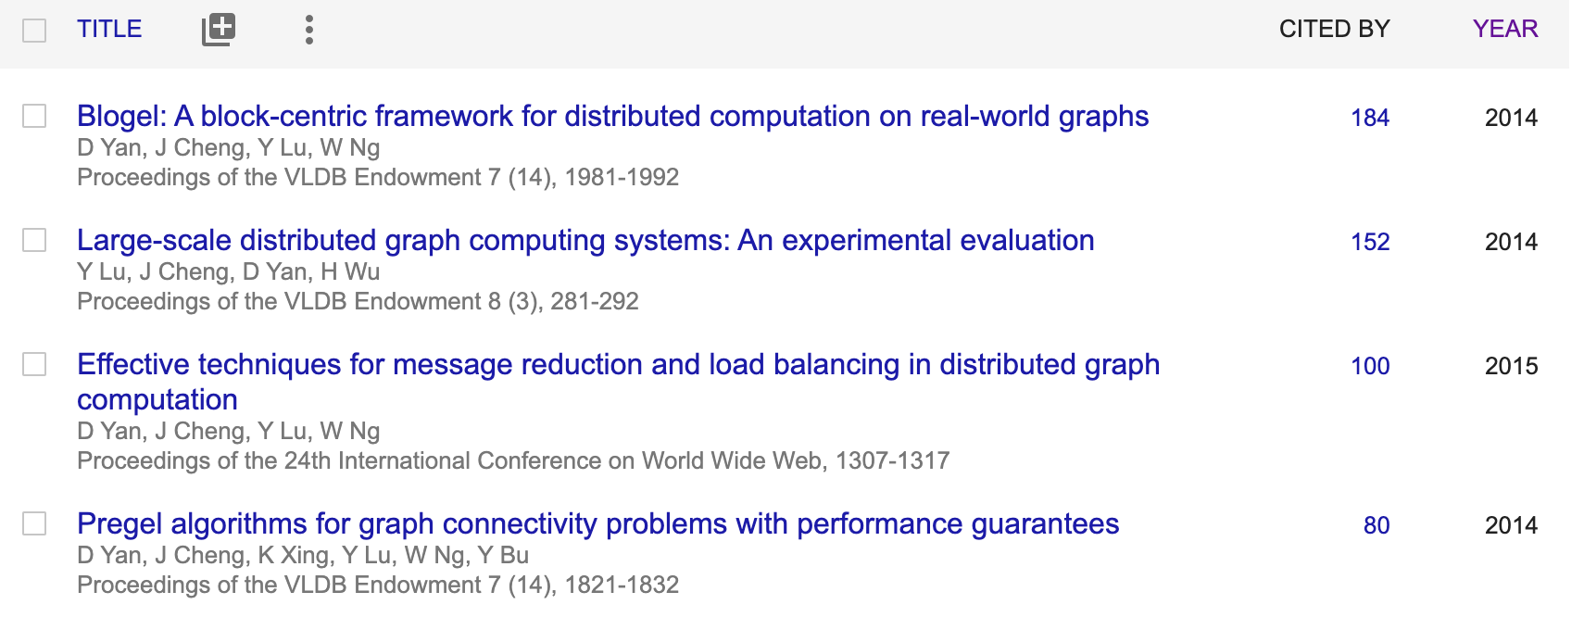
Motivation
Notes:
Our works have gained a lot of attention with systems being used by other researchers, and the papers well cited.

Slide 5
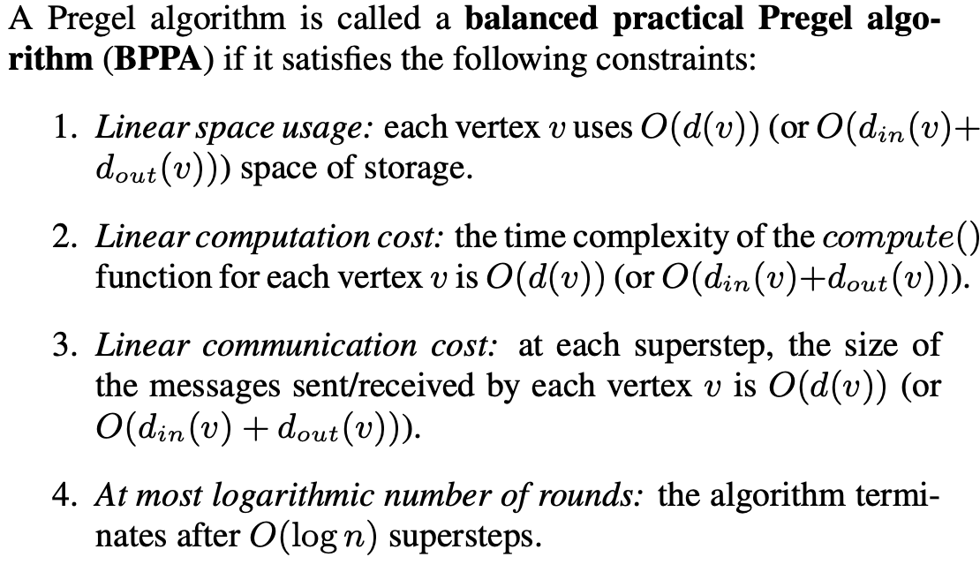
Motivation
Vertex-Centric Systems: for low-time-complexity problems
http://www.vldb.org/pvldb/vol7/p1821-yan.pdf
Notes:
However, as this paper that we published in PVLDB 2014 indicates, Pregel-like systems are really designed for iterative algorithms where each iteration runs with a cost linear to the graph size, and the computation runs for a limited number of iterations

Slide 6
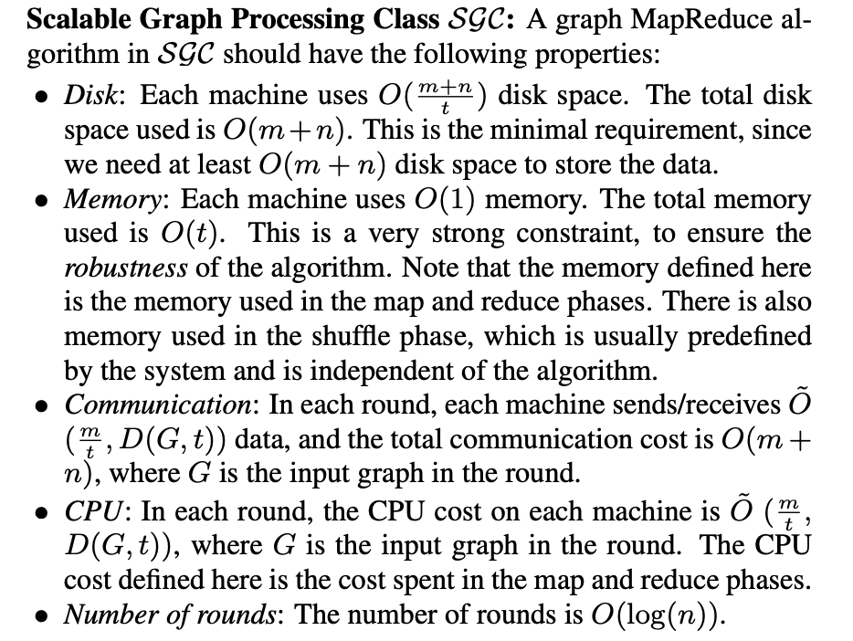
Motivation
Vertex-Centric Systems: for low-time-complexity problems
http://www-std1.se.cuhk.edu.hk/~hcheng/paper/SIGMOD2014qin.pdf
Notes:
There’s also a similar work that simulates Pregel’s message passing using MapReduce, and the conclusion is similar.
In fact, most of those papers study graph problems with a low time complexity, such as computing connected components, PageRanks, and single-source shortest paths

Slide 7
Motivation
How about Graph Mining?
Some are data-intensive / IO-bound
Peeling algorithm of k-core: O(n)
Random walks (e.g., PageRank)
Some are compute-intensive!
Dense subgraph structure mining: quasi-cliques, k-plexes
Frequent (and closed) subgraph pattern mining
Topics of this talk!
We illustrate with subtree patterns
Notes:
In the domain of graph mining, the number of papers are relatively limited. [click]
In fact, graph mining problems are very diverse, and there is no one-size-fit-all solution. Some problems have low time complexity such as computing k-core or PageRanks
[click]
Others can have a very high time complexity, such as mining dense subgraphs from a big graph, and mining frequent subgraph patterns from a graph database [click]
As a breakthrough in this area, we have developed a distributed framework called G-thinker for mining dense subgraphs [click]
We have also developed a parallel framework called PrefixFPM for mining frequent patterns in general, which is the foundation of the current work.

Slide 8
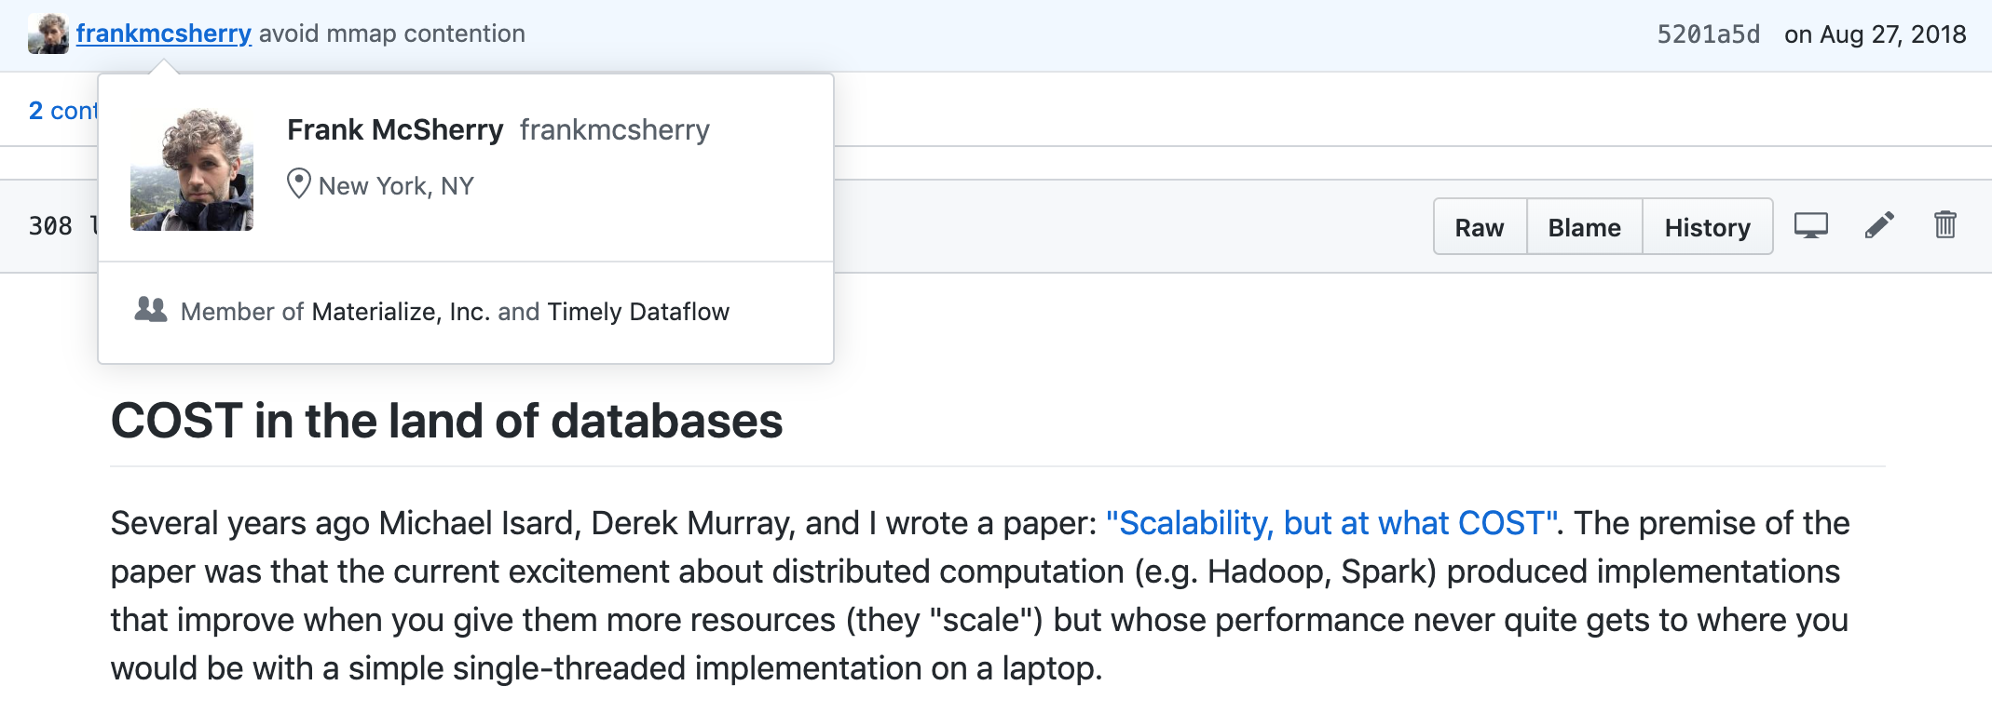
Motivation
Data-Intensive v.s. Compute-Intensive
Fundamental and familiar to the DB community
But people simply do not get it (‘system’-dizziness)
https://github.com/frankmcsherry/blog/blob/master/posts/2017-09-23.md
Notes:
It is worth noting that the current excitement of Big Data systems are nothing more than building data-intensive frameworks where different data partitions can be streamed in parallel, and messages can be exchanged in parallel.
They are good for IO-heavy operations, but the aggregate IO-bandwidth utilized is often comparable or less than the throughput of a single CPU core, as indicated in this post by Frank McSherry

Slide 9
Motivation
Data-Intensive v.s. Compute-Intensive
Fundamental and familiar to the DB community
But people simply do not get it (‘system’-dizziness)
Cont.
Notes:
Frank McSherry thinks that people are overexcited about Big Data systems, and people are developing systems with poor performance.
My experience talking to researchers interested in Big Data systems is that, some people simply get excited when hearing the word ‘system’, think that systems need a lot of time to develop and thus novelty can be slightly compromised.
Reviewers expect that the programming interface should be super-simple even for algorithms that are complicated by themselves, and performance can be compromised for programming simplicity.
We have to compare with many systems that are similar, and the best shot to get a paper accepted is to focus on simple toy algorithms so that programming can be presented in a simple manner.

Slide 10
Motivation
Data-Intensive v.s. Compute-Intensive
C
C
C
C
B₁
B₃
B₅
B₇
B₂
B₄
B₆
B₈
Ethernet
C
C
200 %
throuphput
core #
Notes:
However, data-intensive frameworks have communication as the bottleneck and CPU cores are often underutilized.
For example, if each data block generates an amount, C, of communication, and your network bandwith is 2C.
Then even if you have many CPU cores, you can at most fully utilize 2 CPU cores, which is a waste of resources for compute-intensive problems.

Slide 11
Motivation
Data-Intensive v.s. Compute-Intensive
Data-intensive
IO-bound
Compute-intensive
CPU-bound
throuphput
throuphput
1
2
3
4
core #
1
2
3
4
core #
more disks
faster networks
faster disks
more CPUs
more memory
Notes:
A lot of problems are actually compute-intensive, where the workloads come from the exponentially large search space rather than the large data volume.
If we address them using a data-intensive framework, we achieve a throughput that is similar to a couple of CPU cores on a single machine.

Slide 12
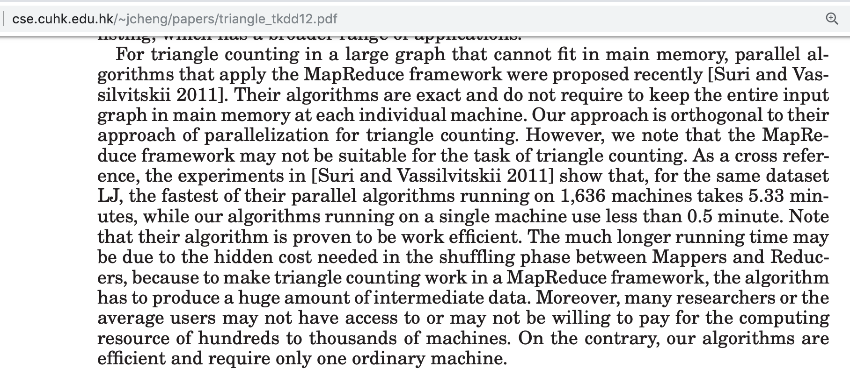
Motivation
Notes:
In fact, things can get even worse given that the network throughput can be much lower than that of a CPU core, and the IO-bound execution slows down the entire process
For example, in this TKDD paper, the authors find that for triangle counting, their single-threaded algorithm is 10 times faster than the state-of-the-art MapReduce solution running with over 1600 machines

Slide 13
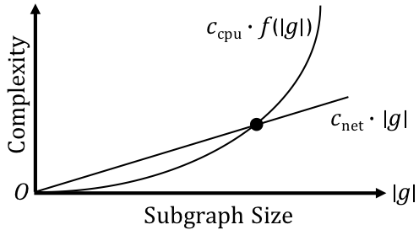
Motivation
T-thinker: Divide and conquer
Task-based: data pulling + computation on top
Notes:
The solution is to make the execution engine of a framework compute-intensive by itself.
We have proposed a new paradigm called T-thinker, or task-thinker, which utilizes divide and conquer to achieve compute-intensive execution.
The key insight is that a lot of problems can be represented as tasks, where a big task over a big dataset can be decomposed into independent tasks over smaller data subsets for parallel execution
So, if the data needed by a task is large enough, the linear cost of fetching the data into a local machine is well offset by the subsequent compute-intensive mining over the fetched data, and the concurrent execution of multiple tasks can hide the communication latency

Slide 14
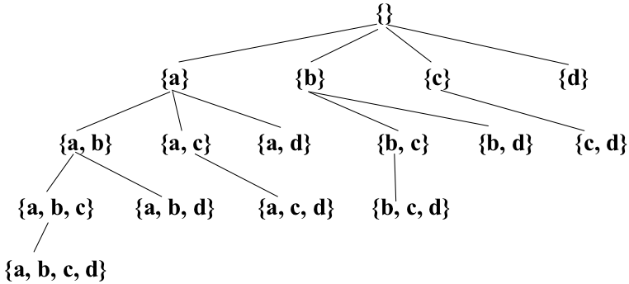
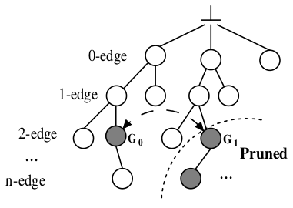
Motivation
Programming Simplicity Over-Emphasized
pattern-to-instance
instance-to-pattern
Embedding-Centric: Arabesque (SOSP’15), RStream (OSDI’18)
Notes:
Of course, task-based execution has been there in the HPC community for a long time. Our contribution should be that the programming model is easy for the targeted category of problems.
However, existing pioneering frameworks in graph mining simply materializes and grows all potential subgraphs in the search space, the cost of which is prohibitive.
Examples include the embedding-centric API of Arabesque that attempts to handle both dense subgraph mining that allows backtracking without subgraph materialization, and frequent subgraph mining that need pattern deduplication by subgraph isomorphism checking.
Since the problems are quite different in nature, a unified design leads to the worst of both worlds.

Slide 15
G-thinker
Task-Centric Programming Interface
UDF: spawn_task(vertex)
UDF: compute(task, frontier)
pull(vertex_id)
add_task(task)
Task Metadata
Task Subgraph
Notes:
Our G-thinker system addresses the dense subgraph mining problem by spawning tasks from individual vertices to grow candidate subgraphs for mining, and big tasks can be decomposed into smaller tasks to divide the workloads by multiple CPU cores.
Since this talk focuses on the other system, PrefixFPM, for parallel frequent pattern mining, we refer interested audience to our ICDE 2020 paper for the details about G-thinker.
Without any further delay, let’s welcome Wenwen to give the second part of this talk.

Slide 16
PART II: PrefixFPM & Subtree Mining
Presenter: Wenwen Qu
wenwenqu@sei.ecnu.edu.cn
Notes:
Hi everyone, my name is Wenwen Qu and I’ll present the 2nd part to elaborate on how we mine subtree patterns in parallel.
First, let me introduce the important concepts used in frequent pattern mining.

Slide 17
Target Problems
Frequent Pattern Mining
Illustration with itemset as our pattern
Market Bucket Transactions
Transaction ID | Items Bought
1 | Bread, Milk
2 | Bread, Diaper, Beer, Eggs
3 | Milk, Diaper, Beer, Coke
4 | Bread, Milk, Diaper, Beer
5 | Beer, Milk, Diaper, Coke
6 | Beer, Milk, Diaper, Bread
Itemset (Pattern): {Milk, Bread, Diaper}
Notes:
We will illustrate the concepts using itemsets as the patterns.
In this slide, we have a database of 6 transactions indicating the items that people buy from a supermarket.
[click]
From this database, we would like to mine patterns in the form of itemsets, where an itemset with 3 items is shown at the bottom.

Slide 18
Target Problems
Frequent Pattern Mining
Illustration with itemset as our pattern
Market Bucket Transactions
Transaction ID | Items Bought
1 | Bread, Milk
2 | Bread, Diaper, Beer, Eggs
3 | Milk, Diaper, Beer, Coke
4 | Bread, Milk, Diaper, Beer
5 | Beer, Milk, Diaper, Coke
6 | Beer, Milk, Diaper, Bread
Pattern Size: |{Milk, Bread, Diaper}| = 3
Notes:
For a pattern, we have the concept of pattern size.
In our itemset pattern, the size is 3 since we have 3 items in the set.

Slide 19
Target Problems
Frequent Pattern Mining
Illustration with itemset as our pattern
Market Bucket Transactions
Transaction ID | Items Bought
1 | Bread, Milk
2 | Bread, Diaper, Beer, Eggs
3 | Milk, Diaper, Beer, Coke
4 | Bread, Milk, Diaper, Beer
5 | Beer, Milk, Diaper, Coke
6 | Beer, Milk, Diaper, Bread
Support (Count): σ{Milk, Bread, Diaper} = 2
Notes:
If we check the itemset against the database, we can see that Transactions 4 and 6 cover our itemset,
and therefore, we say that the support count of our pattern is 2

Slide 20
Target Problems
Frequent Pattern Mining
A database of transactions
Concepts:
Transaction
Pattern
Support: count or fraction
Problem:
Finding all patterns with support >= a support threshold
Notes:
Here is a recap of the concepts in frequent pattern mining.
We have a database of transactions, and we want to find those patterns that are covered by a significant number of transactions in our database.

Slide 21
Target Problems
Types of Patterns
Itemset
Subsequence
Subgraph
Subtree
Notes:
We remark that the pattern type is not limited to itemset.
Depending on the database type, a pattern can also be a subsequence, a subgraph or even a subtree.
For example, in a database of chemical compounds, it would be interesting to find frequent subgraph structures that often hints useful functionalities.
As another example, we can also mine subtree patterns from an XML file such as that of DBLP, to capture patterns like frequent coauthorships in a particular journal.

Slide 22
Target Problems
Pattern Constraints
Induced v.s. embedded (tree and graph)
B
is an embedded pattern
B
D
Notes:
It is also common to define constraints on the desired patterns.
In this slide, we show a tree-structured transaction, and if we consider embedded pattern which only requires the preservation of ancestor-descendant relationship between nodes, then the pattern BBD is covered even though it is not an induced subgraph of the tree transaction.

Slide 23
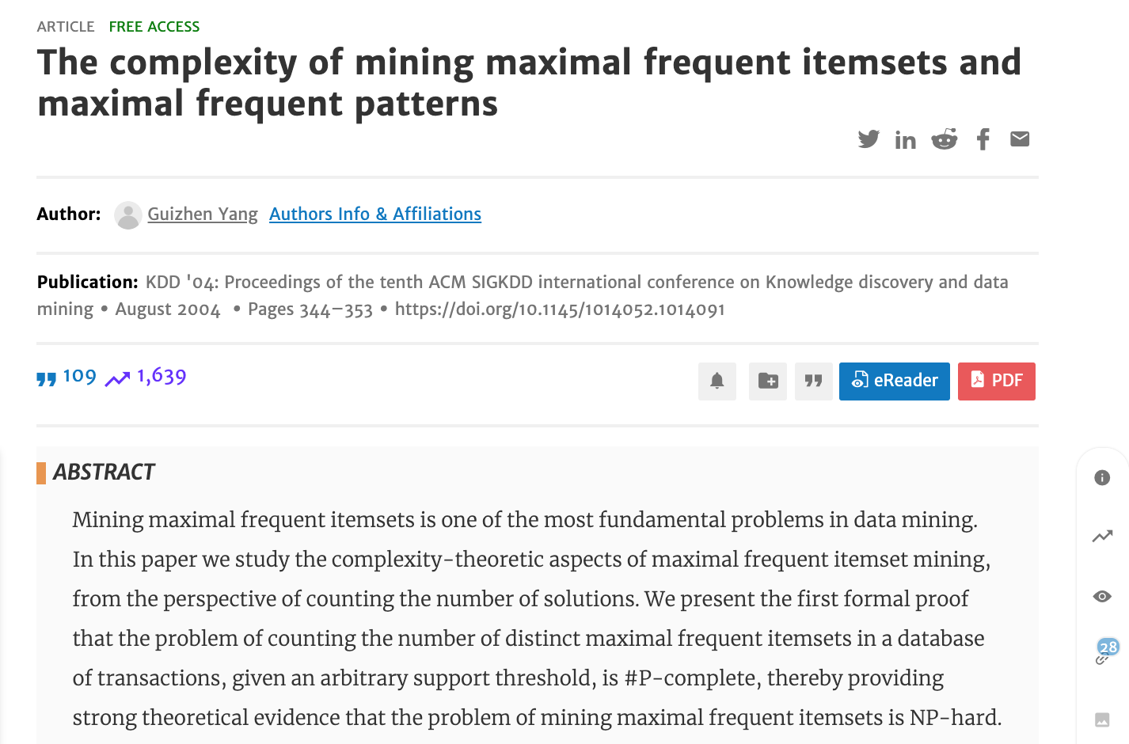
Target Problems
Compute-intensive: need parallel computing to scale
Notes:
In fact, frequent pattern mining is NP-hard, and it is important to utilize all the CPU cores in a multi-core machine for effective pattern mining.

Slide 24
Target Problems
Our Goals
Efficient: all CPU cores are busy mining
General Programming Framework: can be customized to handle all kinds of patterns
Itemset
Subsequence
Subgraph
Subtree
…
order-free
parallel
FP-tree
PFP
parallel
Prefix Projection
PrefixPFM
order matters
Depth-First Pattern Search/Recursion !
Notes:
Therefore, we aim to design a parallel framework that is able to keep all CPU cores busy in mining frequent patterns.
[click]
An important goal is to make our framework's programming interface general enough for mining all kinds of patterns.
[click]
We remark that the pattern of itemset is special because there is no order over the items in a set, so we can use algorithms that define its own order for effective mining, such as the FP-growth algorithm.
[click]
However, we do not target this problem as it has been well addressed by Google‘s parallel FP-growth algorithm which is shown at the top.
[click]
We consider those patterns where it matters how the elements are ordered or connected.
[click]
Our framework is designed based on the idea of prefix projection, the idea of which will be reviewed shortly.
Our framework is called PrefixFPM as we use prefix projection and tackles general frequent pattern mining, or FPM in short.
[click]
An important feature of PrefixFPM is that, we consider algorithms that check patterns in the depth-first order of pattern growth.

Slide 25
Prefix Projection
PrefixSpan (Sequential Pattern Mining)
SID | Sequence
s₁ | ABCBC
s₂ | BABC
s₃ | AB
s₄ | BC
SID | Sequence
s₁ | _BCBC
s₂ | _BC
s₃ | _B
SID | Sequence
s₁ | _CBC
s₂ | _C
s₃ | _
SID | Sequence
s₁ | _BC
s₂ | _
A
B
C
(d) D|_{ABC}
(b) D|_{A}
(c) D|_{AB}
(a) D
Projected DB
Transaction DB
Pattern: ABC
Pattern: ∅
Pattern: A
Pattern: AB
Notes:
Let us now illustrate the idea of prefix projection by considering the problem of mining frequent subsequence patterns from a sequence database.
Here, we can see that database D has 4 sequences.
[click]
If we consider pattern A, then s4 is filtered as it has no A, and the underscored positions are those that match A.
[click]
We call such a database as a projected database projected by pattern A.
[click]
Now if we grow pattern A with one more element B, we only need to continue matching from the projected database of A.
We will continue matching B starting from the underscored positions.
This will give us the projected database of AB.
[click]
We can further grow the pattern by C, and check against the projected database of AB to find those sequence transactions that contain pattern ABC.

Slide 26
Prefix Projection
Depth-First Pattern Growth
Alphabet is {A, B, C}
Transaction DB
∅
Projected DB
frequent
A
C
B
…
…
Projected DB
Projected DB
AA
AB
AC
A stack of projected DBs with shrinking size
…
infrequent
frequent
Effective pattern pruning
Projected DB
Projected DB
ABB
ABC
Incremental projected DB construction
ABA
…
Child-branches are embarrassingly parallel !!!
infrequent
infrequent
Notes:
PrefixSpan actually checks the patterns in depth-first pattern-growing order.
Let us consider a sequence database where there are only 3 element types, A, B and C.
[click]
We will first grow an initial empty pattern by A to obtain A's projected database.
[click]
If it contains sufficient transactions, we consider A as frequent and output it.
[click]
We then grow pattern A into AA, create its projected database from that of A.
[click]
Assume that the projected database does not have sufficient transactions, so AA is infrequent. Then, AA is pruned and we do not need to consider to grow AA further.
[click]
After backtracking to pattern A, we will consider the next child pattern AB, and assume that it is frequent.
[click]
Then we will continue to check its child-patterns ABA, [click] ABB [click] and ABC
[click]
We will continue to check all the patterns in depth-first order of the pattern-growth tree, until all frequent patterns are found.
This algorithm has several desirable features.
[click]
Firstly, we only check a child-pattern over its parent-pattern's projected database, which gets smaller as the parent-pattern grows in size.
[click]
Secondly, we can prune the whole subtree in our pattern search space once a pattern is found to be infrequent.
[click]
Thirdly, we will remember how a parent-pattern is matched to each transaction, so that a child-pattern can continue its matching rather than starting from scratch.
[click]
Finally, all child-subtrees can be checked independently and are therefore amenable to parallel computing.

Slide 27
Prefix Projection
From Sequences to Trees
Encode pattern-graph into a sequence
BAB$D$$B$C$
BAB$D$$C$B$
BC$B$AB$D$$
Notes:
We remark that this prefix-projection idea is not limited to mining sequential patterns.
For example, we can find subtree patterns from a tree database in a similar manner, by encoding each tree pattern into a sequence representation.
This allows us to run a PrefixSpan-style algorithm on the encoded sequence pattern space.
In the slide, each tree is encoded using depth-first preorder node traversal, except that we need to add a dollar sign each time we backtrack.
For example, for the first tree, we have <move the mouse following each label in the encoding!> BAB$D$$B$C$.

Slide 28
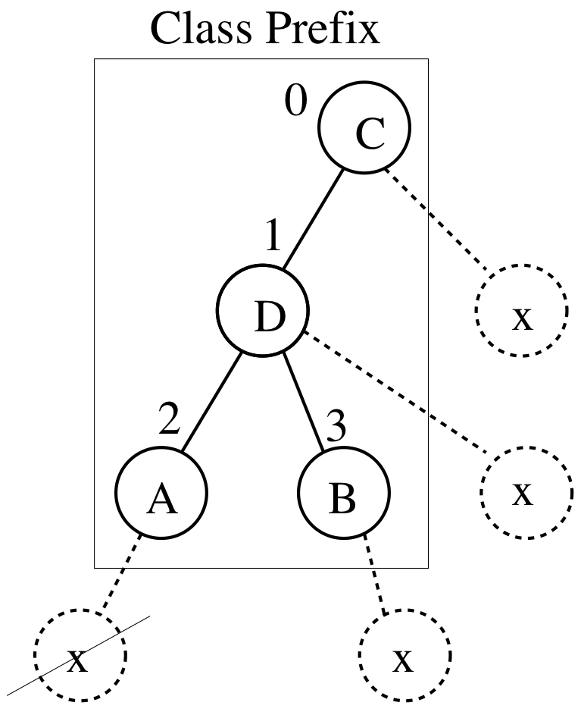
Prefix Projection
From Sequences to Trees
Edge extension
along rightmost path
Notes:
Patterns are grown by extending one adjacent edge each time, and not all adjacent edges need to be considered for extension.
For example, we do not need to consider growing from Node 2 in the slide since x is not on the rightmost path.
This is because our encoding is in depth-first order and an earlier encoding in DFS order should have considered that branch.

Slide 29
PrefixFPM: A Task View
Each pattern α is associated with a task t_{α}
Task t_{α} checks the frequency of α over D|_{α}
Task t_{α} grows α by one more element for recursion
If D|_{α} is large, child-patterns are wrapped as tasks (added to a shared queue) for concurrent processing
Otherwise, the whole pattern subtree is processed by the current tasks
α
α + e₁
α + e₂
… …
α + e_{m}
Notes:
Our PrefixFPM framework adopts a task-centric computation model, where each pattern is associated with a task.
The task will check if that pattern is frequent,
[click]
and if so, it will grow the pattern by one more element to generate child-patterns for further checking.
[click]
If the projected database is big, child-patterns are wrapped into independent tasks which are then added to a task queue to be fetched by other threads for mining.
[click]
Otherwise, the task is efficient to process by the current thread itself, so the thread will directly process it in depth-first pattern growth order.

Slide 30
Programming Interface
Trans
ProjTrans
Pattern
int transaction_id
// transaction data
int transaction_id
// transaction match
// α and D|_{α}
UDF: print(ostream& fout)
Task <PatternT, ChildrenT, TransT>
PatternT pattern
ChildrenT children
UDF: setChildren()
UDF: Task* get_next_child() //”new” a task from a child pattern
UDF: bool pre_check(ostream& fout)
UDF: bool needSplit()
Entry Function: run(ostream& fout)
Worker <TaskT>
ifstream input_file
UDF: readNextTrans(vector<TransT>& D)
UDF: setRoot(stack<TaskT*>& Q_{task})
Entry Function: run()
Notes:
The programming interface of PrefixPFM is shown here, where we have a Task base class whose user-defined function setChildren() indicates how to grow a parent pattern by one more element into child patterns.
We will see how these UDFs are used in the next slide.
There is also a Worker base class which creates the initial size-1 pattern tasks and puts them into the task queue for concurrent processing.
This is conducted by the setRoot(.) function which is also user-defined.

Slide 31
PrefixFPM: A Task View
1
2
3
4
5
6
7
8
9
10
11
12
13
14
15
16
17
void run(ostream& fout){
if(!pre_check(fout)) return;
//generate new patterns
setChildren(children);
//run new child tasks
while(Task* t= get_next_child()){
if(needSplit()){
q_mtx.lock();
queue().push(t);
q_mtx.unlock();
}
else{
t->run(fout);
delete t;
}
}
}
Task queue is a stack
Old tasks are prioritized
Notes:
This slide shows how a thread processes a task using the user-defined functions, where Line 2 first checks if we need to skip the current pattern, which is often useful if we have additional constraints on patterns.
Then Line 4 will generate child patterns and their projected databases.
Each child-pattern is then processed in the while loop where Line 7 checks if we should wrap child-patterns into tasks for concurrent processing.
Otherwise, the current thread will call the same function in Line 13 on the child-pattern to check and grow it recursively.
[click]
We make the task queue a stack so that tasks are fetched in depth-first priority.
[click]
This strategy prioritizes old tasks to minimize memory footprint occupied by the projected databases that are being mined upon.

Slide 32
Concurrent Processing
Task Parallelism
Alphabet is {A, B, C}
Transaction DB
∅
DB-parallelism
Projected DB
A
B
C
…
…
Thread 3
Thread 4
infrequent
AA
AB
AC
…
Thread 2
ABA
ABB
ABC
Thread 1
Notes:
Here, we illustrate how our parallel framework divides the pattern search space.
[click]
For example, thread 1 could be processing pattern AB.
[click]
The next pattern in depth-first order, which is AC, is fetched and processed by Thread 2.
[click]
Thread 3 [click] and Thread 4 will then process the next 2 patterns in depth-first order.
Note that these tasks may add more child-pattern tasks into the current task queue, so that idle threads can then fetch them for processing.
We also allow a pattern to be checked against a big projected database in parallel, which is helpful initially when there are not many tasks to keep all the CPU cores busy.

Slide 33
This Work
PrefixTreeSpan
TreeMiner
Notes:
In this work, we implement and compare two serial algorithms for mining embedded subtree patterns on top of our PrefixFPM framework.
The two algorithms are PrefixTreeSpan and TreeMiner.

Slide 34
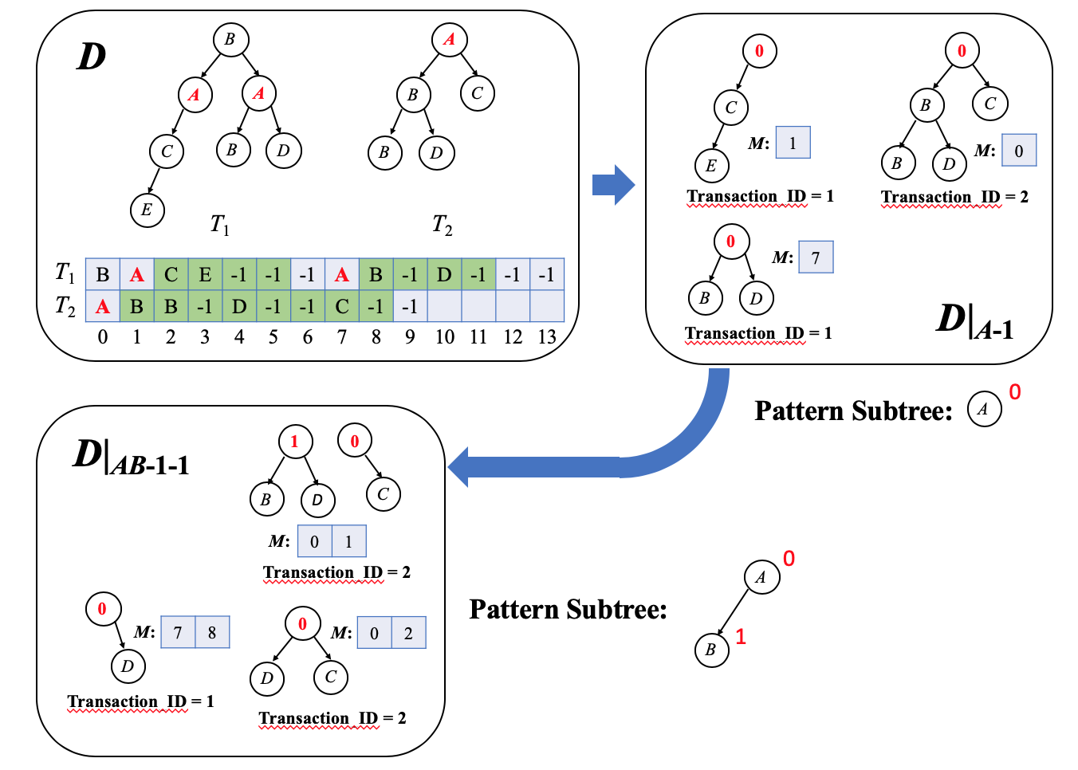
PrefixTreeSpan
Notes:
PrefixTreeSpan is similar to PrefixSpan.
Here, a tree is encoded as we mentioned before where backtracking from a child is denoted by -1.
For example, T1 in D is encoded as BACE-1-1-1A, etc. (use mouse to follow!)
A prefix tree projects each data tree into a so-called postfix-forest.
For example, given prefix tree AB (use mouse to follow), we obtain two postfix-trees in the forest after projection.
To extend edges from the rightmost path, we only check elements starting from right after the last matched position in the data tree encoding.
For example, when extending pattern tree A into AB (use mouse to follow), for this projected instance of T1 (use mouse to point to B0D), the last matched location is 7 (use mouse to follow), and therefore we start scan from position 8 for extension, where B at position 8 (use mouse to follow) is then matched to the second pattern node

Slide 35
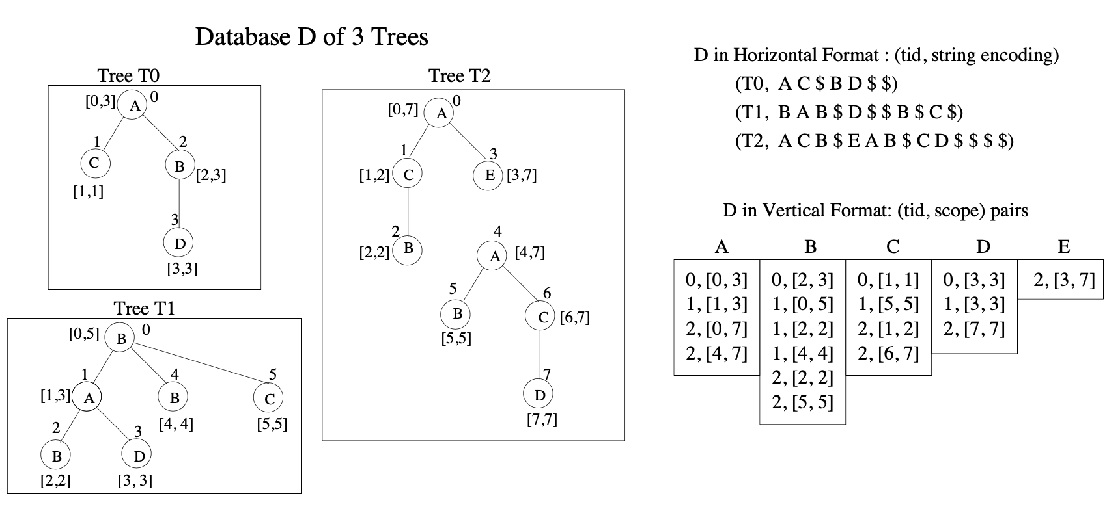
TreeMiner
Notes:
The other algorithm, Tree Miner, uses a similar hortizontal encoding for trees, but projected transaction instance are represented using a pair of tree ID plus a scope.
For example, for tree pattern A, it has two matches (use mouse to follow) in tree T2, one at node 0 whose subtree covers scope [0, 7], and the other at node 4 whose subtree covers scope [4, 7]
The scope is computed using preorder depth-first traversal where the rightmost node in the subtree defines the scope boundary. Scopes are used to decide if a new edge is a child extension below the last matched node, or a cousin extension from an ancestor node along the rightmost path.
Each pattern is associated with a list of such scopes which acts as the pattern’s projected database.

Slide 36
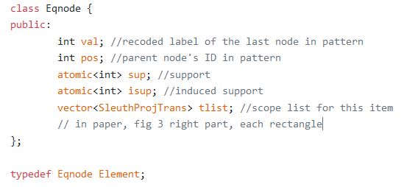
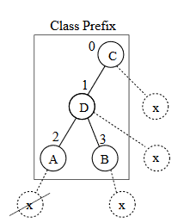
TreeMiner
Generates a size-(k + 1) pattern from two size-k patterns that share the same size-(k − 1) prefix encoding
x
i
P
Projected DB
(i, x)
P
Notes:
Unlike PrefixTreeSpan, TreeMiner generates a size-(k + 1) pattern from two size-k patterns that share the same size-(k − 1) prefix encoding, which allows the pattern-growth to be more selective.
Each pattern P here is actually a size-(k-1) prefix that can be extended by different edges, and to generate the projected instances of a size-(k+1) pattern, we join the projected database of two size-k patterns that share the same prefix P, one extended with edge (i, x), the other with edge (j, y)
Here, you can see that the pattern object P also maintains a list of child-patterns each with its projected database, for pairwise join

Slide 37
TreeMiner
Generates a size-(k + 1) pattern from two size-k patterns that share the same size-(k − 1) prefix encoding
UDF: setChildren()
1:
2:
3:
4:
5:
6:
7:
for each (i, x) ∈ [P]
L₁ ← scope list of P_{x}^{i}
for each (j, y) ∈ [P]
if i < j: continue
L₂ ← scope list of P_{y}^{j}
Q_{y}^{j} ← join(L₁, L₂) // note that Q = P_{x}^{i}
if Q_{y}^{j} is frequent: children[Q].add(Q_{y}^{j})
Notes:
Here’s the user-defined setChildren function for TreeMiner, where the projected databases, aka. scope lists, of two child patterns of P are joined to construct the projected databases of patterns of size-(k+1) for use by the child-tasks with prefix Q

Slide 38
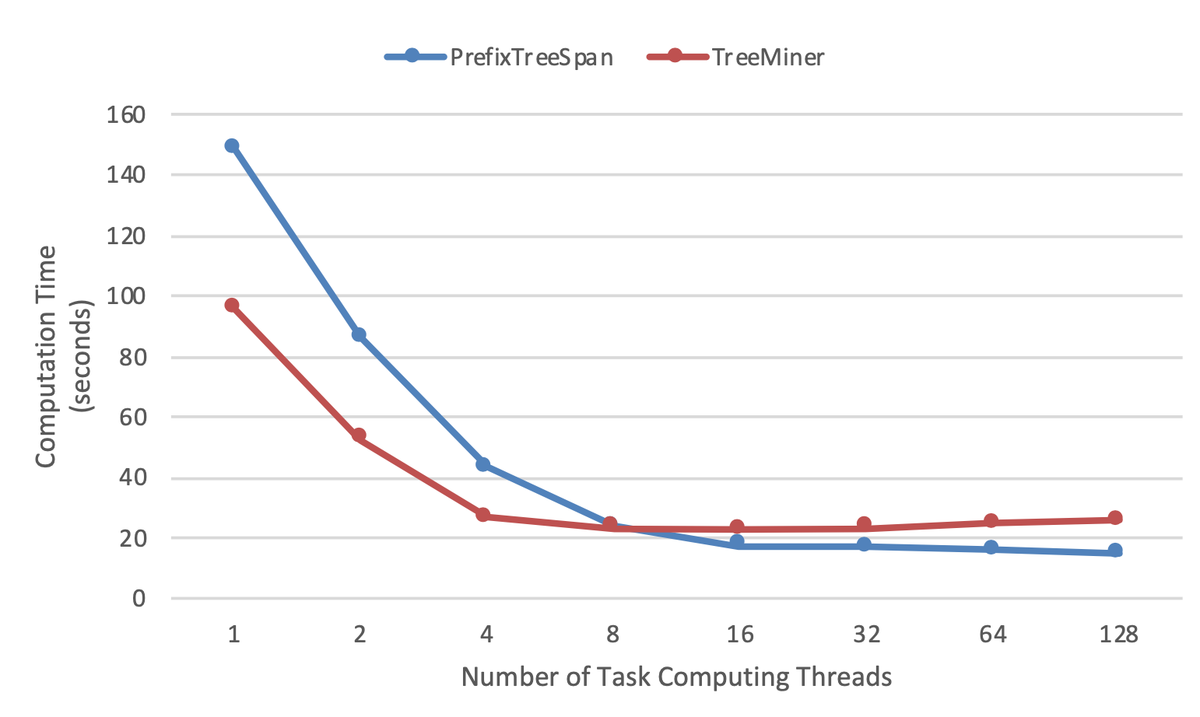
This Work
Conclusion
TreeMiner has less overall mining workload
But PrefixTreeSpan is more amenable to parallelism
Notes:
Note that each task in TreeMiner keeps a list of projected databases for the child-patterns of prefix P, so the task granularity is one level bigger than those tasks in PrefixTreeSpan
This actually compromises the degree of parallelism
In our experiments, we find that TreeMiner undoubtedly has a lower overall mining cost, but when the parallelism becomes high, such as more than 8 threads, it can sometimes be beaten by PrefixTreeSpan where a task only handles one pattern rather than a list of child patterns.

Slide 39
QU, Wenwen
Contact Info:
Email: wenwenqu@sei.ecnu.edu.cn
Check out our GitHub page: https://github.com/wenwen-Q/PrefixFPM
Thanks !
YAN, Da
Contact Info:
Email: yanda@uab.edu
Webpage: https://yanlab19870714.github.io/yanda
Notes:
We have open-sourced our code on GitHub with detailed documentation, and you are welcome to check it out!
Thanks for your attention, and now I am ready to take questions.

