Slide 1



Systems for Scalable Graph Analytics and Machine Learning: Trends and Methods
Da Yan, Lyuheng Yuan, Akhlaque Ahmad
Indiana University Bloomington
Chenguang Zheng,
Hongzhi Chen, James Cheng
The Chinese University of Hong Kong
Notes:
Good morning everyone! Welcome to our tutorial titled “Systems for Scalable Graph Analytics and Machine Learning: Trends and Methods”.
This tutorial is contributed by two groups from both Indiana University Bloomington and the Chinese University of Hong Kong.
My name is Da Yan, an Associate Professor from Indiana University Bloomington.
While I and the other presenters could not join the conference in person and we will play the tutorial video instead, my student Saugat has connected us through Zoom so that we can answer your questions.
So, please feel free to ask us questions.

Slide 2
Tutorial Outline
Vertex Analytics (Brief, 10 min)
Structure Analytics (20 min)
Graph Neural Networks (1 hr)
From the Systems Perspective!
Notes:
A real graph analytics pipeline often involves a combination of three types of graph operations, including vertex analytics, structure analytics, and graph machine learning.
[click]
This tutorial focuses on the system design perspective of these graph operations.

Slide 3
Tutorial Outline
Vertex Analytics (Brief, 10 min)
Structure Analytics (20 min)
Graph Neural Networks (1 hr)
Graph Algorithms + Mining
Graph (Deep) Learning
Notes:
This tutorial is divided into two parts.
The first part is on vertex and structure analytics, which are based on conventional graph algorithms and graph mining methods, and I will be the presenter.
The second part is on systems for training graph neural networks, which will be presented by my PhD student Lyuheng Yuan.

Slide 4
Vertex Analytics:
Think-Like-a-Vertex (TLAV) Model
Da Yan
yanda@iu.edu
Associate Professor of Computer Science
Indiana University Bloomington
Notes:
First, let’s look at vertex analytics.
Such tasks are often solved using the think-like-a-vertex computing model.

Slide 5
Think Like a Vertex (TLAV)
Pregel-Like Systems
u₁
0.5
w₁
1
u₂
v
w₂
1
1
1
3
summation
u₃
w₃
1.5
v.compute(messages)
Simplified Illustration Without Damping
Notes:
This model is first proposed by Google researchers in their system called Pregel, which has motivated many other vertex-centric systems such as GraphLab, Giraph and GraphX.
The vertex-centric model asks users to write a compute function, which is run by each individual vertex to collectively complete the task.
Taking PageRank computation as an example, in the compute function, each vertex v first
[click]
gathers messages from its in-neighbors,
[click]
sum them up to become v’s new PageRank value, and then
[click]
divides it evenly to the out-neighbors.

Slide 6



Think Like a Vertex (TLAV)
Vertex-Centric, Iterative
  Low time complexity:
  O(|E|) per iteration (message passing between vertices)
  O(polylog(|G|)) iterations
Notes:
A vertex-centric program runs iteratively, where each iteration has cost linear to the graph size, such as sending one message along each edge, and there are only a small number of iterations such as logarithmic to the graph size.
This leads to a time complexity upper bound of (n\log n), so the think-like-a-vertex model is only suitable for graph problems with a low time complexity.
This scalability restriction has been noticed by many works as listed on this page.

Slide 7
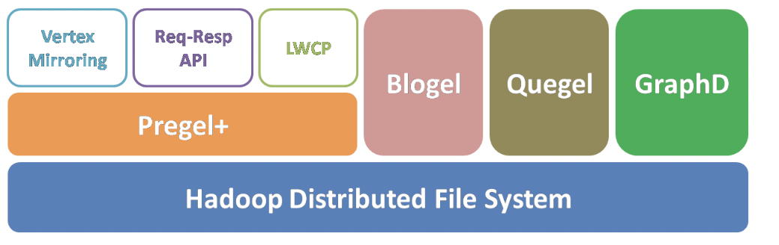
Think Like a Vertex (TLAV)
Our Pregel-Like Systems
Pregel+: techniques to reduce message numbers (PVLDB’14, WWW’15, ICDE’18, TCBB’19)
Blogel: graph partitioning + think like a partition (PVLDB’14)
Quegel: online query processing with interactive speed (PVLDB’16)
GraphD: distributed out-of-core execution (TPDS’18)
LWFT: faster checkpointing and recovery (ICPP’19)
Notes:
We have a long history of working on vertex-centric systems, some of which are shown on this page.
We have improved Google’s Pregel model from various aspects including message reduction, graph partitioning, online querying, out-of-core execution, and fault tolerance.

Slide 8
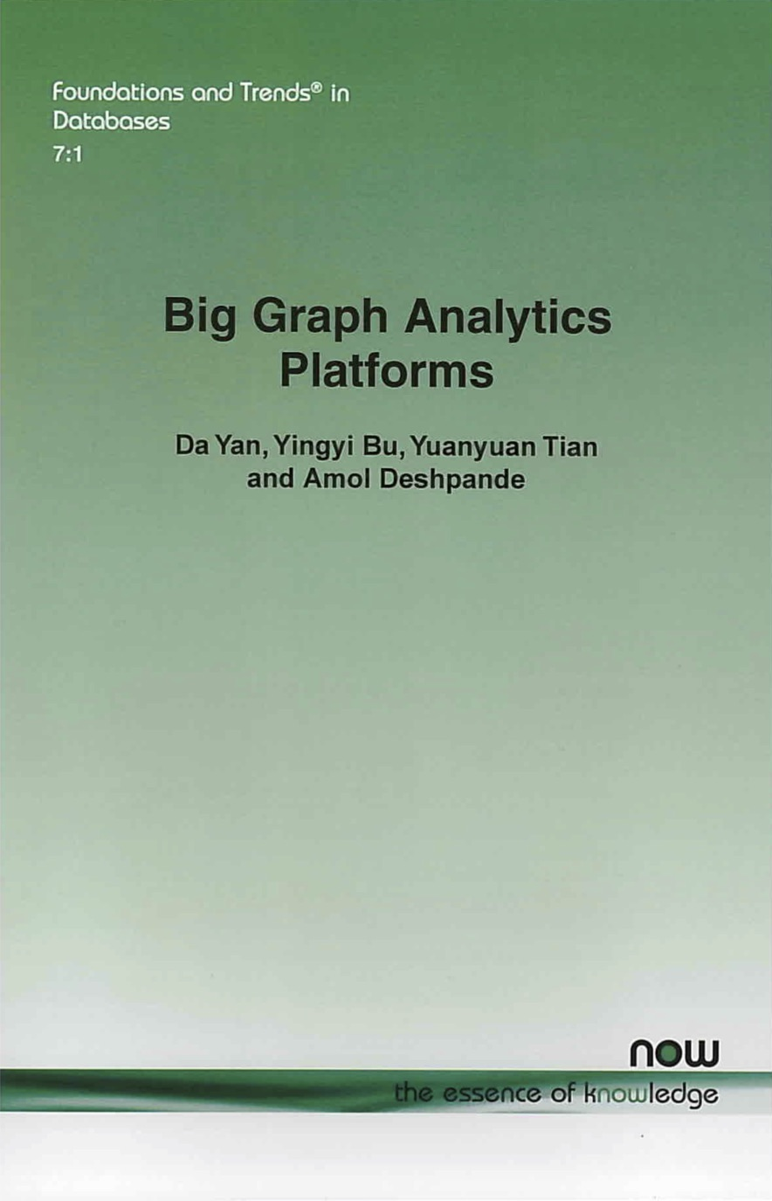
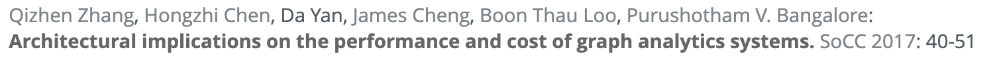
Our TLAV Research
Notes:
Here are the related publications.

Slide 9
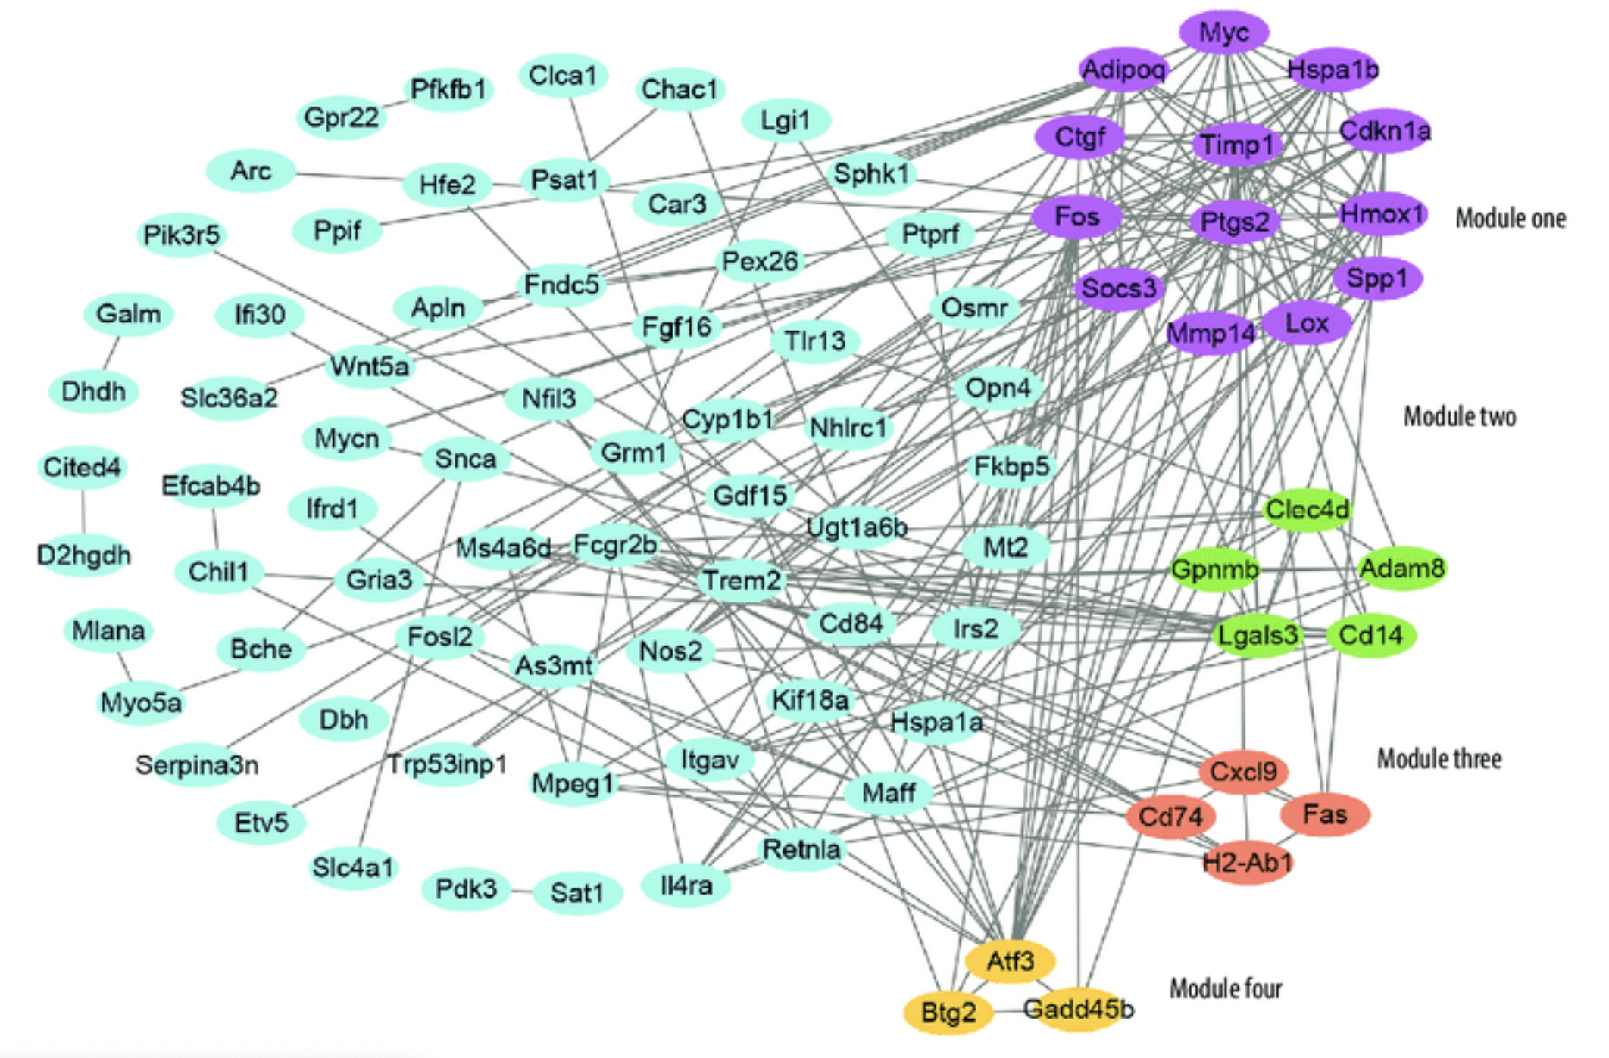
Is TLAV Sufficient?
Graph-Centric, Recursive
  High time complexity
  Often NP-hard due to search space explosion
  Heavily relies on effective pruning techniques
Graph DB
Notes:
A natural question to ask is: can all graph problems solved by the vertex-centric model efficiently?
The answer is no.
For example, problems that mine subgraph structures with certain properties often have a very high time complexity, and their computation operates on subgraphs rather than individual vertices, so it is neither convenient nor efficient to solve them using the vertex-centric model.
In fact, their algorithms usually follow a backtracking process on a search space tree where each node corresponds to a set of vertices, so the search space can be as large as the power set of the vertex set.

Slide 10
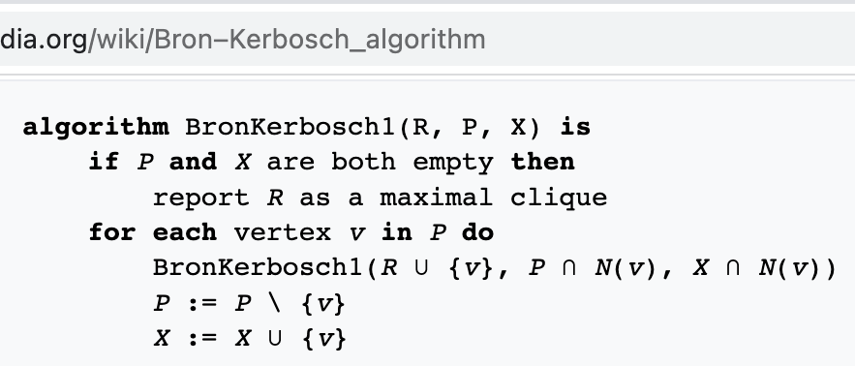
Is TLAV Sufficient?
Bron–Kerbosch Algorithm
{}
{a}
{b}
{c}
{d}
{a, b}
{a, c}
{a, d}
{b, c}
{b, d}
{c, d}
{a, b, c}
{a, b, d}
{a, c, d}
{b, c, d}
a < b < c < d
{a, b, c, d}
Set-enumeration tree
Also applicable to k-plexes, γ-quasi-cliques, etc.
Notes:
An example is the Bron-Kerbosch algorithm for mining maximal cliques, which recursively extends the current set of vertices that form a clique with one more candidate, and this search process can be organized as a set-enumeration tree.

Slide 11
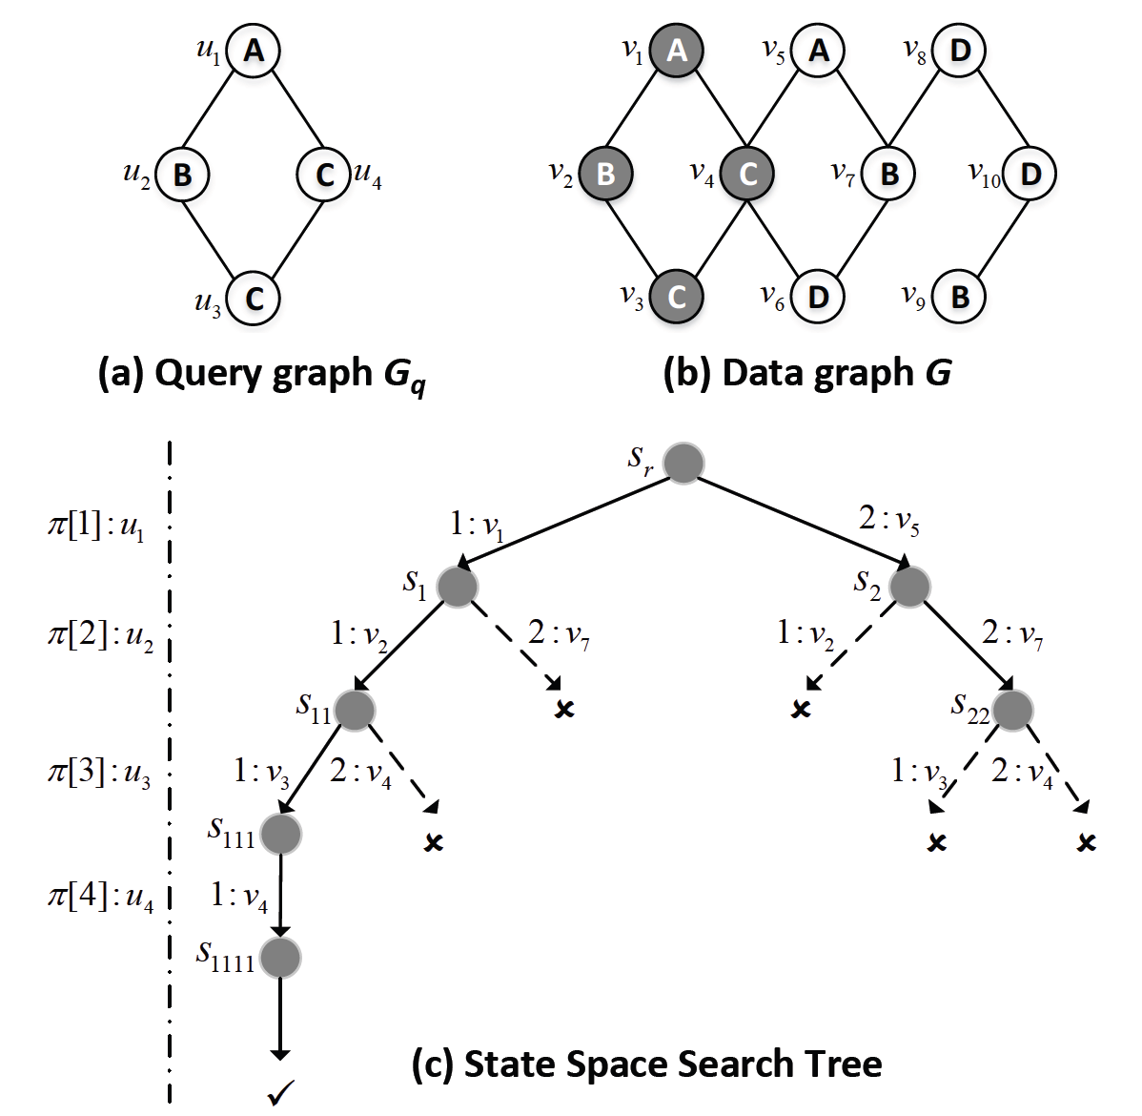
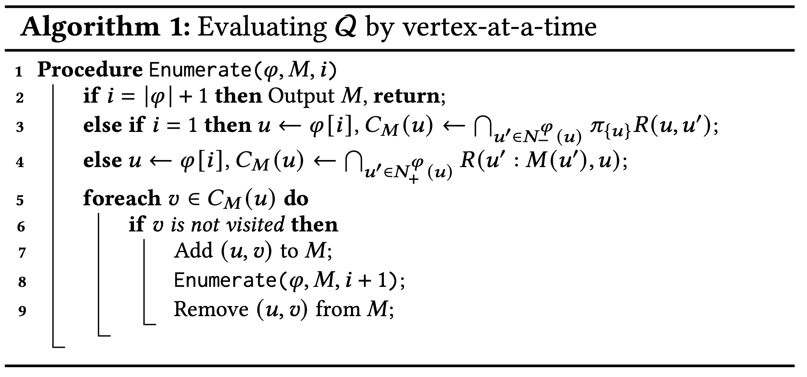
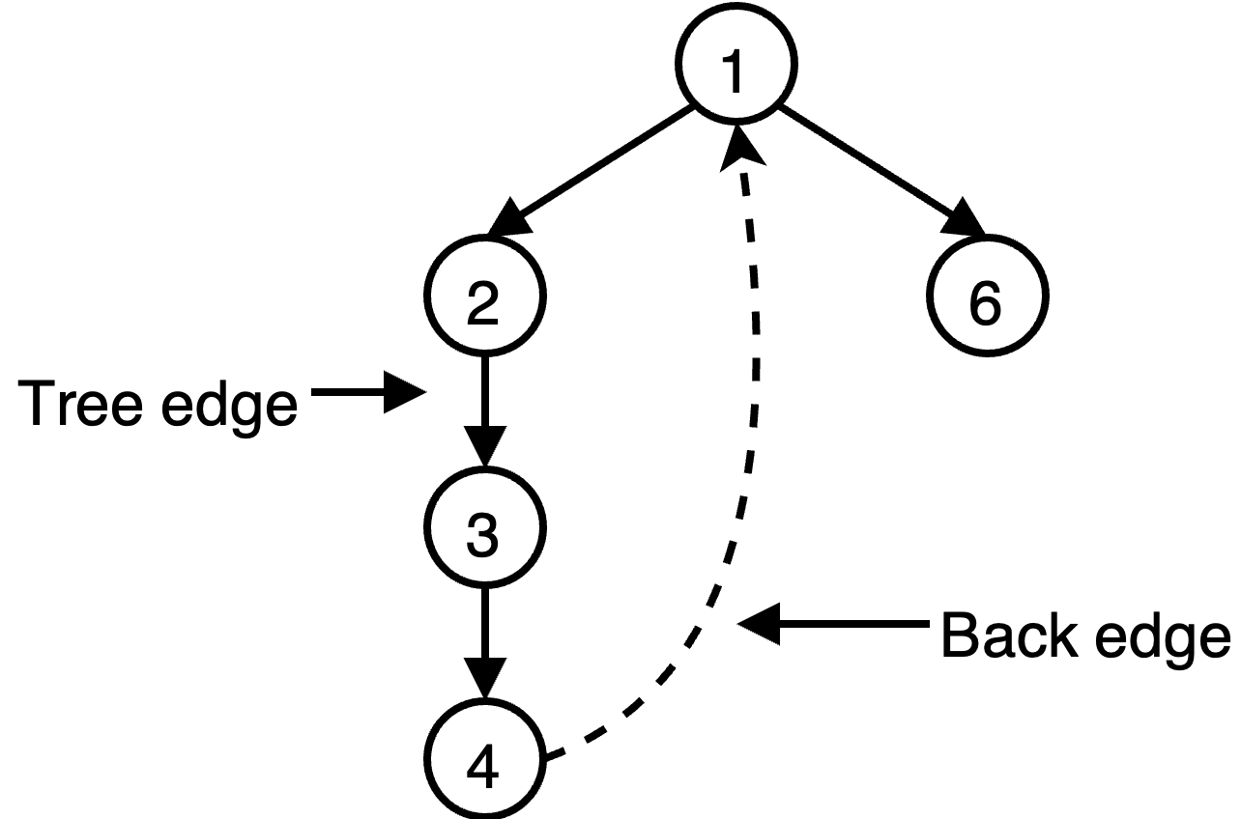
Is TLAV Sufficient?
Ullmann’s Algorithm
Notes:
A second example is Ullmann’s algorithm for subgraph matching, which finds all subgraphs in a data graph that match a given query graph. The algorithm recursively extends the current set of vertex match with one more query vertex to match, and this search process can be organized as a state-space tree.

Slide 12
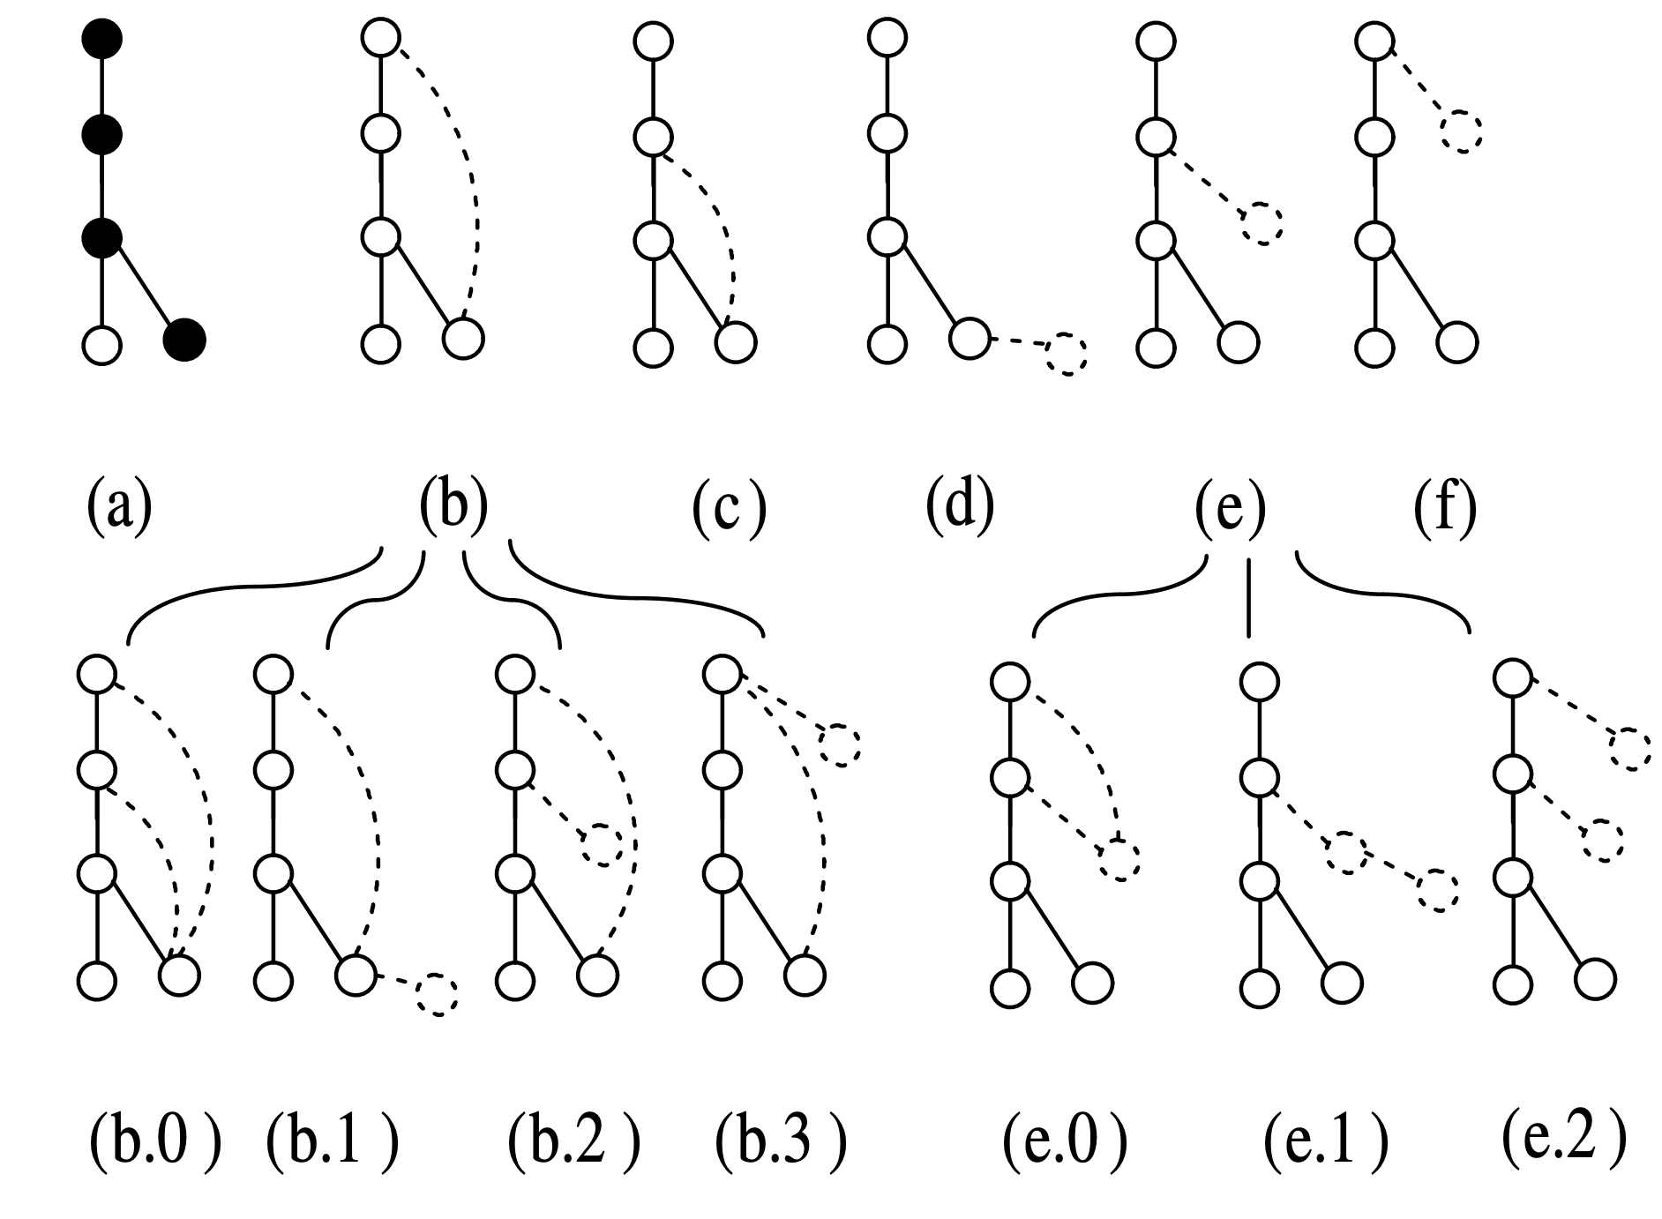
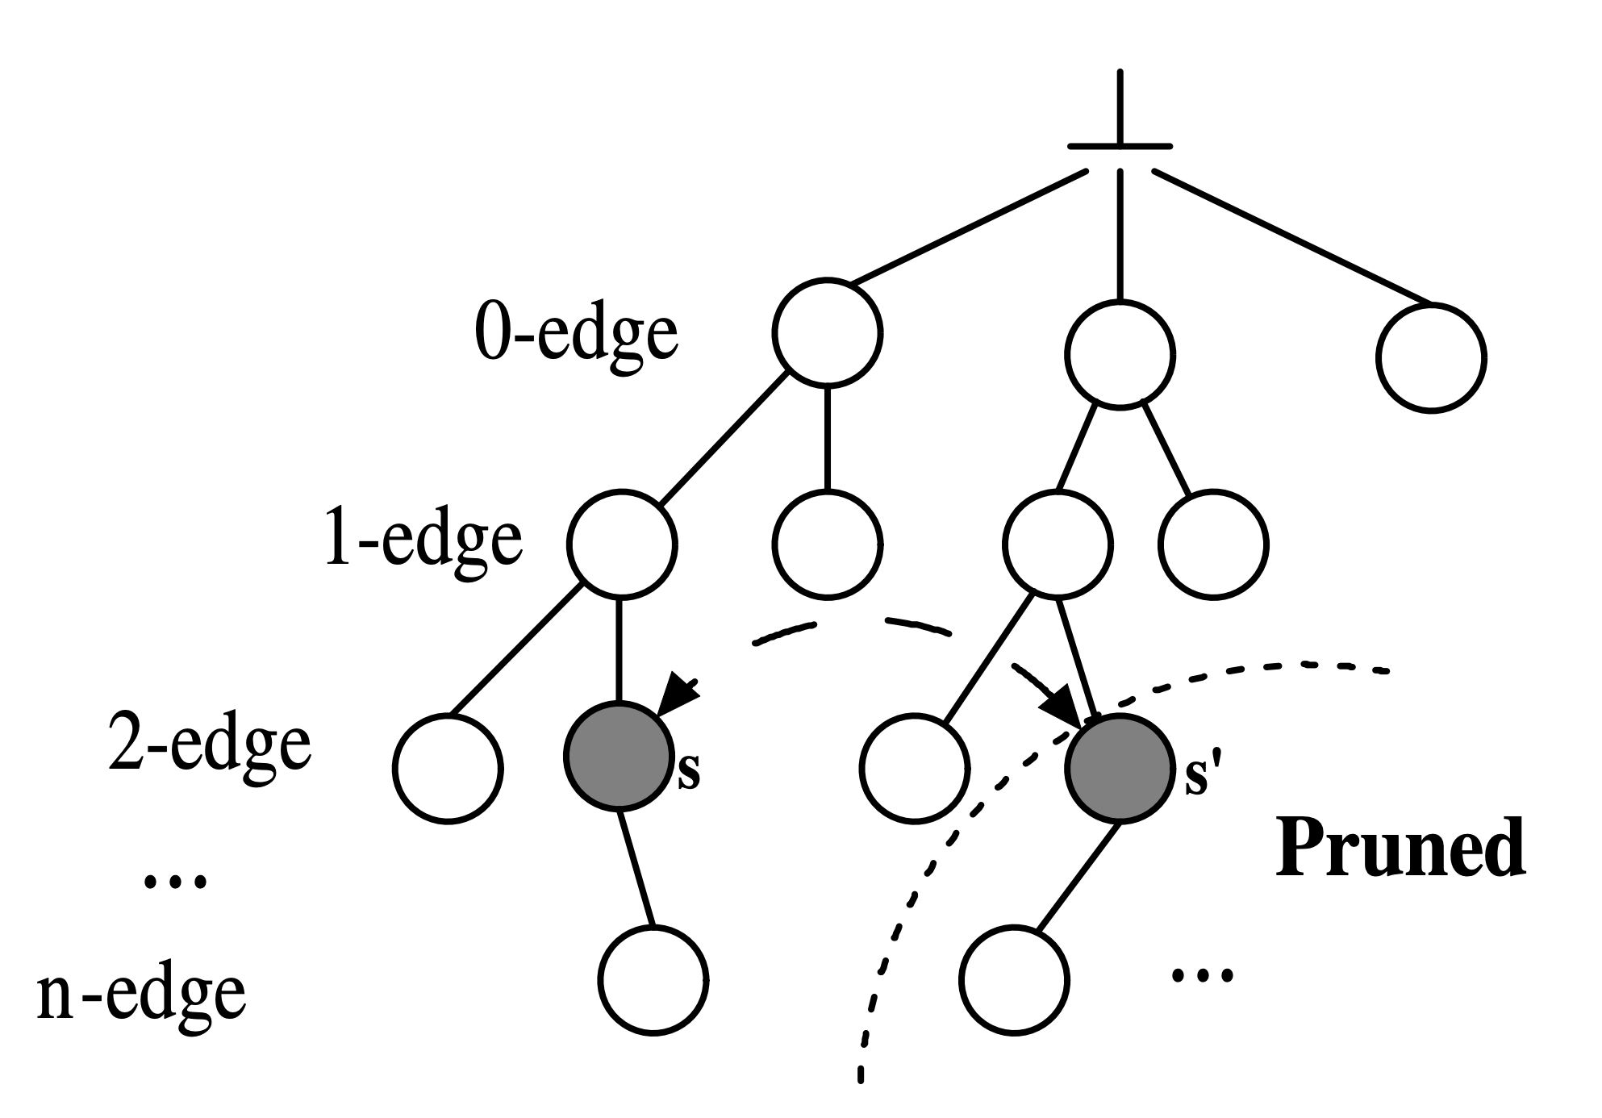
Is TLAV Sufficient?
gSpan/GraMi
Notes:
A last example is the depth-first subgraph pattern generation for checking pattern frequentness in the application of frequent subgraph pattern mining. The pattern graph growing process can also be organized as a search tree.

Slide 13
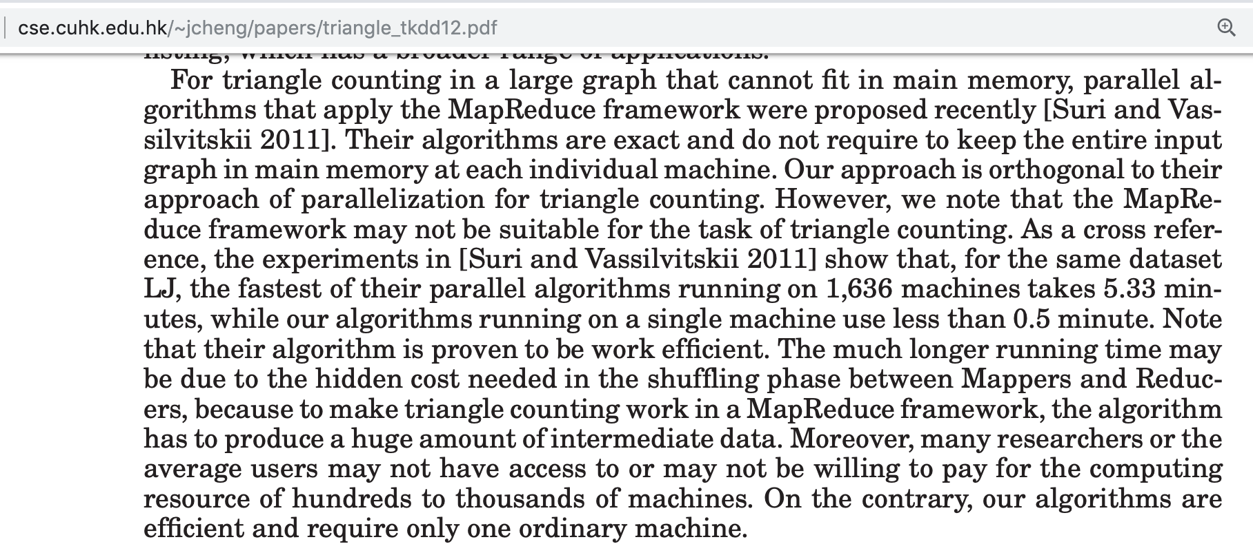
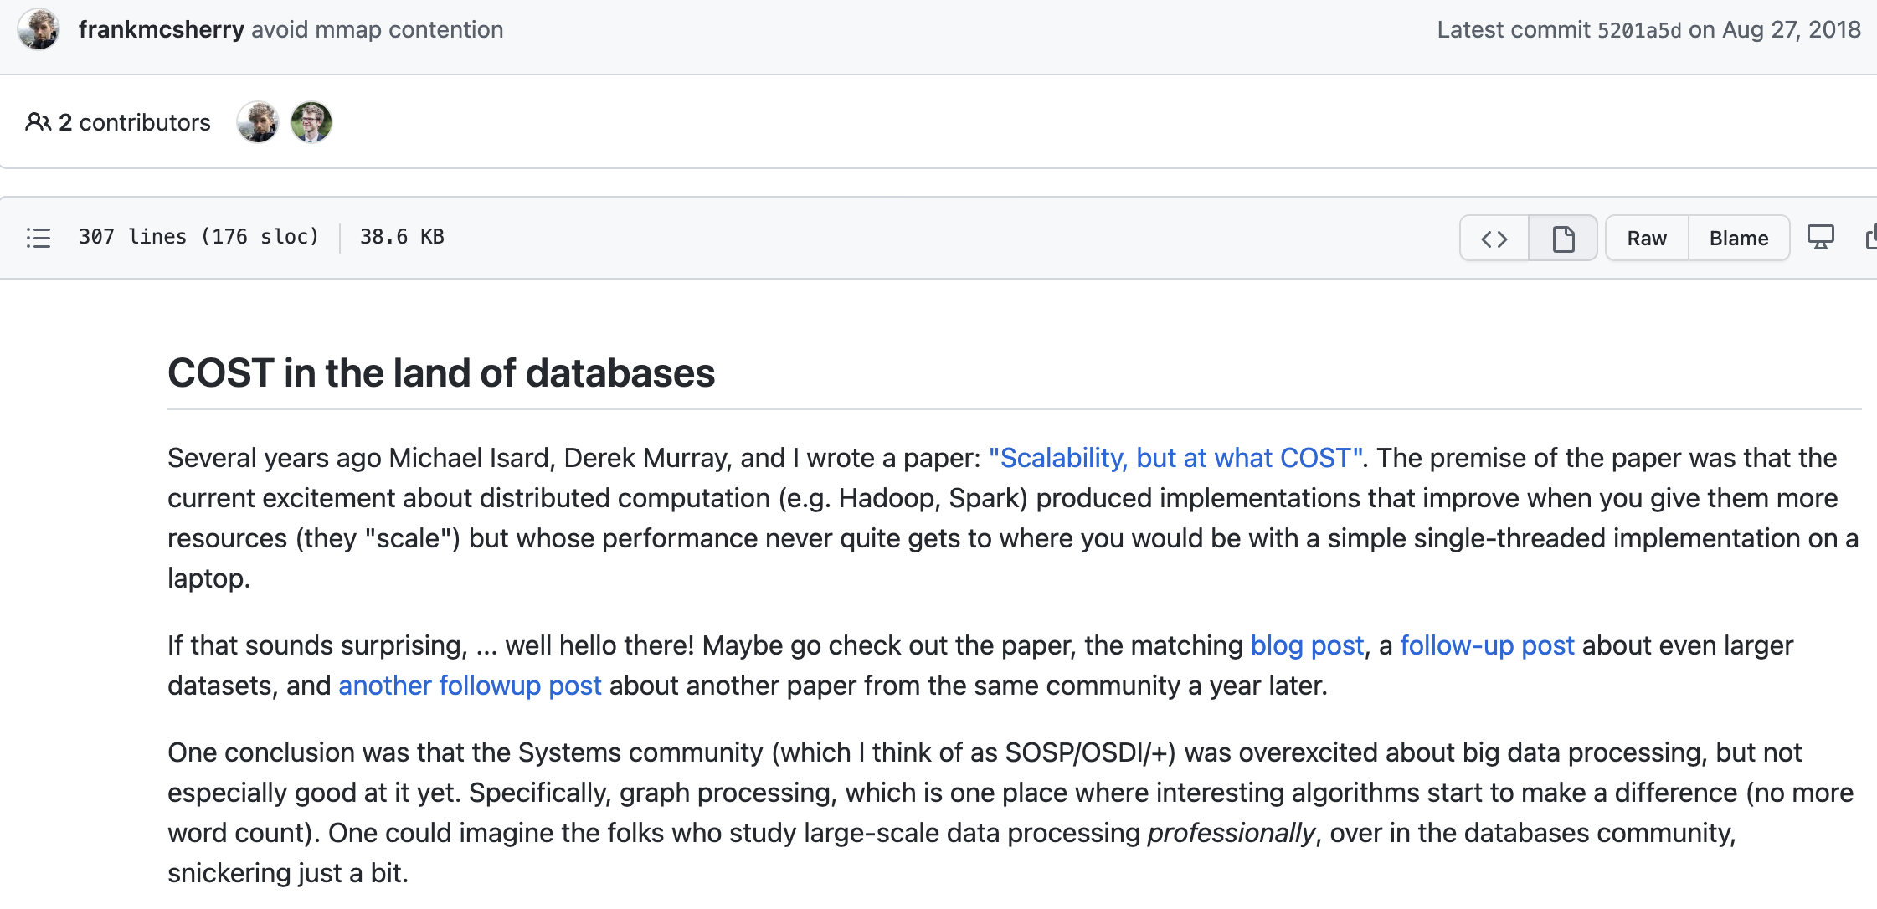
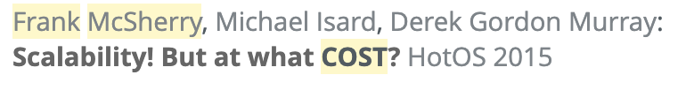
Is TLAV Sufficient?
What’s next in graph systems research?
Notes:
There are works applying vertex-centric programs simulated by MapReduce or Pregel-like systems for structure analytics problems, but the performance is terrible.
For example,
[click]
a TKDD paper on single-threaded external-memory triangle counting algorithm finds that their program is 10 times faster than a state-of-the-art MapReduce algorithm for triangle counting, even though the MapReduce algorithm uses more than 16 hundred machines.
This is mainly because the cost of materializing and transmitting the intermediate subgraph results.
[click]
Frank McSherry also notice that existing Big Data frameworks can scale with the data size by adding more machines and hence memories, but the computing performance is not much faster than a single-threaded external-memory program running on the SSD of a laptop.
[click]
He further indicate that the systems community as represented by the OSDI and SOSP community was overexcited about but not very good at it.
[click]
So, in the domain of structure analysis, or we say, subgraph analysis, we would need a new computing model that can fully utilize the CPU cores by avoiding unnecessary IO cost incurred by materializing and transmitting the intermediate subgraph results.

Slide 14
Structure Analytics:
Think-Like-a-Task (TLAT) Model
Da Yan
yanda@iu.edu
Associate Professor of Computer Science
Indiana University Bloomington
Notes:
Next, I will provide a solution to structure analysis, which is based on a recent computing model called T-thinker, or think-like-a-task, that I propose to efficiently solve compute-intensive problems in parallel.

Slide 15
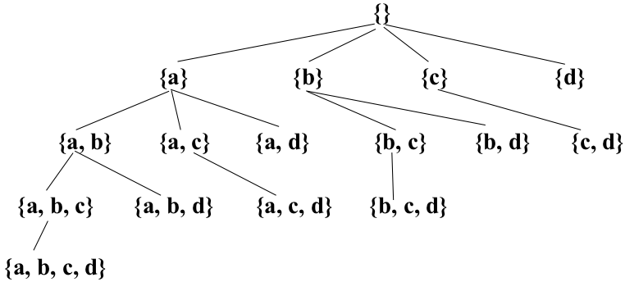
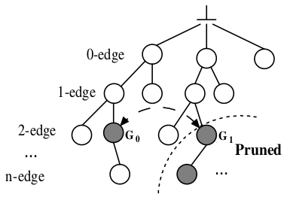
Existing Solutions
Programming Simplicity Over-Emphasized
Dense Subgraph Mining
Frequent Subgraph Mining
pattern-to-instance
instance-to-pattern
Embedding-Centric: Arabesque (SOSP’15), RStream (OSDI’18)
Notes:
Unfortunately, before T-thinker, all current solutions are IO-bound and materialize the subgraphs level-by-level in a search tree, causing a lot of intermediate subgraphs being materialized which not only hurts performance but also limits the size of the graph that can be processed.
Surprisingly, these works were accepted by the best systems conferences such as OSDI and SOSP.

Slide 16
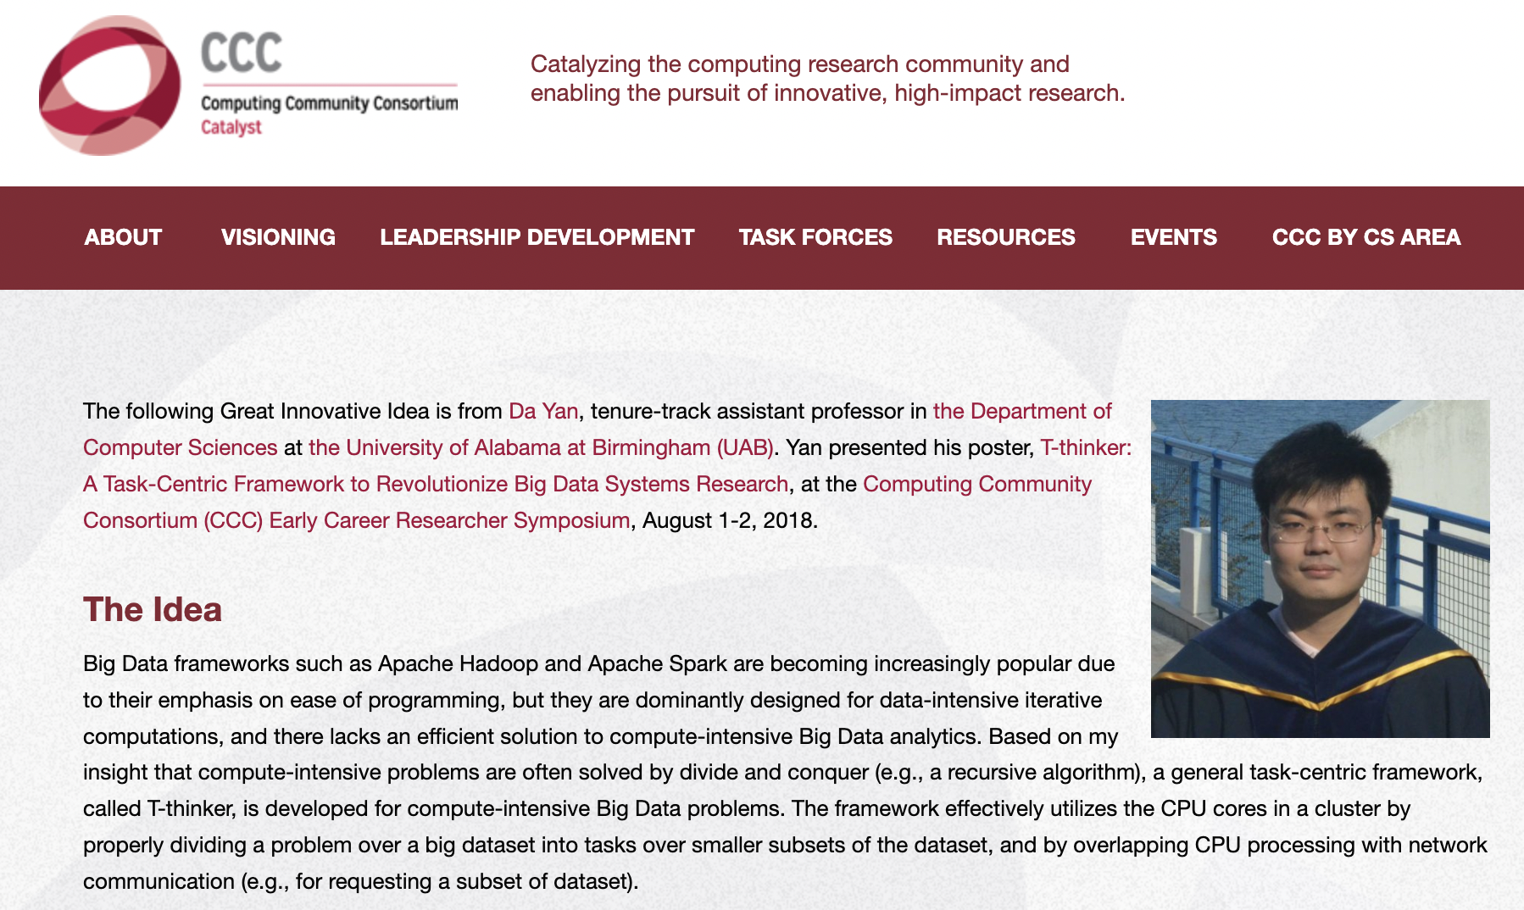
Notes:
In 2018, realizing these problems, I propose the framework of T-thinker, which effectively utilizes the CPU cores in a cluster by properly dividing a problem over a big dataset into tasks over smaller subsets of the dataset.

Slide 17
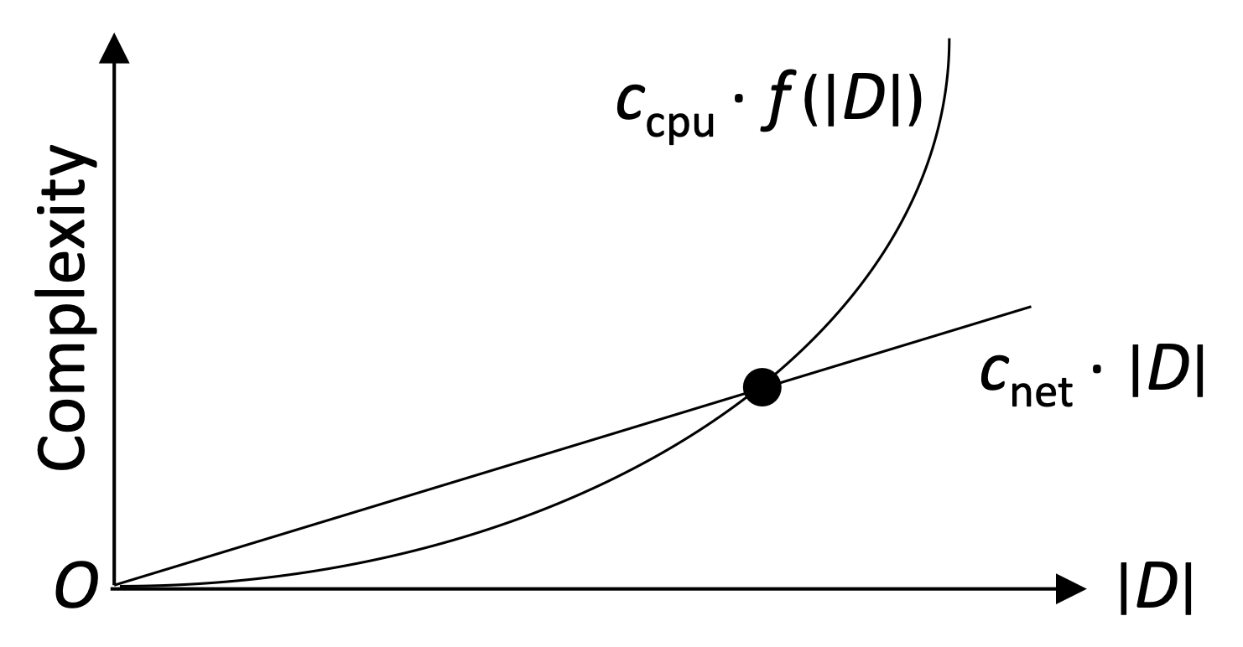
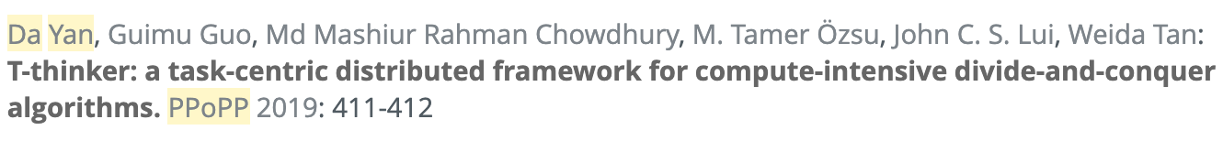
Think Like a Task (T-Thinker)
Divide and Conquer
Think Like a Task
Data pulling + computation on top
Notes:
Since the problems we target has a high time complexity, as long as each task handles sufficient data, the cost of pulling the data into memory by a thread is linear while the computation on top is super-linear, so the communication can be fully overlapped with computation to keep CPUs in a cluster busy.

Slide 18
Think Like a Task (T-Thinker)
Tasks & Programming Model
Notes:
In the framework, the system engine manages the various tasks to ensure high concurrency and bounded memory usage.
Users need to specify how to create initial tasks from individual vertices by a specifying a task_spawn function, and how to grow and mine a subgraph afterwards specifying a compute function.

Slide 19
Think Like a Task (T-Thinker)
Recent Systems Start to Explore the Right Direction!
Notes:
We would like to indicate that in recent years, a few systems have been proposed including ours,
[click]
which now avoid subgraph materialization as much as possible by resorting to backtracking search as in the serial algorithm counterparts, and they have achieved orders of magnitude speedup.

Slide 20
Think Like a Task (T-Thinker)
Due to time limit, we focus on 3 systems
G-thinker
Subgraph finding: dense subgraphs, subgraph matching, …
PrefixFPM
frequent subgraph patterns (many small graph transactions)
T-FSM
frequent subgraph patterns (a single big graph)
Notes:
Due to time limitation, we will review 3 such systems developed by us for various structure analytics problems.
First, we will look at G-thinker, which is designed to find from a big graph those subgraphs that satisfy certain conditions, such as dense subgraph mining and subgraph matching.

Slide 21
G-thinker
Vertex Pulling & Remote Vertex Caching
Tasks can share vertices to reduce # of remote vertex requests
8
6 | 7
0
1 | 3
6
5 | 8
5
4 | 6
8
6 | 7
0
1 | 3
1
0 | 2 | 3
2
1 | 3 | 4 | 7
3
0 | 1 | 2 | 7
4
2 | 5 | 7
5
4 | 6
6
5 | 8
7
2 | 3 | 4 | 8
8
6 | 7
M₀
M₁
M₂
Notes:
G-thinker is a distributed system where the adjacency lists are kept with a distributed key-value store.
Each machine also maintains a vertex cache to cache remote vertices so that multiple local tasks can access them without requesting again.

Slide 22

G-thinker
Task-Centric Programming Interface
  UDF: spawn_task(vertex)
  UDF: compute(task, frontier)
  pull(vertex_id)
  add_task(task)
Task Metadata
Task Subgraph
* UDF = user-defined function
Notes:
The programming interface is shown on this slide, where initial tasks are spawned from individual vertices.
Each task computes in iterations, where the input argument "frontier" keeps the adjacency lists of all vertices requested in the previous iteration, and one may call the pull function to request for new vertices.
Users can expand the subgraph of the current task in iterations until all the needed data are ready, after which the computation can happen on the subgraph.
One may also decompose the current task into smaller tasks and call the add_task function to add them to the system for parallel computation.

Slide 23
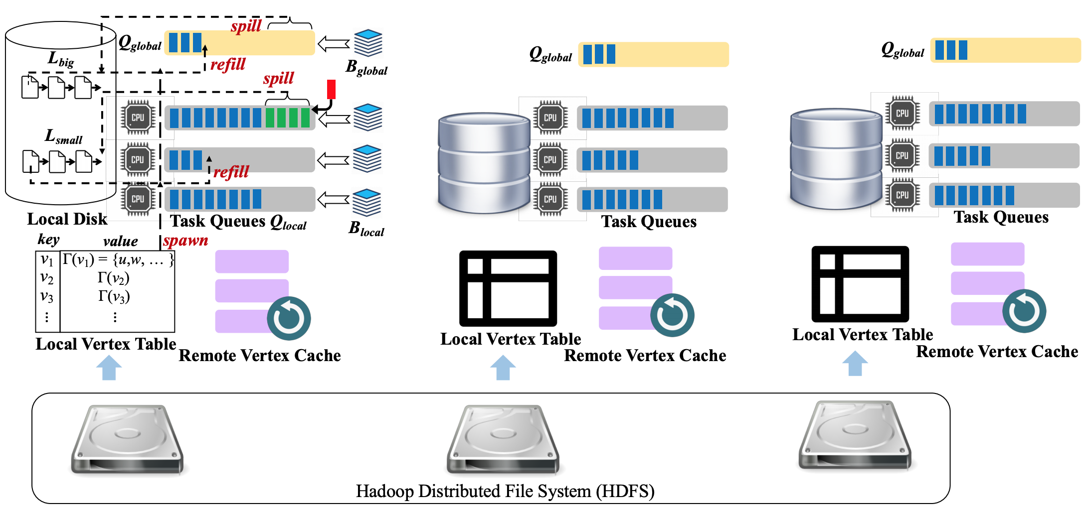
G-thinker
Notes:
Here is an overview of the G-thinker system with three machines.
Note that each machine has a yellow global task queue to hold big tasks that are time-consuming, and gray task queues local to each CPU core to hold regular tasks to avoid contention.

Slide 24
G-thinker
small task
big task
Head-of-line blocking
Task Queues
Task Queues
Notes:
Note that without a shared global task queue, if a local task queue holds many big tasks,
[click]
head-of-line blocking happens where a CPU core becomes the straggler while the other CPU cores finish quickly and become idle.

Slide 25
G-thinker
small task
big task
Work Stealing
Q_{global}
Q_{global}
Task Queues
Task Queues
Notes:
By keeping all big tasks in the shared global task queue supporting work stealing among machines,
[click, wait for annotation to complete] [click]
the big tasks can be scheduled with priority among all available CPU cores for timely processing, or even be further decomposed to create more parallelism opportunities.

Slide 26
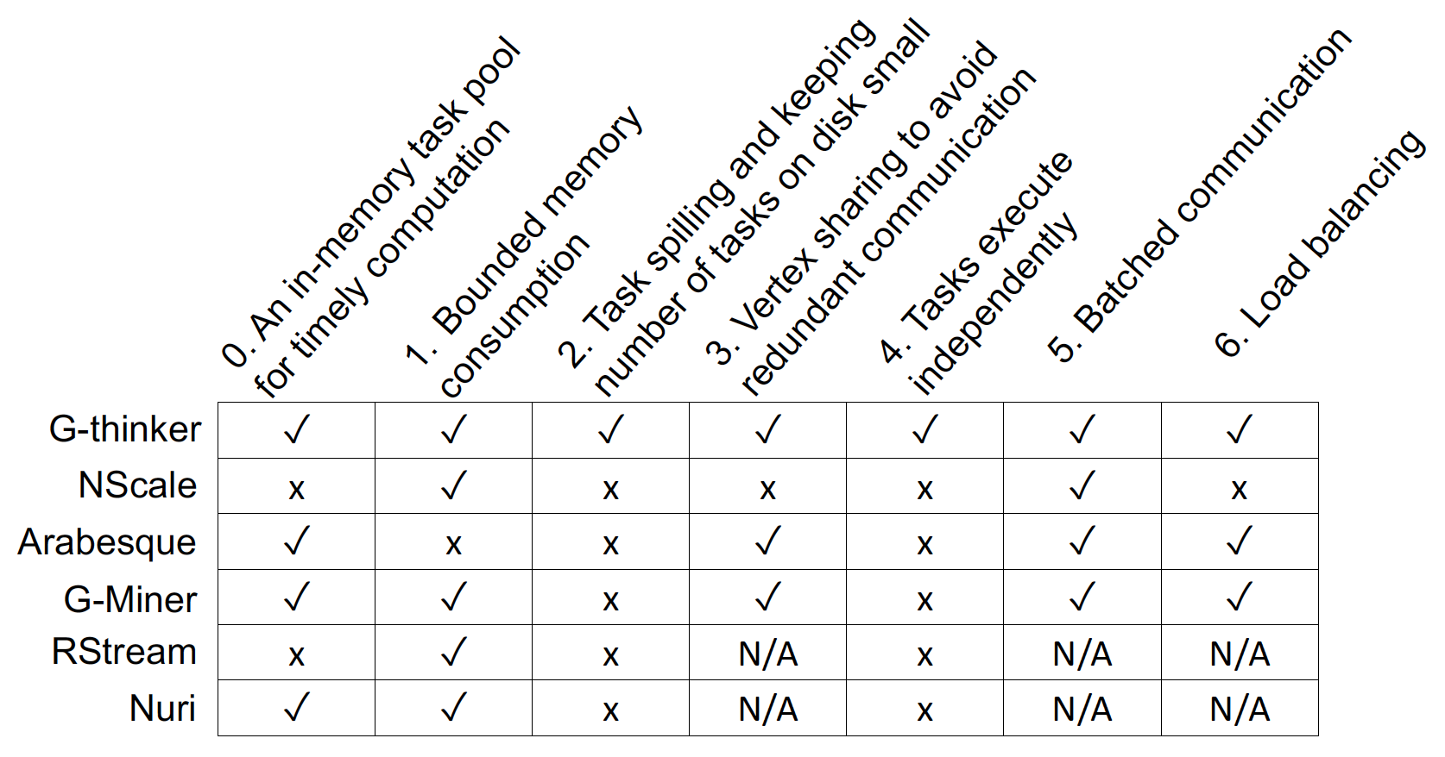
G-thinker
Friendster (|V| = 65.6 M, |E| = 1806 M)
  Maximum Clique:
    G-Miner: 10644 sec / 7.4 GB per machine
    G-thinker: 252 sec / 3.4 GB per machine
  Triangle Counting:
    G-Miner: 10915 sec / 9.2 GB per machine
    G-thinker: 516 sec / 3.1 GB per machine
Large Maximum Cliques
WikiLinks: |Q_{max}| = 1109 / 70 min 51 sec
WebUK: |Q_{max}| = 944 / 691 sec
Notes:
G-thinker is two orders of magnitude faster than existing systems, and can find very large maximum cliques of size over 1000 vertices in a reasonable amount of time, for which other systems would run almost forever.

Slide 27
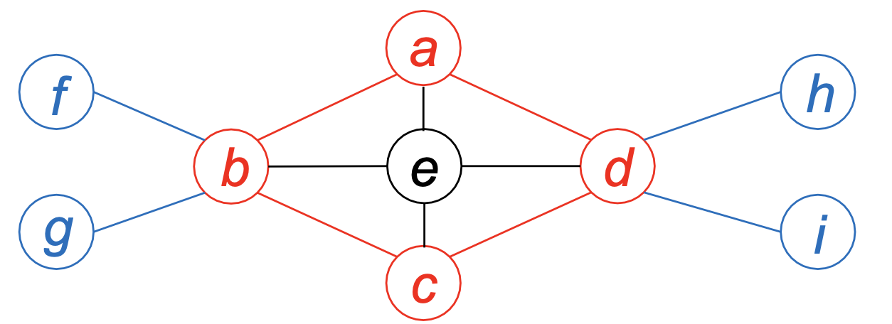
Quasi-Cliques on G-thinker
A graph G = (V, E) is a γ-quasi-clique (0 ≤ γ ≤ 1) if G is connected and for any v ∈ V , we have d(v) ≥ ⌈γ · (|V| − 1)⌉.
S₁ = {a, b, c, d}
S₂ = S₁ ∪ e
Both S₁ and S₂ are 2/3-quasi-cliques
Only S₂ is a maximal 2/3-quasi-clique
Notes:
We have tested many algorithms on G-thinker such as maximum clique finding, triangle counting and subgraph matching, all achieved ideal speedup with the number of CPU cores.
So, we moved on to tackle the more challenging problem of mining gamma-quasi-cliques, which previously has only been tested on very small graphs.
A gamma-quasi-clique is a dense subgraph where every vertex connects to at least gamma fraction of the other vertices. Consider the subgraph induced by a,b,c,d, we can see that each vertex connects to at least 2 of the 3 other vertices.
For example, "a" connects to b,d but not c. Therefore, abcd is a 2-by-3 quasi-clique.
Next consider abcde, and the induced subgraph is also a 2-by-3 quasi-clique since each vertex connects to at least 3 of the other 4 vertices, and the ratio 3/4 is larger than 2/3
Since abcde contains abcd, abcd is not maximal and our goal is to find all the maximal gamma-quasi-cliques.

Slide 28
Quasi-Cliques on G-thinker
S: set of nodes already in subgraph
ext(S): set of valid candidates to add
{}
{a}
{b}
{c}
{d}
{a, b}
{a, c}
{a, d}
{b, c}
{b, d}
{c, d}
Can be a straggler !
{a, b, c}
{a, b, d}
{a, c, d}
{b, c, d}
a < b < c < d
{a, b, c, d}
  UDF: spawn_task(vertex)
Notes:
In G-thinker, [click] we can create initial tasks from individual vertices,
[click]
but these tasks can have very imbalanced workloads.

Slide 29
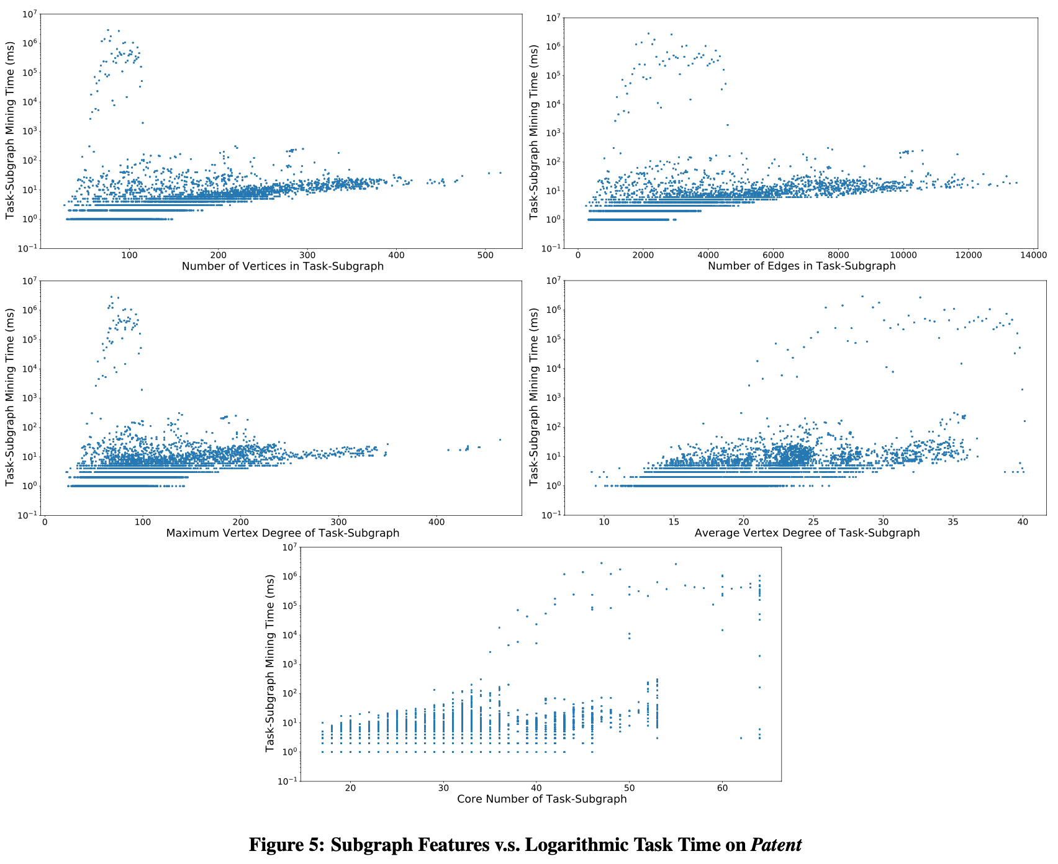
8 orders of magnitude
Why Such Huge Task Time Difference?
Notes:
Here we explored the task running time with respect to difference subgraph features such as number of nodes and edges, and density measures such as average degree and core number, but we can see that even for small feature values, some tasks can be orders of magnitude more expensive than others, and we find that no machine learning model can predict these expensive big tasks effectively.
[click]
Why is there such a huge task time difference among tasks?

Slide 30
Quasi-Cliques on G-thinker
Heavily relies on pruning rules to be tractable
Graph-Diameter Based Pruning
Size-Threshold Based Pruning
Degree-Based Pruning
Upper- and Lower-Bound Based Pruning
Critical-Vertex Based Pruning
Cover-Vertex Based Pruning
Notes:
This is because our algorithm relies on many pruning rules to significantly reduce the search space, but these rules depend on the complicated connection relationships among the current set of vertices under exploration, and the timing when a pruning rule is applicable is difficult to predict.

Slide 31
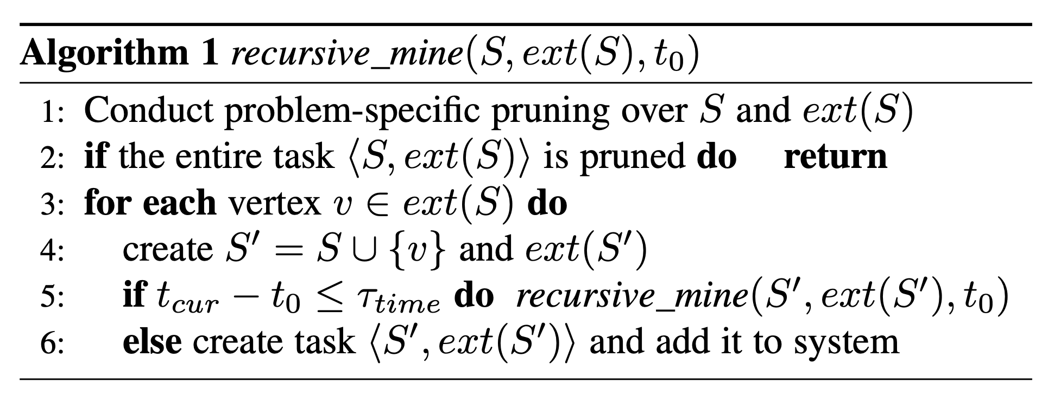
Quasi-Cliques on G-thinker
Timeout Mechanism for Task Decomposition
When {a, c} computes, it may timeout and decompose again
t₀ = 0
{a}
Q_{global}
t₁
t₅ > τ_{time}
t₆ > τ_{time}
{a, b}
{a, c}
{a, d}
t₂
t₄ > τ_{time}
{a, b, c}
{a, b, d}
{a, c, d}
t₃
{a, b, c, d}
Notes:
We therefore propose a timeout mechanism, where a task runs the recursive algorithm to traverse the search space tree in depth-first order, but if the task runs for too long and beyond a timeout threshold, we let the task create new subtasks to be added to the system rather than to recursively process the search space by itself.
For example, the task spawned by {a} here traverses the search space tree and right before it processes abd, it finds that the time t4 times out, so abd becomes an independent task added to the system, and when the recursive algorithm backtracks, t5 and t6 also time out so ac and ad are also created as new tasks.
[click, let animation to finish] Smaller tasks will be added to the local queue, while big tasks such as those with many candidate vertices to expand will be added to the global queue,
[click]
and it may timeout again and be further decomposed later.
This way, straggler tasks are effectively eliminated to allow effective load balancing.

Slide 32
Think Like a Task (T-Thinker)
Due to time limit, we focus on 3 systems
G-thinker
Subgraph finding: dense subgraphs, subgraph matching, …
PrefixFPM
frequent subgraph patterns (many small graph transactions)
T-FSM
frequent subgraph patterns (a single big graph)
Notes:
We next review PrefixFPM, which is for frequent pattern mining in general, for the context where there are many data transactions, and we would like to find patterns that appear in at least certain fraction of all the transactions.

Slide 33
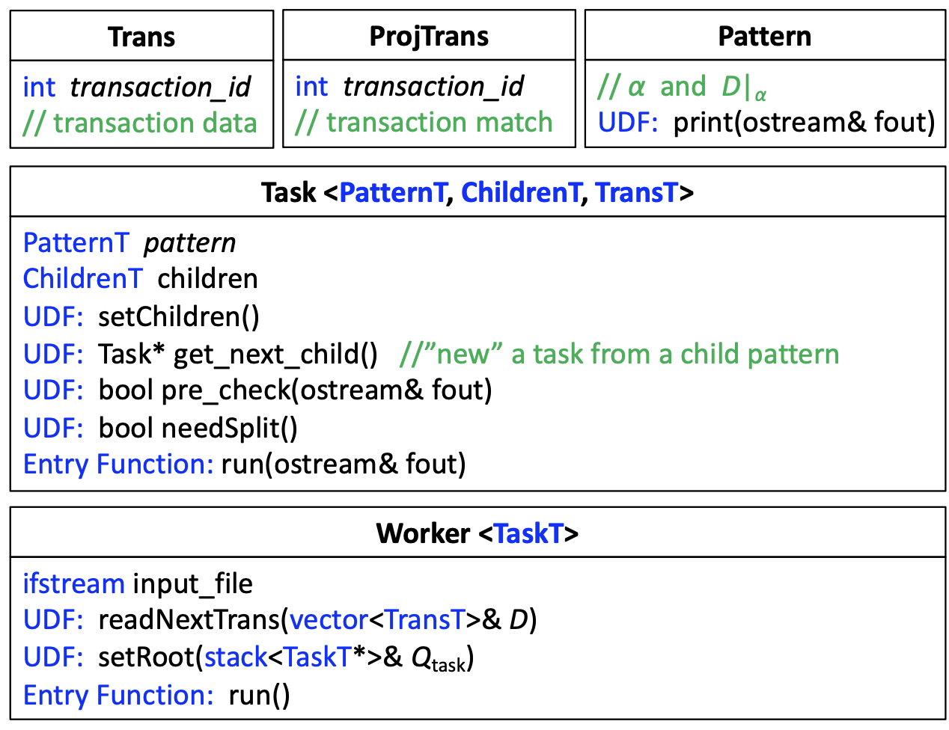
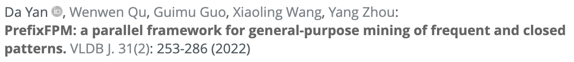
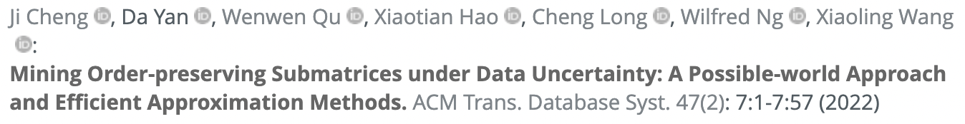
PrefixFPM
General Programming Framework for Frequent Pattern Mining
Subsequences, subtrees, subgraphs, submatrices
Notes:
PrefixFPM provides a unified programming interface for users to specify the mining algorithms for various patterns.
We have applied PrefixFPM for mining various patterns such as subsequences, subtrees, subgraphs and submatrices.
The related papers are listed on this slide.

Slide 34
PrefixFPM
Prefix Projection (Illustration by Sequence DB)
SID | Sequence
s₁ | ABCBC
s₂ | BABC
s₃ | AB
s₄ | BC
SID | Sequence
s₁ | _BCBC
s₂ | _BC
s₃ | _B
SID | Sequence
s₁ | _CBC
s₂ | _C
s₃ | _
SID | Sequence
s₁ | _BC
s₂ | _
A
B
C
(d) D|_{ABC}
(b) D|_{A}
(c) D|_{AB}
(a) D
Projected DB
Transaction DB
Pattern: ABC
Pattern: ∅
Pattern: A
Pattern: AB
Notes:
The key idea of PrefixFPM’s design is prefix projection, which we illustrate here using sequential pattern mining.
Initially, the prefix is empty so we have all the sequences in the database.
[click]
If we grow the prefix with an element A, then s4 is gone since it does not contain A, and the matched positions of the other three sequences are recorded in the database projected by A [click].
[click]
If we further grow the prefix with B, then we can match B on the previous projected database, and a new database projected by AB is obtained.
Here, if the frequency threshold is 3 or less, AB is still a frequent pattern,
[click]
so we can grow it further with element C

Slide 35
PrefixFPM
Prefix Projection (Illustration by Sequence DB)
Alphabet is {A, B, C}
Transaction DB
∅
Projected DB
frequent
A
C
B
…
…
Projected DB
Projected DB
AA
AB
AC
A stack of projected DBs with shrinking size
…
infrequent
frequent
Incremental projected DB construction
Projected DB
Projected DB
ABB
ABC
Child-branches are embarrassingly parallel !!!
ABA
…
infrequent
infrequent
Notes:
Here is an example of the mining process
[… need to keep describing while clicking]
[click]
The benefit of this approach is that, each pattern extension only checks a small projected database rather than the entire database
[click]
Also, the pattern to database matching is incremental from the previous matches rather than from scratch
[click]
Finally, the child branches in this search tree are totally independent and can run in parallel.

Slide 36

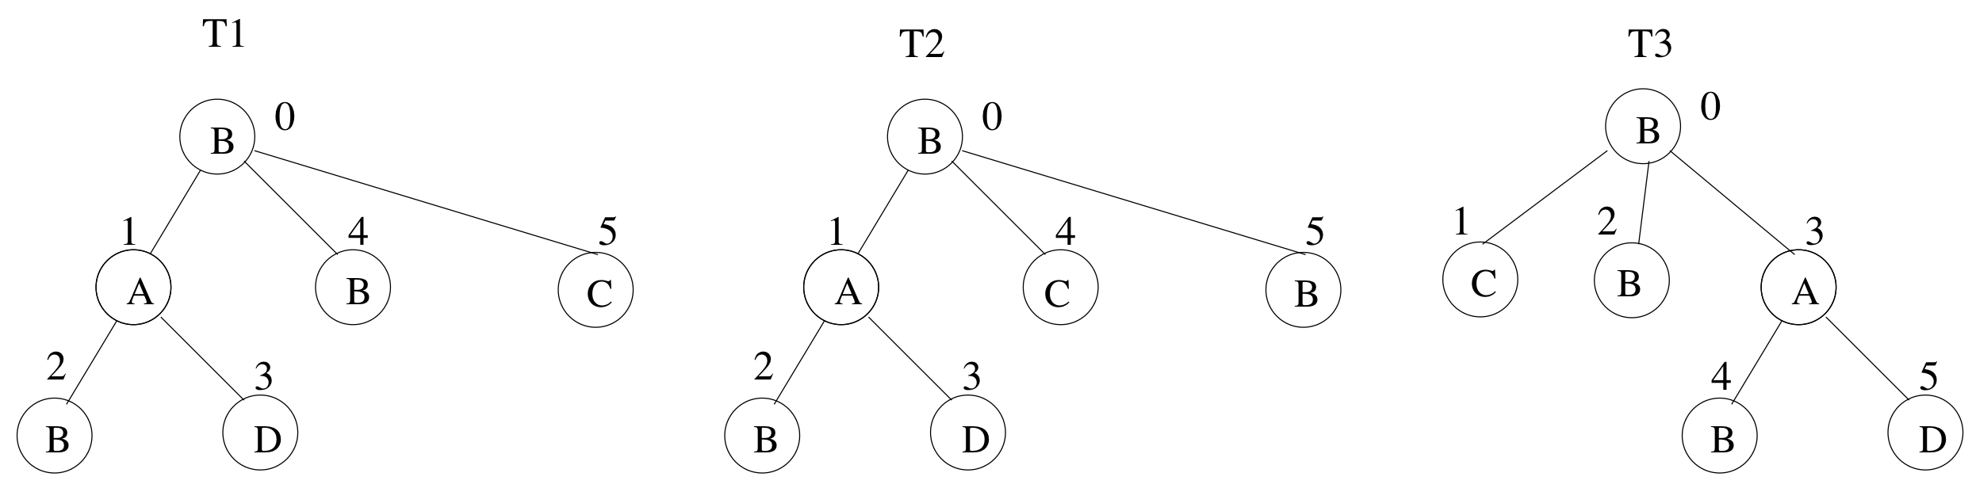
PrefixFPM
Deduplicate by canonical encoding
From Sequences to Graphs
Duplicated patterns for different sequences
BAB$D$$B$C$
BAB$D$$C$B$
BC$B$AB$D$$
canonical encoding
Notes:
Note that the idea of prefix projection carries over to graph patterns, but since different pattern extension paths may lead to isomorphic patterns, redundancy avoidance is important.
Here, we show three tree patterns that are isomorphic if we ignore the children order.
We can define the one whose DFS serialization code is the smallest to be canonical, then we only need to expand a pattern if its DFS serialization code is canonical.
[click]
For tree patterns, canonicality is easy to check since only the pattern with children ordered exactly following the element order in the alphabet is canonical. This checking is more complicated for graphs but schemes like the DFS code of gSpan can be applied.
[click]
The other redundant branches will be pruned as shown on the right.

Slide 37
PrefixFPM
Task Parallelism
Alphabet is {A, B, C}
Transaction DB
∅
PDB-parallelism (root task)
Projected DB
A
B
C
…
…
Thread 3
Thread 4
AA
AB
AC
infrequent
…
Thread 2
ABA
ABB
ABC
Thread 1
Notes:
Here we show the mining process in PrefixFPM, where the first available node on the leftmost path will be fetched as a task by each computing thread for mining its subtree.
[click] x 4
If the mining by a task times out, the subtrees of the child nodes will be treated as new tasks and added to the system for parallel processing to avoid stragglers.
[click]
Initially when there are not many patterns, parallelism can come from the concurrent examining of data items for pattern matching.

Slide 38
Think Like a Task (T-Thinker)
Due to time limit, we focus on 3 systems
G-thinker
Subgraph finding: dense subgraphs, subgraph matching, …
PrefixFPM
frequent subgraph patterns (many small graph transactions)
T-FSM
frequent subgraph patterns (a single big graph)
Notes:
Finally, we review the T-FSM system which is for frequent subgraph pattern mining on a single big graph.

Slide 39
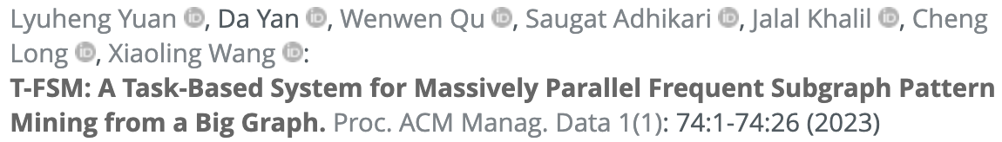
T-FSM
Frequent Subgraph Patterns from a Big Graph
Frequency is not anti-monotonic
S₁
u₁
G₁
v₂
A
B
count = 1
v₁
A
S₂
u₁
A
B
u₂
v₃
B
v₄
B
count = 3
Notes:
A notable difference from mining frequent patterns from a transaction database is that, frequency here is not an anti-monotonic measure.
[click]
For example, S1 appears only once in G1, but its superpattern S2 appears 3 times, which is even larger.

Slide 40
T-FSM
Frequent Subgraph Patterns from a Big Graph
Anti-monotonic measure: MNI
  Least number of distinct valid matches from any pattern vertex
x
G₂
v₂
v₆
B
A
v₁
A
v₅
B
S₂
u₁
A
B
u₂
v₃
B
v₄
B
v₇
A
v₈
A
4
Notes:
MNI is the widely adopted anti-monotonic measure for support, which equals the least number of distinct valid matches from any pattern vertex
For example, u1 in S2 has four valid matches [click] x 4

Slide 41
T-FSM
Frequent Subgraph Patterns from a Big Graph
Anti-monotonic measure: MNI
  Least number of distinct valid matches from any pattern vertex
x
G₂
v₂
v₆
B
A
v₁
A
v₅
B
S₂
u₁
A
B
u₂
v₃
B
v₄
B
v₇
A
v₈
A
4
4
MNI = { , } = 4
Ground truth is 2
Notes:
and u2 also has four valid matches [click] x 4
[click]
So the MNI is the minimum of the two numbers which is 4.
[click]
However, the ground truth should be 2 since we can get at most 2 pairs of AB in the data graph

Slide 42
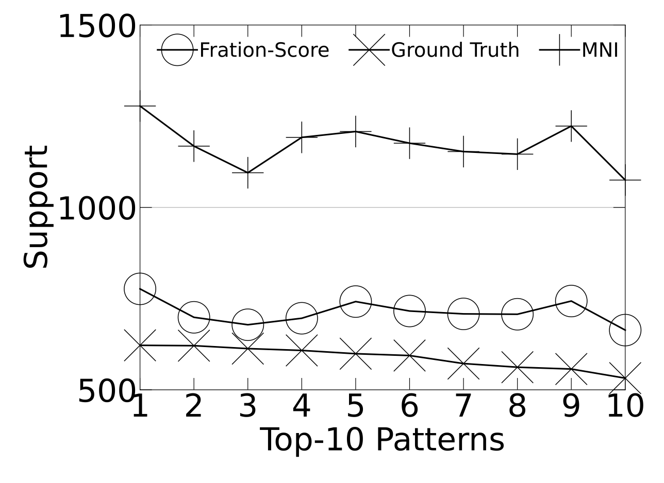
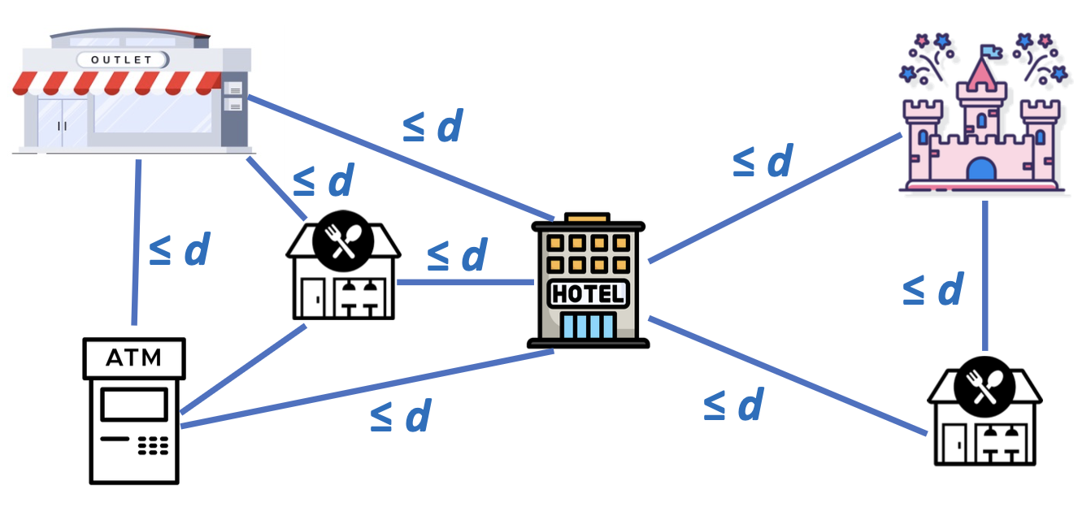
T-FSM
Solution: Fraction-Score
Extending from our prior work on colocation pattern mining
Notes:
Our solution is to extend the concept of Fraction-Score from our prior work on colocation pattern mining to the current setting.
Note that colocation pattern mining requires every POI to be within distance d from each other, while our patterns are more general as shown on the right, which allows two clusters of locations around a hotel, one for theme park visit on a day of travel, and the other for shopping at an outlet on another day.
Fraction-Score is much tighter than MNI in our context since it avoids double counting an object involved in multiple matches.
In the figure on the left, we use a synthetic dataset for which we know the ground-truth support to compare the tightness of Fraction-Score and MNI, where we can see that Fraction-Score is much closer to the ground truth.
In our previous example, Fraction-Score can successfully recover the ground-truth support 2.

Slide 43
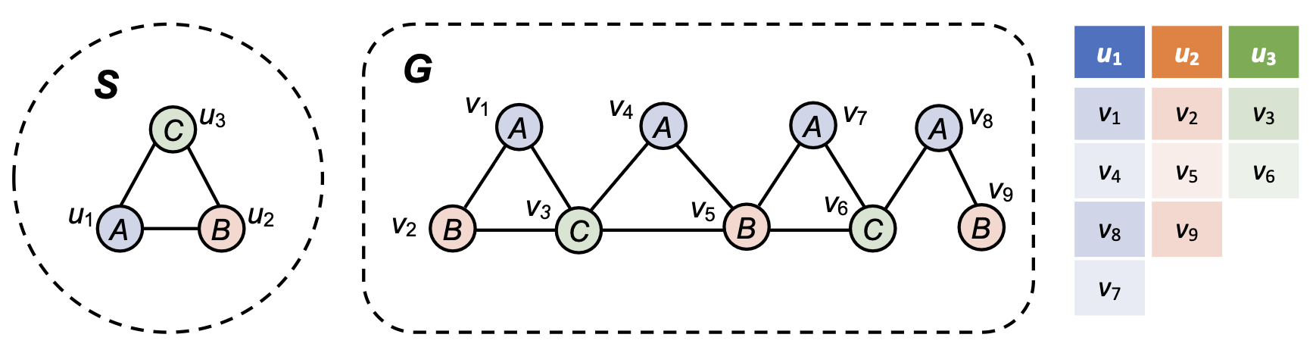
T-FSM
Domain Table
Each pattern = many subgraph-matching tasks
Notes:
As we have previously seen, given a pattern, to check if it is frequent according to MNI or Fraction-Score | can be converted into the checking of whether a subgraph matching of the pattern can be found from each data vertex v that can match each query vertex ui
MNI is simply the smallest number of valid matches to any ui.
[can use u1 -> v1, v4, v8-noTriangle, v_7 to illustrate]
Note that a lot pruning is possible. For example, if we require MNI to be 2 to be frequent, then we can stop checking the data vertices for each ui as soon as 2 matches have been found.

Slide 44
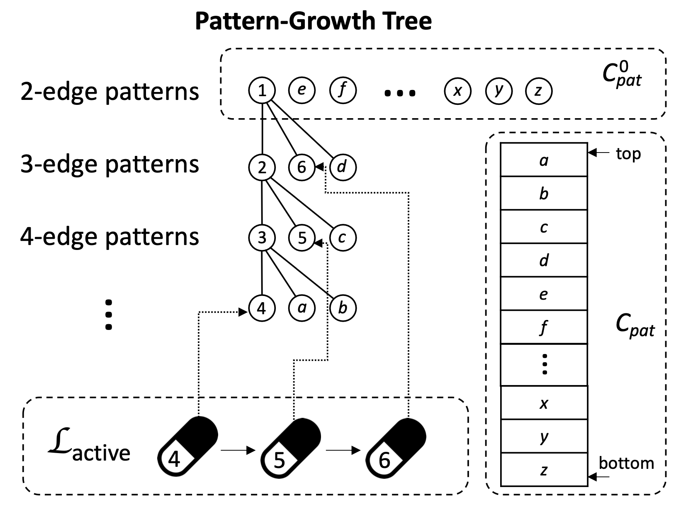
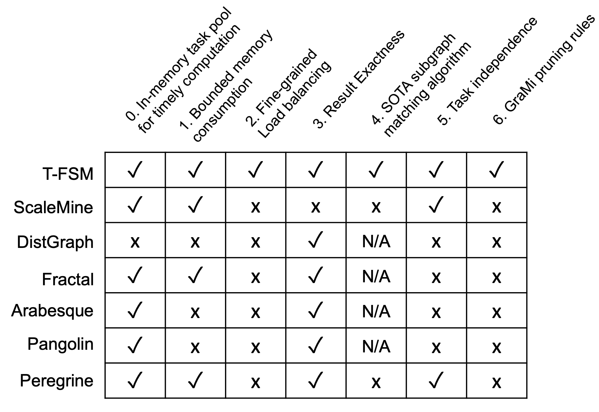

T-FSM
Task Management
Each active pattern has a pattern capsule
graph matching from v_{i}
head
v_{i}
tail
① fetch a task
?
② update status
L
_{active}
…
⑤ delete capsule
③ if pattern frequentness finalized
C_{pat}
…
⑥ pop
④ if frequent: extend & push
Initial 2-edge patterns (computed by the worker)
…
Notes:
In our T-FSM system, we only keep at most 32 patterns active with subgraph-matching tasks at any time | to keep the memory consumption bounded.
Here, the tasks of each active pattern is kept in a pattern capsule.
When a computing thread fetches a task to process [click],
it will obtain the first pattern in the list with an available task, so that patterns that were added early are prioritized for processing, to finish early to make room for new patterns to be added to the active list.
Assume that a subgraph-matching task from the second pattern capsule is obtained, then [click] we will update the pattern status using the task result after task computation.
[click] If we can determine whether a pattern is frequent or not after the status update of some task,
[click] we will extend the pattern if it is frequent, and add the child patterns to a stack of pending patterns to process
[click] The current pattern is then deleted from the active list since it finishes processing
[click] Later if a computing thread cannot get any task after checking all the active pattern capsules, a new pattern can be moved to the active list for task creation to fill the available capacity slot.
[click] By organizing the pending pattern pool as a last-in-first-out stack, we can show that the memory consumption is bounded.
[click] The next question is how are tasks in a pattern capsule organized?

Slide 45
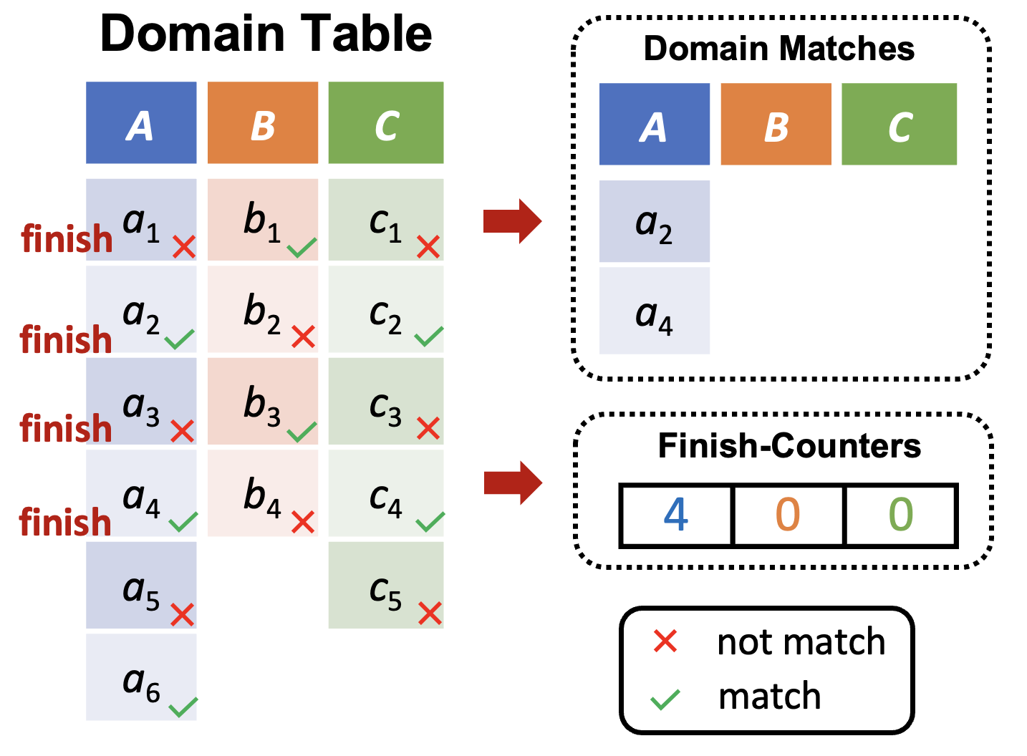
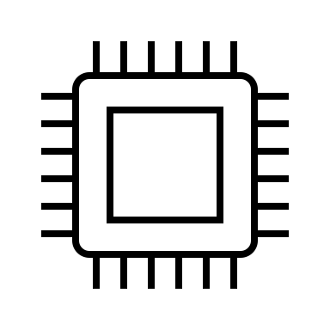
T-FSM
Pattern Capsule (for Each Pattern)
v₃
v₆
u₁
v₁
v₄
v₇
u₂
v₂
v₅
…
u₃
v₃
v₆
…
② fetch
① refill
v₇
v₂
v₅
Q_{reg}
compers
③ timeout & insert
v₄
…
…
…
…
L_{timeout}
② fetch
…
…
v₁
⑤ insert
④ timeout & decompose
…
v_{1a}
v_{1b}
Pattern Capsule
Notes:
Inside a pattern capsule, the subgraph-matching tasks are initially spawned from vertices in the domain table when capacity allows.
If a task times out, it will be decomposed and the new tasks will be added to a timeout task list for load balancing.
The tasks are fetched by computing threads in the order such that u1’s tasks will be prioritized for processing before those of u2, which are in turn before those of u3, to facilitate early pruning.

Slide 46
Thank you !
Questions?
Notes:
This concludes the first part of the tutorial.
Thanks for your attention, and do you have any questions?

Slide 47


Systems for Distributed
Graph Neural Network Training
Lyuheng Yuan
Indiana University Bloomington
Email: lyyuan@iu.edu
Notes:
Hello everyone. This is Lyuheng Yuan. I am a PhD student at the Indiana University Bloomington. I will be presenting for the rest of tutorial and we will be talking about systems for distributed graph neural network training.

Slide 48
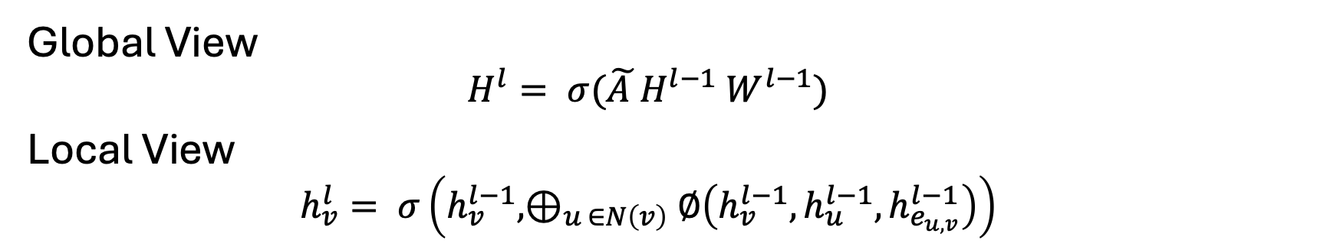
Graph Neural Networks (GNNs)
Global View
  $$H^{l}= σ(\tilde{A }H^{l−1} W^{l−1})$$
Local View
  $$h_{v}^{l}= σ\left(h_{v}^{l−1}, ⊕_{u ∈N\left(v\right)}∅\left(h_{v}^{l−1},h_{u}^{l−1},h_{e_{u,v}}^{l−1}\right)\right)$$
* Forward Propagation Shown Only
Notes:
The training of GNN consists of 2 parts: forward propagation and backward propagation. We can understand the forward propagation from 2 perspectives. From the global view, we can use the normalized adjacency matrix times the vertex embedding of the current layer times the weight matrix and we can obtain the vertex embedding of next layer.
If we just focus on a single vertex, we can use the concept of message passing to describe this process. For each neighbor of the vertex, we let the neighbor’s feature pass a dense layer, Since a vertex may have multiple neighbors, we aggregate the output of its neighbors into a single feature vector. Then we concatenate it with the feature of the vertex itself, pass another dense layer, and we obtain the feature of next layer.

Slide 49







Graph Neural Networks (GNNs)
$$h_{0}^{(l−1)}$$
0
$$h_{0,2}^{(l)}$$
2
3
Aggregate
$$h_{1}^{(l−1)}$$
1
$$h_{1,2}^{(l)}$$
A
2
$$h_{2}^{(l)}$$
0
1
$$h_{3}^{(l−1)}$$
3
$$h_{3,2}^{(l)}$$
Original Graph
Forward Computation
Notes:
Let’s use a more concrete example to illustrate the forward propagation. Suppose we want to compute the feature of vertex 2 in the original graph, we can observe that vertex 2 has 3 incoming neighbors, 0, 1 and 3. [CLICK]
So we first get the features of 0, 1 and 3, and let them pass a dense layer and we can get the corresponding features for 3 incoming edges. [CLICK]
Then we will aggregate these 3 edge features into a single feature vector. [CLICK]
And we let this feature pass another dense layer and the final output is the feature of vertex 2.

Slide 50







Graph Neural Networks (GNNs)
$${∇h}_{0,2}^{(l)}$$
0
$${∇h}_{0}^{(l−1)}$$
Scatter
2
3
2
$${∇h}_{2}^{(l)}$$
2
S
$${∇h}_{1,2}^{(l)}$$
1
$${∇h}_{1}^{(l−1)}$$
0
1
$${∇h}_{3,2}^{(l)}$$
$${∇h}_{3}^{(l−1)}$$
3
Original Graph
Backward Computation
Notes:
The backward propagation is very similar to the forward propagation.
Suppose we have the gradient of vertex 2 and we want to compute the gradient of vertex 2's incoming neighbors, 0, 1, 3. [CLICK]
Firstly we do a matrix multiplication on input gradient and get an intermediate result S. [CLICK]
And then we do a scatter operation to scatter S onto 3 incoming edges and we get the gradient of 3 incoming edges.
[CLICK]
Finally we do another matrix multiplication on the edge gradient and we can get the gradient of 3 incoming neighbors.

Slide 51
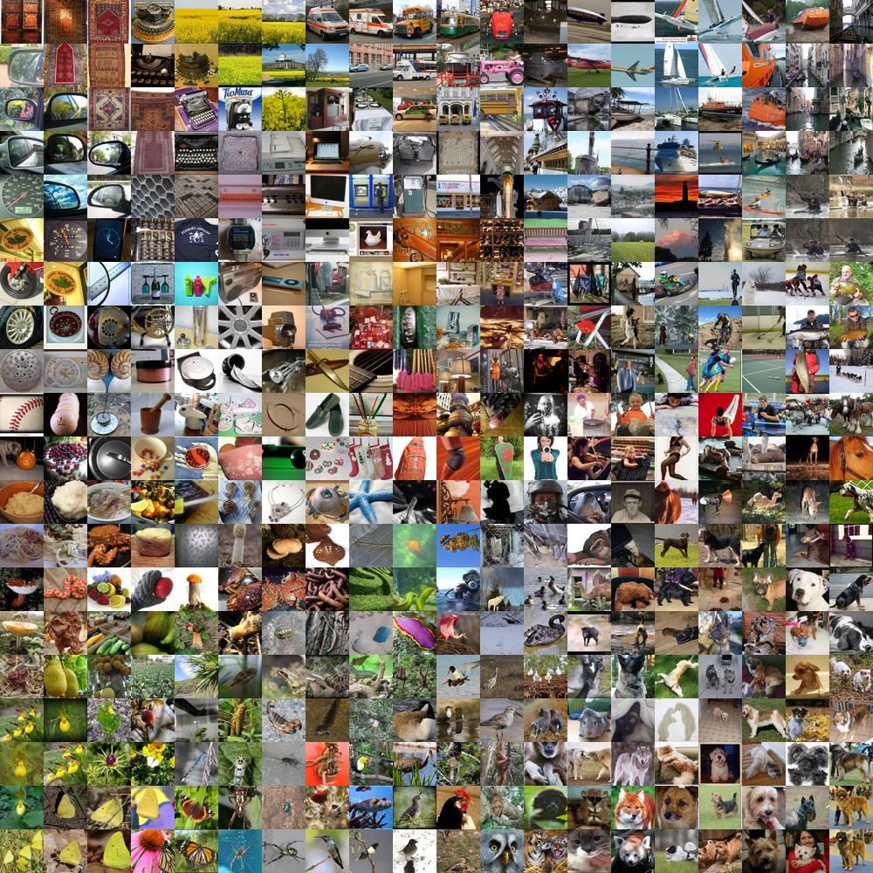
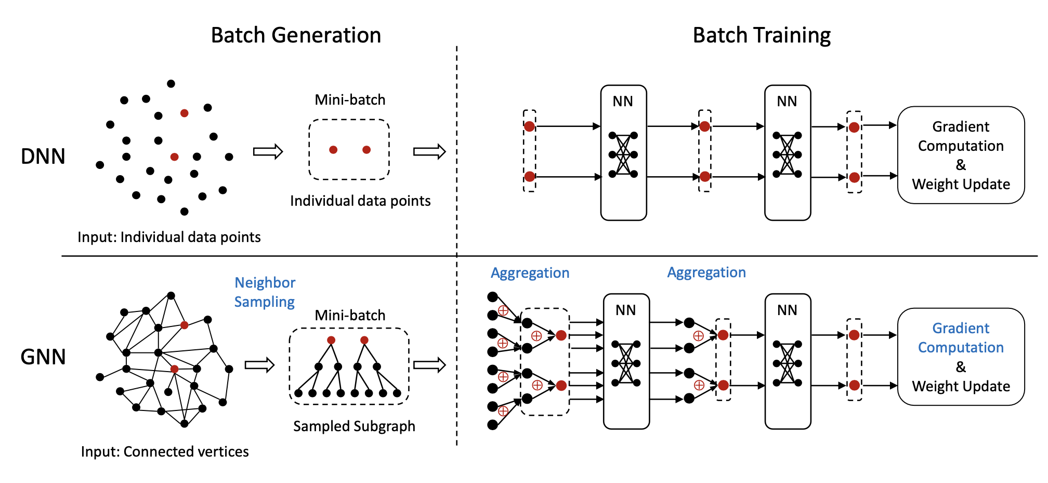
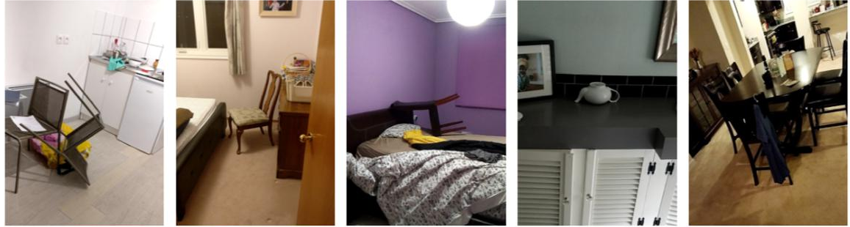
Differences to DNNs
GNNs require L-hop neighborhood.
Additional aggregation & scattering operations.
Notes:
Now let's take a look at some of the major differences between GNN and Deep Neural Network, DNN.
In normal DNNs, suppose every data point is an image, we can sample a mini-batch of these images. In the following propagation, every computation only depends on the data in the mini-batch or pixel values.
[CLICK]
However, in the GNN training, it's quite different. [CLICK]
The forward propagation of a vertex relies on the feature from its neighborhood. If a GNN has L layers, then we must obtain the features from its L-hop neighborhood. This requirement makes GNN training an IO-intensive problem which may become a bottleneck.
[CLICK]
Secondly, as I mentioned earlier, there're 2 special operations that don't exist in DNN training, which are aggregation and scattering. Therefore, we need to make additional efforts in optimization these 2 operations if we want to achieve efficient training.

Slide 52
Approaches to GNN Training
Mini-batch GNN training
  + Reduce computation, memory and IO demands by sampling
  Lower accuracy
  AliGraph [VLDB’19], P3 [OSDI’21], Dorylus [OSDI’21]
  ByteGNN [VLDB’22], BGL [NSDI’23], …
Full-graph GNN training
  + No accuracy loss
  High demand for computation, memory and IO
  DistGNN [SC’21], NeutronStar [SIGMOD’22]
  Sancus [VLDB’22], HongTu [SIGMOD’24], …
Notes:
There're basically 2 main approaches to training a GNN, namely mini-batch GNN training and full-graph GNN training. For mini-batch training, we sample a mini-batch of vertices and their neighbors. If the size of neighbors is very large, we usually sample part of their neighbors as the training data. Of course the sampling can reduce large amount of computation and IO workload, but it turns out the accuracy may be sacrificed, which is found by researchers in the AI community.
On the other hand, full-graph training has no accuracy loss, but it has higher demand in computation and IO, since we must take every neighbor into consideration so the workload compared to mini-batch training is much larger.
[CLICK]
In the tutorial, we will cover several works from both categories publish in last 5 years, and we will talk more on these works later.

Slide 53
Agenda
Why Distributed & Challenges
Mini-batch GNN training
Full-graph GNN training
Communication Optimizations
Staleness Tolerance
Notes:
Here's the agenda of the remaining part.
First, I will talk about why we are interested in distributed training and what challenges we may encounter in distributed training.
[CLICK]
Then we will discuss the mini-batch GNN training.
[CLICK]
and Full-graph GNN training as well.
[CLICK]
Next since communication is a severe issue in GNN training, we will look at some works targeting this problem and how they try to optimize this issue.
[CLICK]
Finally, I will discuss staleness in GNN training and how these existing works tolerate staleness in the system.

Slide 54
Distributed GNN Training
Why Distributed?
  High parallelism for computation
    Many CPUs, each with multi-core parallelism
    Many GPUs, each with thousands of CUDA threads
  Insufficient memory for vertex embeddings
    Large graph scale
    High input embedding dimension
    Limited GPU memory
Notes:
The first question is why we're interested in distributed GNN training and why it is important.
[CLIKC]
A very straightforward answer is it offers high parallelism for computation. A modern cluster usually has 100 of machines and with so many CPU cores, we can achieve multi-core parallelism.
A modern GPU has thousands of cuda cores, and is very efficient in computing matrix multiplication. Training GNN requires large amount of matrix multiplications. So if we know how to use multiple GPUs together, we can achieve massive parallelism and a very efficient training pipeline.
[CLICK]
Another reason would be insufficient memory space for vertex embeddings.
Nowadays, the size of graph is increasing to 10 billions of edges or even larger. Storing the graph itself requires a large storage. Besides, some embedding dimension can reach to 1000, and with so many vertices/edges, storing embeddings needs additional storage. However, GPU memory is always an scarce resource. For example, A100 GPU only has 40/80 GB so it's really insufficient comparing with such large amount of training data. If we have multiple machines/devices, we can collectively use their memory space, which will be more flexible and effcient.

Slide 55
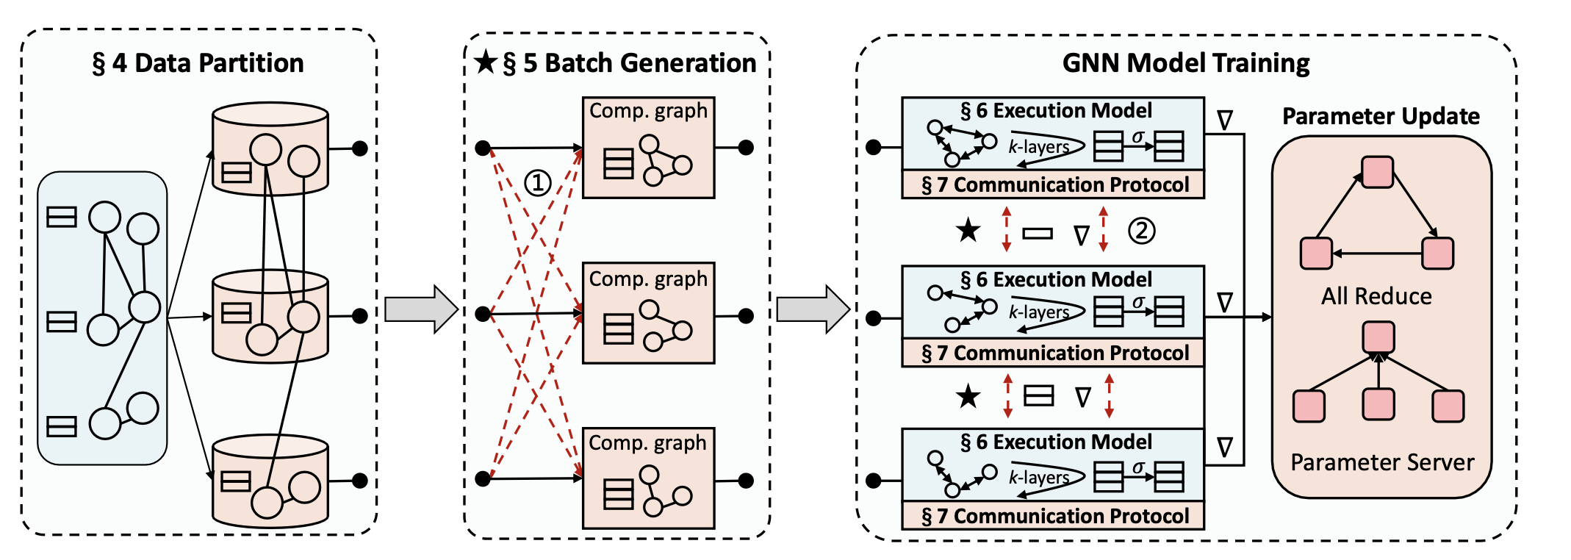



Distributed GNN Training Pipelines
Notes:
This slide shows the pipelines of distributed GNN training. Firstly we have data partition or graph partition. Since we are talking about distributed training, we want each device to maintain part of graph or a subset of vertices and their corresponding features.
[CLICK]
Next we have a step called batch generation we're doing mini-batch GNN training. Since the training data of one mini-batch may come from multiple machines, so we need to request each of those machines and wait until the dependent data is received.
But if we are doing full-graph GNN training, this step is skipped.
[CLICK]
The final step is called GNN model training. the training consists of forward propagation. loss computation, backward propagation, and weight updates. We'll focus on the exeuction model in the training and we'll also cover communication protocal & optimization in later slides.

Slide 56
Challenges in Dist. GNN Training
Massive embedding communication
  Overlap communication & computation [NeutronStar]
  Avoid redundant IO [HongTu]
  Adopt faster link [DGCL]
  Staleness-aware broadcast [Sancus]
  Model parallelism [P3]
  …
Notes:
Now let's talk about the challenges in dist. GNN training.
As we've already know, the communication is always a major bottleneck in dist GNN training, how to handle such large amount of data communication is a key challenge to handle.
[CLICK]
A number of existing works came up with some solutions to fix this issue, such as 1.2.3.4.5 and so on. We will talk about these works in detail.

Slide 57
Challenges in Dist. GNN Training
Imbalanced workloads, stragglers
  Heuristic cost model [BGL, ByteGNN]
  Graph partitioning
    Vertex-cut [DistGNN]
    Edge-cut [NeutronStar]
    METIS [DGCL]
  Adjacency-matrix partitioning [Sancus]
  Feature partitioning [P3]
  …
Notes:
Another challenge is the imbalance workloads or stragglers. If we have multiple machines to use, how to evenly assign the workload to multiple machines is an important problem because we don't want one machine does most of the work while others just being idle. Straggler problem almost happens in all distributed computing problems.
[CLICK]
In the context of GNN training, a series of existing works proposes different ways to do the workload assignment, including 1, 2, ,3 4 and so on. We will talk about these works in detai as well.

Slide 58
Distributed GNN Training Pipelines
Notes:
Now let’s talk about graph partitioning.

Slide 59
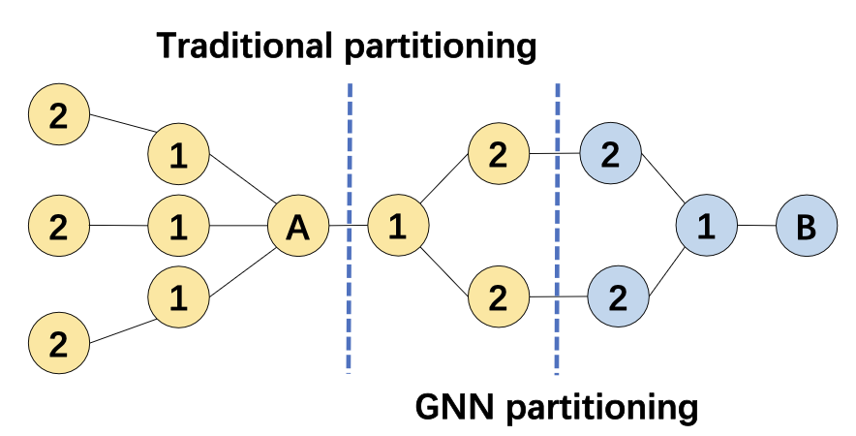
Graph Partitioning
Vertex-cut, edge-cut, METIS are commonly used.
Heuristic cost models also help.
Figure from ByteGNN [VLDB’22]
Notes:
Graph partitioning is not a very severe problem in GNN training. Many existing works just use off-the-shelf solution for partitioning the input graph, such as vertex-cut, edge-cut and METIS. But some works still have some insight on this problem. For example, METIS is a graph partitioning algo. aiming to minimizing the number of cross-partition edges. Suppose we use METIS on this graph, the cut is in blue dashed line since there's only 1 cross-partition edge. But A and B in red circle are 2 training vertices,
[CLICK]
we may cut this way since yellow partition is the 2-hop neighborhood of the training vertex A and blue partition is the 2-hop neighborhood of B, which means we don't need to have any communication between 2 partitions when training A and B.
Therefore, we might need some heuristic cost models to estimate the workload.

Slide 60
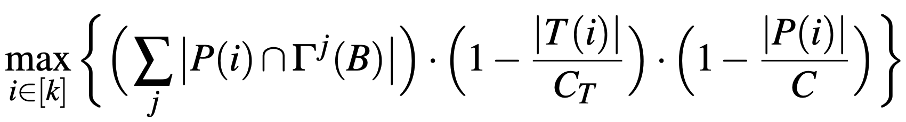
Graph Partitioning
BGL [NSDI’23] introduces a heuristic for vertex assignment.
# of training nodes
assigned to partition i so far
# of nodes assigned to
partition i so far
Avg # of training nodes
per partition
Avg # of nodes
per partition
Current partition
j-hop neighbors
* B is a vertex block
Notes:
BGL in NSDI'23 introduces the following heuristic model for vertex assignment.
Let's first figure out what each term stands for.
[CLICK]
Gamma^j (B) stands for the j-hop neighbors of a vertex block B. A vertex block is a set of vertices that are closely connected in the original graph, usually consists of 100 to 10k vertices. P(i) stands for the current partition with index i we are looking at. The intersection in between means the cross edge connecting the vertex block and the current partition. This term represents the cohesiveness of 2 subgraphs. And the summation means we're first considering 1-hop, then 2-hop, 3-hop and so on.
[CLICK]
CT and C stands for the average # of training nodes and nodes per partition.
[CLICK]
On the nominator side, T(i) is # of training nodes assigned to partition i so far.
and P(i) is # of nodes assigned to partition i so far.
These 2 terms encourages each partition to have roughly equal # of training nodes and node. These 2 term will penalize those partitions with more nodes than average being assigned already.
For each vertex block B, we will select a partition i such that this heuristic is maximized, and vertex block is then merged into the partition.

Slide 61
Distributed GNN Training Pipelines
Notes:
Now let's look at the batch generation step.

Slide 62
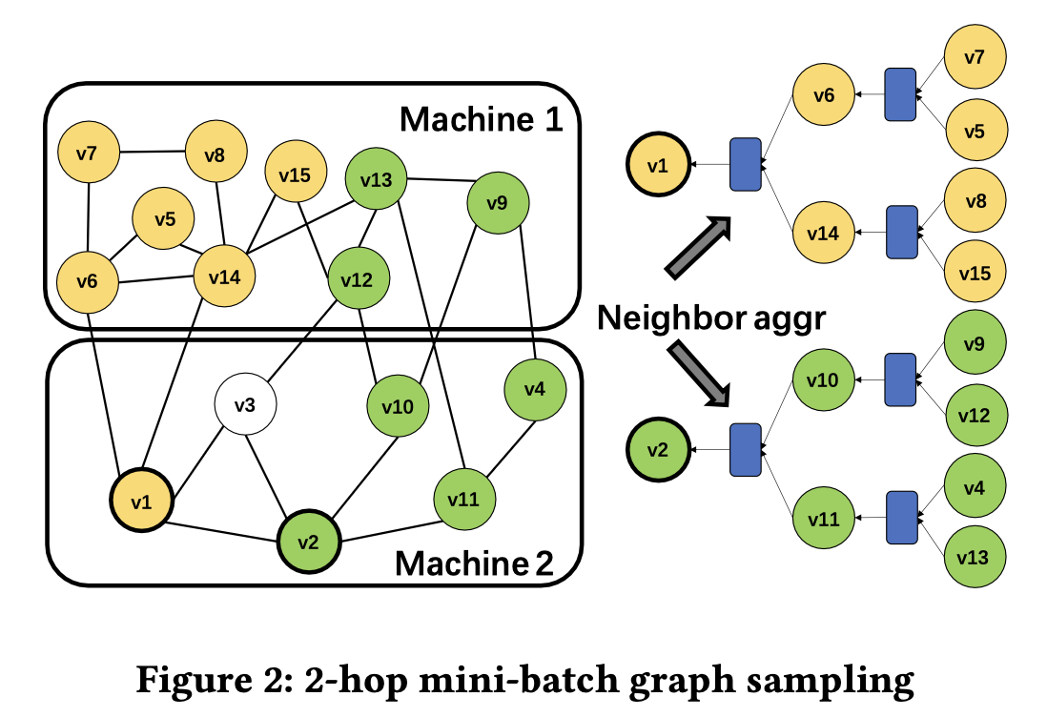
GNN Batch Generation
From ByteGNN:
D₁ = 25, D₂ = 10 is good enough.
Sample D₁
neighbors
Sample D₂
neighbors
Mini-batch Neighborhood Sampling
Seed vertex
Figure from ByteGNN [VLDB’22]
Notes:
A simple and straightforward way to do the sampling is
[CLICK]
we first select some seed vertices, v1 and v2 in this case.
[CLICK]
Then we look at the neighbors of seed vertex, select at most D1 out of the neighbors. For example, v1 has 4 neighbors, but only 2 of them are selected.
[CLICK]
Next we iterate this process for the vertices selected in last round. If the numb er of neighbors is greater than a threshold, we only select part of them.
[CLICK]
From ByteGNN paper in VLDB'22, if you choose d1= 25 and d2 = 10 you can get emmprically good results, but there's no rigorious guarantee for this conclusion.

Slide 63
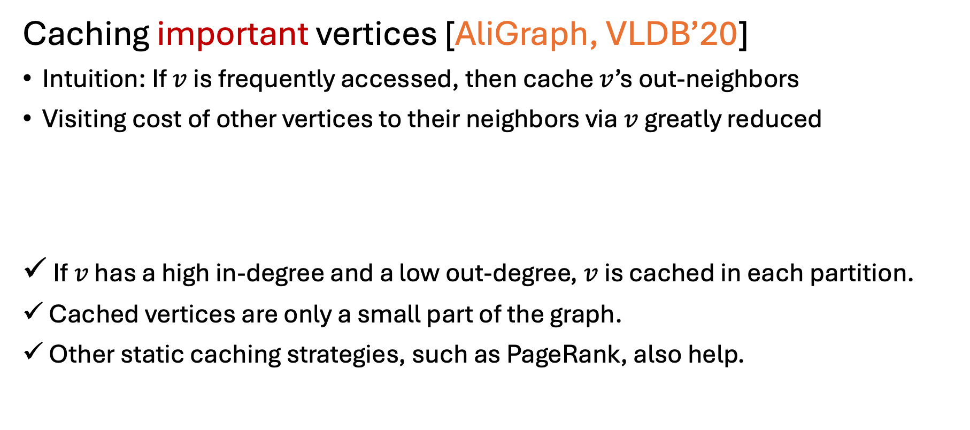
GNN Batch Generation
Caching important vertices [AliGraph, VLDB’20]
Intuition: If $v$is frequently accessed, then cache $v$’s out-neighbors
Visiting cost of other vertices to their neighbors via $v$ greatly reduced
If $v$ has a high in-degree and a low out-degree, $v$ is cached in each partition.
Cached vertices are only a small part of the graph.
Other static caching strategies, such as PageRank, also help.
Notes:
In general, there might be some vertices that is frequently accessed in the batch generation. In Aligraph paper in VLDB'20, they proposed to cache these frequently accessed vertices locally. In their definition, they call such vertices important vertices.
The intuition is if a vertex is important, then I should cache its out-neighbors, so that the other vertices can easily obtain their 2-hop neighbors through this important vertex.
[CLICK]
In their paper, they introduce a factor defined as in-degree divided by out-degree to describe how important a vertex is.
If a vertex has high indegree and low out-degree, then v will be cached.
[CLICK]
Cached vertices are only a small part of the graph, so the cache won't take a large amount of space.
[CLICK]
Other static cache strategies, such as pagerank also works where you first run a pagerank algorithm, and every vertex ends up with a score. You can use this score to measure whether you want to cache it or not.

Slide 64
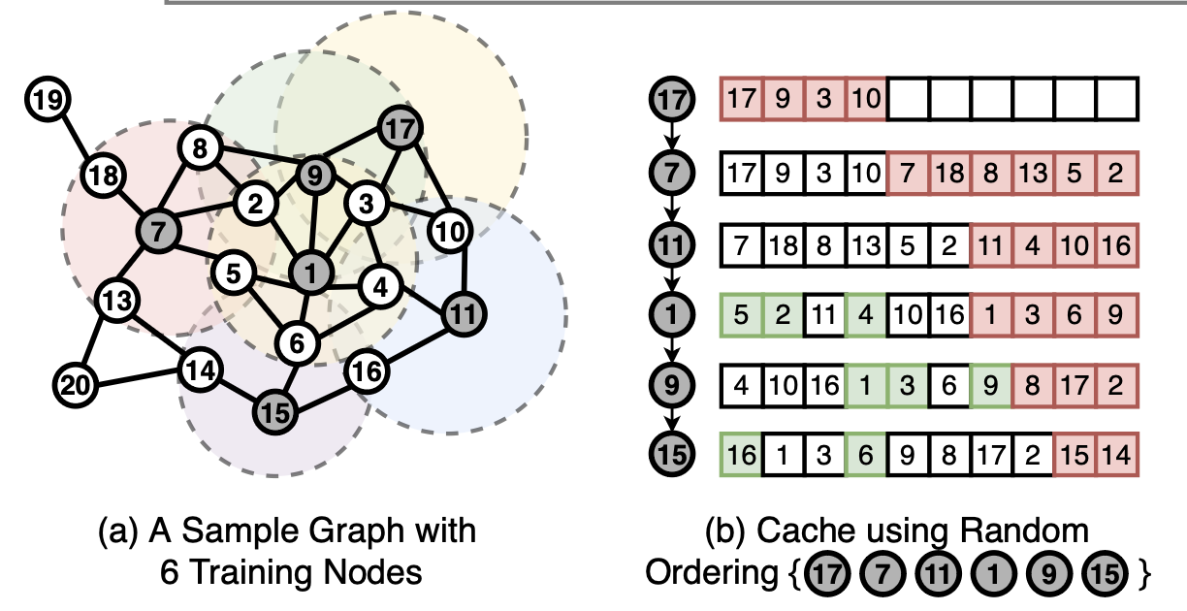

GNN Batch Generation
What about dynamic caching?
BGL [NSDI’23] applies FIFO policy.
Low cache hit rate!
17, 7 and11 are far from each other!
Notes:
Then what about dynamic cache? This paper BGL applies FIFO policy as their cache strategy.
[CLICK]
Suppose the current mini-batch contains these 6 vertices pointed by the red arrow, and we use a random order to fetch their neighbors.
[CLICK]
First we put 17 and its neighbors into the cache.
[CLICK]
Then we put 7 and its neighbors into the empty space of the cache.
[CLICK]
Next we put 11 and its neighbors into the cache. Since the number of cache vertices is limited, some vertices are evicted from the cache.
[CLICK]
we can observe that the first 3 vertices has no common neighbors at all, which means the cache hit ratio is really low since not a single vertex is read from cache.
[CLICK]
The reason is the first 3 vertices 17, 7 and 11 are far from each other in the input graph, so they share very few common neighbors.

Slide 65

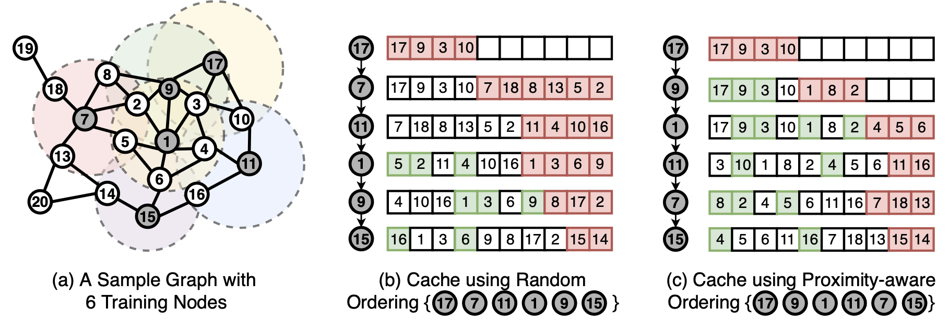
GNN Batch Generation
BGL [NSDI’23] proposes Proximity-Aware Ordering (PPO).
High cache hit rate!
BFS ordering
Notes:
To resolve this low cache hit issue, BGL proposes Proximity-aware ordering or PPO.
[CLICK]
If we use the BFS ordering rather than random ordering,
[CLICK]
Firstly, we put 17 and its neighbors into the cache.
[CLICK]
Then we put 9 and its neighbors into the cache because 9 is in the 1-hop neighborhood from 17. The good news is that 3 neighbors are already in cache, so we can directly use it.
[CLICK]
Then we put 1 and its neighbors, because 1 is in 2-hop neighborhood.
[CLICK] [CLICK] [CLICK]
Then 11 and 7 and lastly 15.
[CLICK]
We can observe much higher cache hit ratio using PPO/BFS ordering compared to random ordering since we take the connectivity of the vertices into account.

Slide 66
GNN Batch Generation
But PPO violates the i.i.d. requirement of SGD.
BGL [NSDI’23] also introduces randomness.
Select BFS sequence in a round-robin fashion.
BFS Seq #1
BFS Seq #2
BFS Seq #3
Notes:
However, PPO violates the i.i.d requirement of SGD, since we enforce a BFS ordering within a single mini-batch, but it's supposed to be a random order. Violating iid requirement would make the model hard to converge.
[CLICK]
To fix this issue, BGL also introduce randomness.
[CLICK]
where we can have 3 BFS sequence at the same time, and we can sample them in a round-robin fashion.
[CLICK]
For example, we first select some vertices in seq 1 and switch to seq 2, take some vertices and switch to seq 3. Then we iterate back to seq 1. This paper claims that you don't lose significant accuracy while in the meantime improving the cache hit.

Slide 67
Distributed GNN Training Pipelines
Notes:
Now let’s go through the last step model training and discuss the execution model in detail.

Slide 68
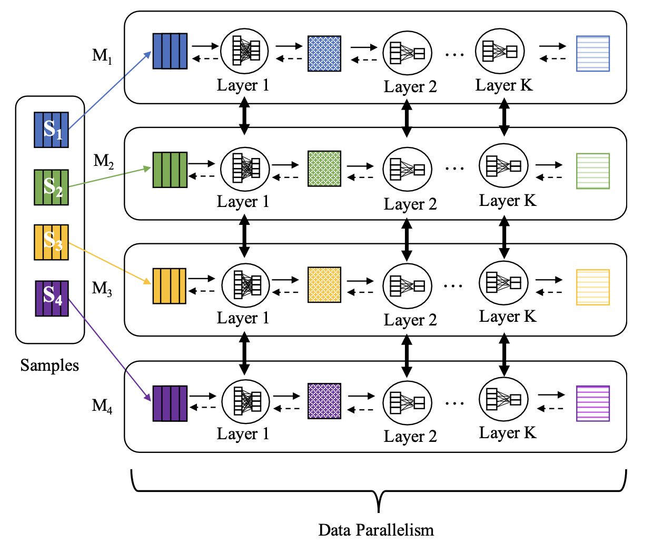

Mini-Batch GNN Execution Model
D
M1
M1
M2
M2
|V|
M3
M3
…
M4
M4
…
Embedding Matrix
Data Shuffling
k-hop subgraphs +
input features (~1k dimension)
Notes:
A widely used execution model is shown in the slide, where we first partition the embedding matrix horizontally. In other word, each machine holds the embedding of a subset of vertices.
Then each machine will be assigned with a mini-batches of training vertices, which may rely on multiple machines. So an all2all broadcast is required to communicate the sampled subgraph and the embeddings of its L-hop neighborhood.
After all the dependent data is received, each machine can continue forward propagation and backward propagation without any trouble. We call this as data parallelism where each machine is in charge of a different mini-batch.
[CLICK]
However, this all2all broadcast or data shuffling might be very time-consuming if the input feature dimension is very large, for example, up to a 1k.

Slide 69
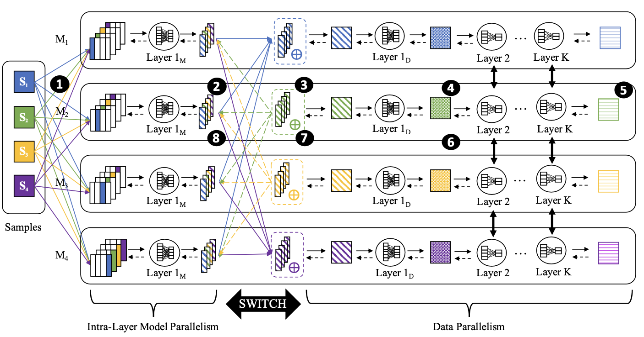
Mini-Batch GNN Execution Model
D
|V|
M1
M2
M3
M4
P3 [OSDI’21] introduces Push-Pull Parallelism.
Embedding Matrix
shuffling k-hop subgraphs only
hidden features
(~100 dimension)
Notes:
This work called P3 in OSDI'21 introduces a different way of maintaining vertex embeddings.
Instead of horizontally split the embedding matrix, it vertically splits the matrix where each machine holds a partial embedding feature for all the vertices. For example, if the input dimension is 1k, then each machine will hold a vector of 250 dimension for each vertex.
[CLICK]
The benefit of such strategy is during the first all2all broadcast, we only broadcast the subgraphs itself, so the feature communication is completely avoided.
Then each machine will compute the first layer for 4 mini-batches, but the result will only be 1/4 of the total dimension.
[CLICK]
After the first layer is done, we do another all2all feature broadcasting to let each machine maintain a complete mini-batch. Remember than the feature being broadcast is just hidden feature, which often has far less dimension than the input feature, for example, 100. Then each machine will be in charge of a different mini-batch.
To summarize, in P3, first we have a model parallelism where we partition the workload w.r..t the dimension. Then we have an all2all broadcast, and then we switch to data parallelism. By doing this, the communication overhead will be significantly reduced.

Slide 70
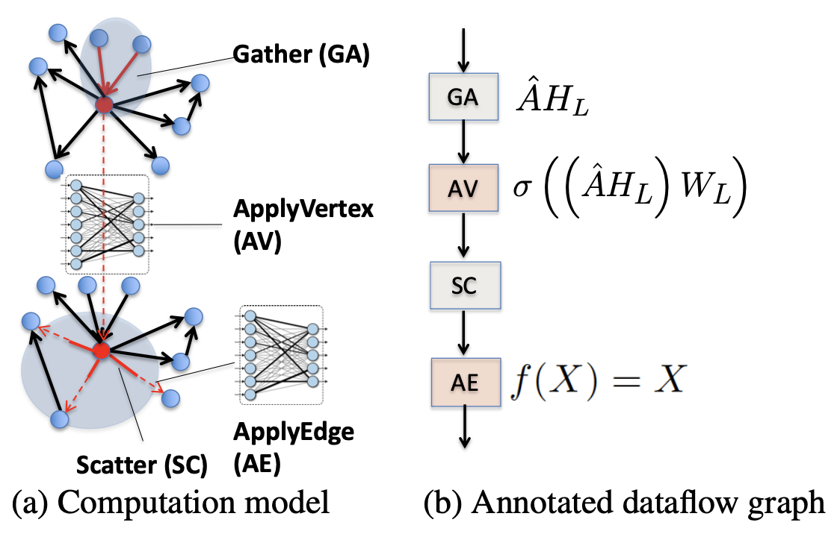
Mini-Batch GNN Execution Model
Dorylus [OSDI’21] abstracts dataflow graph in each forward layer.
Figure from Dorylus [OSDI’21]
Notes:
Now let's talk about an asynchronous training pipeline.
Dorylus in OSDI'21 introduce an abstraction of the dataflow graph in each forward layer.
Firstly, we have gather to aggregate the feature of a vertex's neighborhood.

Slide 71
Mini-Batch GNN Execution Model
Dorylus [OSDI’21] abstracts dataflow graph in each forward layer.
Figure from Dorylus [OSDI’21]
Notes:
Then we have ApplyVertex. We use this aggregated vector to multiply the weight matrix.

Slide 72
Mini-Batch GNN Execution Model
Dorylus [OSDI’21] abstracts dataflow graph in each forward layer.
Figure from Dorylus [OSDI’21]
Notes:
Then we have scatter to distribute the result to its neighbors.
Finally, we have ApplyEdge.
In a simplified GNN model, ApplyEdge doesn’t do anything, its output is simply just input.

Slide 73
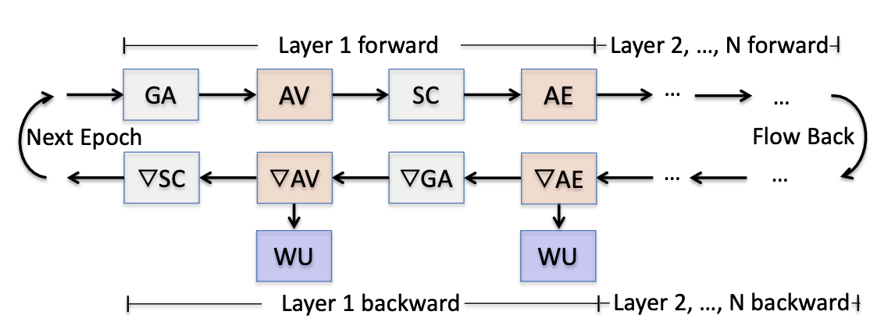
Mini-Batch GNN Execution Model
Dorylus [OSDI’21] splits each layer into individual tasks.
Figure from Dorylus [OSDI’21]
Notes:
Dorylus splits the propagation of each layer into 9 individual tasks. On the last slide, we introduce 4 tasks in the forward propagation. For the backward propagation, we have another 4 tasks in the gradient version. Weight Update is also treated as a task.
Therefore the execution model is converted into the problem of how to schedule these 9 tasks.

Slide 74

Mini-Batch GNN Execution Model
Dorylus [OSDI’21] pipelines these tasks using task queues.
Tasks are executed by CPU threads and serverless threads.
Figure from Dorylus [OSDI’21]
Notes:
Recall that each layer contains 9 tasks. So each of these 9 tasks has an associated queue to maintain tasks for each category.
Tasks are fetched and then executed by CPU threads or serverless threads depending on their categories. For example, Gather and Scatter are IO-intensive operations and therefore are executed by CPU threads in EC2 servers.
ApplyVertex and its backward version are basically matrix multiplication, which are computational-intensive, and therefore is executed by serverless threads.
If you don’t know what serverless thread is, you can just think of them as a thread with low computational-power but you can use them with an extremely low price. So you can have millions of these serverless threads in order to achieve relatively high parallelism.
In Dorylus, in order to maximize training efficiency, the workers/threads will not wait for the completion of the last mini-batches and weight updates. In other words, as long as there’re remaining tasks in task queues, it will try to fetch them and start the computation immediately.
[CLICK]
For example, the mini-batch pointed by the red arrow is in the middle of weight update.
[CLICK]
But the mini-batch pointed by the blue arrow is already starting ApplyVertex. So you can see the task scheduling order is quite relaxed and random.
Therefore, this work describes a highly asynchronous training pipeline but in the meantime not losing signification accuracy. And we will talk more on the asynchoronous training and staleness tolerance in the following slide.

Slide 75
Full-Graph GNN Execution Model
NeutronStar [SIGMOD’22] summarizes 2 paradigms of solving vertex dependencies: DepCache & DepComm.
Notes:
We’ve seen some execution models for mini-batch based training pipeline, Now let’s look at how to design the execution model in a full-graph training system.
NeutronStar, appears in SIGMOD’22, summarizes 2 paradigms of solving vertex dependenies in a distributed setting, which are dep Cache and communication Dependency. Vertex dependency is the scenario when a vertex wants to aggregate the feature of its neighbors but some neighbors may locate on another machine. So in order to compute my feature, I need to first request remote features and that’s why vertex dependencies are a severe bottleneck in dist. Gnn training, especially on full-graph training.

Slide 76
Full-Graph GNN Execution Model
NeutronStar [SIGMOD’22] summarizes 2 paradigms of solving vertex dependencies: DepCache & DepComm.
DepCache
3
3
3
Partition 1
2
2
2
2
3
1
1
0
0
+ Sparse graph
+ Good for high hidden layer dimension
- Additional storage
- Redundant computation
1
3
3
0
2
Partition 0
1
1
1
0
0
0
Notes:
Let me first explain Dependency Cache. DepCache says when a vertex has remote dependencies on remote machines, it will first cache those remote vertices and their features locally, so that if some vertex depends on this feature, it doesn’t have to request the remote machine anymore. For example, suppose we’re considering a 2-layer GCN, we first partition these 4 vertices in 2 partitions, 0,1 and 2,3.
[CLICK]
If we want to compute the final feature of 1, we notice that it has 2 incoming neighbors, 0 and 3. 0 can be accessed locally, but 3 is in another partition. So we need to find a way to get the feature of vertex 3. The same case happens for vertex 2. It has 3 incoming neighbors, but 0 and 1 are in another partition.
[CLICK]
According to the definition of Dep Cache, we need to cache those dependent vertices. In this example, 2, 3 should be cached in partition 0 since we need them to compute feature for 1 and 3. 0, 1 should be cached in partition 1 since we need them to compute feature for 0, 1 and 2.
[CLICK]
Therefore, a very obvious drawback is it requires additional storage for caching and sometimes the required space can be large. For example in this case, we end up cache all vertices in each partitioning. Also, if you look at the red arrow, the feature of 1 is derived from 0 and 3. This feature is computed twice on two partitions, which means there exists redundant computation is the DepCache paradigm.
But there're also benefit for DepCache paradigm. If the graph is sparse, the number of cached vertices will be small. Besides, if the network design has high hidden layer dimension, we can avoid heavy feature communication through the network.

Slide 77
Full-Graph GNN Execution Model
DepComm
3
3
3
2
3
Partition 1
2
2
2
+ Good for low hidden layer dimension
+ No redundant computation
+ No additional storage
- High demand for fast network
0
1
1
1
1
Partition 0
0
0
0
Notes:
Dependency Communication is another paradigm where we don’t do any caching at all. When a vertex depends on another remote vertex, it will wait until that feature is received from the link of 2 devices, The link can be fast links like NVLink or slow links like PCIe or network.
[CLICK]
In the same example, in partition 0, 1 still depends on 0 and 3. it will wait until it received the feature of 3 sent by partition 1. For vertex 2, it relies on 0 and 1 remotely, so it will also wait until partition 0 sends 0 and 1.
[CLICK]
The first layer also contains feature communication between 2 partitions.
[CLICK]
This DepComm paradigm apparently has no redundant computation, and is desirable if the hidden layer dimension is low, because the communicated feature vector is short. No additional storage is required is this paradigm since we don't cache any vertex.
However, we can notice that every layer will likely depends on other partitions. If the data is received by a large latency, the training efficiency is compromised. Therefore, this paradigm has high demand for fast network to reduce the latency for data comm.

Slide 78

Full-Graph GNN Execution Model
+ Adaptive to diff. graph/network
+ Less redundant computation
+ Less additional storage
+ Less demand for fast network
Hybrid Dependency Management
Figure from NeutronStar [SIGMOD’22]
Notes:
This work notices that these 2 paradigms both have their own pros and cons,
it wants to combine these 2 paradigms in order to kind of get the best from both worlds. Therefore it proposes a novel technique called hybrid dependency management.
For example, in the left figure where depCache is used, blue vertices are cached locally so we can do computation without any trouble.
In the middle figure where depComm is used, red vertices are sent from remote machines so that we can continue computing as long as the dependent features are received.
However, in the hybrid scenario, some vertices are cached locally and the rest of the dependent vertices will be requested remotely.
[CLICK]
For example in the right figure, Vertex 1 is sent remotely while the rest blue vertices are cached.
Regarding the question that which vertices we want to cache or which vertices we need to remotely request, you can check out this paper where they introduces a heuristic way to determine.
[CLICK]
The hybrid management is obviously better than 2 individual paradigms, because it's adaptive to different input graphs and network design. We just need to run the heuristic algorithm in the paper and we can obtain the best strategy for the ratio of caching and communication nodes.
Besides, we have less redundant computation, we need less additional storage. We don't need very fast network in the hybrid scenario.

Slide 79
Communication Optimization
Overlapping Comm. w/ Comp.
  NeutronStar [SIGMOD’22]
Faster Links
  DGCL [EuroSys’21]
Redundant IO/Data Reuse
  HongTu [SIGMOD’24]
Notes:
As we've introduced the execution model for mini-batch based and full- graph distributed GNN training, it's obvious that communication between 2 devices or communication among multiple devices is frequently utilized. That's why the communication is oftentimes a severe bottleneck compared to DNN training.
A series of works came up with some solutions to alleviate this issue, and we will be looking at 3 representative approaches. They are overlapping comm. w/ comp. using faster links and avoiding redundant IO or reusing data.
[CLICK]
We will take 3 recent works as examples to illustrate how these approaches can be applied in distributed GNN training context.

Slide 80
Overlapping Comm. w/ Comp.
Ring-based Communication
Comm
0
 | 0
0
 | 0
0
 | 0
0
 | 0
Comp
Worker 0
Worker 1
Worker 2
Worker 3
Notes:
Recall that All2All broadcast is widely used in distributed training pipeline. An efficient implementation for the all2all broadcast is called ring-based communication. The intuition is each worker only send to one worker and received from one worker in each round. So that we can avoid congestion and contention in data communication.
For example, suppose we have 4 workers here to do the all2all broadcast. In the first round, the order is defined as worker 0 to 1, 1 to 2, 2 to 3 and 3 to 0. In this example, Worker 0 send the data in green to worker 1, worker 2 send grey data to worker3.
[CLICK]
Worker 1 send orange data to worker 2. and worker 3 send blue data to work 0.

Slide 81
Overlapping Comm. w/ Comp.
Ring-based Communication
Comm
0 | 1
 | 0 | 1
0 | 1
 | 0 | 1
0 | 1
 | 0 | 1
0 | 1
 | 0 | 1
Comp
Worker 0
Worker 1
Worker 2
Worker 3
Notes:
[CLICK]
In the next round, we let worker 0 and 2 exchange data and 1 and 3 exchange data.
[CLICK]
Besides, when the data in the first round is received, each worker can start computation immediately in the current round. By doing this we can overlap the comm w/ comp. to achieve better efficiency.

Slide 82
Overlapping Comm. w/ Comp.
Overlapping Comm. with Comp.
Comm
0 | 1
 | 0 | 1
0 | 1
 | 0 | 1
0 | 1
 | 0 | 1
0 | 1
 | 0 | 1
Comp
Worker 0
Worker 1
Worker 2
Worker 3
Notes:
[CLICK]
In the next round, we let worker 0 and 2 exchange data and 1 and 3 exchange data.
[CLICK]
Besides, when the data in the first round is received, each worker can start computation immediately in the current round. Therefore we can overlap the comm w/ comp. to achieve better efficiency.

Slide 83


Faster Links
DGCL [EuroSys’21] uses faster links (NVLink) to speed up data communication.
Notes:
The next technique is to use faster links/Nvlinks to speed up data communication, proposed by DGCL in EuroSys’21. This diagrams shows the architecture of how modern CPUs and GPUs are connected and how data flows between CPU and GPU. Specifically, CPUs and GPUs are connected by PCIe link and GPUs internally are connected by a much fast link called NVLink. Modern servers often have more than 1 CPU sockets and in this figure, the server has 2 CPU sockets which are connected by QuickPath Interconnect or QPI. That CPU also has 4 GPUs attached.
If we want to send data from GPU 1 to GPU 6, we can directly use NVLink.
[CLICK]
This table show the bandwidth for various links connecting different hardward. We can see that NVlink is the fastest, then followed by PCIe and QPI, the network is the slowest.

Slide 84

Faster Links
Planning Principles
Utilize fast links (d1 to d3)
Notes:
This paper introduces several principles on how to plan and schedule these communication.
I will introduce them one by one.
The first principle is utilizing faster links. For example, if we want to send data from d1 to d3, we have 2 options.
[CLICK]
One option is highlighted in red where d1 can send data to its CPU through PCIe and send to another CPU through QPI and to d3 through PCIe again.
[CLICK]
The other option is highlighted in yellow where d1 can send data to d2 through NVLink and then to d3 through NVLink again.
Obviously the NVlink option is much better then PCIe-QPI route since it has higher bandwidth and thus lower latency.

Slide 85
Faster Links
Planning Principles
  Fuse Communication (d1 to d2, d3 separately)
Notes:
The second principle is called fuse communication.
For exmaple, if we want to send data from d1 to d2 and d3 separately. A straightforward way is to let d1 send to d2 through NVlink and d1 to d3 through PCIe-QPI-PCIe route.
[CLICK]
However, we could have saved some bandwidth by fusing 2 routes into a single route. A more efficient way is to let d1 send to d2 and d2 to d3, so that d2 and d3 can receive the same data.

Slide 86
Faster Links
Planning Principles
  Avoid Contention (d1 to d3, d2 to d4)
Notes:
The third principle is to avoid contention.
Suppose we want to send data from d1 to d3 and d2 to d4,
[CLICK]
we can notice that the link from d2 to d3 is shared for 2 routes. Therefore, we need to consider such scenario where a link is shared by multiple routes so the amount of data transferred on the link is way beyond its bandwidth. This link is likely to become a bottleneck and we need to prevent such scenario.

Slide 87
Faster Links
Planning Principles
  Balance loads on different links (d1 to d3 via both NVLink & PCIe-QPI)
Notes:
The last principle is to balance workloads on different links. Suppose we want to transfer large amount of data from d1 to d3. Rather than relying on only 1 route to transfer all the data, we can divide the data, and let part of the data use the NVLink and the rest of data use the PCIe-QPI-PCIe route. By doing this, we can fully exploit the bandwidth for such heavy data movement and minimize the network latency.

Slide 88
Faster Links
Transform into a link graph
d1
d4
CPU0
CPU1
d2
d3
Notes:
Given all these principles, how do we actually formulate this problem in a mathmatical form?
Firstly, we can transform the hardware architecture into a link graph where each node represents a device, and the edge between 2 nodes is the link between them. For example, d1 to d4 are 4 GPUs which are partially connected by NVLink. Each CPU has 2 GPUs attached to it. These 2 CPUs are internally connected by QPI.

Slide 89
Faster Links
Shortest path problem (Dijkstra Algorithm)
v
d1
d4
5
6
8
2
CPU0
CPU1
4
5
5
d2
d3
3
Notes:
Now suppose we want to send the feature of v from d1 to d3, which route is the most efficient? We can assign a cost value to each edge describing the cost we need to pay if the data is sent through this link. This value is related to the bandwidth of the link and the amount of data that has been assigned to this link.
Since we know the source is d1 and destination is d3, we can run a Dijkstra algorithm to find the shortest path between these 2 nodes such that the cost is minimized. We can record this shortest path as part of the plan. After the plan is determined, we will start actual data communication.

Slide 90
Redundant IO/Data Reuse
HongTu [SIGMOD’24] maintains vertex embeddings on CPU and offloads computation to GPU.
GPU 0
GPU 1
GPU 2
GPU 3
1
0
0
2
1
4
0
6
Batch 0
3
3
3
4
7
4
Batch 1
Vertex 3’s feature vector is loaded 3 times to GPUs
through slow PCIe!
Redundant IO!
Notes:
Now let’s talk about Redundant IO or Data Reuse. HongTu in SIGMOD’24 introduces a scenario where the vertex embedding is stored in the CPU memory. It offloads the computation to GPU and copy the necessary vertex embedding from CPU to GPU in every batch.
For example, suppose we have 4 GPUs here and each GPU is assigned with 1 vertex and it requires some dependent features. In the most straightforward approach, the CPU will copy the data 4 times, each time to 1 GPU.
[CLICK]
However, since the vertex 3 is required by GPU 0,1 and 3, its feature is repeatedly loaded 3 times to GPUs through the slow PCIe link.
[CLICK]
That’s why there exists redundant IO in the CPU-GPU data copying. And this work aims to get rid of such redundant IO.

Slide 91
Redundant IO/Data Reuse
Inter-GPU Communication
GPU 0
GPU 1
GPU 2
GPU 3
0, 1
2, 3
4
7
No redundant IO!
Inter-GPU broadcast
through fast NVLink
1, 3, 4
0, 3, 7
1
0, 3, 4
Batch 0
1
0
0
2
1
4
0
6
3
3
3
4
7
4
Notes:
The work introduces inter-gpu comm where on the CPU side, it loads each vertex only once even if a vertex is required by more than 1 GPU, like vertex 3 in this case.
Then the GPUs can internally do an all2all broadcast to feed each device with necessary data. This broadcast is done through the fast NVLink, rather than the slow PCIe link.
[CLICK]
This solution not only get rid of redundant IO but also speeds up data comm w/ faster links.

Slide 92

Redundant IO/Data Reuse
Intra-GPU Data Reuse
GPU 0
GPU 1
GPU 2
GPU 3
0, 1
2, 3
4
7
Batch 0
1, 3, 4
0, 3, 7
1
0, 3, 4
2, 3
4
5
6
CPU
Batch 1
Broadcast
6
2, 5, 6
2, 4
2, 3, 6
Notes:
We just talk about redundant IO inside a single batch. There’re also opportunities to reuse the data between consecutive batches.
For example, now in the case, the workload for the next batch is shown. We can observe that vertex 2 and 3 is used also in the next batch, and the good news is we’ve already load them in the previous batch.
[CLICK]
Therefore, we don’t have to load vertex 2 and 3 again, we can just reuse the data from previous batch.
[CLICK]
The same happens on vertex 4. We can also reuse vertex 4’s data rather than loading it again.
[CLICK]
But vertex 5 is not the case so we need to load vertex 5 from CPU.
This technique is called intra-GPU data reuse because it happens only in the same device between consecutive batches.

Slide 93

Staleness Tolerance
  $$H^{l}= σ(\tilde{A }H^{l−1} W^{l−1})$$
Embedding Staleness
  DistGNN [SC’21]
  Sancus [VLDB’22 best paper]
Weight/Gradient Staleness
  P3 [OSDI’21]
  Dorylus [OSDI’21]
Notes:
Staleness is an interesting problem which inspires a series of GNN system papers. Roughly speaking, it can be split into 2 categories, namely embedding staleness and weight/gradient staleness. The reason some systems tolerates staleness in training is either they want to reduce the amount of data that are broadcast to reduce IO bottleneck or they support highly asynchronous training pipeline in order to maximize the efficiency.
[CLICK]
For embedding staleness, we will talk about DistGNN and Sancus. Btw, Sancus won the best paper award in VLDB’22 so you can see that it’s very hot topic. And for weight/gradient staleness, P3 and dorylus will be covered.

Slide 94
Embedding Staleness
DistGNN [SC’21] proposes Delayed Remote Partial Aggregates.
I need to aggregate features from 3 remote machines!
After Partitioning
GPU 0
GPU 1
GPU 2
GPU 3
Notes:
DistGNN in SC'21 employs a very simple staleness design. Suppose we have an input graph and after partitioning into 4 parts, we obtain the result on the right.
[CLICK]
Now in the GPU1, in order to do the forward propagation, this vertex need to aggregate feature from 3 remote machines which can be a severe bottleneck. So this paper proposes a technique called delayed remote partial aggregates.

Slide 95
Embedding Staleness
Each remote vertex starts communication in epoch 𝑖 and asynchronously receives and processes aggregates in epoch (𝑖 + 𝑟).
I receive and aggregate at Epoch 5.
GPU 0
GPU 1
Epoch 5
GPU 2
GPU 3
I send my features of Epoch 3.
Notes:
What this means is each remote vertex starts communication in epoch i and asynchronously receives and processes aggregates in epoch i + r.
[CLICK]
For example, Suppose we are at Epoch 5 right now.
GPU 3 send its feature to GPU 1 at Epoch 3 and this feature will be used and aggregated at Epoch 5. So we tolerate stale embeddings from 2 epochs ago and these 2 epochs’ time can be used to do data communication in case the network is congested or slow.

Slide 96





Embedding Staleness
Sancus [VLDB’22]
A₀
A₁
=
A₂
A₃
Adjacency Matrix $A$
Feature $H$
Weight $W$
Next Layer Feature $H$’
  $$H^{l}= σ(\tilde{A }H^{l−1} W^{l−1})$$
Notes:
Sancus in VLDB’22 employs a more fine-grained staleness control. Recall that the forward propagation is formulated as adjacent matrix A times vertex embedding H times weight matrix W and we can obtain the vertex embeddings for next layer.

Slide 97
Embedding Staleness
Sancus [VLDB’22]
A₀
H’₀
A₁
H’₁
=
A₂
H’₂
H’₃
A₃
Adjacency Matrix $A$
Feature $H$
Weight $W$
Next Layer Feature $H$’
  $$H^{l}= σ(\tilde{A }H^{l−1} W^{l−1})$$
Notes:
If we partition this adjacent matrix horizontally into 4 parts, then the result will also be partitioned into 4 parts, each parts corresponds to 1/4 of the input adjacency matrix.

Slide 98
Embedding Staleness
Adjacency-matrix partitioning
A₀
A₁
A₂
A₃
H
W
H
W
H
W
H
W
H’₀
H’₁
H’₂
H’₃
GPU 0
GPU 1
GPU 2
GPU 3
Notes:
Sancus first partition the adjacency matrix into 4 sub-matrices a0 a1, a2 and a3 assume we have 4 GPUs. In other words, each GPU maintains 1/4 of the total vertex.
[CLICK]
Then each GPU starts the computation based on its partial adjacent matrix, the result would be the partial vertex embeddings for the next layer.
In order to compute for the next layer, each GPU has to do an all2all broadcast to exchange their partial H’.

Slide 99

Embedding Staleness
We need AlltoAll broadcast to communicate H’₀ H’₁ H’₂ H’₃
Sancus proposes Skip-Broadcast
H’₂ in G0, G1, G3 are stale
Heavy IO!
Less IO!
Figure from Sancus [VLDB’22]
Notes:
So we need all2all broadcast to communicate H0', H1', H2', H3' such that each GPU has the result of the complete H’,
[CLICK]
But this leads to heavy data shuffling.
[CLICK]
Therefore Sancus propose Skip-Broadcast.
[CLICK]
What this means is if we don’t tolerate any staleness, we would do a complete broadcast just like the left fig.
If we can skip some broadcast, for example in the middle figure, G2 decided not to broadcast its H2’ to others.
[CLICK]
So the H2' in the rest GPUs G0, G1 and G3 will be stale.
[CLICK]
But the good news is we skip several broadcast and get less IO to save some bandwidth.

Slide 100













































Embedding Staleness
GPU 0
GPU 1
GPU 2
GPU 3
GPU 0
GPU 1
GPU 2
GPU 3
GPU 0
GPU 1
GPU 2
GPU 3
$$H_{1_9}$$
$$H_{1_8}$$
$$H_{1_8}$$
$$H_{1_8}$$
$$H_{1_10}$$
$$H_{1_8}$$
$$H_{1_8}$$
$$H_{1_8}$$
$$H_{1_11}$$
$$H_{1_11}$$
$$H_{1_11}$$
$$H_{1_11}$$
$$H_{2_7}$$
$$H_{2_9}$$
$$H_{2_7}$$
$$H_{2_7}$$
$$H_{2_10}$$
$$H_{2_10}$$
$$H_{2_10}$$
$$H_{2_10}$$
$$H_{2_10}$$
$$H_{2_11}$$
$$H_{2_10}$$
$$H_{2_10}$$
$$H_{3_9}$$
$$H_{3_9}$$
$$H_{3_9}$$
$$H_{3_9}$$
$$H_{3_9}$$
$$H_{3_9}$$
$$H_{3_10}$$
$$H_{3_9}$$
$$H_{3_9}$$
$$H_{3_9}$$
$$H_{3_11}$$
$$H_{3_9}$$
$$H_{4_9}$$
$$H_{4_9}$$
$$H_{4_9}$$
$$H_{4_9}$$
$$H_{4_9}$$
$$H_{4_9}$$
$$H_{4_9}$$
$$H_{4_10}$$
$$H_{4_9}$$
$$H_{4_9}$$
$$H_{4_9}$$
$$H_{4_11}$$
Epoch 9
Epoch 10
Epoch 11
Notes:
Suppose we are at Epoch 9, Since the full embedding matrix comes from 4 parts, we can see that each GPU maintains 4 separate embeddings. For example in GPU 0, H1_9 stands for the first part is computed from Epoch 9, H2_7 stands for the second part is computed from Epoch 7. If we tolerate embeddings from last 2 epochs at most, H2_7 is already on the edge of being overly stale and invalid.
[CLICK]
So the next epoch, GPU1 will broadcast it latest H2_10 to others so that every one can get a newer version of H2. Now the H1 kept in the rest 3 GPUs are on the edge on being overly stale and invalid,
[CLICK]
So at Epoch 11, GPU 0 will broadcast its latest H1 to others so that every one can get a newer version of H1. And now H3 and H4 are on the edge so they must be updated in the following epoches.
This work also introduces some definitions on how to determine if a H is overly stale or not, you can check out their papers for more details.

Slide 101

Weight Staleness
P3 [OSDI’21] introduces staleness by pipeline delay.
  Regular: $w_{t+1}=w_{t}−η ∇f(w_{t})$
  Pipelined delayed: $w_{t+1}=w_{t}−η ∇f(w_{t−3})$
Notes:
Now let move onto the weight staleness or gradient staleness since the computation of gradient must rely on the current weight. If the weight is already stale, the gradient must be stale as well.
P3 introduces staleness by adopting a technique called pipeline delay which is inspired by traditional DNN training. In the most regular form, the gradient is obtained using the current weight, and we can do a weight update based on this gradient.
But in the pipelined delayed version, the gradient is computed using the weights from 3 mini-batches ago.

Slide 102
Mini-Batch GNN Execution Model
D
|V|
M1
M2
M3
M4
Recall P3’s Pipeline
P3 [OSDI’21] introduces Push-Pull Parallelism.
Embedding Matrix
shuffling k-hop subgraphs only
hidden features
(~100 dimension)
Notes:
Let’s first recall P3’s training pipeline. For every mini-batch, the first layer of GNN uses the model parallelism, where each machine is in charge of 1/4 of the total dimension. Then followed by an all2all broadcast to communicate hidden features, such that every machine can obtain a complete hidden embedding matrix for an individual mini-batch. Then the model moves into the data parallelism all the way to the end.

Slide 103

Weight Staleness
P3 [OSDI’21] introduces staleness by pipeline delay.
  Regular: $w_{t+1}=w_{t}−η ∇f(w_{t})$
  Pipelined delayed: $w_{t+1}=w_{t}−η ∇f(w_{t−3})$
Recall P3’s pipeline
Model Parallelism
Data
Communication
Data Parallelism
Forward
Model Parallelism
Data
Communication
Data Parallelism
Backward
Notes:
This simplified figure abstracts P3's pipeline. On the forward propagation side, we have model parallelism, the data communication, and data parallelism. And on the backward propagation side, the operations are reversed. So we have data parallelism, followed by data communication and model parallelism.

Slide 104

Weight Staleness
P3 [OSDI’21] introduces staleness by pipeline delay.
  Regular: $w_{t+1}=w_{t}−η ∇f(w_{t})$
  Pipelined delayed: $w_{t+1}=w_{t}−η ∇f(w_{t−3})$
For example, in mini-batch #3,
3_{M}
Data
Communication
3_{D}
Forward
3_{M}
Data
Communication
3_{D}
Backward
Notes:
Let’s use some notations to represent these steps. Suppose we’re in mini-batch #3, 3M represents the model parallelism in mini-batch 3, and 3D represents the data parallelism in mini-batch 3.
You can also think of the arrow as a dependent relationship between 2 phases. Only the previous phase is completed, the next phase will be started.

Slide 105


Weight Staleness
Overlap Comm. w/ Comp.
  $$w_{4}=w_{0}−η ∇f\left(w_{1}\right)$$
  $$w_{5}=w_{4}− η ∇f(w_{2})$$
P3 [OSDI’21] employs pipelining mechanism to schedule 3 mini-batches.
Notes:
P3 schedule 3 mini-batches simultaneously in order to hide the data communication latency.
For example, if we look at red arrow in the figure, 3D relies on 3M. So the time in between can be used to launch the data communication. In the backward version, 3M relies on 3D, So the time in between can be used to launch the gradient communication.
[CLICK]
So by using the pipelining mechanism, we can overlap comm w/ comp and hide its latency.
[CLICK]
If we look at the red square, the forward pass of min-batch 4 is right after the weight update of mini-batch 1.
so, the update looks like w4 which is the weight that will be used in mini-batch 4, equals to the initial weight w0, minus the gradient of mini-batch 1 times a learning step.
[CLICK]
As another example, If we look at the purple square, the forward pass of min-batch 5 is right after the weight update of mini-batch 2.
so, the update looks like w5 which is the weight that will be used in mini-batch 5, equals to the last weight w4, minus the gradient of mini-batch 2 times a learning step.

Slide 106

Weight Staleness
In Dorylus [OSDI’21], to reach full-power of training, workers do not need to wait for updates to proceed.
Working on multiple
mini-batches concurrently
Different weights among Parameter Servers
Notes:
Recall that dorylus introduces a highly asynchronous training pipeline using the cloud computing platform like AWS to reach full-power of training.
[CLICK]
We can observe that the Lambda/serverless threads are working on multiple mini-batches concurrently, so there must be some threads using stale weight. For example, if you look at red arrow, some threads are working on vertices 11-20, while some threads are working on vertices 31-40.
[CLICK]
Besides, the weight matrix maintained in these parameter servers may not be exactly same to each other, so these parameter servers need to do an internal synchronization periodically. So those weight matrices kept in PSes may be stale before a synchronization round.

Slide 107
Summary
Mini-batch GNN training
  Graph Partitioning
  Batch Generation
  Execution (model & data parallelism, task queue)
Full-graph GNN training
  Execution (DepCache & DepComm)
Communication Optimization
  Pipelining & Overlapping Comm. w/ Comp.
  Faster Links
  Redundant IO/Data Reuse
Notes:
Ok, Let's do a quick summary on what we have talk about so far.
[CLICK]
We first introduce mini-batch GNN training which can be divided into 3 steps. graph partitioning, batch generation and its execution model where we talk about model & data parallelism, and also talk queue to support asynchronous training.
[CLICK]
Then we introduce full-graph GNN training where we talk about the pros and cons of DepCache and DepComm, and the hybrid version can get the best of both worlds.
[CLICK]
Then we focus on the communication bottleneck in GNN and introduce 3 representative solutions to reduce communication latency. they are , ......

Slide 108

Summary (Cont’)
Staleness Tolerance
  Embedding Staleness
  Weight/Gradient Staleness
Questions?
Contact: lyyuan@iu.edu
Notes:
Lastly, we introduce staleness tolerance and its 2 categories, embedding staleness and weight or gradient staleness.
[CLICK]
And this is the end of the tutorial. Thank you all for your attention. If you have any questions, please feel free to let me know. You can contact me at this email, I would like to answer it. Thank you!

