Slide 1
Now Taking Place Virtually
Tutorial 3: Systems and Algorithms for Massively Parallel Graph Mining
Da Yan yanda@uab.edu
Guimu Guo guimuguo@uab.edu
Department of Computer Science
The University of Alabama at Birmingham (UAB)
Notes:
Welcome everyone!
This is Da Yan. I am an Assistant Professor from the Computer Science Department of the University of Alabama at Birmingham. Today, I will present this tutorial together with my PhD student Guimu Guo.
The topic of our tutorial is “Systems and Algorithms for Massively Parallel Graph Mining”

Slide 2
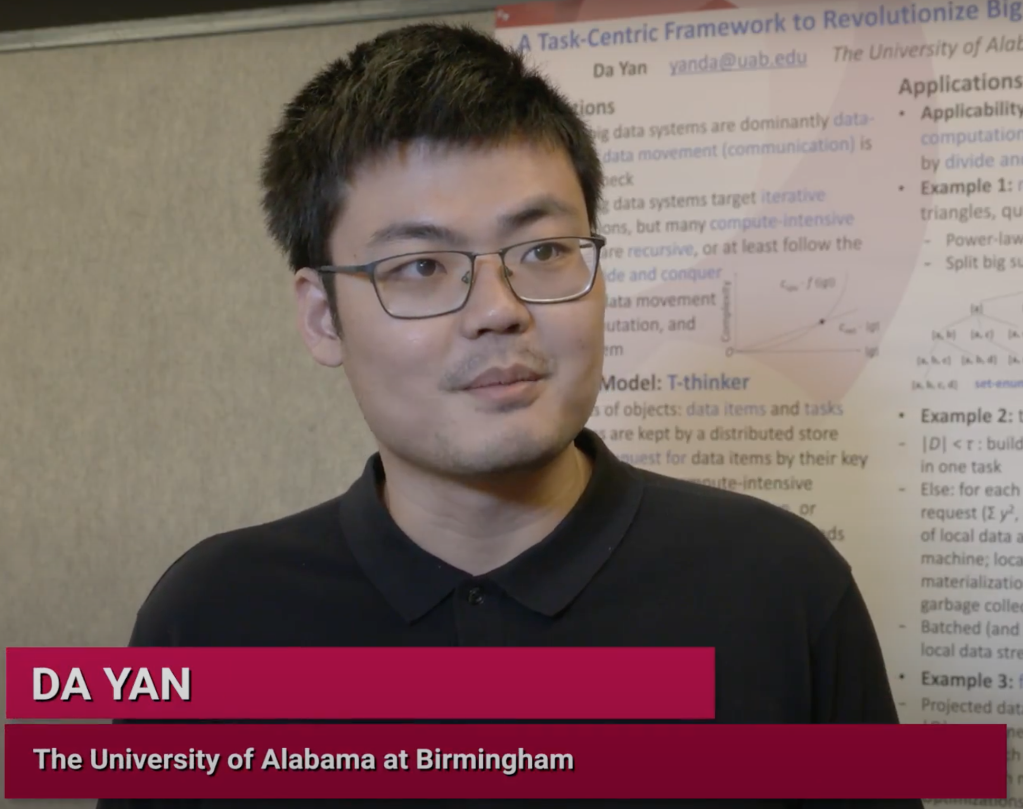
Overview
Part I: Delivered by Da Yan
Graph Mining Problems: A Categorization
Think Like a Vertex: Data-Intensive Mining
Why TLAV is not Sufficient? Compute-Intensive!
PrefixFPM for Frequent Subgraph Mining
G-thinker: Think Like a Subgraph
TLAS Algorithms for Subgraph Mining
Notes:
This tutorial will be split into two parts.
Part I will be presented by me, where I will first motivate a categorization of graph mining problems from the perspective of algorithm time complexity, followed by an introduction of how to conduct graph mining using think-like-a-vertex frameworks.
I will then indicate the weakness of such frameworks in addressing compute-intensive graph mining problems, to motivate our task-based mining frameworks.
Finally, I will walk through the design of PrefixFPM, a compute-intensive system for frequent pattern mining in general, including the problem of frequent subgraph pattern mining.

Slide 3
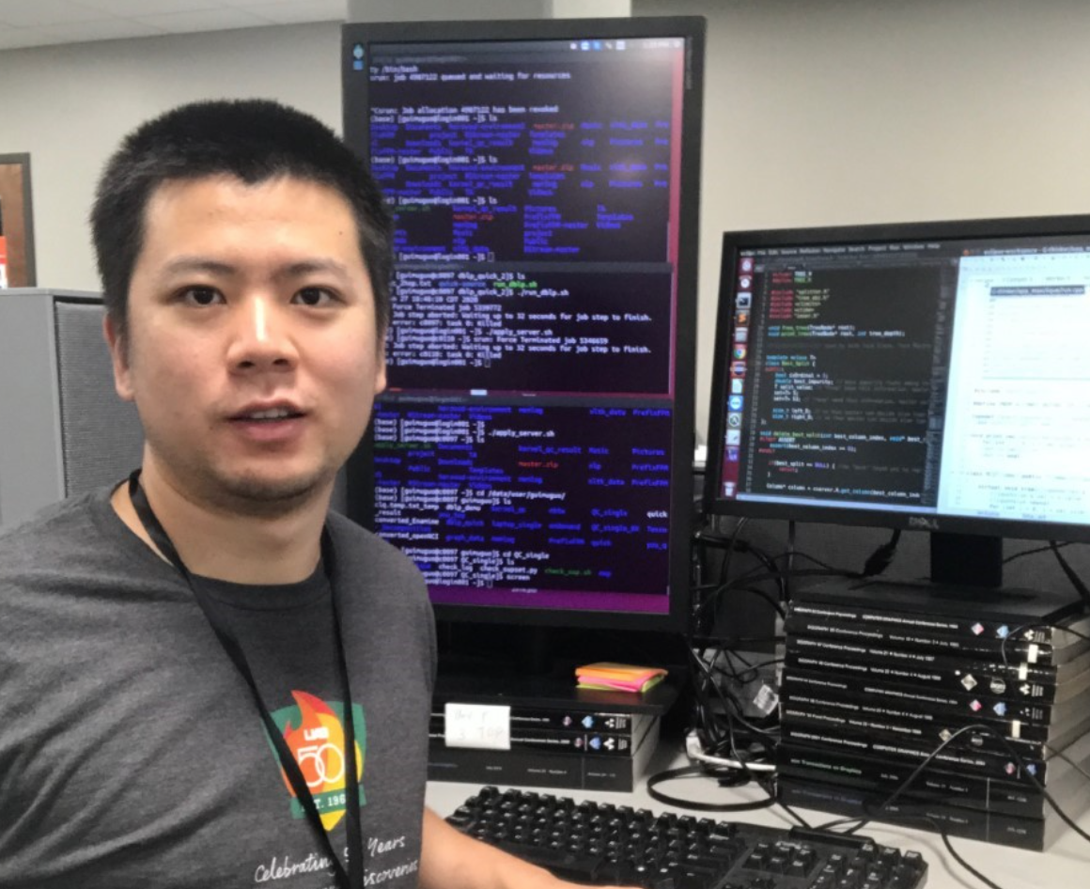
Overview
Part II: Delivered by Guimu Guo
Graph Mining Problems: A Categorization
Think Like a Vertex: Data-Intensive Mining
Why TLAV is not Sufficient? Compute-Intensive!
PrefixFPM for Frequent Subgraph Mining
G-thinker: Think Like a Subgraph
TLAS Algorithms for Subgraph Mining
Notes:
Part II will be presented by my student PhD Guimu Guo, where he will walk through the design of our G-thinker system that follows a think-like-a-subgraph programming model, followed by an introduction on how to write parallel graph mining algorithms on top.
Guimu will also be concluding this tutorial.

Slide 4
Overview
Graph Mining Problems: A Categorization
Think Like a Vertex: Data-Intensive Mining
Why TLAV is not Sufficient? Compute-Intensive!
PrefixFPM for Frequent Subgraph Mining
G-thinker: Think Like a Subgraph
TLAS Algorithms for Subgraph Mining
Notes:
Now, let's first look at how we can categorize graph mining problems.
Since we are considering to parallelize graph mining in a parallel and even distributed environment, the target problem's time complexity actually plays a key role in deciding which parallel framework design is appropriate.
So, we will focus on a categorization driven by the problem time complexity.

Slide 5
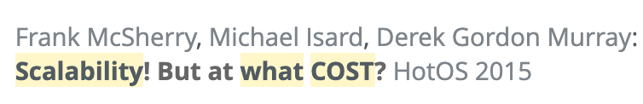
Problem Categorization
Unlike relational database, operations on graphs are highly heterogeneous
No one-size-fit-all solution!
There has been attempts to unify many graph heterogeneous algorithms into one framework
Simple programming, but performance hurts !
Notes:
Relational database has been popular for many decades, thanks to the powerful set of relational operators such as select and join that can be assembled to answer all kinds of queries on tabular data.
Unfortunately, the operations on graph data have been very heterogeneous, and graph data management has not been fully unified despite recent efforts by graph databases such as Neo4j and graph query languages such as the new GQL standard.
[click]
In the domain of parallel programming frameworks, there have also been attempts to unify many different graph algorithms under one framework.
These frameworks often adopts a simple programming model that is more flexible and general, but the performance really hurts since the problem specific optimizations cannot be utilized.
[click]
A researcher, Frank McSherry, has actually wrote a workshop paper in HotOS to criticize the performance suffering of existing graph-parallel frameworks.

Slide 6
Problem Categorization
Time-Complexity Perspective
  Some are data-intensive (low complexity)
    Peeling algorithm of k-core: O(n)
    Random walks (e.g., PageRank)
  Some are compute-intensive!
    Dense subgraph structure mining: quasi-cliques, k-plexes
    Frequent (and closed) subgraph pattern mining
NP-hard !
Notes:
To understand better why different graph algorithms need different parallelization frameworks, let us look at some popular graph problems from the perspective of time-complexity.
One problem is to find the k-core of a graph, which is the maximal subgraph where each vertex has a degree no smaller than k. In fact, we can go one step further to do k-core decomposition which basically computes k-core for all k-values. It is well known that k-core decomposition can be done in linear time using a peeling algorithm that iteratively removes vertices with the smallest vertex degree,
so even if this particular algorithm also finds dense subgraphs, it nevertheless has a low time complexity.
Another problem is random walk, as represented by algorithms such as PageRank. These algorithms also have a low time complexity since they are iterative, where in each iteration, a message is passed along each edge, and the algorithms usually run for a small number of iterations.
[click]
In contrast, some other graph mining algorithms are NP-hard. Examples include mining pseudo-clique structures such as quasi-cliques and k-plexes, and mining frequent subgraph patterns.

Slide 7
Problem Categorization
A Big Data Framework Should
  Be easy to program, simple model and simple API
  Cover a sufficient range of problems for system reuse
But… do not attempt to cover everything!
Easy to program
Our Solution:
Divide and Conquer
Problem coverage
Execution efficiency
Notes:
We identify the following desirable design goals that a big data framework should possess, and this is actually what made the simple MapReduce model popular more than one decade ago.
Firstly, a big data framework should be easy to program even for those programmers who know nothing about parallel programming.
Believe it or not, such programmers are actually the majority, and that's why even though MPI has many similar functions for gathering and scattering data as well as MPI_Reduce operations, MapReduce was so much more popular until Apache Spark beats it with more transformation functions that are easier to use.
In the Big Data systems domain, the priority is never about technical sophistication, but user-friendliness. So, API design is the key to the success of a framework.
However, performance is equally important, since that's the purpose of using a parallel framework to operate on Big Data.
[click]
Another important aspect of big data frameworks is that the programming model should cover a reasonably large range of problems, so that it is worth users' time investment to learn a new API, and so that the execution engine can be reused for different problems.
[click]
However, this does not mean that the big data framework you design, should be able to do everything, since the more general your computing model is, the less opportunities there are for problem domain specific performance optimizations.
In general, there is a tradeoff between the 3 metrics shown on this slide, that is, how easy to program, how many problems are covered, and how efficient your computing model can run.
A common mistake that researchers make is that they propose simple programming APIs that can apply to a lot of problems, so that a research paper can be written in an elegant way, but the performance is actually terrible and against the first two V's of Big Data, that is volume and velocity.
Of course, when everyone is doing this, you can always find a slower baseline to compare with in your paper...
This is especially severe for problems where the time complexity is high.
[click]
My group solves this performance problem by pinning the execution efficiency and programmability to be high, and adjusting the problem coverage so that each of our systems can solve a reasonable range of problems but still being able to utilize domain specific performance optimizations.
One solution that we propose along this direction is to keep CPU cores busy for compute-heavy problems by utilizing divide and conquer, which we shall explain throughout this tutorial.

Slide 8
Problem Categorization
Our Approach
  Divide the graph mining problem space
  Develop a dedicated framework for each problem category
  Ensure both program simplicity and execution efficiency
Notes:
Specifically, we divide the graph mining problems based on their algorithm time complexities
[click]
We then develop dedicated frameworks for each problem category
[click]
And as we emphasized earlier, we pin the two metrics to be high, that is, programmability and execution efficiency.
Different frameworks can interoperate in the Hadoop Ecosystem, so there is no need to make them unified under the same framework.

Slide 9


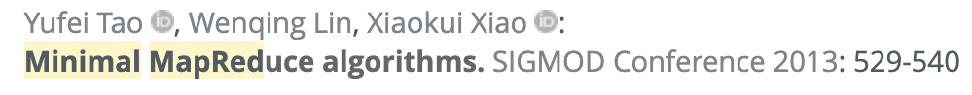
Problem Categorization
We assume G = (V, E)
Category I: Iterative Algorithms
  Low time complexity: O(|E|) per iteration (message passing between vertices), O(polylog(|G|)) iterations
Notes:
The first category of graph mining problems that we define are iterative algorithms.
These algorithms have a low time complexity, usually passing messages between vertices along edges, and running for a logarithmic number of iterations, giving a time complexity of about n polylog n
[click]
Here's a list of papers that advocate the design of iterative algorithms following this n polylog n complexity paradigm, in order for these distributed algorithms to be scalable.

Slide 10
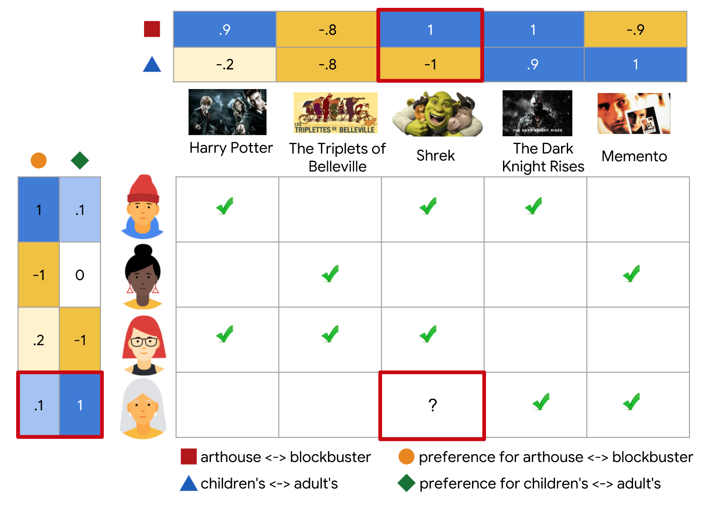
Problem Categorization
Mostly node and/or edge scoring
Category I: Iterative Algorithms
  Examples: PageRanks (random walks), loopy belief propagation, collaborative filtering (ALS)
Notes:
Problems following this category include random walk algorithms such as PageRank, machine learning algorithms such as belief propagation and alternating least squares, all of which follows an iterative algorithmic workflow.
[click]
We can see that those problems also have a linear-sized output, typically one score for each vertex or each edge.

Slide 11
Problem Categorization
Category II: Patterns from Transaction DB
  Examples: (closed, maximal) frequent subgraph pattern mining
NP-hard !
Graph DB
Notes:
The second category of graph problems we identify is frequent subgraph pattern mining.
Here you want to find subgraph patterns that frequently appear in a graph database. The graph database can contain many graphs such as chemical compounds, or it can keep a big graph like an online social network or a knowledge graph.
Besides the frequency criterion, we can also add other restrictions such as pattern closeness and pattern maximality.
[click]
However, it is well known that frequent pattern mining is NP-hard, meaning that the problem time complexity is very high needing a lot of CPU time to compute, even though effective pruning rules can eliminate a lot of the search space.

Slide 12
Problem Categorization
Category III: Patterns from a Big Graph
  Examples: dense subgraph mining (triangle, k-truss, clique, k-plex, γ-quasi-clique), subgraph matching (not mining?)
Often NP-hard !
Notes:
The third category of graph problems we identify is structure-constrained subgraph mining from a big graph.
Here you want to find subgraph instances that satisfy some predefined criteria, from a really big real graph such as an online social network.
Example applications include dense subgraph structure mining, and subgraph matching, although the latter is a query not a mining task, so it is not our focus in this tutorial
[click]
It is well known that these problems are NP-hard, so they also need a lot of CPU time to compute.
Unlike iterative algorithms in Category 1 where the output size is linear to the size of the input graph, the last 2 categories of problems output subgraphs that may overlap, and the output size can be exponential.

Slide 13
Overview
Graph Mining Problems: A Categorization
Think Like a Vertex: Data-Intensive Mining
Why TLAV is not Sufficient? Compute-Intensive!
PrefixFPM for Frequent Subgraph Mining
G-thinker: Think Like a Subgraph
TLAS Algorithms for Subgraph Mining
Notes:
Next, I will introduce the first category of graph mining problems that are solved by iterative algorithms. I will focus on the think-like-a-vertex programming model that is used to parallelize such algorithms.

Slide 14
Category I: Iterative Algorithms
Programming Model
  Think like a vertex (TLAV), or its variants
  Information passed along edges
  Vertex states get updated till converge
  Output is usually a value for each vertex
Notes:
In the think-like-a-vertex programming model, or TLAV in short,
[click]
information on vertex states are passed as messages along edges,
[click]
and vertices update their states based on the received messages until all vertex states converge.
[click]
The output of a TLAV algorithm is usually one value for each vertex.

Slide 15
Category I: Iterative Algorithms
TLAV Model
u₁
0.5
w₁
1
u₂
v
w₂
1
1
3
summation
1
u₃
w₃
1.5
v.compute(messages)
Notes:
In a TLAV programming model, users specify a user-defined compute function as shown on the right, to indicate how a vertex processes its received messages to update its state and to generate outgoing messages in an iteration.
In this example, we are looking at PageRank computation,
[click]
where a vertex adds up the received messages
[click]
and assigns the summation as its new PageRank value,
[click]
and in the meanwhile, evenly distribute this summed value among its outgoing neighbors.

Slide 16
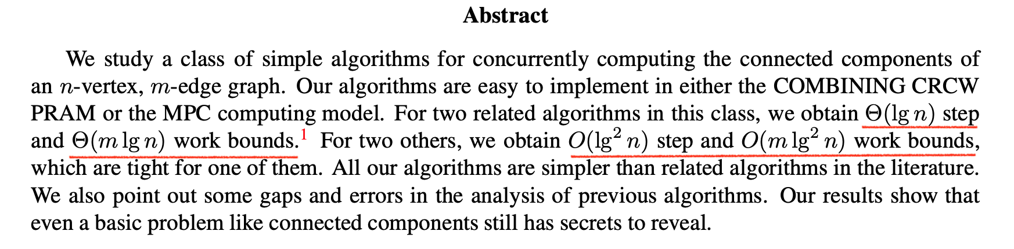
Category I: Iterative Algorithms
TLAV is not just for mining
Motivation for Parallel/Distributed Mining
  Low time complexity: CPU is not the bottleneck
  Example: Connected Components is O(|V| + |E|)
Need pointer jump for “log” rounds
Work may increase in parallel setting
Notes:
We can see that if we distribute vertices on different machines and pass messages through the computer network, the CPU cost of summing messages is not a bottleneck compared with the communication cost to receive and send messages.
[click]
Here's a list of research papers studying how to develop TLAV algorithms, and notice that TLAV is for general graph problems with a low time complexity, not just for graph mining problems.
[click]
In the last paper by Sixue Liu and Robert Tarjan, they showed that for computing the connected components of a big graph in parallel using the TLAV paradigm, we need an algorithm with a time complexity of n polylog n.
We know that a serial algorithm to compute connected components by depth-first search takes only linear time, so the total workload may increase when we move from a single-threaded algorithm to a parallel one.
[click]
We also remark that even this n polylog n time complexity is not easy to achieve as a parallel algorithm, and a technique called pointer jumping is necessary to allow the number of iterations to be logarithmic.

Slide 17
Category I: Iterative Algorithms
Motivation for TLAV Systems
  Why bother parallel/distributed computing if the serial complexity is O(|V|)?
  Answer: input graph is huge
    Parallel graph loading from HDFS
    Part of a dataflow in Hadoop Ecosystem
    One machine does not have enough RAM space
    Fast to code in TLAV API
Notes:
A natural question to ask is, why we care about parallel computing if a serial algorithm has a linear cost?
[click]
The main motivation is that our input graph can be huge, so you want the graph to be loaded from many disks in parallel to benefit from the total disk bandwidth, which can be achieved if your data is kept on Hadoop Distributed File System.
[click]
Also, your job may just be one operation in a long dataflow on top of the Hadoop Ecosystem, so you want to use a Hadoop compatible framework.
[click]
More importantly, your laptop may not have enough memory space or even disk space to keep such a big graph.
[click]
Last but not least, you only need to define a compute function for a vertex in the TLAV API, which is much faster to implement.

Slide 18
Category I: Iterative Algorithms
Existing TLAV Systems
  Lots of papers, but many only works for special applications where new vertex state is an aggregate of incoming messages (e.g., no pointer jumping)
Our focus in this tutorial
… …
Notes:
There have been a lot of papers developing systems where users can program graph algorithms using the TLAV API.
However, we would like to remark that a lot of them only focus on applications where a vertex can aggregate the messages received along its incoming edges into one value to be used in the compute-function, such as the message summation in PageRank, but this is a narrower subset of what a general TLAV API can solve.
For example, they cannot support pointer jumping. However, since those systems focus on a narrower set of algorithms, they can utilize more optimization opportunities.
GraphLab is such a system, while others like Pregel and Giraph are more general.
[click]
In fact, Google's Pregel is the first TLAV system, and so all these systems are often called Pregel-like systems. We will mainly discuss Pregel in this tutorial.

Slide 19
Category I: Iterative Algorithms
Design Variants in Pregel-Like Systems
API: GAS (Gather, Apply and Scatter)
as an example
Vertex-cut
Notes:
Before introducing Pregel, I would like to point out that GraphLab follows a quite different design.
[click]
Specifically, it uses a so-called vertex-cut partitioning method where edges are distributed to different machines rather than vertices.
Since different edges of a vertex can be in different machines, the state of this vertex need to be mirrored to all those machines.
[click]
GraphLab's vertex-program is also a bit different, following a gather-apply-scatter programming model.
Here, each vertex can directly access data from its adjacent vertices and edges, since they have been mirrored in the current machine, but data synchronization is needed for data consistency.

Slide 20
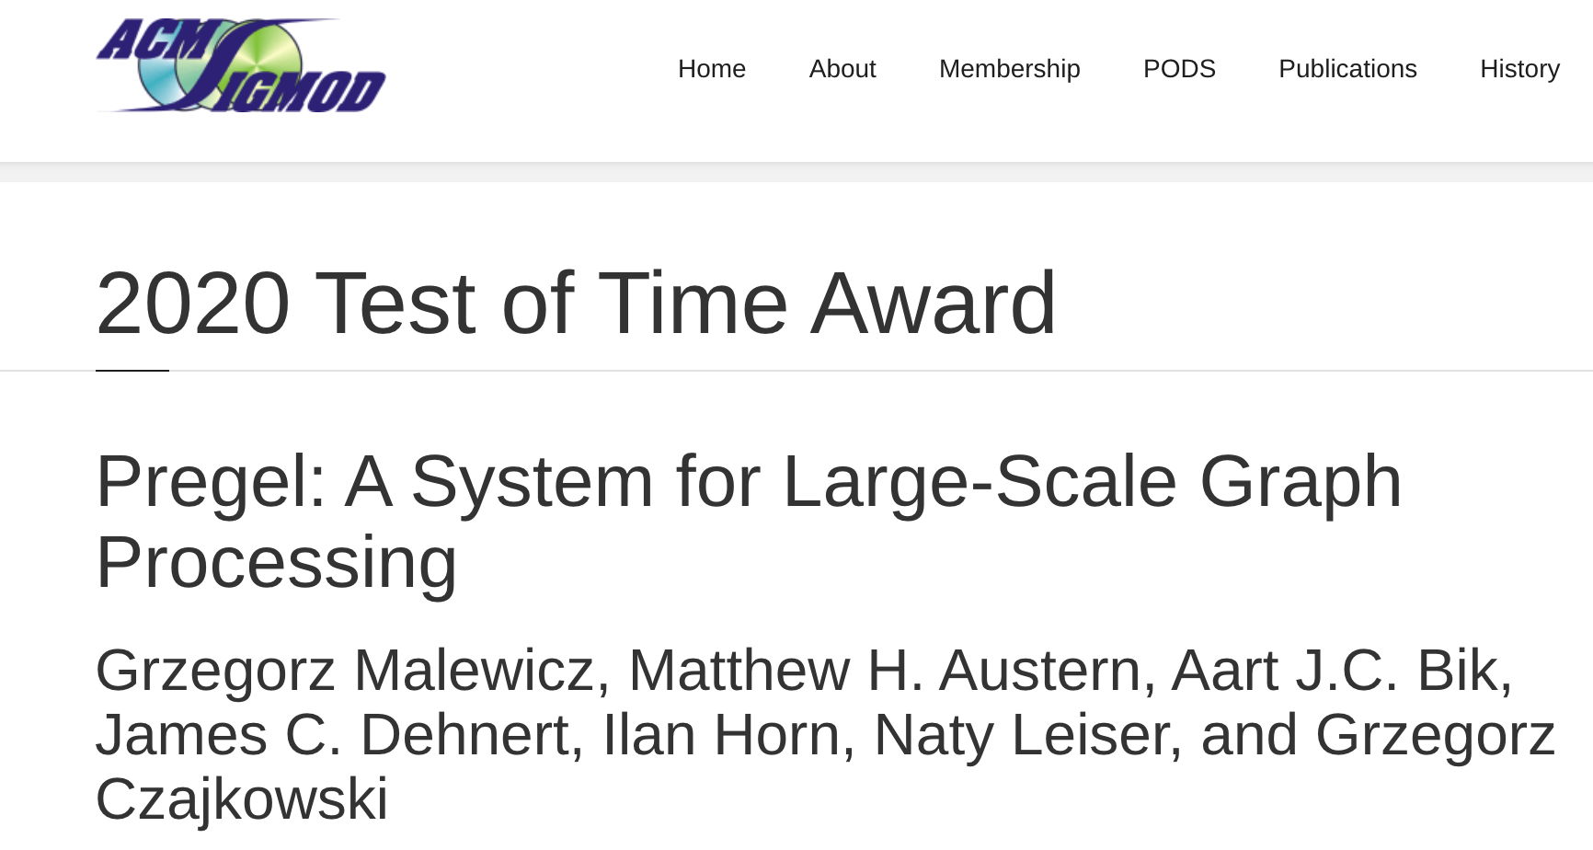
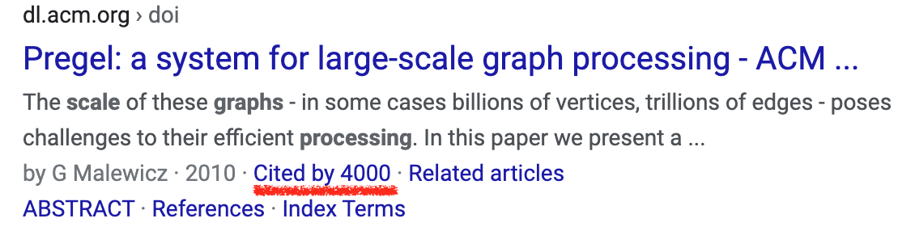
Google’s Pregel
TLAV Pioneer
  Message passing between vertices
  Iterative
    Each iteration is called a superstep
Not sure how much impact inside Google…
But inspires many TLAV works in academia
Notes:
Pregel's model is cleaner, without mirroring vertex and edge data.
As we have indicated, Pregel is the pioneer of the TLAV model.
[click]
Unlike GraphLab where you directly take data from adjacent vertices and edges, a vertex passes messages to other vertices to propagation information updates.
[click]
The computation is also iterative where in each iteration, vertices pass messages to other vertices, and these messages will be received in the next iteration.
[click]
I have not heard how much impact Pregel has inside Google,
[click]
but it definitely has inspired many research on TLAV models in academia.
[click]
The Pregel paper actually won the test of time award in SIGMOD 2020.

Slide 21
Google’s Pregel
Vertex Partitioning
1
2
4
5
6
0
3
7
8
0
1 | 3
1
0 | 2 | 3
2
1 | 3 | 4 | 7
3
0 | 1 | 2 | 7
4
2 | 5 | 7
5
4 | 6
6
5 | 8
7
2 | 3 | 4 | 8
8
6 | 7
M₀
M₁
M₂
Notes:
Given a big graph,
[click]
Pregel partitions vertices into different machines by ID hashing, where each vertex is accompanied with a list of its neighbors that it can send messages to.

Slide 22
Google’s Pregel
Programming Interfaces
  u.compute(msgs)
  u.send_msg(v, msg)
  get_superstep_number()
  u.vote_to_halt()
Called inside u.compute(msgs)
Notes:
Each vertex u is associated with a user-defined function, where the input argument is the set of messages received by u from the previous iteration.
[click]
Inside the compute-function, the vertex can send messages to other vertices, get the current iteration number to determine what action should be taken, and deactivate itself by voting to halt.

Slide 23
Google’s Pregel
Vertex state
  Active / inactive
  Reactivated by messages
Stop condition
  All vertices are halted, and
  No pending messages for the next superstep
Notes:
Note that so far, we have not explained how a Pregel job terminates. This is actually achieved by setting the active status of vertices.
Specifically, each vertex has a status flag indicating whether it is active, and an inactive vertex can be reactivated if it receives a message in the current iteration.
[click]
A Pregel job terminates if after an iteration, all vertices are inactive, and meanwhile, no messages have been sent in this iteration, since otherwise, some vertex will be reactivated in the next iteration.

Slide 24
Google’s Pregel
Hash-Min: Connected Components
v.compute(messages)
u₁
id₁
id₃
min
u₂
v
u₃
id
u₄
id₂
id₄
Notes:
In the next few slides, we will go through some graph mining problems that can be addressed in the TLAV paradigm of Pregel.
One example is to compute connected components, where in the compute-function, a vertex receives messages on the smallest vertex IDs that its neighbors have seen,
[click]
finds the smallest received ID among those messages,

Slide 25
Google’s Pregel
Hash-Min: Connected Components
v.compute(messages)
If min < id:
u₁
min
u₂
min
min
v
min
min
u₃
id
=
u₄
Finally, vote to halt
Notes:
and if the value is smaller than the smallest ID that the current vertex has seen before,
[click]
we will update the smallest ID seen by the current vertex,
[click]
and broadcast this ID to all its neighbors.
[click]
A vertex always votes to halt at the end of an iteration.

Slide 26
Google’s Pregel
Hash-Min: Connected Components
3
13
3
13
1
11
1
11
7
5
0
6
8
17
15
10
10
16
18
7
5
0
6
8
17
15
10
16
18
2
12
2
12
4
14
4
14
Superstep 1
Notes:
We illustrate this process using a graph with two connected components.
Initially, every vertex only sees their own ID, and will broadcast this ID to its neighbors

Slide 27
Google’s Pregel
Hash-Min: Connected Components
3
13
1
11
1
11
0
10
7
5
0
6
8
17
15
10
10
16
18
5
0
0
0
6
15
10
10
10
16
2
12
0
10
4
14
2
12
Superstep 2
Notes:
[movement w.r.t. vertex 5]
In the second iteration, for example, 0 will be passed to vertex 5, and since a smaller ID is received, vertex 5 will update the smallest ID it sees as 0, and send 0 to its neighbors 0 and 7

Slide 28
Google’s Pregel
Hash-Min: Connected Components
3
13
0
10
1
11
0
10
7
5
0
6
8
17
15
10
10
16
18
0
0
0
0
0
10
10
10
10
10
2
12
0
10
4
14
0
10
Superstep 3
Notes:
In iteration 3, vertex 7 will receive message 0 from 5, so it will update its smallest ID seen as 0, and broadcast 0 to neighbors.
We can see that no vertex can receive a smaller ID in the next iteration, so in iteration 4 no vertex will send messages and all vertices will vote to halt.
Therefore, the job ends in 4 iterations, and the value at every vertex is the smallest vertex ID in its connected component, and we can get connected components by grouping vertices using that value.

Slide 29
Google’s Pregel
k = 3
Delete received neighbors
If v.degree < k
delete v
send “v” to neighbors
Vote to halt
Computing k-Core
v.compute(messages)
Notes:
Next, let us consider how to compute the k-core of a graph.
We will illustrate the algorithm assuming that k equals 3, that is, we want to find the maximal subgraph where each vertex has degree at least 3.
[click]
In the compute function,
if the current vertex finds that its degree is less than k, it deletes itself, and in the meanwhile, sends messages to its neighbors to notify them to remove the current vertex from their neighbor list.
[click]
A vertex always votes to halt at the end of an iteration.
[click]
And as we have indicated earlier, it will remove those vertex IDs that it receives, from its neighbor list.
Here, in iteration 1, the green vertices will find their degrees to be less than 3, and thus they will remove themselves from the graph

Slide 30
Google’s Pregel
k = 3
Delete received neighbors
If v.degree < k
delete v
send “v” to neighbors
Vote to halt
Computing k-Core
v.compute(messages)
Notes:
In iteration 2, the yellow vertices find their degrees to be less than 3, and thus will remove themselves.

Slide 31
Google’s Pregel
k = 3
Delete received neighbors
If v.degree < k
delete v
send “v” to neighbors
Vote to halt
Computing k-Core
v.compute(messages)
Notes:
In iteration 3, all vertices find their degrees to be at least 3, so there is no more messages passed, and all vertices vote to halt at the end, which terminates the entire Pregel job.
The remaining graph shown here is the 3-core of the input graph.

Slide 32
Google’s Pregel
Core Decomposition
Computing core number of every vertex
Initializing core numbers with vertex degrees
1
3
2
1
1
3
2
1
5
4
3
6
1
3
2
3
3
1
4
2
2
3
3
6
5
3
2
2
3
1
2
2
1
3
2
3
2
1
1
2
1
1
Notes:
Next, let's go one step further and consider the problem of k-core decomposition, which for each vertex, computes the largest k that this vertex is in a k-core, which is called the vertex's core index.
We have shown the core index of every vertex on this slide.
Next we explain how the compute function looks like.
[click]
In the first iteration, every vertex initializes their value as their vertex degree.

Slide 33
Google’s Pregel
Core Decomposition
h-index operator: list adjacent nodes from large to small
based on the core value until support = core number
1
3
2
1
1
3
2
1
5
4
3
6
1
3
2
3
3
1
4
2
2
3
3
6
5
3
2
2
3
1
2
2
1
3
2
3
2
1
1
2
1
1
Notes:
Then, in each iteration, a vertex computes an h-index operator which we explain next.

Slide 34
Google’s Pregel
Each vertex iteratively call the h-index operator till convergence
core value = 3
Core Decomposition
support = 3
h-index operator: list adjacent nodes from large to small
based on the core value until support = core number
1
3
2
1
1
3
2
1
5
4
3
6
1
3
2
3
3
1
4
2
2
3
2
3
3
6
5
3
2
3
1
2
2
1
3
2
3
2
1
1
2
1
1
Notes:
Consider this vertex,
[click]
we will get all its neighbors' values into a list and sort them in non-increasing order.
These values can be broadcasted by its neighbors in a previous iteration.
[click]
Here, the third value is the current core value from a neighbor, and it equals 3.
[click]
The h-index operator scans from the first number, till we reach a core value that equals the number of values scanned in the list, for which we call the support.
Here, after scanning 3 values, the third value equals 3, so the h-index operator returns 3. Note that in the local neighborhood of the current vertex together with the first 3 neighbor vertices, every vertex has a degree at least 3.
[click]
so the core value of the current vertex is reduced from 6 to 3.
[click]
The TLAV algorithm for core decomposition basically lets every vertex repeat this h-index operation to reduce its core number iteration by iteration, until the core values of all vertices no longer change. We can prove that the final values are the core indices of the vertices.

Slide 35
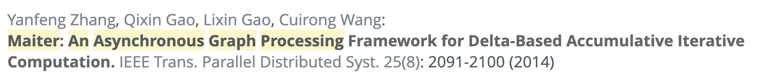
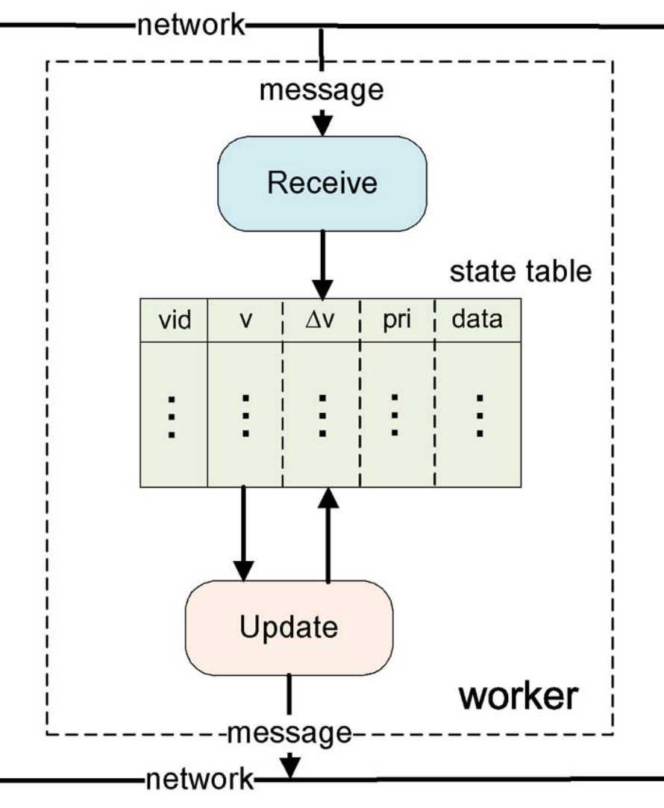
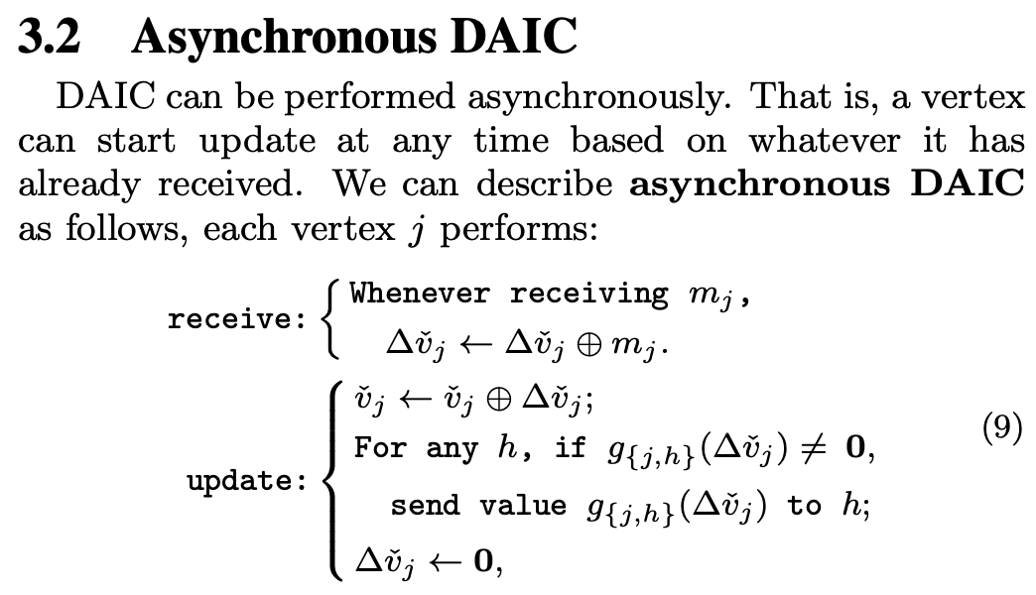
Maiter
DAIC
  Unlike GraphLab, DAIC has exactness guarantee
Notes:
There is another work that I think is worth mentioning, which is the Maiter system that advocates a model called delta-based accumulative iterative computation, or DAIC in short.
This is an asynchronous model which allows different vertices to run different number of iterations, so that those vertices that converge slowly can do more computations.
GraphLab also allows asynchronous computation, but the method is a bit cheating.
It basically does not propagate value changes less than a small threshold epsilon so that some almost converged vertices will not participate in computation. But such small changes are lost and the method is approximate.
Maiter, on the other hand, directly computes on the value changes rather than vertex values themselves, and is an exact method.
Value changes to a vertex are never lost, but accumulated until being large enough so that the vertex is scheduled for computation.

Slide 36
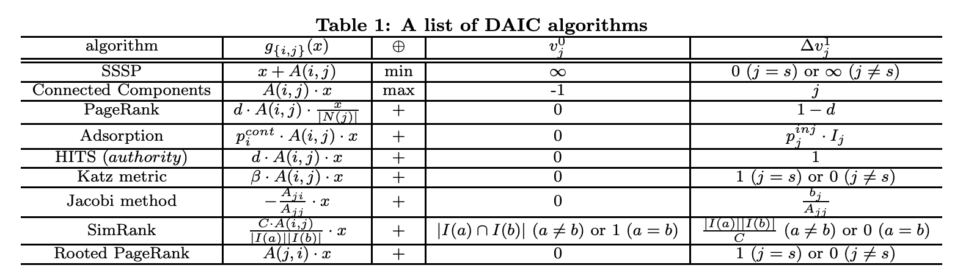
Maiter
DAIC
  Unlike GraphLab, DAIC has exactness guarantee
Notes:
Maiter is applicable to a lot of problems where the message values can be aggregated into one value, so its problem scope is the same as the gather-apply-scatter model of GraphLab.
Maiter also does not need to mirror vertex and edge values.
Surprisingly, although Maiter seems to be superior to GraphLab in almost all aspects, it does not receive as many attention as GraphLab even though both systems support asynchronous computation.

Slide 37
Chronicle of BD Systems
Each round of shuffling means data go through HDFS once
MapReduce papers explode !!!
(MapReduce Hype)
Where am I？
Giraph born
Incubation period …
2010
2012
2009
2013
GraphLab
GraphChi
(OSDI’12)
Putting everything in (distributed) memory
(RDD), add more operations than MapReduce
Pregel born
Spark
(NSDI’12)
Notes:
Here's a research timeline for Big Data systems.
Since the proposal of MapReduce by Google in 2004 and the advent of Hadoop MapReduce, we saw an explosion of MapReduce related research papers in the database community since 2009.
Then in 2010, Pregel is proposed by Google researchers to replace MapReduce for graph processing, to avoid unnecessary data dumping and loading through HDFS between iterations.
[click]
Since Pregel was not open-sourced, it took two years for the next Pregel-related research to appear.
[click]
In OSDI 2012, two related systems were published, GraphLab and GraphChi. Since OSDI is a high-impact venue, I believe this line of research was gaining a lot of attention at that time.
[click]
Meanwhile, in NSDI 2012, the Spark paper was published as a replacement technology for MapReduce.
[click]
The key idea is to hold intermediate data in distributed memory rather than on HDFS, and add more transformation functions that can be accomplished, say, as map-only jobs.
[click]
The next year in 2013, Giraph was born, which is considered the open-source replication of Pregel, though Giraph is in Java.
[click]
So where was I at that time?

Slide 38
Chronicle of BD Systems
Do Pregel !
Ph.D.
HKUST
Postdoc @CUHK
2009
2013
2014
2016
Querying and Indexing Geo-Spatial Data
HK 2015 Young Scientist Award
Data Uncertainty
Notes:
I was doing my PhD study on algorithms research in Hong Kong,
[click]
and at my final year from 2013 to 2014, I started to pay attention to graph-parallel systems, thanks to the access to a Hadoop cluster invested by my postdoc advisor that I started to collaborate with.
[click]
I then moved to the Chinese University of Hong Kong to continue Pregel-related research for two years, until I became an Assistant Professor in the US in 2016.
[click]
We did pretty well in Pregel-related research, and I won the Hong Kong Young Scientist Award in Physical/Mathematical Science for the Year 2015.

Slide 39
Pregel Research Back in 2013
Difficulty – Productivity – Competition
Difficulty
Productivity
Competition
Notes:
In retrospect, I think the key reason we were successful at that time is that, Pregel research was just started in 2013 with a lot of research topics and opportunities that can be explored to do foundational works, and the competition at that time is not high.
Overall, I think finding a research direction is essentially balancing the 3 aspects: difficulty, productivity and competition.
I was fortunate that the productivity dimension for Pregel research was promising in 2013, and the competition was not high.

Slide 40
Pregel Research Now
Many opportunities already explored, tools are useful
Difficulty – Productivity – Competition
Difficulty
Productivity
Competition
Notes:
Now this direction is a bit crowded and a lot of good ideas have been explored.

Slide 41
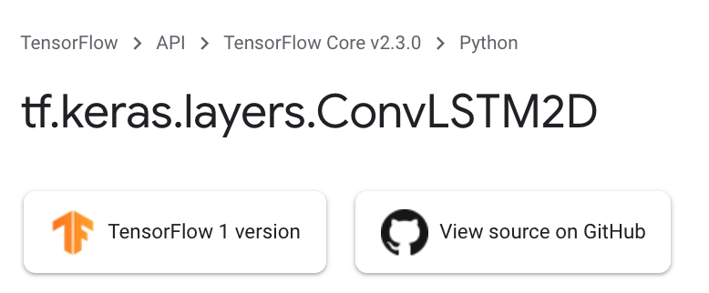
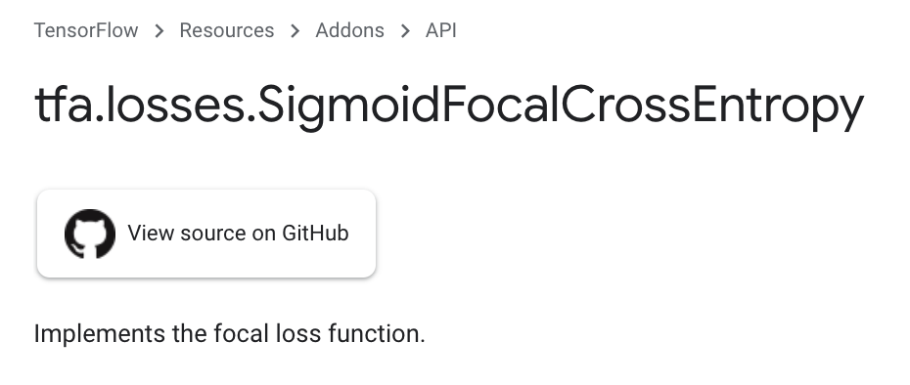
Deep Learning Now
Just for Fun…
Difficulty
Productivity
Competition
Notes:
As a comparison just for fun, deep learning has become a hype in recent years, and if you get the basic concepts and then learn a bit Keras or PyTorch via YouTube videos, you can easily program awesome models yourself and the math is hidden by the Keras or PyTorch functions totally.
As you can imagine, while the difficulty is not very high and productivity can be quite high, there are also a lot of competitions in this direction.

Slide 42
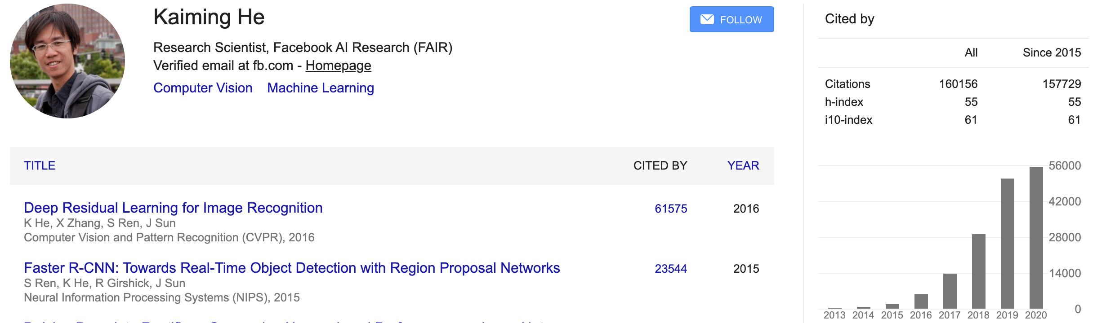
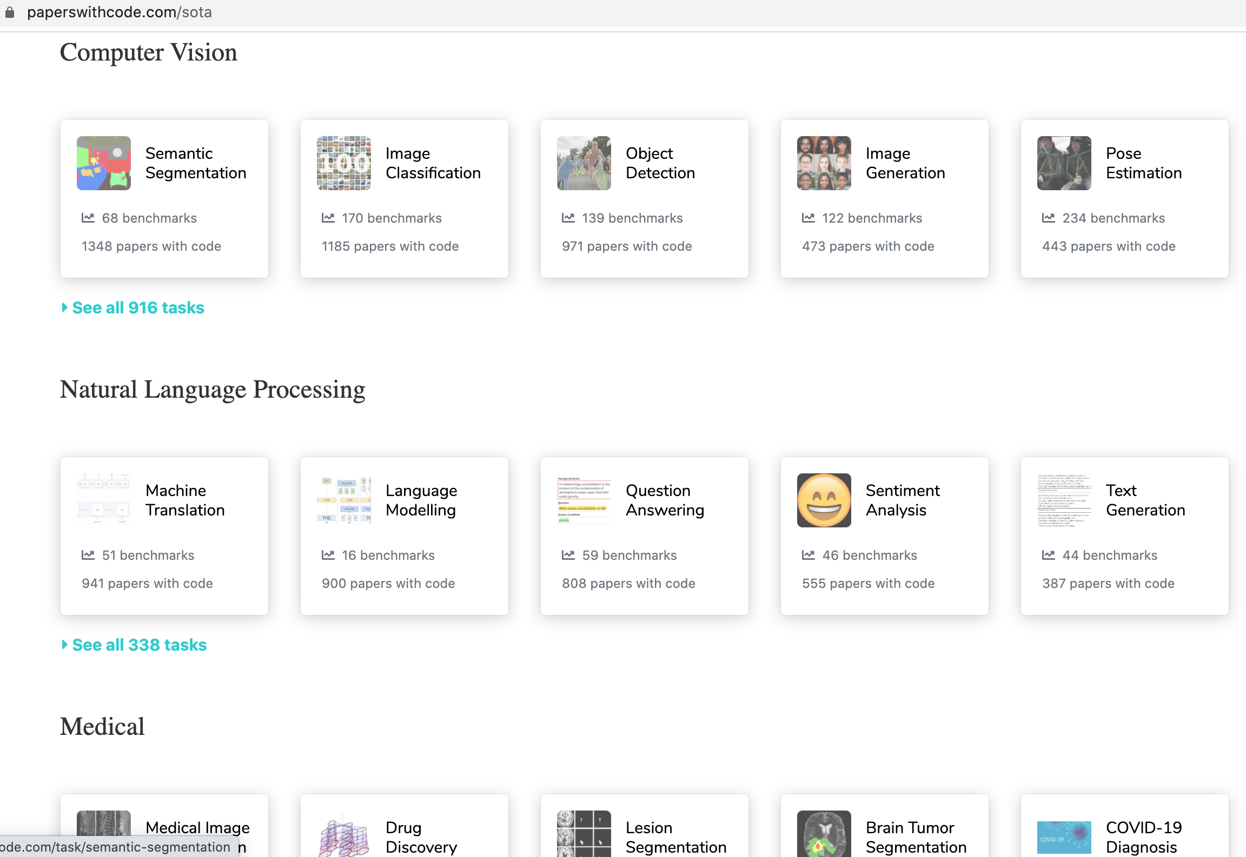
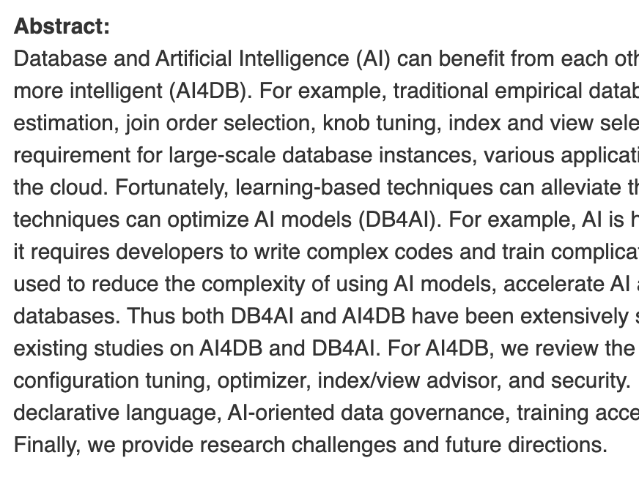
Deep Learning Now
Just for Fun…
Notes:
One researcher that I admire a lot is Kaiming He who is the inventor of a lot important things like ResNet, Faster R-CNN, and He initialization.
As you can see, his citation is crazy, which reflects how crowded the AI area has become. It is also contagious and in the database community, we see a lot of deep learning methods used these days. I am quite surprised to learn that there is a work even trying to replace the efficient B+-tree index with a deep learning model.

Slide 43
Our Works
Pregel+: techniques to reduce message numbers (PVLDB’14, WWW’15, ICDE’18, TCBB’19)
Blogel: graph partitioning + think like a partition (PVLDB’14)
Quegel: online query processing with interactive speed (PVLDB’16)
GraphD: distributed out-of-core execution (TPDS’18)
LWFT: faster checkpointing and recovery (ICPP’19)
Notes:
Now, let me briefly introduce the graph-parallel frameworks we developed that improved Pregel’s design from various aspects.
All the frameworks shown here are in the form of C++ libraries, which can be used to implement iterative graph-parallel algorithms.
Pregel+ improves over Pregel by proposing techniques to reduce the number of messages transmitted
Blogel groups vertices into blocks to eliminate communication within each block, and proposes a corresponding think-like-a-block programming model
Quegel adapts the TLAV API for interactive online graph querying
GraphD scales Pregel further by supporting distributed out-of-core execution
LWFT proposes a faster method for fault tolerance and recovery than Pregel's original checkpointing method.

Slide 44
Our Works
BigGraph@CUHK
http://www.cse.cuhk.edu.hk/systems/graph/
Notes:
Here's the graph-parallel ecosystem that we developed, called BigGraph@CUHK and can be accessed using the URL below.
You can also directly google BigGraph@CUHK to find the system websites.
Notably, all our frameworks load graph from HDFS, and can write results to HDFS, so they can interoperate with other frameworks in the Hadoop Ecosystem.

Slide 45
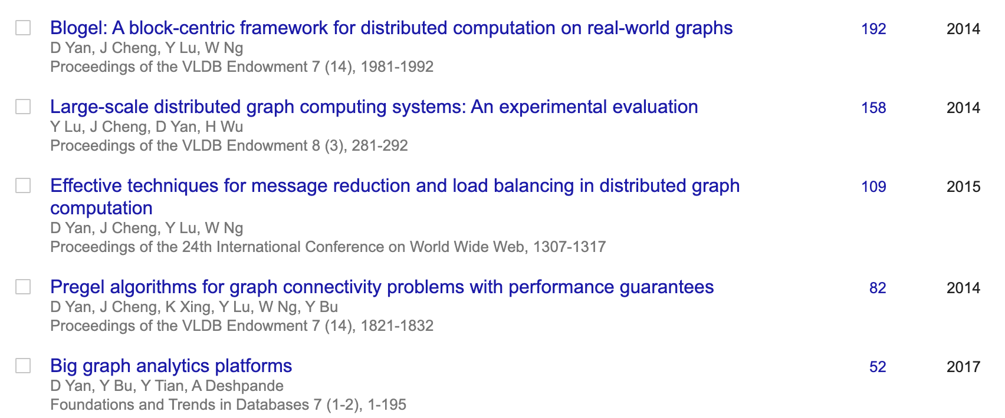
Our Works
Notes:
You can see that the previously mentioned works are well cited

Slide 46
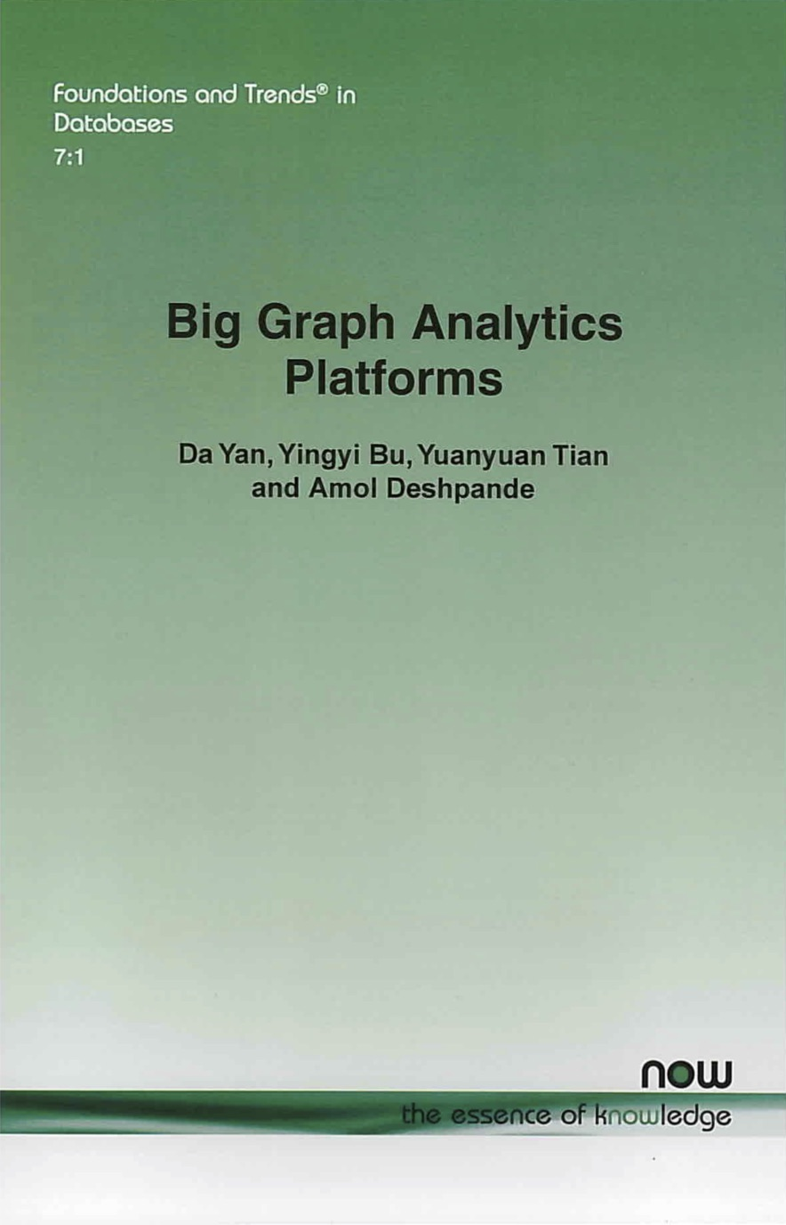

Books
Notes:
We also have two books on this topic, with comprehensive review of not only our own frameworks, but also other important state of the arts in the field.

Slide 47
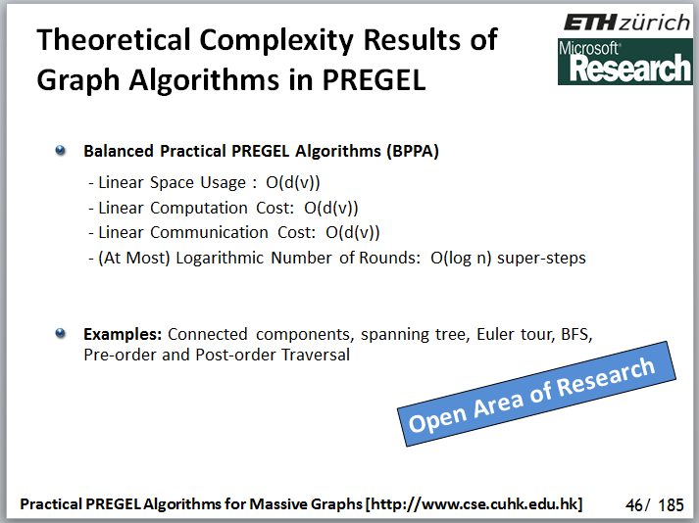
Practical Pregel Alogorithms
Practical Pregel Algorithms (PPAs) [PVLDB’14]
  The first cost model for Pregel algorithm design
  PPAs for fundamental graph problems
    Breadth-first search, list ranking, spanning tree, Euler tour, pre/post-order traversal, connected components, bi-connected components, strongly connected components, etc.
Notes:
In this PVLDB 2014 paper, we proposed the concept of PPA, which is a class of scalable Pregel algorithms that runs for logarithmic number of iterations, and each iteration has a linear cost.
[click]
We designed PPA for a series of fundamental graph problems such as list ranking and connected components, and these PPAs can be used as building blocks to implement PPAs for other more advanced graph problems.
[click]
This work was highly commented by peer researchers, such as this slide from a tutorial in VLDB 2014.

Slide 48
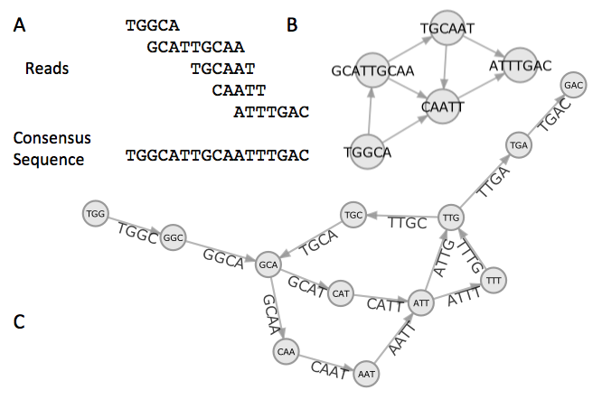
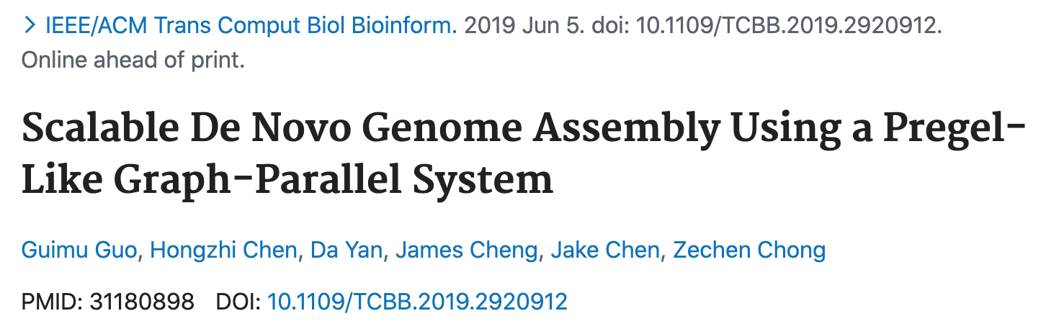
Practical Pregel Alogorithms
ACM/IEEE TCBB journal version also
Application: Genome Assembly [ICDE’18]
Notes:
The list ranking and connected component PPAs have been applied for genome assembly in our ICDE 2018 short paper.
[click]
An extension of this work has also been accepted by TCBB.

Slide 49
Block-Centric Computation
Blogel: Block-Centric Model [PVLDB’14]
  Orders of magnitude performance improvement
    e.g., one hour → 10 seconds
Notes:
In another PVLDB 2014 paper, we proposed a novel framework called Blogel, which groups nearby vertices into subgraph units called blocks, so that message passing only happens among blocks. Within each block, a serial algorithm can be run to propagate vertex states without any network communication
Based on this design, we also propose a new programming model called think-like-a-block for users to write their distributed graph algorithms in Blogel.
The performance improvement is significant. For example, a Pregel job that runs for one hour can now finish in 10 seconds in Blogel.
To efficiently create blocks, Blogel supports an automatic graph partitioner based on the idea graph Voronoi diagram, which is highly efficient to run.

Slide 50
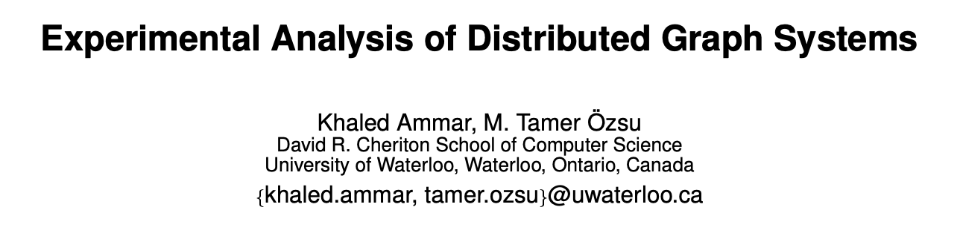
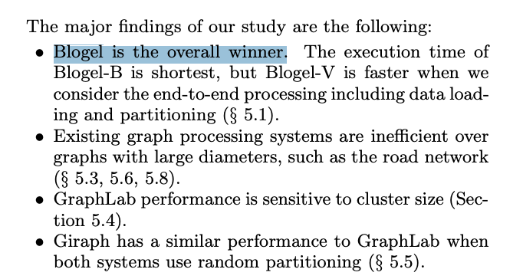
Block-Centric Computation
Blogel: Block-Centric Model [PVLDB’14]
Notes:
Blogel has also been highly commented by peer researchers.
For example, in this PVLDB 2018 paper, the authors compared many graph-parallel systems, and found Blogel to be the overall winner.

Slide 51
Message Reduction
Message Reduction in Pregel+ [WWW’15]
  Two techniques to reduce # of messages transmitted
    Vertex Mirroring
    Request-Respond Paradigm
u₁
v₁
a(u₁) + a(u₂) + a(u₃)
u₂
v₂
u₃
v₃
a(u₄)
u₄
u₄
v₄
…
…
Notes:
In this WWW 2015 paper, we propose two message reduction techniques to reduce the number of messages transmitted through the network in Pregel, without the need of making any changes to the original TLAV API.
Since the second technique is for pointer-jumping algorithms which takes time to present, here, we just briefly explain the first technique, vertex mirroring.
As this diagram shows, if many vertices on a machine need to send messages to the same vertex in another machine, their messages can be combined for certain applications. An example is our PageRank application, where we can simply sum the message values and then just send the summation over the network. Pregel has a mechanism called message combiner to implement this idea.
In contrast, we find that if a high-degree vertex needs to broadcast its value to the neighbors, it needs to send the same value many times to each machine, such as vertex u4 here. A solution would be to send the vertex value to its mirror in another machine, and let the mirror forward the message value to each local neighbor without communication. This mechanism is called vertex mirroring.
We find that message combining and vertex mirroring are mutually exclusive. For example, the message from u4 to v2 cannot be combined with those from u1, u2 and u3 in this diagram.
We should only mirror high degree vertices to allow messages of low-degree vertices to be combined. And our paper derives an optimal degree threshold for vertex mirroring.

Slide 52
Online Graph Querying
Quegel: Query-Centric Framework [PVLDB’16]
  A graph query usually has a light workload
    Only a portion of the whole graph gets accessed
  Existing solutions are unsatisfactory
  Orders of magnitude performance improvement
    e.g., point-to-point shortest path query on Twitter
    Giraph: > 100 seconds per query
    Quegel: 3 queries per second
Notes:
In this PVLDB 2016 paper, we propose to redesign Pregel that was originally designed for offline graph processing towards online graph query answering.
The motivation is that the TLAV API is very user-friendly to write algorithms to answer graph queries such as shortest path and reachability queries, but those algorithms are lightweight and visit only a small portion of the whole graph. They also often rely on an index to speed up querying.
Our Quegel framework achieves those goals, where graph indexing is supported and each online query only visits a small number of vertices, while the query answering algorithms are still written in the TLAV paradigm.
Compared with Giraph where a shortest path query on a Twitter graph takes 100 seconds to finish, Quegel can answer 3 such queries in one second.

Slide 53
Out-of-Core Support
GraphD: Out-of-Core Pregel [TPDS’18]
  Desktop PCs + Gigabit Ethernet switch
  Disk streaming bandwidth >> network bandwidth
  Each machine stores edges and messages on local disk
  O(|V| / #{machines}) memory on each machine
  Same performance as in-memory Pregel
Notes:
The systems we see so far are all in-memory systems, where the adjacency lists and messages are kept in main memory. This is actually not necessary in Pregel, since message passing is the bottleneck in a typical Ethernet environment, and if we keep the adjacency lists and messages on local disks for streaming, and overlap the disk IO operations with the network IO operations, the running time will not increase.
In this TPDS 2018 paper, we propose a GraphD system that keeps adjacency lists and messages on local disks for streaming during the execution, so that the memory cost is negligible.
As a result, GraphD can scale to very big graphs.
We observe GraphD has the same performance as ouri n-memory Pregel+ system, meaning that the significantly reduced memory consumption is a free lunch.

Slide 54
Fault Tolerance
Lightweight Checkpointing & Vertex Logging [ICPP’19]
  Only checkpointing vertex states, not messages
  Edges are checkpointed incrementally
  Generating messages from vertex states during recovery
  Logging vertex states to local disks to avoid recomputation during recovery
Notes:
Regarding fault tolerance, existing Pregel-like systems rely on checkpointing.
For example, in PageRank computation, we can write the current status of computation to HDFS every 10 iterations, so that, for example, if a job fails in iteration 98, it can load the checkpoint saved at iteration 90 and rerun from there, rather than rerun from the first iteration.
Pregel needs to save everything into a checkpoint including messages and adjacency lists. This is because some vertices may become inactive and do not send messages,
and some edges may be deleted during the computation such as in our Pregel algorithm for k-core presented earlier.
In this ICPP 2019 paper, we propose to only save vertex states to a checkpoint, and regenerate messages from them during recovery. For edges, we propose incremental checkpointing that only logs the edge updates for replay during recovery. We also propose to let machines log messages locally, so that during recovery, only those messages from failed machines need to be transmitted.
These techniques improve the performance of checkpointing and fault recovery by over one order of magnitude.

Slide 55
Overview
Graph Mining Problems: A Categorization
Think Like a Vertex: Data-Intensive Mining
Why TLAV is not Sufficient? Compute-Intensive!
PrefixFPM for Frequent Subgraph Mining
G-thinker: Think Like a Subgraph
TLAS Algorithms for Subgraph Mining
Notes:
So far, we have been looking at Pregel-like frameworks that adopt the TLAV, or think-like-a-vertex, programming paradigm.
TLAV looks great so far for iterative graph algorithms that belong to Category 1 in our Categorization of graph mining problems.
So, people naturally will extend it to solve other graph mining problems, including those NP-hard ones that we introduced earlier in Categories 2 and 3.
As expected, the performance reported is often terrible, but at that time there were no other parallel framework choices. Our tutorial from now on will explain how we filled this gap.
Firstly, let’s understand why TLAV systems are inefficient when it comes to compute-intensive graph mining problems.

Slide 56
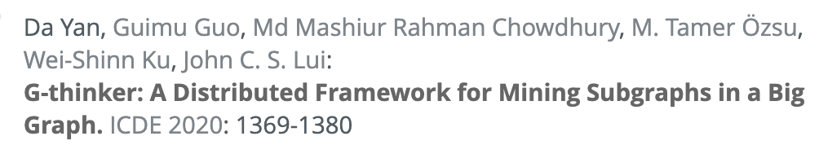
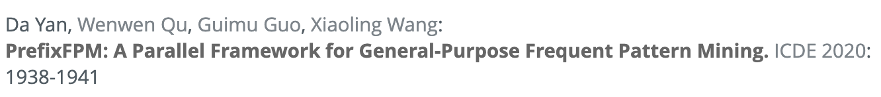
Motivation
Will be presented by
Graph Mining Tasks?
  Some are data-intensive / IO-bound
    Peeling algorithm of k-core: O(n)
    Random walks (e.g., PageRank)
  Some are compute-intensive!
    Dense subgraph structure mining: quasi-cliques, k-plexes
    Frequent (and closed) subgraph pattern mining
To present next
Notes:
As we have seen, not all graph mining problems exhibit the same characteristics, with some being IO-intensive such as those we just presented, and others being compute-intensive where the bottleneck comes from the enormous CPU time needed, not the data volume.
Such problems include mining dense subgraphs from a big graph as in our Category 3, and mining frequent subgraph patterns from a graph database as in our Category 2
[click]
As a breakthrough in this area, we have developed a distributed framework called G-thinker for mining dense subgraphs, which will be presented by my student Guimu.
[click]
We have also developed a parallel framework called PrefixFPM for mining frequent patterns in general, which I will introduce next after motivating why TLAV systems are inefficient when going beyond iterative data-intensive graph analytics.

Slide 57
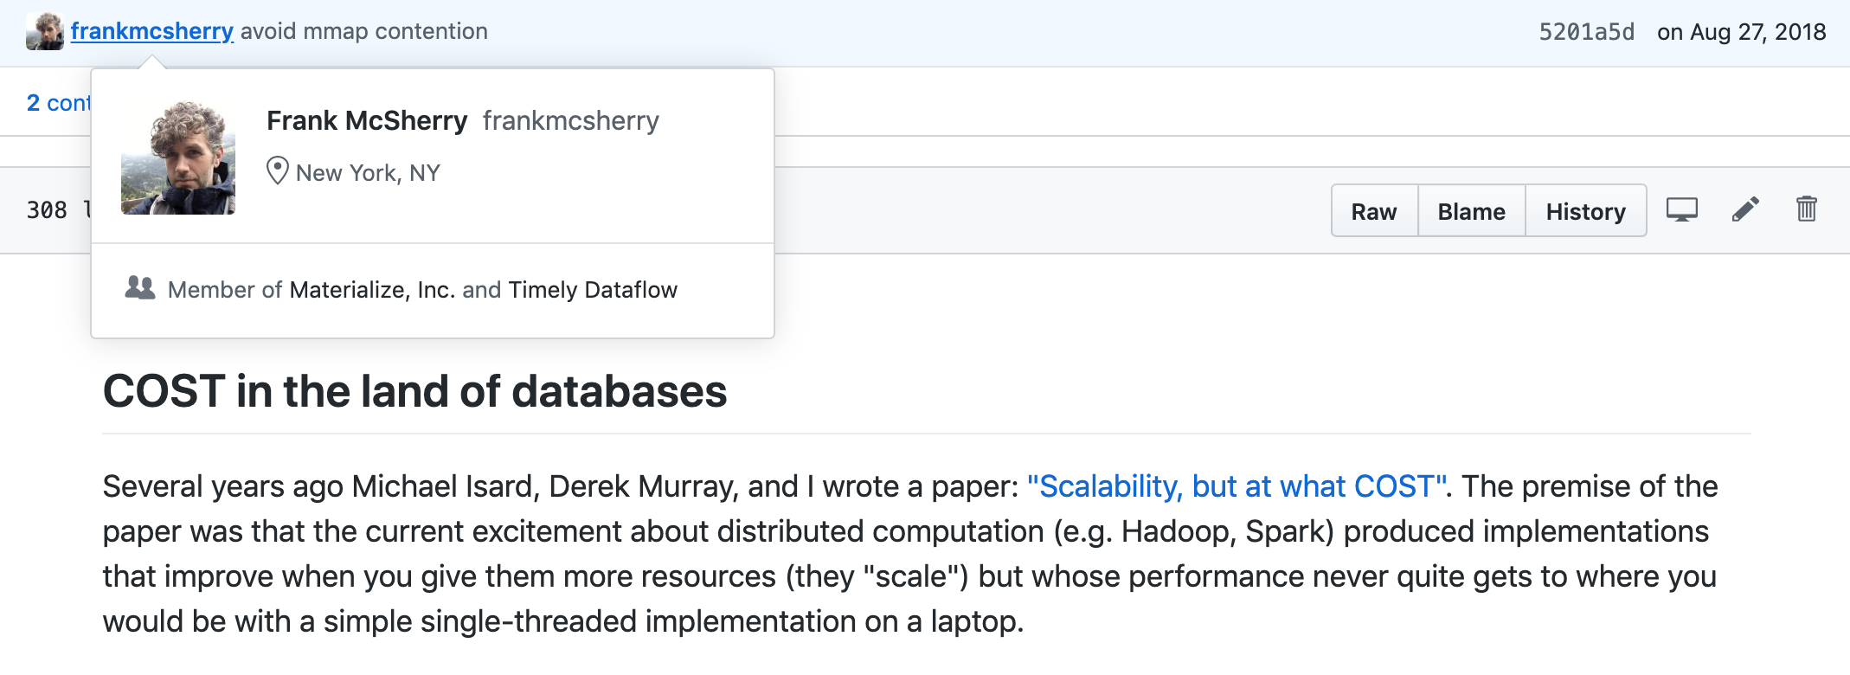
Motivation
Data-Intensive v.s. Compute-Intensive
  Fundamental and familiar to the DB community
  But people simply get lost (the ‘system hype’)
https://github.com/frankmcsherry/blog/blob/master/posts/2017-09-23.md
Notes:
It is worth noting that the current excitement of Big Data systems are nothing more than building data-intensive frameworks where different data partitions can be streamed in parallel, and messages can be exchanged in parallel.
[click]
They are good for IO-heavy operations, [move mouse] but the aggregate IO-bandwidth utilized is often comparable or less than the throughput of a single CPU core, as indicated in this post by Frank McSherry

Slide 58
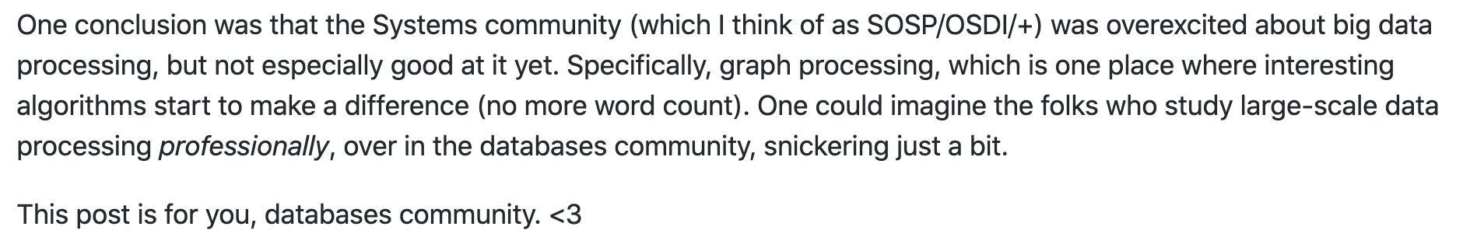
Motivation
Data-Intensive v.s. Compute-Intensive
  Fundamental and familiar to the DB community
  But people simply get lost (the ‘system hype’)
Cont.
Notes:
Frank McSherry thinks that people are overexcited about Big Data systems, and people are developing systems with poor performance.

Slide 59
Motivation
Data-Intensive v.s. Compute-Intensive
C
C
C
C
B₁
B₃
B₅
B₇
B₂
B₄
B₆
B₈
Ethernet
C
C
200 %
throuphput
core #
Notes:
In fact, data-intensive frameworks have communication as the bottleneck and CPU cores are often underutilized.
[move mouse]
For example, if each data block generates an amount, C, of communication, and your network bandwidth is 2C.
Then even if you have many CPU cores, you can at most fully utilize 2 CPU cores, which is a waste of resources for compute-intensive problems.

Slide 60
Motivation
Data-Intensive v.s. Compute-Intensive
Data-intensive
IO-bound
Compute-intensive
CPU-bound
throuphput
throuphput
1
2
3
4
core #
1
2
3
4
core #
more disks
faster networks
faster disks
more CPUs
more memory
Notes:
A lot of problems are actually compute-intensive, where the workloads come from the exponentially large search space rather than the large data volume.
If we address them using a data-intensive framework, we achieve a throughput that is similar to a couple of CPU cores on a single machine at best.

Slide 61
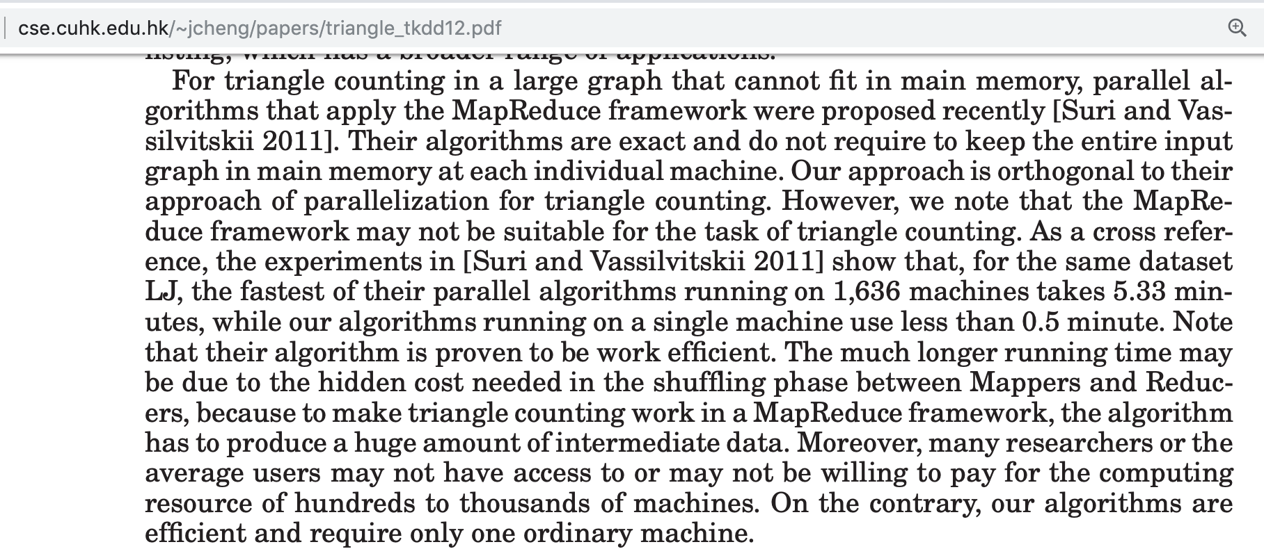
Motivation
Notes:
In fact, things can get even worse given that the network throughput can be much lower than that of a CPU core, and the IO-bound execution slows down the entire process
For example, in this TKDD paper, the authors find that for triangle counting, their single-threaded algorithm is 10 times faster than the state-of-the-art MapReduce solution running with over 1600 machines.
[click]
Despite these criticisms, no solution was proposed.

Slide 62
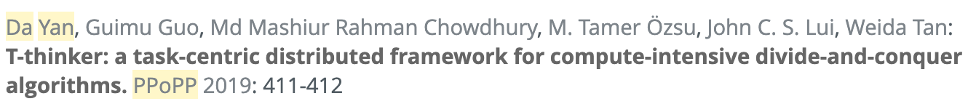
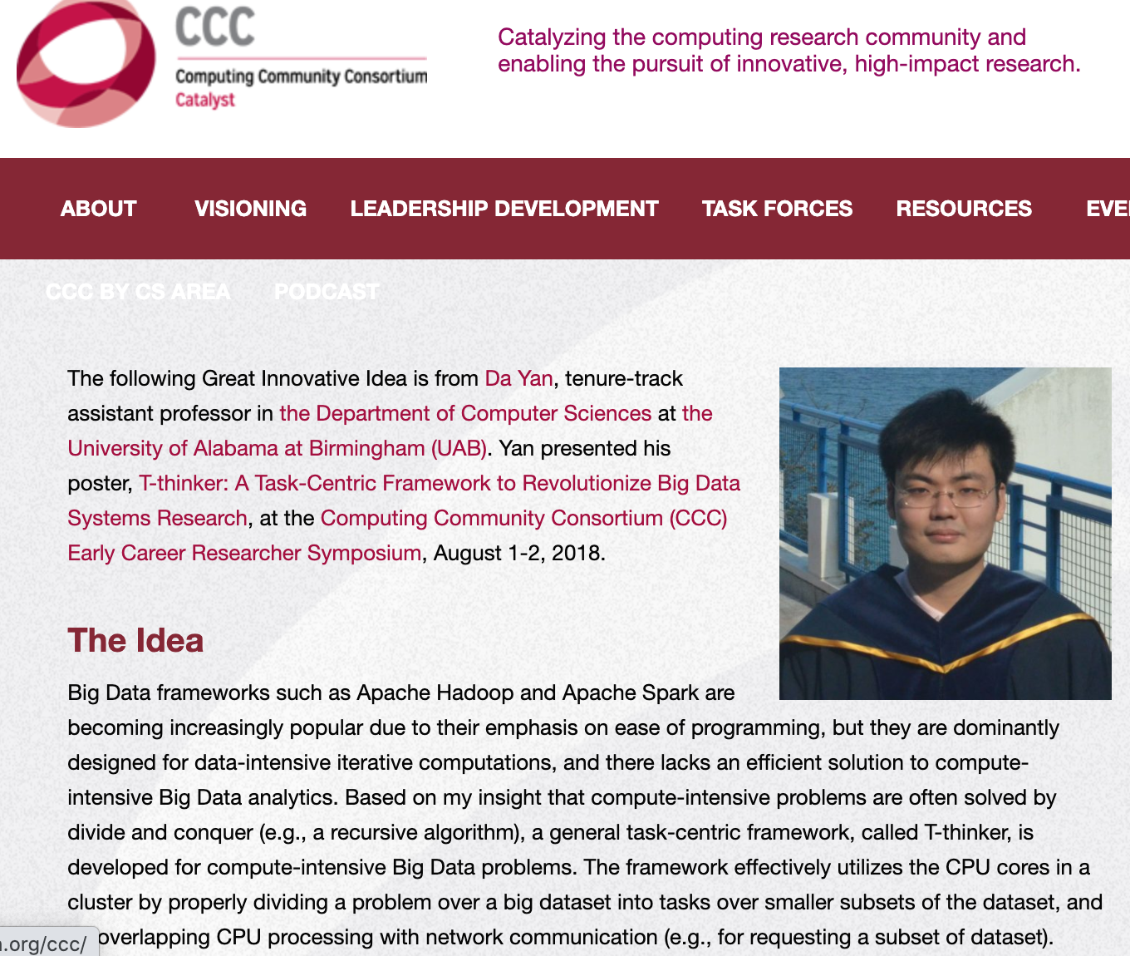
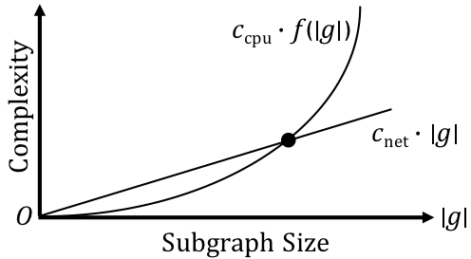
Motivation
T-thinker: Divide and Conquer
  Task-based: data pulling + computation on top
Notes:
The solution is to make the execution engine of a framework compute-intensive by itself.
We have proposed a new paradigm called T-thinker, or Task-thinker, which utilizes divide and conquer to achieve compute-intensive execution.
The key insight is that a lot of problems can be represented as tasks, where a big task over a big dataset can be decomposed into independent tasks over smaller data subsets for parallel execution.
So, if the data needed by a task is large enough, [move mouse] the linear cost of fetching the data into a local machine is well offset by the subsequent compute-intensive mining over the fetched data, and the concurrent execution of multiple tasks can hide the communication latency

Slide 63
T-thinker Research Now
Difficulty – Productivity – Competition
We have queued many works to be done !
Difficulty
Just us right now…
Productivity
Competition
Notes:
In this tutorial, we are advocating the development of Big Data programming frameworks following the T-thinker paradigm.
[click]
This is a new area like Pregel research a decade ago, with many research topics to explore, and a low degree of competition.
[click]
We have already obtained a number of successes, and we are also working on a number of works along this line that can be foundational.

Slide 64
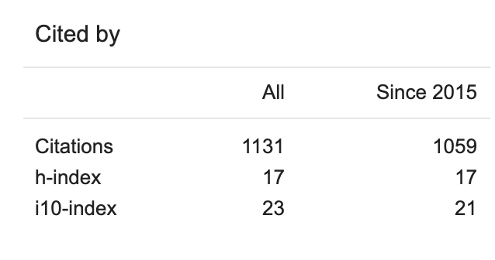
Five Years from Now?
Time to make impact!
2020
+????
+??
+??
+????
+??
+??
?
Competition
Notes:
It is time to make impacts, and if you start investing in this research direction, you could be another Kaiming He 5 years from now!

Slide 65
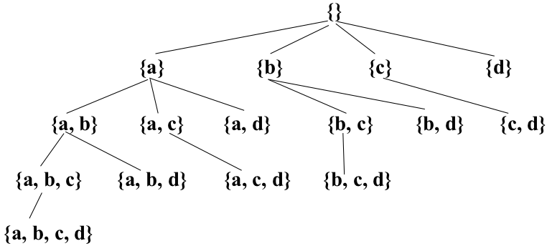
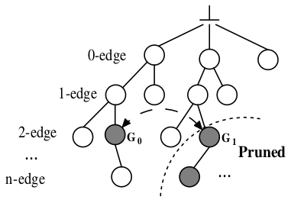
Motivation
Programming Simplicity Over-Emphasized
Dense Subgraph Mining
Frequent Subgraph Mining
pattern-to-instance
instance-to-pattern
Embedding-Centric: Arabesque (SOSP’15), RStream (OSDI’18)
Notes:
Of course, task-based execution has been there in the HPC community for a while. So the contribution of a task-based Big Data framework should be that the programming model is easy for the targeted category of problems.
However, existing pioneering frameworks in graph mining simply materializes and grows all potential subgraphs in the search space, the cost of which is prohibitive.
Examples include the embedding-centric API of Arabesque that attempts to handle both dense subgraph mining that allows backtracking without subgraph materialization, and frequent subgraph pattern mining that needs pattern deduplication by subgraph isomorphism check.
Since the problems are quite different in nature, a unified design actually leads to the worst of both worlds.
Note that dense subgraph mining is a pattern-to-instance process where you have a pattern in mind, and find subgraph instances in a big graph that satisfy that pattern.
In contrast, frequent subgraph pattern mining is a reverse process that discovers new subgraph patterns; you do not have any patterns in mind initially, but you examine the subgraph instances to evaluate whether a subgraph pattern is frequent or not.
We will explain this in more detail later in this tutorial.

Slide 66

G-thinker
Will be presented by
Task-Centric Programming Interface
  UDF: spawn_task(vertex)
  UDF: compute(task, frontier)
  pull(vertex_id)
  add_task(task)
Task Metadata
Task Subgraph
Notes:
Our G-thinker system addresses the dense subgraph mining problem by spawning tasks from individual vertices to grow candidate subgraphs for mining, and big tasks can be decomposed into smaller tasks to divide the workloads by multiple CPU cores.
[click]
G-thinker will be presented in detail by Guimu.

Slide 67
Overview
Graph Mining Problems: A Categorization
Think Like a Vertex: Data-Intensive Mining
Why TLAV is not Sufficient? Compute-Intensive!
PrefixFPM for Frequent Subgraph Mining
G-thinker: Think Like a Subgraph
TLAS Algorithms for Subgraph Mining
Notes:
In the last part of my talk, I will introduce how we design PrefixFPM, our compute-intensive framework for frequent pattern mining, which can be used to mine frequent subgraph patterns from a database of graph transactions.

Slide 68
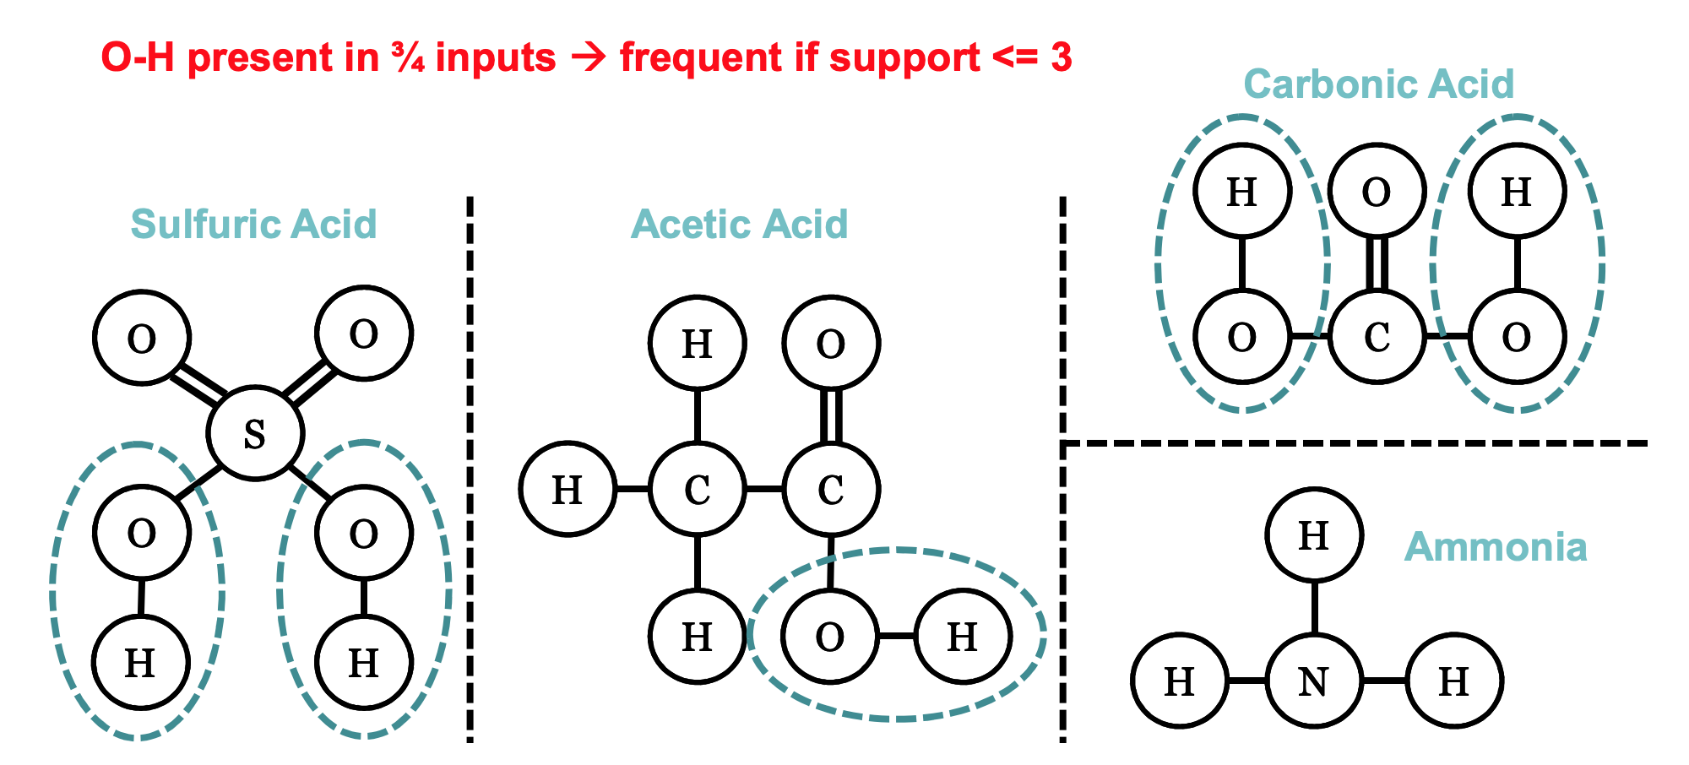
Frequent Subgraph Pattern Mining
Discovery of graph structures that occur a significant number of times across a set of graphs
Notes:
The graph mining problem we consider here, is frequent subgraph pattern mining.
This problem is illustrated by this slide.
Here, we have a graph database of 4 chemical compounds, and pattern OH appears in three of them.
So if we require a pattern to appear in at least 3 quarters of the graph transactions, OH will be considered as a frequent subgraph pattern.

Slide 69
Category II: Frequent Patterns
Frequent Pattern Mining in General
  A database of transactions
  Concepts:
    Transaction
    Pattern
    Support: count or fraction
  Problem:
    Finding all patterns with support >= a support threshold
Market Bucket Transactions
Transaction ID | Items Bought
1 | Bread, Milk
2 | Bread, Diaper, Beer, Eggs
3 | Milk, Diaper, Beer, Coke
4 | Bread, Milk, Diaper, Beer
5 | Beer, Milk, Diaper, Coke
6 | Beer, Milk, Diaper, Bread
Support (Count): σ{Milk, Bread, Diaper} = 2
Notes:
Let us first illustrate the concepts in frequent pattern mining using itemsets as the patterns.
In this slide, we have a database of 6 transactions indicating the items that people bought from a supermarket.
From this database, we would like to mine patterns in the form of itemsets, where an itemset with 3 items is shown at the bottom.
For a pattern, we have the concept of pattern length. In our itemset pattern, the size is 3 since we have 3 items in the set.
If we check the itemset against the database, we can see that Transactions 4 and 6 cover our itemset, and therefore, we say that the support count of our pattern is 2
We can also define support as the fraction of transactions in the database that cover our pattern, which is one-third in our case

Slide 70
Category II: Frequent Patterns
Types of Patterns
  Itemset
  Subsequence
  Subgraph
  Subtree
Notes:
We remark that the pattern type is not limited to itemset.
Depending on the database type, a pattern can also be a subsequence, a subgraph or even a subtree.
Besides the chemical compounds database we saw earlier, another example is to mine subtree patterns from XML files such as those from DBLP, to capture patterns like frequent coauthorships in a particular conference.

Slide 71
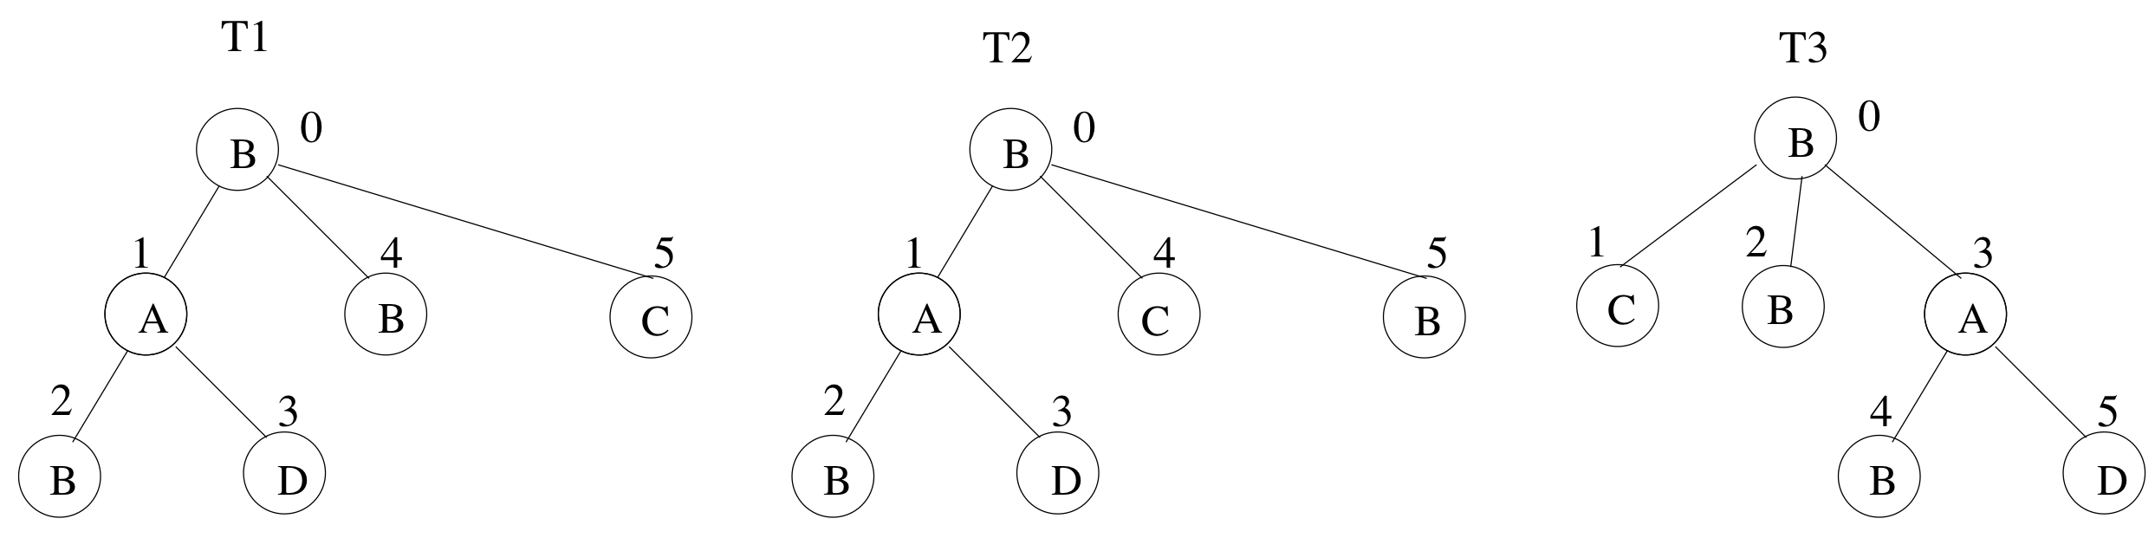
Category II: Frequent Patterns
Pattern Constraints
  Gap or path length constraints
  Induced v.s. embedded
B
  is an embedded pattern
B
D
Notes:
It is also common to add constraints to the desired patterns, such as the requirement that two elements in a sequential pattern cannot be more than 3 elements away in a sequence transaction.
In this slide, we show a tree-structured transaction, and if we consider embedded patterns which only require the preservation of ancestor-descendant relationships between nodes, then the pattern [!!! 划一下BBD !!!] BBD is covered even though it is not an induced subgraph of the tree transaction

Slide 72
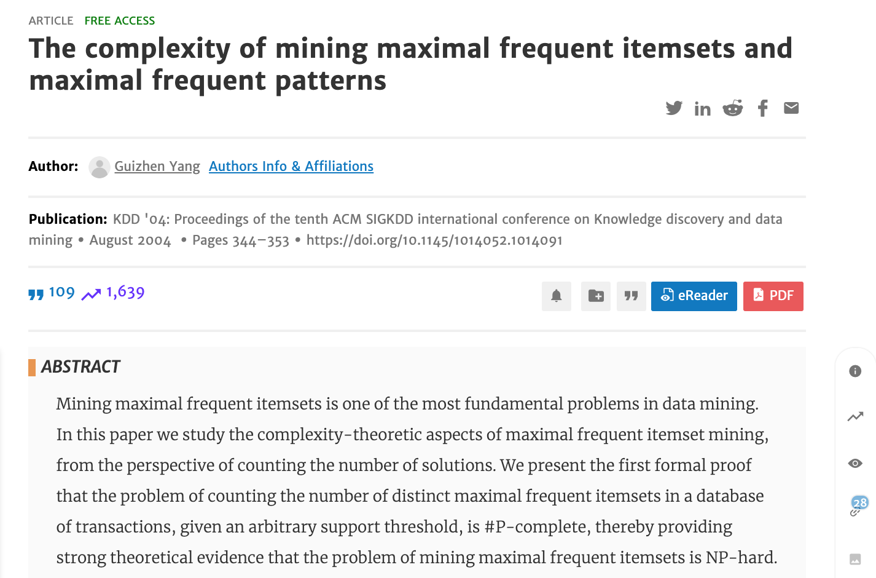
Category II: Frequent Patterns
Compute-intensive: need parallel computing to scale
Notes:
In fact, frequent pattern mining is NP-hard, and it is important to utilize all the CPU cores in a multi-core machine for effective pattern mining.

Slide 73
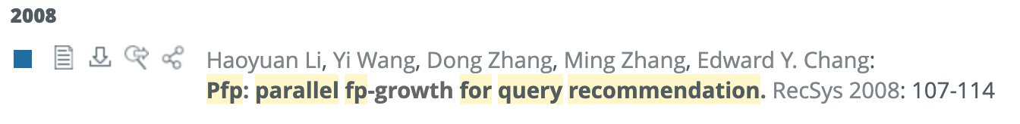
Category II: Frequent Patterns
Our Goals
  Efficient: all CPU cores are busy mining
  General Programming Framework: can be customized to handle all kinds of patterns
    Itemset
    Subsequence
    Subgraph
    Subtree
    …
order-free
parallel
FP-tree
PFP
parallel
Prefix Projection
PrefixPFM
order matters
Depth-First Pattern Search/Recursion !
Notes:
Therefore, we aim to design a parallel framework that is able to keep all CPU cores busy in mining frequent patterns.
[CLICK]
Another important goal is to make our framework's programming interface general enough for mining all kinds of patterns.
[CLICK]
We remark that the pattern of itemset is special because there is no order over the items in a set, so we can use algorithms that define its own order for effective mining, such as the FP-growth algorithm.
[CLICK]
However, we do not target this problem as it has been well solved by Google's parallel fp-growth algorithm, which is shown at the top.
[CLICK]
We consider those patterns where it matters how the elements are ordered or connected.
Our framework is designed based on the idea of prefix projection, the idea of which will be reviewed shortly.
[CLICK]
Our framework is called PrefixFPM as we use prefix projection and tackles general frequent pattern mining, or FPM in short.
[CLICK]
An important feature of PrefixFPM is that, we consider algorithms that check patterns in the depth-first order of pattern growth.

Slide 74
Category II: Frequent Patterns
PrefixSpan (Sequential Pattern Mining)
SID | Sequence
s₁ | ABCBC
s₂ | BABC
s₃ | AB
s₄ | BC
SID | Sequence
s₁ | _BCBC
s₂ | _BC
s₃ | _B
SID | Sequence
s₁ | _CBC
s₂ | _C
s₃ | _
SID | Sequence
s₁ | _BC
s₂ | _
A
B
C
(d) D|_{ABC}
(b) D|_{A}
(c) D|_{AB}
(a) D
Projected DB
Transaction DB
Pattern: ABC
Pattern: ∅
Pattern: A
Pattern: AB
Notes:
Let us now illustrate the idea of prefix projection by considering the problem of mining frequent subsequence patterns from a sequence database.
Here, we can see that database D has 4 sequences.
[CLICK]
If we consider pattern A, then s4 is filtered as it has no A, and the underscored positions are those that match A.
[CLICK]
We call such a database as a projected database projected by pattern A.
[CLICK]
Now if we grow pattern A with one more element B, we only need to continue matching from the projected database of A
We will continue matching B starting from the underscored positions
This will give us the projected database of AB.
[CLICK]
We can further grow the pattern by C, and check against the projected database of AB to find those sequence transactions that contain pattern ABC.

Slide 75
Category II: Frequent Patterns
Depth-First Pattern Growth
Alphabet is {A, B, C}
Transaction DB
∅
Projected DB
frequent
A
C
B
…
…
Projected DB
Projected DB
AA
AB
AC
A stack of projected DBs with shrinking size
…
infrequent
frequent
Effective pattern pruning
Projected DB
Projected DB
ABB
ABC
Incremental projected DB construction
ABA
…
Child-branches are embarrassingly parallel !!!
infrequent
infrequent
Notes:
PrefixSpan actually checks the patterns in depth-first pattern-growing order.
Let us consider a sequence database where there are only 3 element types, A, B and C.
We will first grow an initial empty pattern by A to obtain A's projected database.
[CLICK]
If it contains sufficient transactions, we consider A as frequent and output.
[CLICK]
We then grow pattern A into AA, create its projected database from that of A.
[CLICK]
Assume that the projected database does not have sufficient transactions, so AA is infrequent.
Then, AA is pruned and we do not need to grow AA further.
[CLICK]
After backtracking to pattern A, we will consider the next child pattern AB, and assume that it is frequent.
[CLICK]
Then we will continue to check its child-patterns ABA, [!!!CLICK!!!] ABB and [!!!CLICK!!!]ABC.
[CLICK]
We will continue to check all the patterns in depth-first order of the pattern-growth tree, until all frequent patterns are found.
This algorithm has several desirable features.
[CLICK]
Firstly, we only check a child-pattern over its parent-pattern's projected database, which gets smaller as the parent-pattern grows in size.
[CLICK]
Secondly, we can prune the whole subtree in our pattern search space once a pattern is found to be infrequent.
[CLICK]
Thirdly, we will remember how a parent-pattern is matched to each transaction, so that a child-pattern can continue its matching rather than starting from scratch.
[CLICK]
Finally, all child-subtrees can be checked independently and are therefore amenable to parallel computing.

Slide 76
Prefix Projection
From Sequences to Graphs
Duplicated patterns for different sequences
Encode a tree into a sequence
BAB$D$$B$C$
BAB$D$$C$B$
BC$B$AB$D$$
canonical encoding
Notes:
We remark that this prefix-projection idea is not limited to mining sequential patterns.
For example, we can find subgraph patterns from a graph database in a similar manner.
[CLICK]
For this purpose, we need to encode each graph pattern into a sequence representation.
This allows us to run a PrefixSpan-style algorithm on the encoded sequence pattern space.
This will however give rise to duplicate patterns since different sequences can correspond to the same subgraph.
Taking tree patterns as an example, where we do not differentiate the order of children nodes.
Here we can simply encode a tree pattern using depth-first node traversal, except that we need to add a dollar sign each time we backtrack.
[!!! Pointer moving !!!]
For example, for the first tree, we have BAB$D$$B$C$.
We can see that the other two trees are the same pattern but with different children order, but their encodings are different.
[CLICK]
Therefore, a canonical encoding is uniquely defined for each pattern, as the smallest sequence encoding among that pattern's all possible encodings.

Slide 77

Prefix Projection
From Sequences to Graphs
Deduplicate by canonical encoding
Notes:
During the actual mining, we only consider and grow a pattern if its encoding is canonical.
As the pattern search tree shows, G0's encoding is canonical but G1's is not.
G1 and G0 are actually the same subgraph pattern, and therefore we prune G1 to avoid duplicated pattern checking.

Slide 78
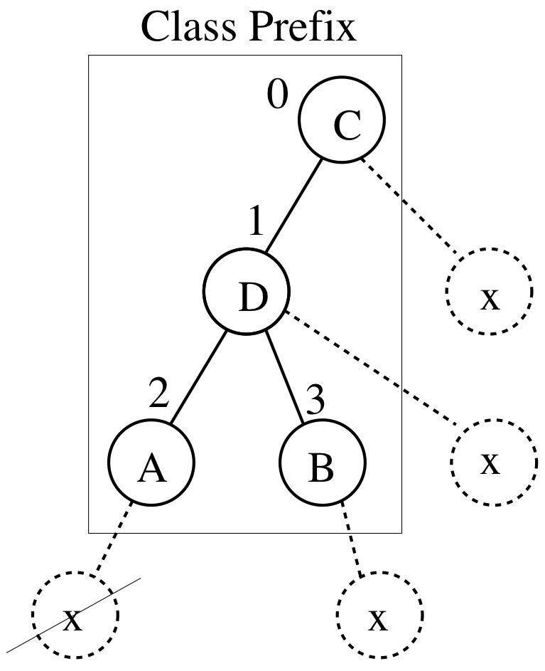
Prefix Projection
From Sequences to Graphs
Truncated pattern growth
Notes:
Pattern growth is usually by an additional element each time, and subgraph patterns also do not need to consider all growing possibilities.
For example, we do not need to consider growing from Node 2 in the slide since x is not on the rightmost path.
This is because our encoding is in depth-first order and an earlier encoding in DFS order should have considered that branch.

Slide 79
Related Work
Transactions and patterns are repeatedly dumped and loaded
Not enjoying a shrinking projected DB for frequency examination
Early MapReduce-based Papers on Itemsets
Breadth-First Pattern Growth
Pattern Mining
A
B
C
Hadoop Distribute File System
A
B
C
Pattern Mining
AA AB BB BC CA
Hadoop Distribute File System
AA AB BB BC CA
Pattern Mining
ABB ABC BBA BBC BCA CAB
Notes:
Now let's briefly overview the related work.
[CLICK]
There are a lot of earlier works that adapt the Apriori algorithm on MapReduce to grow patterns in a breadth-first order, where patterns of size i is checked only if all smaller patterns have been checked.
[CLICK]
For example, size-1 patterns will first be mined.
[CLICK]
These patterns are then saved to HDFS.
[CLICK]
The next MapReduce job will then load them back,
[CLICK]
mine size-2 patterns grown from them,
[CLICK]
and save to HDFS.
[CLICK]
They are then loaded back,
[CLICK]
to mine patterns of size 3.
[CLICK]
A problem with such a MapReduce solution is that transactions and patterns are repeatedly saved to HDFS and then loaded back, which incurs a lot of IO overhead
[CLICK]
Secondly, the patterns need to be checked against the entire transaction database rather than a smaller projected database.

Slide 80
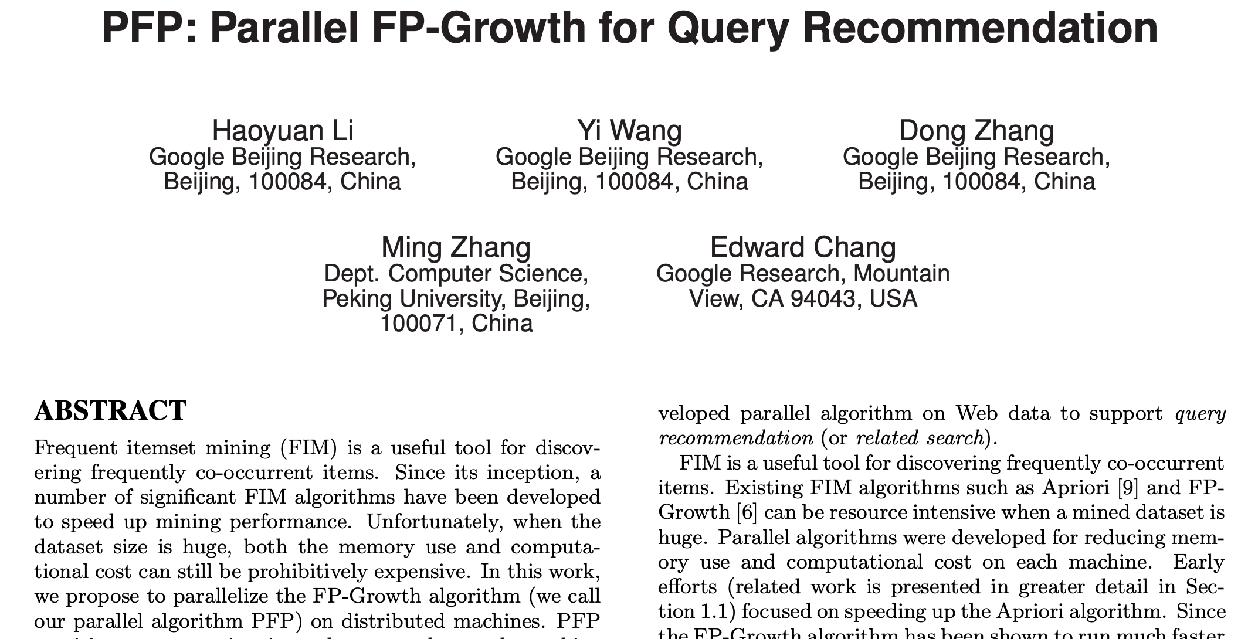
Related Work
Google’s PFP (Parallel FP-growth)
Depth-First Pattern Growth
Itemset Patterns Solved
Notes:
A satisfactory solution that uses the depth-first FP-growth algorithm is proposed by Google researchers, which make the FP-growth algorithm run in parallel with a MapReduce job.

Slide 81

Related Work
Graph Patterns: Depth-First Pattern Growth
Transaction DB
Pattern Refinement
UNION
Local Frequent Patterns
Local Frequent Patterns
Local Frequent Patterns
DFS mining
DFS mining
DFS mining
Notes:
The previous works are on itemset patterns. Regarding subgraph patterns,
[CLICK]
a depth-first solution was proposed in ICDE 2014, using two rounds of MapReduce.
[CLICK]
In the first job, transactions are partitioned among machines,
[CLICK]
and each machine only mines its local frequent patterns in depth-first order.
[CLICK]
These patterns are then unioned
[CLICK]
and given to the second job for refinement. This is correct because if a pattern is not frequent on any local transaction database, it cannot be globally frequent.
The work actually also incorporates some local patterns that are just below the support threshold to further improve the refinement performance.

Slide 82
Related Work
Graph Patterns: Breath-First Pattern Growth
  Arabesque (SOSP 2015)
    Distributed framework, embedding-centric API
    Combined with dense subgraph mining, graph matching
  RStream (OSDI 2018)
    Same API, single-machine out-of-core
    Faster than Arabesque
Pattern-to-instance, not instance-to-pattern
Forced isomorphism check, subgraph materialization
Check out G-thinker !!!
Notes:
More recently, Arabesque proposes a very user-friendly programming interface for graph mining, called as embedding-centric.
Here, an embedding is a materialized subgraph, and these subgraphs are still grown in a breadth-first manner for checking.
Arabesque is a distributed system and subgraph materialization makes it IO-bound.
[CLICK]
A follow-up work called RStream, is a single-machine out-of-core system that follows Arabesque's API, but is found to be more efficient. However, RStream is disk IO-bound.
[CLICK]
We remark that Arabesque tries to combine frequent subgraph pattern mining with problems like clique mining, but they are different problems.
For example, cliques are predefined patterns and the problem finds matched instances in a data graph, but our problem does not predefine subgraph patterns, but checks instances in our database to find these frequent patterns.
[CLICK]
In fact, Arabesque's API forces dense subgraph mining problems to conduct unnecessary subgraph isomorphism check, as well as subgraph materialization which can otherwise be handled by simple node backtracking.
[CLICK]
Our G-thinker system satisfactorily addresses these weaknesses and please check out Guimu's presentation on G-thinker!

Slide 83
Think Like A Task
Each pattern α is associated with a task t_{α}
  Task t_{α} checks the frequency of α over D|_{α}
  Task t_{α} grows α by one more element for recursion
  If D|_{α} is large, child-patterns are wrapped as tasks (added to a shared queue) for concurrent processing
  Otherwise, the whole pattern subtree is processed by the current tasks
α
α + e₁
α + e₂
… …
α + e_{m}
Notes:
We adopt a task-centric computation model, where each pattern is associated with a task.
The task will check if that pattern is frequent,
[CLICK]
and if so, it will grow the pattern by one more element to generate child-patterns for further checking.
[CLICK]
If the projected database is big, child-patterns are wrapped into independent tasks which are then added to a task queue to be fetched by other threads for mining.
[CLICK]
Otherwise, the task is efficient to process by the current thread itself so the thread will directly process it in depth-first pattern growth order.

Slide 84
Think Like A Task
1
2
3
4
5
6
7
8
9
10
11
12
13
14
15
16
17
void run(ostream& fout){
if(!pre_check(fout)) return;
//generate new patterns
setChildren(children);
//run new child tasks
while(Task* t= get_next_child()){
if(needSplit()){
q_mtx.lock();
queue().push(t);
q_mtx.unlock();
    }
    else{
    t->run(fout);
    delete t;
    }
}
}
Task queue is a stack
Old tasks are prioritized
Notes:
This slide shows how a thread processes a task, where Line 2 first checks if we need to skip the current pattern, for example, its encoding may not be canonical.
Then Line 4 will generate child patterns and their projected databases.
Each child-pattern is then processed in the while loop where Line 7 checks if we should wrap child-patterns into tasks for concurrent processing.
Otherwise, the current thread will call the same function in Line 13 on the child-pattern to check and grow it recursively.
[CLICK]
We make the task queue a stack so that tasks are fetched in depth-first priority.
[CLICK]
This strategy prioritizes old tasks to minimize memory footprint occupied by the projected databases that are being mined upon.

Slide 85
Programming Interface
Trans
ProjTrans
Pattern
int transaction_id
// transaction data
int transaction_id
// transaction match
// α and D|_{α}
UDF: print(ostream& fout)
Task <PatternT, ChildrenT, TransT>
PatternT pattern
ChildrenT children
UDF: setChildren()
UDF: Task* get_next_child() //”new” a task from a child pattern
UDF: bool pre_check(ostream& fout)
UDF: bool needSplit()
Entry Function: run(ostream& fout)
Worker <TaskT>
ifstream input_file
UDF: readNextTrans(vector<TransT>& D)
UDF: setRoot(stack<TaskT*>& Q_{task})
Entry Function: run()
Notes:
Our programming interface is shown here, where we have covered those user-defined functions of the Task base class in our previous slide.
There is also a worker class which creates the initial size-one pattern tasks and puts them into the task queue for concurrent processing, which is by the setRoot function which is also user-defined.

Slide 86
Concurrent Processing
Task Parallelism
Alphabet is {A, B, C}
Transaction DB
∅
PDB-parallelism (root task)
Projected DB
A
B
C
…
…
Thread 3
Thread 4
infrequent
AA
AB
AC
…
Thread 2
ABA
ABB
ABC
Thread 1
Notes:
Here, we illustrate how our parallel framework divides the pattern search space.
[CLICK]
For example, thread 1 could be processing pattern AB,
[CLICK]
the next pattern in depth-first order, which is AC, is fetched and processed by thread 2,
[CLICK]
then thread 3 and
[CLICK]
thread 4 will process the next 2 patterns in depth-first order.
Note that these tasks may add more child-pattern tasks into the current task queue, so that idle threads can then fetch them for processing.
[CLICK]
We also allow a pattern to be checked against a big projected database in parallel, which is helpful initially when there are not many tasks to keep all the mining threads busy

Slide 87
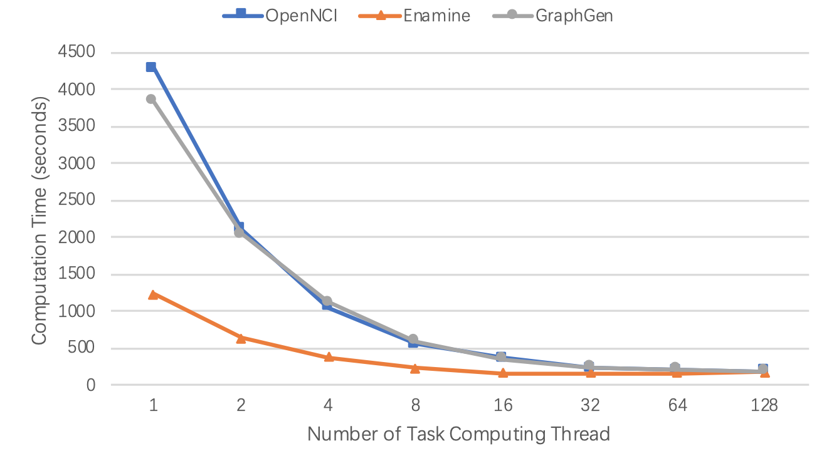
Performance
gSpan Parallelization
Notes:
Here is a speedup result for our parallel gSpan algorithm for frequent subgraph pattern mining implemented on top of PrefixFPM, where three graph datasets have been tested,
and we can see that the performance scales well with the number of CPU cores used.

Slide 88
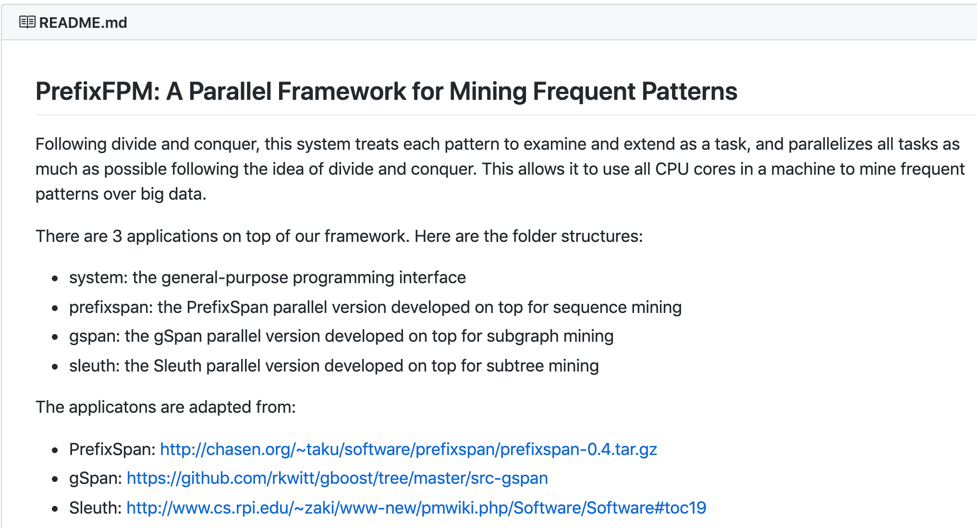
Open Source Software
Check out Our GitHub Page
  https://github.com/yanlab19870714/PrefixFPM
  Demo: https://youtu.be/PfioC0GDpsw
Notes:
We have open-sourced our code on GitHub with detailed documentation, and there is also a video demo for you to check out!
[CLICK]
We implemented three algorithms on top of our framework, which are parallel versions of PrefixSpan for sequence patterns, gSpan for subgraph patterns, and Sleuth for embedded tree patterns.
Our experiments show ideal speedup with the number of CPU cores in our server which contains 32 CPU cores.

Slide 89
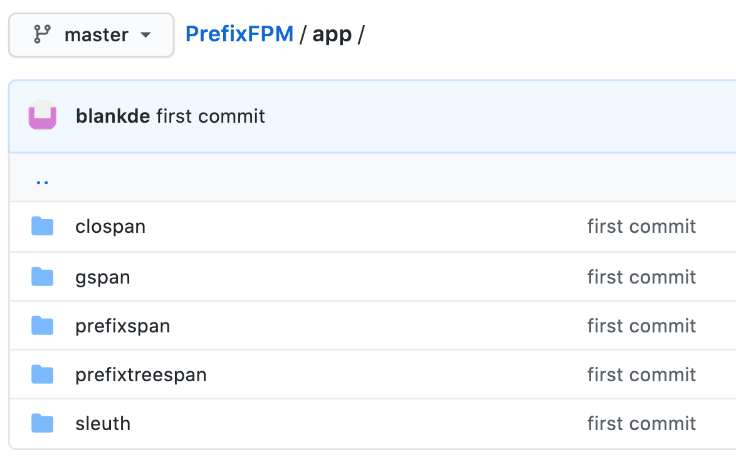
Recent Improvement
Check out Our GitHub Page
  https://github.com/wenwenQu/PrefixFPM
  Now with more applications
Notes:
We have recently added more applications on top of our PrefixFPM framework, including algorithms to find closed patterns.
You can get the code for those applications from this URL.

Slide 90
Recent Improvement
void run(ostream& fout){
{pseudocode: track task starting time here}
if(!pre_check(fout)) return;
//generate new patterns
setChildren(children);
//run new child tasks
while(Task* t= get_next_child()){
if(timeout){
q_mtx.lock();
queue().push(t);
while(Task* t= get_next_child())
queue().push(t);
q_mtx.unlock();
return;
}
if(needSplit()){
q_mtx.lock();
queue().push(t);
q_mtx.unlock();
    }
    else{
    t->run(fout);
    delete t;
    }
}
}
Timeout Mechanism
t₀ = 0
∅
t₁
t₉ > τ_{time}
t₈ > τ_{time}
A
B
C
t₂
t₃
t₇ > τ_{time}
AA
AB
AC
t₄
t₅
t₆ > τ_{time}
ABA
ABB
ABC
Notes:
We also added a timeout mechanism to avoid the mining of a very big pattern subtree, for example, in case those patterns in the subtree are all frequent in the transaction database, which keeps the subtree growing bigger.
Here, before entering each pattern, we will check if the task times out. If so, instead of continuing mining, the remaining nodes in this recursion level are wrapped as new tasks and added to the system to be scheduled, and backtracking happens to create tasks for upper-level tree nodes.
[move mouse]
For example, assume that we are mining this subtree in depth first order, and before mining pattern ABC, time out happens, then ABC will become a new task, and we backtrack to the parent level, where AC also times out and becomes a new task, followed by B, and C
We can see that we do not over-partition a task in this method.
[move mouse]
For example, the subtree of node C becomes a new task, not any subtree under node C

Slide 91
Overview
Graph Mining Problems: A Categorization
Think Like a Vertex: Data-Intensive Mining
Why TLAV is not Sufficient? Compute-Intensive!
PrefixFPM for Frequent Subgraph Mining
G-thinker: Think Like a Subgraph
TLAS Algorithms for Subgraph Mining
Notes:
Without any further delay, let’s welcome Guimu to give the second part of this talk.
-------
Hello everyone, my name is Guimu Guo and I am a PhD from the Computer Science department of the University of Alabama at Birmingham. I will present the next 2 sections, mainly on the G-thinker system.

Slide 92
Target Problems
Finding dense subgraphs in a big graph
  Maximum/maximal Cliques
  Quasi-cliques, k-plexes
  Other definitions
    n-cliques
    n-clans
    n-clubs
    …
Notes:
First, let me introduce the target problems of G-thinker, that is, to find qualified subgraph instances from a big graph.
One example application is to mine dense subgraph structures such as cliques, pseudo-cliques and many other dense subgraph definitions. For example, quasi-cliquesare a kind of , pseudo-cliques that require each node to be connected to the majority of other nodes,.

Slide 93
Target Problems
Finding dense subgraphs in a big graph
  Applications:
    Social communities
    Gene regulatory network, PPI network
Notes:
Mining these dense subgraph structures is useful in real applications such as finding social communities and coexpressed genes.

Slide 94
Target Problems
Subgraph matching (not mining)
  Graph pattern recognition (e.g., on biological networks)
  Searching text-rich networks like the Semantic Web
Notes:
Another example application is subgraph matching, where given a query graph, we want to find subgraph instances that match it in a big data graph.
This query is useful in searching knowledge graphs and biological networks.

Slide 95
Problem Features
S: set of nodes already in subgraph
ext(S): set of valid candidates to add
High computational complexity
Search space: power set of vertex set
{}
{a}
{b}
{c}
{d}
{a, b}
{a, c}
{a, d}
{b, c}
{b, d}
{c, d}
{a, b, c}
{a, b, d}
{a, c, d}
{b, c, d}
{a, b, c, d}
a < b < c < d
Notes:
A key feature of those problems that G-thinker targets is that their time complexity is high, often because of the giant search space rather than the data volume itself.
In this slide, we show how we can explore the vertex set of a result subgraph by depth-first backtracking in a vertex-set enumeration tree.
This, for example, applies to our dense subgraph mining problem.
[click]
Specifically, let us use S (move mouse to S) to denote the set of vertices that are already in a subgraph, and let us use extension-S (move mouse to ext(S)) to denote the set of vertex candidates can are to be added to S to form a valid dense subgraph.
In the set enumeration tree, we only show the set S at each node.
To avoid redundancy, we only add new vertices into the set if their IDs are larger than those vertices that are already in the set S.
[move mouse to show on the slide]
For example, to get {a,b,d}, we do not grow {b,d} by a, but rather grow {a,b} by d.

Slide 96
Problem Features
Divide and conquer
Serial algorithms: subgraph backtracking
Example: Finding Maximal Cliques
Notes:
In traditional single-threaded algorithms, we usually solve these problems by divide and conquer.
That is, we backtrack on the nodes in our previous set enumeration search tree.
Let us illustrate by considering the problem of finding maximal cliques.

Slide 97
Problem Features
Divide and conquer
Serial algorithms: subgraph backtracking
v₃
v₂
v₁
v₅
v₄
G
One-Hop Neighborhood
Notes:
Specifically, since each clique is a complete graph where every pair of nodes are one hop away,
[click]
we can construct 1-hop ego-network around each vertex, and find cliques from those subgraphs.
Note that if a vertex, say v1, has a high degree, so the subgraph around it is still very big, we can recursively divide it into smaller overlapping subgraphs for further mining.
[click]
To illustrate this idea, let us zoom in that subgraph, and assume that v1 is already in our result clique.

Slide 98
Problem Features
Divide and conquer
Serial algorithms: subgraph backtracking
Recursive: v₁’s one-hop
v₃
v₁
v₄
v₅
Notes:
We can then consider 2 cases, those cliques containing v3, and those without v3.

Slide 99
Problem Features
Divide and conquer
Serial algorithms: subgraph backtracking
Recursive: {v₁ + v₃}’s one-hop
v₃
v₁
v₄
v₅
Notes:
The pink subgraph assumes that v1 and v3 are already in our clique, and we can continue mining cliques in this subgraph by kicking out those vertices more than one hop away from v3

Slide 100
Problem Features
Divide and conquer
Serial algorithms: subgraph backtracking
Recursive: {v₁ + v₄}’s one-hop
v₃
v₁
v₄
v₅
Notes:
For those without v3, we can further divide them into those with v4 and those without.
The pink subgraph assumes v1 and v4 are in our clique, and we kick out those vertices more than one hop away from v4 from the subgraph and then continue the mining.

Slide 101
Problem Features
Divide and conquer
Serial algorithms: subgraph backtracking
Recursive: {v₁ + v₅}’s one-hop
v₃
v₁
v₄
v₅
Notes:
We can then continue on the remaining subgraph and divide it if necessary.
In fact, the mining algorithm itself follows this recursive procedure and explores our set-enumeration tree in depth-first order.

Slide 102
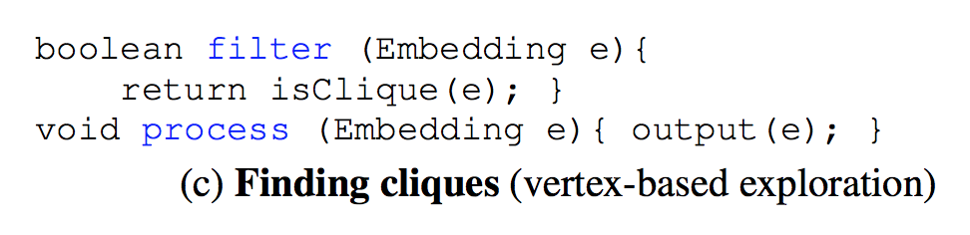
Existing Solutions
MapReduce, Vertex-Centric Systems
Subgraph-Centric Systems
NScale, Arabesque, Rstream, Nuri, G-Miner, …
Arabesque’s API
API is natural
Still IO-bound
Notes:
We next review the related works that tackle the dense subgraph mining problems.
Earlier works use MapReduce, but it is found that the IO-bound MapReduce framework is not suitable even for triangle counting, as the performance is 10 times slower than a single-threaded program.
Due to the popularity of think-like-a-vertex programming models, there are some works solving dense subgraph mining using vertex-centric programs.
%
However, in the vertex-centric paradigm, vertices notify other vertices about their value updates by sending messages along edges, making the execution network IO-bound.
%
Also, the programming is not intuitive for subgraph mining, since vertex-centric programs operate in the unit of vertex, and are usually for computing values for vertices, not for finding subgraphs.
Recently, a number of systems were proposed for graph mining based on the idea of subgraph-centric programming
[click]
which is more intuitive to program dense subgraph mining algorithms.
[click]
However, they only address the programming friendliness issue, but not the low-efficiency issue, as their execution engines are still IO-bound.

Slide 103
Existing Solutions
NScale
  BFS around each node to construct k-hop subgraph
  Conducted by k MapReduce jobs (IO-bound)
  Intermediate subgraphs materialized (HDFS overhead)
  Subgraphs are then distributed for processing by reducers (straggler’s problem)
Notes:
NScale is the first work in this direction, which constructs candidate subgraphs to mine upon around each vertex using k iterations of breadth-first search.
[click]
However, this is conducted by k MapReduce jobs, which makes the process network IO-bound
[click]
Each MapReduce job also needs to load and dump a huge amount of intermediate subgraphs via Hadoop Distributed File System.
[click]
The subgraphs are then finally distributed for concurrent mining with another MapReduce job, which suffers from the curse of the last reducer.

Slide 104
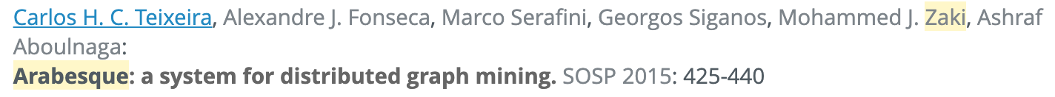
Existing Solutions
Arabesque
  Embedding-centric API
  Subgraphs are materialized in memory and checked in increasing size 1, 2, …
  Distributed, each machine keeps an entire graph
In contrast, G-thinker uses backtracking as much as possible
Notes:
Arabesque proposes a user-friendly programming interface for graph mining, called embedding-centric programming.
[click]
Here, an embedding is a materialized subgraph, and these subgraphs are grown in an increasing size for checking.
[click]
Arabesque is a distributed system where every machine needs to keep an entire data graph in memory, and subgraph materialization is the dominant cost.
[click]
In contrast, our G-thinker uses node backtracking in serial mining algorithms as much as possible to avoid the cost of materializing subgraphs.

Slide 105
Existing Solutions
Arabesque
  Embedding-centric API
  To incorporate frequent subgraph pattern mining, need isomorphism check for each materialized subgraph
Not needed in our subgraph mining problem!
Notes:
Arabesque's API also covers the problem of frequent subgraph pattern mining, which requires Arabesque to conduct subgraph isomorphism check on each newly materialized subgraph.
[click]
But such check is not needed in other subgraph mining problems that we consider.

Slide 106
Problem Features
High computational complexity
Search space: power set of vertex set
{}
{a}
{b}
{c}
{d}
{a, b}
{a, c}
{a, d}
{b, c}
{b, d}
{c, d}
{a, b, c}
{a, b, d}
{a, c, d}
{b, c, d}
{a, b, c, d}
a < b < c < d
Notes:
Recall that our set-enumeration tree perfectly divides the search space, and avoids redundancy by comparing vertex IDs.

Slide 107
Existing Solutions
Recall PrefixFPM
Arabesque
  Embedding-centric API
  To incorporate frequent subgraph pattern mining, need isomorphism check for each materialized subgraph
Not needed in our subgraph mining problem!
API is simple but…
execution is inefficient
Notes:
In summary, [click] Arabesque's API is simple [click] but not amenable to efficient execution.
Check out our PrefixFPM system presented earlier by Dr. Yan for a more efficient solution for frequent pattern mining!

Slide 108
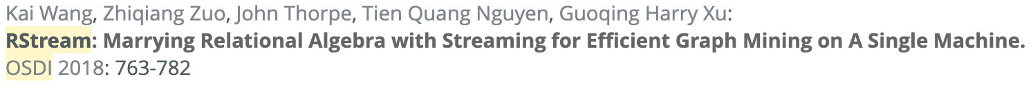
Existing Solutions
RStream
  Inherits the embedding-centric API
  Single-machine out-of-core
  More efficient than Arabesque
Disk IO-bound
Notes:
In fact, removing the slow network communication can speed up the computation, as is realized by the RStream system.
[click]
But as a single-machine system that runs in the out-of-core mode, RStream is still disk IO-bound.

Slide 109

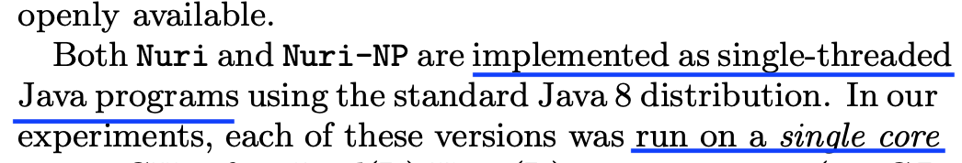
Existing Solutions
Solutions so far do not scale with CPU cores!
Nuri
  To find the k most relevant subgraphs using only a single computer
  Prioritized subgraph expansion
Notes:
Another system, Nuri, proposes to find the top-k result subgraphs rather than all of them.
[click]
But Nuri is a single-threaded Java program.
[click]
All the systems we reviewed so far do not scale their performance with the number of CPU cores they use.

Slide 110
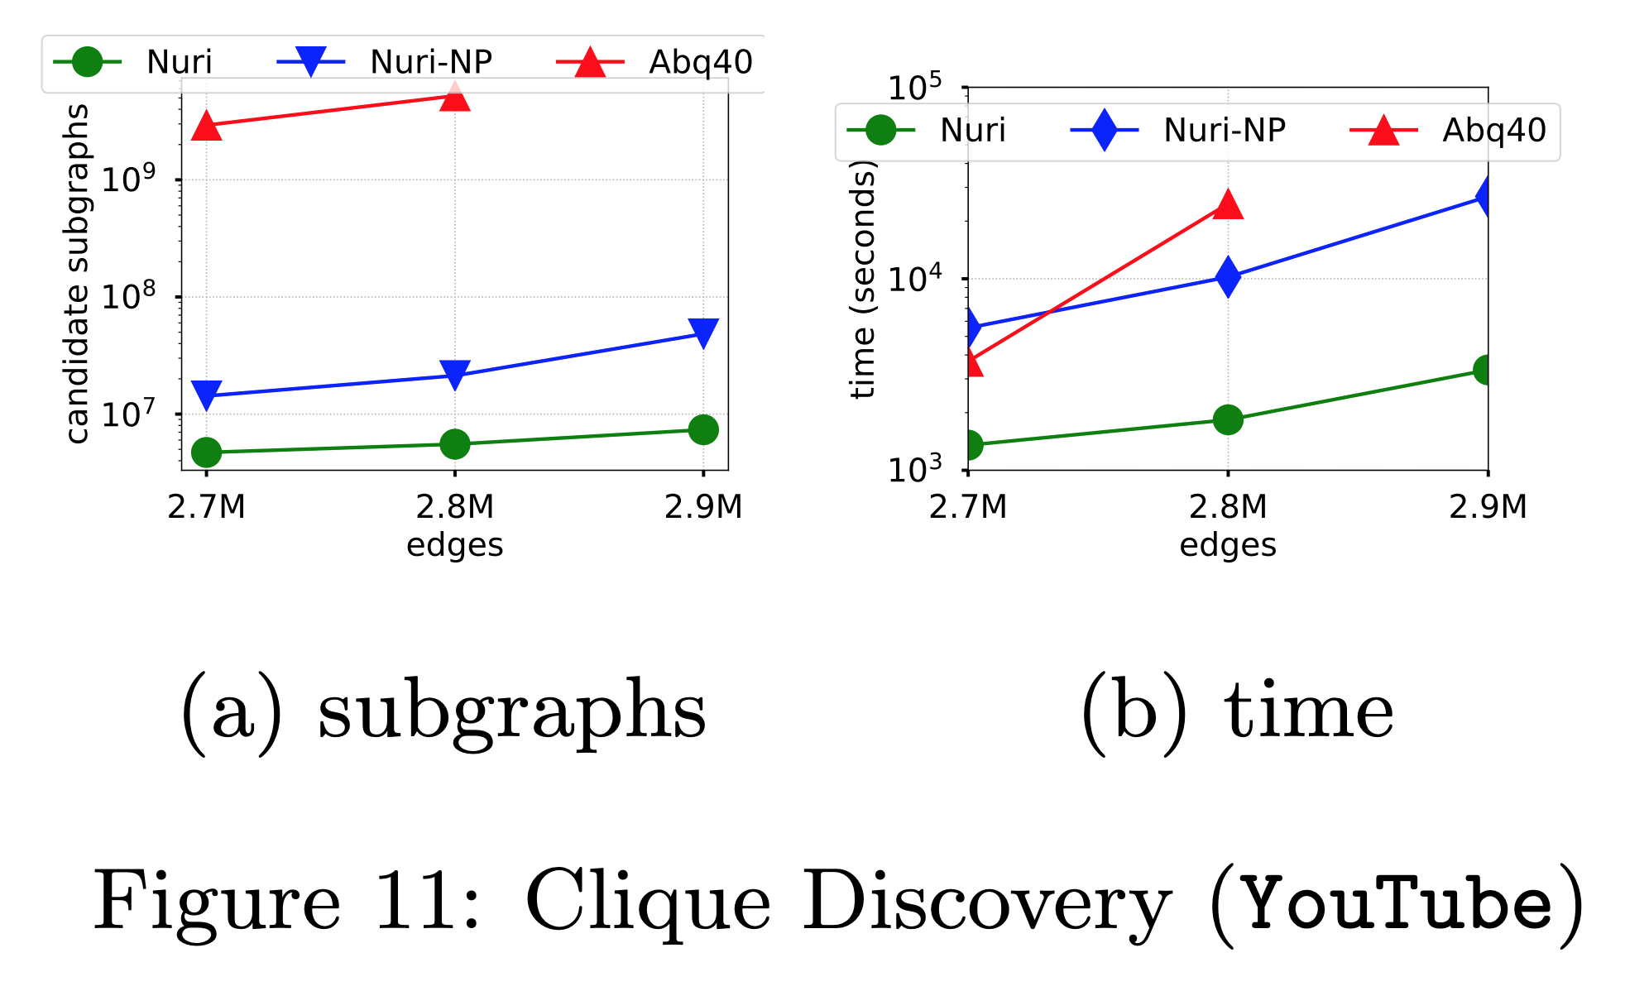
Notes:
For example, on a dataset called YouTube,
[click]
Nuri takes over a thousand seconds to find the cliques.

Slide 111
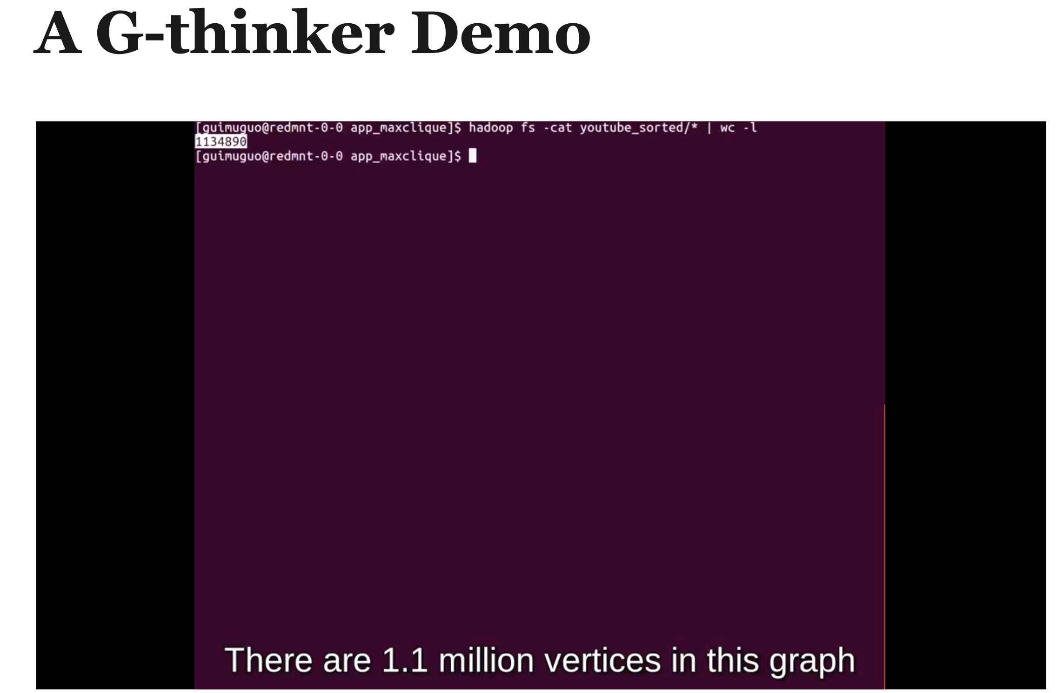
Notes:
If you use our G-thinker system on the same graph with 1 million vertices,

Slide 112

Check out our demo at http://bit.ly/gthinker
http://bit.ly/gthinker
Notes:
it takes only 9.4 seconds on one multi-core machine.
[click]
You are welcomed to check out our demo on the G-thinker website!

Slide 113

The Curse of IO
Current data-intensive frameworks are IO-bound !
Notes:
As a side note, Frank McSherry has criticized the IO-bound performance bottleneck of existing Big Data systems whose performance is often only comparable to a single CPU core's throughput.

Slide 114

Our Solution
Lots of problems !!!
Think Like a Task
  Target giant search space, high time complexity
  Target problems amenable to divide and conquer
c_{cpu} · f ( |g| )
Complexity
c_{net} · |g|
O
|g|
Subgraph Size
Notes:
Our research group has proposed and been working on a new programming paradigm called T-thinker, or, think-like-a-task, which targets high-complexity divide-and-conquer algorithms over big data.
[move mouse to along the 2 curves when describing the next paragraph]
The idea is that if your computing cost is super-linear to data size, then the cost of computing a task on a subset of your data is expensive enough to justify the linear IO cost of collecting the data subset, as long as the computation and communication is well overlapped
Of course we should still keep the programming model more general and friendly than using a conventional HPC library.
[click]
There are actually a lot problems that are amenable to divide and conquer!

Slide 115
Our Solution
Examples that fall in Think-Like-a-Task Paradigm
  Some divide-and-conquer (often recursive) algorithms that are straightforward to implement on G-thinker (beyond simple ones like triangle counting and maximal clique finding, i.e., Bron-Kerbosch algorithm)
…
Notes:
For example, the algorithms of mining quasi-cliques and k-plexes are both amenable to divide and conquer, and they can be straightforwardly implemented on our G-thinker platform.
We have already implemented quasi-clique mining on G-thinker, and the program got a speedup of over 200 times in our small 16-node cluster.

Slide 116

G-thinker History
Prototype: API proposed
No multithreading support, running multiple processes on each machine
Inefficient engine (bad designs):
Vertex cache cannot be concurrently visited by tasks
LSH-based cache design that keeps a lot of partial tasks on disk
Basically our old G-thinker system with multithreading support added
But inherits all bad designs, and thus do not scale
Our new G-thinker implementation has great documentation,
and we actively provide technical support ☺
Notes:
Here is a brief history of our G-thinker system.
G-thinker was originally a prototype where Dr. Yan proposed a vertex-pulling based subgraph API.
[click]
But as a prototype, the execution engine is just to make things work, and it does not even have multithreading support.
[click]
It also has flawed designs. For example, tasks access vertices in a bulk-synchronous parallel manner,
[click] and to reduce memory overheads, subgraphs are saved to disks, but a bad task scheduling strategy leaves many subgraphs on the disks, leading to expensive IO cost.
[click]
Since a full-fledged G-thinker system will take time to develop, the student who helped implemented the old G-thinker prototype simply added multithreading support and termed the resulting system G-Miner,
[click]
but it inherits all the flawed designs, and leads to poor performance when an input graph gets big.
[click]
G-Miner follows the same API as G-thinker, as the G-Miner paper clearly indicated.
[click]
Please check out our new G-thinker website where you can find great documentation!
Our research group will provide full technical support!

Slide 117

G-thinker Overview
Notes:
Here's an overview of G-thinker in a cluster of 3 machines.
[move mouse to show for all the following content, including HDFS, local table, adjacency lists, remote vertex cache, a local task queue, refill arrow, spill arrow]
G-thinker loads the input graph from HDFS, where each machine loads a fraction of vertices along with their adjacency lists into a local table.
Tasks are initialized from each vertex in the local table, and a task can grow its subgraph by requesting neighboring vertices, or actually, their adjacency lists.
To allow multiple tasks in a machine to share remote vertices, a remote vertex cache is maintained but it has a capacity limit to keep memory bounded.
Each computing thread maintains a local task queue to keep it busy. This is the key to our scalability to CPU cores.
When the task queue is about to become empty, new tasks will be refilled to the queue, while if more tasks need to be added to a full task queue, the last batch of tasks in the queue will be spilled to disk to be refilled by other computing threads later.
This allows the memory consumed by tasks to be bounded.

Slide 118
G-thinker
Distributed Key-Value Store
Key: vertex ID
Value: (labeled) adjacency list
Vertex Partitioning
1
2
4
5
6
0
3
7
8
0
1 | 3
1
0 | 2 | 3
2
1 | 3 | 4 | 7
3
0 | 1 | 2 | 7
4
2 | 5 | 7
5
4 | 6
6
5 | 8
7
2 | 3 | 4 | 8
8
6 | 7
M₀
M₁
M₂
Notes:
Here is an illustration of how vertices are partitioned by the local vertex tables of all machines, which form a distributed key-value store where a task can pull the adjacency list of a vertex using its ID.

Slide 119
G-thinker
Vertex Pulling & Remote Vertex Caching
Tasks can share vertices to reduce # of remote vertex requests
8
6 | 7
0
1 | 3
6
5 | 8
5
4 | 6
8
6 | 7
0
1 | 3
1
0 | 2 | 3
2
1 | 3 | 4 | 7
3
0 | 1 | 2 | 7
4
2 | 5 | 7
5
4 | 6
6
5 | 8
7
2 | 3 | 4 | 8
8
6 | 7
M₀
M₁
M₂
Notes:
Here is an illustration of the remote vertex cache.
[move mouse to the following mentioned vertices and vertex caches]
For example, while vertex 8 is not in machine M0, if a task on M0 requests vertex 8, it will be pulled to the cache.
[click]
Note that if another task on M0 also needs 8, it can then directly access it in the cache without sending a duplicate request.

Slide 120
G-thinker
Task-Centric Programming Interface
  UDF: spawn_task(vertex)
  UDF: compute(task, frontier)
  pull(vertex_id)
  add_task(task)
Task Metadata
Task Subgraph
Notes:
Here is the task-centric programming model of G-thinker.
The first user-defined function specifics how a task is spawned from an individual vertex.
The second user-defined function specifics how a task grows its subgraph from those surrounding vertices' adjacency lists, which are pulled into the frontier [move mouse over it] array the last time the compute(.) function is called.
A task calls compute(.) in iterations to expand its subgraph until all needed data are ready, after which the task then mines the constructed subgraph.
When vertices are being pulled, the task is suspended so that CPU cores can be released to process other tasks.
[click]
A task can pull a vertex that is on its subgraph boundary,
[click]
it can also split the subgraph into multiple new tasks for concurrent processing if the subgraph is big. The new tasks can be added to G-thinker by calling the add_task function.

Slide 121
G-thinker
Γ-table is for getting adjacency list given a vertex ID
Counter tracks how many tasks lock a vertex
Vertex Cache: High Concurrency
  Vertices hashed to different buckets can be accessed concurrently
Bucket # |  | Γ-tables |  |  | Z-tables |  | R-tables
 |  | ID(v) | Γ(v), lock-count |  | ID(v) |  | ID(v) | lock-count
0 |  | 10 | Γ(10), 0 |  | 10 |  | 20 | 1
1 |  | 11 | Γ(11), 1
2 |  | 12 | Γ(12), 1 |  |  |  | 22 | 3
3 |  | 13 | Γ(13), 2
9
A bucket
…
…
…
…
…
Vertices hashed to buckets
Buckets protected by mutex
Each bucket has
A Γ-table
A Z-table
An R-table
…
…
…
…
…
…
…
…
…
…
…
…
…
…
…
…
…
…
…
…
…
…
…
…
…
…
…
…
B_{v} = v mod 10
Notes:
The next question is how to design our remote vertex cache so that tasks can access vertices concurrently,
while the requested vertices can be continuously added when received from remote machines,
and vertices no longer needed by the tasks can be evicted to make room for new requests?
[move mouse to the bucket IDs]
One solution is to hash vertices into different buckets using their IDs, so that if two vertices are in different buckets, their processing can happen together.
[move mouse to the green words]
In this slide, we assume vertices are hashed to 10 buckets by hashing their IDs modulo 10.
[click]
Each bucket is protected by a lock so that only one operation can be carried out each time.
A bucket has 3 containers:
[click]
Gamma-table keeps the adjacency lists.
[click]
It also keeps a counter to track how many tasks lock a vertex.

Slide 122
G-thinker
Z-table tracks the subset of vertices that can be evicted
Otherwise, GC has to scan an entire Γ-table
Vertex Cache: High Concurrency
  Vertices hashed to different buckets can be accessed concurrently
Bucket # |  | Γ-tables |  |  | Z-tables |  | R-tables
 |  | ID(v) | Γ(v), lock-count |  | ID(v) |  | ID(v) | lock-count
0 |  | 10 | Γ(10), 0 |  | 10 |  | 20 | 1
1 |  | 11 | Γ(11), 1
2 |  | 12 | Γ(12), 1 |  |  |  | 22 | 3
3 |  | 13 | Γ(13), 2
9
A bucket
…
…
…
…
…
Vertices hashed to buckets
Buckets protected by mutex
Each bucket has
A Γ-table
A Z-table
An R-table
…
…
…
…
…
…
…
…
…
…
…
…
…
…
…
…
…
…
…
…
…
…
…
…
…
…
…
…
B_{v} = v mod 10
Notes:
Z-table, or zero-table, tracks which vertices are no longer needed by tasks;
[click]
With Z-table, we do not need to scan the entire gamma table when evicting vertices

Slide 123
G-thinker
R-table tracks those vertices requested but not received yet
Used to avoid sending the same vertex-request again
Vertex Cache: High Concurrency
  Vertices hashed to different buckets can be accessed concurrently
Bucket # |  | Γ-tables |  |  | Z-tables |  | R-tables
 |  | ID(v) | Γ(v), lock-count |  | ID(v) |  | ID(v) | lock-count
0 |  | 10 | Γ(10), 0 |  | 10 |  | 20 | 1
1 |  | 11 | Γ(11), 1
2 |  | 12 | Γ(12), 1 |  |  |  | 22 | 3
3 |  | 13 | Γ(13), 2
9
A bucket
…
…
…
…
…
Vertices hashed to buckets
Buckets protected by mutex
Each bucket has
A Γ-table
A Z-table
An R-table
…
…
…
…
…
…
…
…
…
…
…
…
…
…
…
…
…
…
…
…
…
…
…
…
…
…
…
…
B_{v} = v mod 10
Notes:
R-table, or Request-table, keeps those vertices that are requested by tasks, but whose adjacency lists are still being transmitted and not yet received.
[click]
It also has a counter to track how many tasks request each vertex, which avoid sending the same vertex-requests many times.

Slide 124
G-thinker
Vertex Cache: High Concurrency
  Computing threads
Bucket # |  | Γ-tables |  |  | Z-tables |  | R-tables
 |  | ID(v) | Γ(v), lock-count |  | ID(v) |  | ID(v) | lock-count
0 |  | 10 | Γ(10), 0 |  | 10 |  | 20 | 1
1 |  | 11 | Γ(11), 1
2 |  | 12 | Γ(12), 1 |  |  |  | 22 | 3
3 |  | 13 | Γ(13), 2
9
Bucket # |  | Γ-tables |  |  | Z-tables |  | R-tables
 |  | ID(v) | Γ(v), lock-count |  | ID(v) |  | ID(v) | lock-count
0 |  | 10 | Γ(10), 1 |  |  |  | 20 | 2
1 |  | 11 | Γ(11), 2 |  |  |  | 21 | 1
2 |  | 12 22 | Γ(12), 0 Γ(22), 3 |  | 12
3 |  | 13 | Γ(13), 2
9
…
…
…
…
…
…
…
…
…
…
…
…
…
…
pull(10)
pull(11)
…
…
…
…
…
…
…
…
…
…
…
…
…
…
…
…
…
…
…
…
…
…
…
…
…
…
…
…
…
…
…
…
…
…
…
…
…
…
…
…
…
…
…
…
…
…
…
…
…
…
…
…
…
…
…
Notes:
We next illustrate how these containers are used.
[use mouse to point to the below mentioned vertices and counters in tables]
For example, if some task requests remote vertices 10 and 11, and their adjacency lists happen to be in gamma-tables, then we simply add their counters by 1 to indicate that one more task is holding them.
Here, vertex 10 is also removed from Z-table as its counter is no longer 0 and it cannot be evicted any more.

Slide 125
G-thinker
Vertex Cache: High Concurrency
  Computing threads
Bucket # |  | Γ-tables |  |  | Z-tables |  | R-tables
 |  | ID(v) | Γ(v), lock-count |  | ID(v) |  | ID(v) | lock-count
0 |  | 10 | Γ(10), 0 |  | 10 |  | 20 | 1
1 |  | 11 | Γ(11), 1
2 |  | 12 | Γ(12), 1 |  |  |  | 22 | 3
3 |  | 13 | Γ(13), 2
9
Bucket # |  | Γ-tables |  |  | Z-tables |  | R-tables
 |  | ID(v) | Γ(v), lock-count |  | ID(v) |  | ID(v) | lock-count
0 |  | 10 | Γ(10), 1 |  |  |  | 20 | 2
1 |  | 11 | Γ(11), 2 |  |  |  | 21 | 1
2 |  | 12 22 | Γ(12), 0 Γ(22), 3 |  | 12
3 |  | 13 | Γ(13), 1
9
…
…
…
…
…
…
…
…
…
…
…
…
…
…
release(12)
release(13)
…
…
…
…
…
…
…
…
…
…
…
…
…
…
…
…
…
…
…
…
…
…
…
…
…
…
…
…
…
…
…
…
…
…
…
…
…
…
…
…
…
…
…
…
…
…
…
…
…
…
…
…
…
…
…
Notes:
[use mouse to point to the below mentioned vertices and counters in tables]
Next, assume a task finishes a round of the compute function call, and releases its hold of the requested vertices, such as 12 and 13 here, then we need to decrement their counters in the gamma-table, and since vertex 12's counter becomes 0, it is added to Z-table to allow eviction.

Slide 126
G-thinker
Vertex Cache: High Concurrency
  Computing threads
Bucket # |  | Γ-tables |  |  | Z-tables |  | R-tables
 |  | ID(v) | Γ(v), lock-count |  | ID(v) |  | ID(v) | lock-count
0 |  | 10 | Γ(10), 0 |  | 10 |  | 20 | 1
1 |  | 11 | Γ(11), 1
2 |  | 12 | Γ(12), 1 |  |  |  | 22 | 3
3 |  | 13 | Γ(13), 2
9
Bucket # |  | Γ-tables |  |  | Z-tables |  | R-tables
 |  | ID(v) | Γ(v), lock-count |  | ID(v) |  | ID(v) | lock-count
0 |  | 10 | Γ(10), 1 |  |  |  | 20 | 2
1 |  | 11 | Γ(11), 2 |  |  |  | 21 | 1
2 |  | 12 22 | Γ(12), 0 Γ(22), 3 |  | 12
3 |  | 13 | Γ(13), 2
9
…
…
…
…
…
…
…
…
…
…
…
…
…
…
pull(20)
pull(21)
…
…
…
…
…
…
…
…
…
…
…
…
…
…
…
…
…
…
…
…
…
…
…
…
…
…
…
…
…
…
…
…
…
…
…
…
…
…
…
…
…
…
…
…
…
…
…
…
…
…
…
…
…
…
…
Notes:
[use mouse to point to the below mentioned vertices and counters in tables]
Now assume a task requests vertices 20 and 21 from our cache, and their adjacency lists are not already in Gamma-tables, then we need to add them to R-tables.
Here, 20 is already in R-table and so we simply increment its counter to avoid sending another redundant request, while 21 is a newcomer and thus, the request is added to the sending queue.
This is how R-table avoids sending redundant vertex requests

Slide 127
G-thinker
Vertex Cache: High Concurrency
  Response receiving thread
Bucket # |  | Γ-tables |  |  | Z-tables |  | R-tables
 |  | ID(v) | Γ(v), lock-count |  | ID(v) |  | ID(v) | lock-count
0 |  | 10 | Γ(10), 0 |  | 10 |  | 20 | 1
1 |  | 11 | Γ(11), 1
2 |  | 12 | Γ(12), 1 |  |  |  | 22 | 3
3 |  | 13 | Γ(13), 2
9
Bucket # |  | Γ-tables |  |  | Z-tables |  | R-tables
 |  | ID(v) | Γ(v), lock-count |  | ID(v) |  | ID(v) | lock-count
0 |  | 10 | Γ(10), 1 |  |  |  | 20 | 2
1 |  | 11 | Γ(11), 2 |  |  |  | 21 | 1
2 |  | 12 22 | Γ(12), 0 Γ(22), 3 |  | 12
3 |  | 13 | Γ(13), 2
9
…
…
…
…
…
…
…
…
…
…
…
…
…
…
Γ(22) received
…
…
…
…
…
…
…
…
…
…
…
…
…
…
…
…
…
…
…
…
…
…
…
…
…
…
…
…
…
…
…
…
…
…
…
…
…
…
…
…
…
…
…
…
…
…
…
…
…
…
…
…
…
…
…
Notes:
[use mouse to point to the below mentioned vertices and counters in tables]
Now assume that vertex 22's adjacency list has arrived, and in R-table, 22 already has 3 task requests, we then move this entry along with its counter 3 to gamma-table, indicating that 3 tasks are holding vertex 22.

Slide 128
G-thinker
Vertex Cache: High Concurrency
  Garbage Collection (GC) thread
Bucket # |  | Γ-tables |  |  | Z-tables |  | R-tables
 |  | ID(v) | Γ(v), lock-count |  | ID(v) |  | ID(v) | lock-count
0 |  | 10 | Γ(10), 1 |  |  |  | 20 | 2
1 |  | 11 | Γ(11), 2 |  |  |  | 21 | 1
2 |  | 12 22 | Γ(12), 0 Γ(22), 3 |  | 12
3 |  | 13 | Γ(13), 2
9
Lazy exec: triggered by cache overflow
Scanning Z-tables repeatedly
Lock one bucket each time
Remove an entry in Z-table
Remove that entry in Γ-table
…
…
…
…
…
…
…
…
…
…
…
…
…
…
…
…
…
…
…
…
…
…
…
…
…
…
…
…
…
…
…
…
…
…
…
…
Notes:
[use mouse to point to the below mentioned vertices and counters in tables]
We also have a garbage collector that periodically scans Z-tables to evict vertices, and that's why we need the small-sized Z-tables: if we let GC scan the larger gamma-tables, it will take a longer time to lock and check each bucket, and hence reducing concurrency.
[click]
An evicted vertex is removed from both Z-table and gamma-table.

Slide 129

G-thinker
Task Management
  Shared data store on a machine
  Accessed by all computing threads
Notes:
Next we look at G-thinker's task management.
In this slide, the components in the red box are shared by all computing threads in a machine, [next slide continues this sentence...]

Slide 130
G-thinker
Task Management
  Shared data store on a machine
  Accessed by all computing threads
Data Src 3:
Tasks Waiting for Remote Data
Data Src 1:
Local Vertex Table
Data Src 2:
Disk-Buffered Tasks
Notes:
including the local vertex table,
[click]
and a list of task files spilled from the task queues of computing threads, both of which are sources of tasks to be refilled into the task queues.
[click]
The black box on the right shows the components for each computing thread, where the 3rd task source is a set of tasks that are waiting for the requested data to arrive.
We will prioritize our refill by considering the task files first as these tasks have been partially processed, and we want to finish pending tasks earlier than spawning new tasks, in order to minimize the number of disk-buffered tasks.

Slide 131
G-thinker
Task Management
  Task containers maintained by each computing thread
Notes:
Now let's look at those components inside each computing thread.

Slide 132
G-thinker
Task Management
  Task queue for each thread (no contention)
  Underflow: get a batch of tasks from shared sources
  Overflow: buffer a batch of tasks at tail to disk
Container 1:
Task Queue
Notes:
The task queue keeps a list of tasks to be computed by the current thread, along with their vertices to request for.
[click]
If the queue has too few tasks, we will refill tasks from one of the previous 3 task sources.
[click]
If the queue is full but a new task needs to be added, we will first spill the last batch of tasks as a file to disk, and then append this new task.

Slide 133
G-thinker
Task Management
  For each popped task, pull requested vertices
  If need to wait for remote vertex: enter task-table
  Set <#met, #req>
Container 2:
Task Table
Container 1:
Task Queue
Notes:
[move mouse on the below mentioned components]
Each computing thread pops a task from the head of the queue each time, requests the vertices, and [click] if any of them is not in the cache, it will put the task into the task table shown here to wait for data.
[click]
We also keep track of how many requested vertices are met. [move mouse to the entries in the task table]

Slide 134
G-thinker
Task Management
  Vertex response triggers task update
  #met ++; If #met == #req, move task to B_{task}
Container 2:
Task Table
Container 3:
Task Buffer
Container 1:
Task Queue
Notes:
[move mouse to task list mentioned below]
If a vertex response is received, we get the task list of that vertex from the R-table.
Earlier, for ease of presentation, we mentioned we maintain a counter for each R-table vertex entry,
but we actually maintain the list of task IDs instead, to track those tasks that request that vertex.
[click]
For each task in the task table, we add the met-counter, and if the counter reaches the number of all requested vertices by the task, [mouse move to black arrow and then task buffer] we move the task to the task buffer here.

Slide 135
G-thinker
pop() is only called if vertex cache and task containers have enough space
push() is necessary to keep tasks flowing
Task Management
  A computing thread repeats
    pop(): pop a task for pulling/computing, underflow handling
    push(): fetch a task from B_{task} for computing, add to Q_{task}
Notes:
[move mouse to items mentioned below]
Each computing thread keeps calling pop to take tasks for processing, and calling push to compute the ready tasks and add them to the task queue if more processing is needed.
Newly created tasks are also appended to the task queue, and tasks may be spilled to the disk.
[click]
We remark that pop() is only called if the vertex cache and task containers have enough space.
[click]
if vertex cache or task containers reach their capacity limit, we only repeat the push function to process ready tasks so that vertices can be released from the vertex cache to make room,
and pop can then be restored to request more vertices for new tasks.

Slide 136
G-thinker
Task Management
  Task stealing:
    Estimate pending tasks: local table + disk-buffered tasks
    Stolen tasks are buffered to disks for computing thread to fetch
Notes:
For task stealing between machines, we will estimate the pending tasks in each machine from [move mouse to "next" arrow in T_{local} downwards] the capacity of the local vertex table and [move mouse to the local disk] task files buffered on the disk, for deciding effective task stealing plans.
[click]
Tasks stolen from other machines are appended to our file list on the disk, to be refilled into the task queues of the computing threads.

Slide 137
G-thinker
Datasets:
Dataset | |V| | |E| | Max Degree | Avg Degree
Youtube | 1,134,890 | 2,987,624 | 28,754 | 5.27
Skitter | 1,696,415 | 11,095,298 | 35,455 | 13.08
Orkut | 3,072,441 | 117,184,899 | 33,313 | 76.28
BTC | 164,732,473 | 361,411,047 | 1,637,619 | 4.39
Friendster | 65,608,366 | 1,806,067,135 | 5,124 | 55.06
Performance
Dataset | Arabesque | Giraph | G-Miner | G-thinker
(a) TC :
Youtube | 60.3 s / 2.8 GB | 74.3 s / 1.5 GB | 14.7 s / 1 GB | 7.1 s / 0.4 GB
Skitter | 90.8 s / 4.8 GB | 73.9 s / 3.9 GB | 17.1 s / 1.1 GB | 9.5 s / 0.5 GB
Orkut | 533 s / 17.7 GB | 197 s / 15 GB | 667 s / 2.3 GB | 26.6 s / 1.2 GB
BTC | x | x | > 24 hr / 6.7 GB | 181 s / 3 GB
Friendster | x | x | 10915 s / 9.2 GB | 516 s / 3.1 GB
(b) MCF :
Youtube | 58.8 s / 4.7 GB | 177 s / 6.2 GB | 13.7 s / 1 GB | 10.4 s / 0.5 GB
Skitter | 145 s / 4.9 GB | x | 26.2 s / 1.2 GB | 85.6 s / 0.6 GB
Orkut | 2007 s / 44.7 GB | x | 691 s / 2.5 GB | 95.9 s / 1.3 GB
BTC | x | x | > 24 hr / 7.3 GB | 1831 s / 3 GB
Friendster | x | x | 10644 s / 7.4 GB | 252 s / 3.4 GB
(c) GM :
Youtube | – | – | 13.2 s / 0.8 GB | 5.2 s / 0.5 GB
Skitter | – | – | 13.9 s / 1.1 GB | 7.8 s / 0.6 GB
Orkut | – | – | 66.2 s / 2.2 GB | 46.7 s / 1.5 GB
BTC | – | – | > 24 hr / 6 GB | 153 s / 4.4 GB
Friendster | – | – | 3669 s / 9.2 GB | 1762 s / 7 GB
Note: (1) x = Out of memory; (2) “–” means inapplicable.
Notes:
As you can see here, G-thinker is orders of magnitude faster than other systems, especially for big graphs.
[click]
The only competitor is G-Miner which can scale with the number of CPU cores used, but it does not scale well when the graph gets big, due to its bad task scheduling scheme that keeps a lot of partially computed tasks on disks.

Slide 138
G-thinker+
https://github.com/yanlab19870714/gthinkerQC
Recent improvement to G-thinker
  Accepted and to appear in PVLDB 2021
  Motivated by the fact that some tasks can be stragglers in pseudo-clique mining
  Besides local task queues for each computing thread, each machine adds a global task queue shared by all computing threads
  Time-consuming tasks are put in the global task queue for prioritized scheduling and for timely work stealing
Notes:
We have recently further improved the G-thinker system.
The reason for an improvement is that we found some dense subgraphs mining algorithms to be much more difficult than what our G-thinker ICDE paper already implemented, such as finding maximal cliques and triangle counting.
This is especially true for mining pseudo-clique structures such as quasi-cliques and k-plexes, where we find that they generate tasks of drastically different running time, and a straightforward parallelization severely suffers from the straggler problem with some bottleneck tasks will run forever, while most other CPU cores become idle.
To address this problem, we redesigned G-thinker’s execution engine.
[click]
Specifically, we added a global task queue to hold big tasks, that is, tasks that are very time-consuming.
This global task queue is shared by all mining threads in a machine.
[click]
Those big tasks in global task queue will be fetched with priority, and task stealing is used to balance big tasks among machines.
In this way, the big tasks can be moved around to idle threads in time, which will solve the straggler problem.

Slide 139

G-thinker+
https://github.com/yanlab19870714/gthinkerQC
Notes:
[use mouse to point out the components mentioned below]
As we have described in the previous slide, we maintain separate task containers for big tasks and normal ones.
For normal tasks, we keep them by using the local task queues of the respective mining threads.
For big tasks, we maintain a global task queue to keep them. It is shared by all mining threads.
The global task queue is also accompanied with other big task containers, such as a file list to buffer big tasks that are spilled from the global task queue.

Slide 140
G-thinker+
https://github.com/yanlab19870714/gthinkerQC
small task
big task
Head-of-line blocking
Task Queues
Task Queues
Notes:
Here we illustrate the straggler problem suffered by the old G-thinker, and how our new design addresses this problem.
In this animation, big tasks are highlighted in red, to differentiate them from normal tasks that are in blue.
If we only let each mining thread to buffer pending tasks in its own local queue, big tasks in the queue cannot be moved around to idle threads in time.
[click]
Big tasks can be stuck by the other big tasks located earlier in a queue, causing the head-of-line blocking and the straggler problem.

Slide 141
G-thinker+
https://github.com/yanlab19870714/gthinkerQC
small task
big task
Work Stealing
Q_{global}
Q_{global}
Task Queues
Task Queues
Notes:
[use mouse to point to yellow queues]
In our new G-thinker, we keep a global task queue for each machine which is shared by all threads on that machine. The big tasks will be stored in the global task queue.
[click, wait for animation to finish] [click]
Since the main performance bottleneck is caused by big tasks, they will be processed with priority by the local mining threads.
Also, task stealing is conducted only on big tasks to balance them among machines.

Slide 142
Overview
Graph Mining Problems: A Categorization
Think Like a Vertex: Data-Intensive Mining
Why TLAV is not Sufficient? Compute-Intensive!
PrefixFPM for Frequent Subgraph Mining
G-thinker: Think Like a Subgraph
TLAS Algorithms for Subgraph Mining
Think like a subgraph, each task maintains a subgraph
Notes:
Next, I will introduce how to design the subgraph mining algorithms on G-thinker.
[click]
We call the programming model as ”think like a subgraph,” since each task maintains a subgraph that the task creates and mines upon.

Slide 143
Algorithms on G-thinker
Algorithm Features
  Divide and conquer, often recursive
  Some tasks can be stragglers
  Task time difficult to predict from graph characteristics
Notes:
Here are a few features of a typical subgraph mining algorithm.
First, they usually follow a divide-and-conquer paradigm and can be divided into multiple mining tasks in G-thinker for parallel computation.
[click]
However, some tasks may be very expensive, running for a much longer period of time than an average task. In this case, we can decompose such big tasks into smaller tasks.
[click]
There is a challenge, however, in identifying such tasks, since in dense subgraph mining, the mining time of a task can be highly unpredictable.
We will elaborate on this in a few later slides

Slide 144
G-thinker
Task-Centric Programming Interface
  UDF: spawn_task(vertex)
  UDF: compute(task, frontier)
  pull(vertex_id)
  add_task(task)
Task Metadata
Task Subgraph
Notes:
Recall that in G-thinker's programming model, a task is spawned from individual vertices, and iteratively calls a user-defined compute-function to expand its subgraph and to mine the created subgraph.

Slide 145
Algorithms on G-thinker
S: set of nodes already in subgraph
ext(S): set of valid candidates to add
Can be a straggler !
{}
{a}
{b}
{c}
{d}
{a, b}
{a, c}
{a, d}
{b, c}
{b, d}
{c, d}
{a, b, c}
{a, b, d}
{a, c, d}
{b, c, d}
a < b < c < d
{a, b, c, d}
  UDF: spawn_task(vertex)
Notes:
Also recall that a dense subgraph mining algorithm can check the subgraphs using a vertex-set enumeration tree, where each node corresponds to a set S of vertices already included in the result subgraph, and is accompanied by a candidate vertex set extension-S to expand the subgraph with.
[click]
In this example set enumeration tree, 4 tasks are initially spawned from individual vertices a, b, c and d by calling the spawn_task() function.
[click]
The set-enumeration subtree under vertex a is big, and if it is totally mined by one task in serial, the cost can be much larger than other tasks, and even their costs combined.
Therefore, this task can become a straggler without task decomposition.

Slide 146

Notes:
In this slide, we plot how each subgraph feature impacts the task running time.
The x-axes in the 5 subplots correspond to 5 subgraph features including vertex number, edge number, maximum vertex degree, average vertex degree, and subgraph core number.
These data are extracted from the G-thinker running profile when mining a YouTube social network for quasi-cliques.
We can see that for about the same feature values, the time can vary a lot along the vertical direction which is the time dimension, and this happens unless the subgraph is very small.
Apparently, expensive tasks cannot be predicted from these features, even though some features such as core number and average degree reflect the graph density.

Slide 147

Notes:
Here is another plot for the running profile when mining quasi-cliques on a US patent citation graph.
The y-axis for task running time is in log-scale. We can again see that the time can vary a lot along the vertical direction for similar feature values.
The reason for such a big time variance is that dense subgraph algorithm relies heavily on pruning rules to reduce the search space, and the timing when a pruning rule’s condition is met and thus applicable depends on the vertex connection dynamics that changes as we expand the current vertex set S, and is very difficult to predict.

Slide 148
Algorithms on G-thinker
Timeout mechanism to avoid stragglers
{}
{a}
{b}
{c}
{d}
{a, b}
{a, c}
{a, d}
{b, c}
{b, d}
{c, d}
{a, b, c}
{a, b, d}
{a, c, d}
{b, c, d}
{a, b, c, d}
Notes:
Since the task running time is difficult to predict, we designed a timeout mechanism to avoid straggler tasks

Slide 149
Algorithms on G-thinker
Timeout mechanism to avoid stragglers
When {a, c} computes, it may timeout and decompose again
t₀ = 0
{a}
Q_{global}
t₁
t₅ > τ_{time}
t₆ > τ_{time}
{a, b}
{a, c}
{a, d}
t₂
t₄ > τ_{time}
{a, b, c}
{a, b, d}
{a, c, d}
t₃
{a, b, c, d}
Notes:
Specifically, we define a time threshold, and decompose a task if it runs for a longer time period than this threshold.
[move to "a", "abd"]
Taking the task spawned from vertex ”a” as an example. Assume that the running time exceeds the time threshold when this task is about to check {a,b,d}.
Then, the task will be decomposed into 3 tasks by backtracking.
For example, at the second level, node "ac" also times out, and its subtree becomes a new task.
[click]
Based on whether a task has a big workload or not, which can be judged by the size of the vertex candidate set, each decomposed task will be added either to the global task queue, or the local task queue of the current mining thread.
[click]
The decomposed tasks may timeout again for further decomposition in their future computation.
The straggler tasks will not be bottleneck by using this timeout mechanism.

Slide 150
Algorithms on G-thinker
Some (S, ext(S))-tasks can be pruned
Only pull v > c
{}
{a}
{b}
{c}
{d}
{a, b}
{a, c}
{a, d}
{b, c}
{b, d}
{c, d}
{a, b, c}
{a, b, d}
{a, c, d}
{b, c, d}
{a, b, c, d}
a < b < c < d
Notes:
Next, we illustrate some pruning rules that can be applied in G-thinker.
[click]
Firstly, in a set enumeration tree, each node S only expands with vertices whose IDs are larger than those in S, so a task never pulls vertices whose IDs are smaller than the vertex that spawns the current task.

Slide 151
Algorithms on G-thinker
Quasi-clique:
Given a user-specified minimum degree threshold γ, a γ-quasi-clique is a subgraph G = (V , E) where each vertex v ∈ V connects to at least γ fraction of the other vertices (i.e., ⌈γ · (|V| − 1)⌉ vertices) in G.
Assume γ ≥ 0.5, diameter of a γ-quasi-clique is at most 2.
≥ 0.5 (|V| − 1)
Proof: ∀ u, v ∈ V,
u
v
…
…
  Sum to |V| + 1
≥ 0.5 (|V| − 1)
Notes:
For different graph mining algorithms, we also have specific pruning rules for them.
Taking maximal quasi-clique mining as an example, where a quasi-clique is defined as shown here [mouse over definition].
Given a minimum degree threshold gamma, a gamma-quasi-clique is a subgraph where each vertex connects to at least gamma fraction of the other vertices in this subgraph.
There is a pruning rule saying that, given a gamma no less than 0.5, the diameter of a gamma-quasi-clique is at most 2.
This can be easily proved as follows.
[click]
For any two vertices ”u” and “v” in a gamma-quasi-clique, based on the definition they should both connect to at least 50% of the other vertices.
[click]
If we assume the neighbors of u and v do not overlap, then the total vertex count of ’u’, ‘v’ and their neighbors will becomes 1 larger than the quasi-clique size, which leads to a contradiction.

Slide 152
Algorithms on G-thinker
Quasi-clique:
Given a user-specified minimum degree threshold γ, a γ-quasi-clique is a subgraph G = (V , E) where each vertex v ∈ V connects to at least γ fraction of the other vertices (i.e., ⌈γ · (|V| − 1)⌉ vertices) in G.
Assume γ ≥ 0.5, diameter of a γ-quasi-clique is at most 2.
≥ 0.5 (|V| − 1)
Proof: ∀ u, v ∈ V,
u
v
…
Must share a neighbor
…
  Sum to |V| + 1
≥ 0.5 (|V| − 1)
Notes:
As a result, u and v must share a neighbor if they are not directly adjacent to each other.
Since ‘u’ and ‘v’ can be any pair of vertices in the gamma-quasi-clique, the diameter of the quasi-clique is at most 2.

Slide 153
Algorithms on G-thinker
Some (S, ext(S))-tasks can be pruned
Do not pull vertices > 2 hops away when γ ≥ 0.5
{}
{a}
{b}
{c}
{d}
{a, b}
{a, c}
{a, d}
{b, c}
{b, d}
{c, d}
Do not pull vertices > 1 hop away when we consider cliques
{a, b, c}
{a, b, d}
{a, c, d}
{b, c, d}
{a, b, c, d}
a < b < c < d
Notes:
We can prune candidate vertices using this property.
[click]
Specifically, when extending S, we can prune extension-S not to include those vertices which are not within 2 hops from any vertex in S.
[click]
A similar pruning rule applies to clique mining, where only direct neighbors of the vertices in S needs to be extended.

Slide 154
Algorithms on G-thinker
Assuming the mining of maximal quasi-cliques
Some (S, ext(S))-tasks can be pruned
  Max-degree vertex “a” covers {w, x, y, z}
{}
… …
{a}
{b}
{u}
{w}
{x}
{y}
{z}
Lots of other pruning rules, see our PVLDB’21 paper for details
w
z
a
x
G
y
Notes:
When mining maximal quasi-cliques, we also have another pruning rule called cover-vertex based pruning, which we illustrate here.
Let’s assume that vertex a has the highest vertex degree, and we move all its neighbors w, x, y, z to the end of the candidate list.
[click]
Then we can prove that when expanding S with one more vertex, we do not need to explore those neighbors.
This is because, any γ-quasi-clique formed only by these neighbors cannot be maximal, as adding "a" to the quasi-clique gives are larger γ-quasi-clique. Note that "a" is connected to all vertices in such a γ-quasi-clique, so γ will not decrease.
We say that "a" covers "w, x, y, z" in this case.
This is actually a simple special case of cover-vertex based pruning, and our quasi-clique mining program usually many more sophisticated pruning rules.
[click]
Please refer to our VLDB paper for more details.

Slide 155
Algorithms on G-thinker
Maximum Clique Finding
  Support of aggregator
    Local threads update the local aggregator
    Aggregators are synchronized every 1 second
    If |S| + |ext(S)| is less than the size of the current maximum clique found, prune task (S, ext(S))
Notes:
In G-thinker, we also support an aggregator which allows users to aggregate results computed by tasks.
[click]
Aggregator values are locally aggregated and periodically synchronized to get globally aggregated values.
Aggregator is useful for search space pruning, and subgraph counting.
[click]
For example, to find maximum cliques, we can use aggregator to track the maximum clique currently found.
A task will be pruned by terminating itself, when it cannot generate a larger clique than what is reported by the aggregator, even if all candidate vertices in extension-S are included.

Slide 156
Conclusion
… …
A number of papers are on their way
Difficulty
Follow our work!
Just us right now…
Productivity
Competition
Notes:
In conclusion, our think-like-a-task programming models are very efficient and user-friendly, and a perfect match for divide-and-conquer algorithms
As a representative system, G-thinker is a very promising direction and there are still a bunch of algorithms waiting to be parallelized with G-thinker.
Our group is currently working on multiple graph mining algorithms that require non-trivial parallel adaptations with G-thinker, and a series of research papers are to be expected in the next couple of years!
You are very welcome to follow our work and try out G-thinker!
[click]
Please also consider to follow our work!
This direction is very promising with a low competition, like Pregel research 10 years age, and will definitely worth your research investment.

Slide 157
GUO, Guimu
Contact Info:
Email: guimuguo@uab.edu
Webpage: https://guimuguo.github.io/
Thanks !
YAN, Da
Contact Info:
Email: yanda@uab.edu
Webpage: http://bit.ly/danielYan
Notes:
Thanks for your attention and please feel free to ask questions!
We will answer your questions from now on.
Dr. Yan is also finding outstanding students to join our research group for this line of research, and please feel free to send him an email if you think you are a good candidate.

